Slide 1
CHIA user workgroup
Don Kirkwood (Manager of Data Release and Procurement)
Sylvia Hobbs (Manager of User Support)
Scott Curley (Manager Privacy & Compliance)
May 25, 2021
CENTER FOR HEALTH INFORMATION AND ANALYSIS

Slide 2
Agenda
Announcements:
  APCD Release 8.0 Updates
  FY20 Case Mix Release Projections
  Data Release and Application Update
Website Updates
Application Reminders
User Support Questions
  Ambulatory Surgery Centers
  Taxonomy Codes
  Trauma Centers in MA APCD compared to Case Mix
  Discharge Status
Q&A

Slide 3
MA APCD Release 8.0
  Available NOW
  Applicants with approved projects that require updated APCD data (Release 8.0) should submit to CHIA a completed Exhibit B (Certificate of Continued Need and Compliance) of the Data Use Agreement. After submitting a completed Exhibit B you will receive an invoice (if applicable) for the requested data. Upon payment of the invoice the order for the data will be placed.
  Release 8.0 includes data on services from January 2014 – December 2018 with six months of claim runout (includes paid claims through 6/30/19).
  Will be linkable to Release 7.0 via crosswalk
  Additional information on highlights and enhancements will be presented in future APCD User Workgroups.

Slide 4

Case Mix FY20 Release
*CURRENT* RELEASE TIMEFRAMES FOR EACH FILE:
  Inpatient (HIDD)
  Available for request
  Emergency Department (ED)
  Late Summer 2021
  Outpatient Observation (OOD)
  Mid-Fall 2021
  Applicants with approved projects that require newly available year(s) of Case Mix Data (e.g., FY 19) should submit to CHIA a completed Exhibit B (Certificate of Continued Need and Compliance) of the Data Use Agreement. After submitting a completed Exhibit B you will receive an invoice (if applicable) for the requested data. Upon payment of the invoice the order for the data will be placed.

Slide 5
Data Release and Application Updates
Due to Governor Baker’s emergency actions to limit the spread of COVID-19 CHIA’s workforce will be remote, for now. This arrangement will limit CHIA’s ability to produce and deliver data extracts. At this time, CHIA is releasing data and providing extracts to requestors.
During this time, CHIA will continue to accept and review data applications for both Case Mix and All-Payer Claims Database (MA APCD) datasets. Review committees, DRC and DPC, will continue their meetings remotely as necessary.
Due to CHIA’s physical office being closed, applications will be accepted without a fee. After receipt of the application, CHIA will issue an invoice which will allow applicants to remit payment online.
If you are a Data User that has a CHIA hard drive in your possession, please keep the hard drive at this time while CHIA’s physical office is closed.

Slide 6
Website Release Updates
  Updates on the production of APCD and Case Mix databases and status of data requests are now posted to CHIA’s website!
    Aim #1 is to provide weekly or bi-weekly status update on CHIA data products as they are in development.
    Aim #2 is to provide applicants with information about expected fulfillment status for individual data requests.
    Request IDs will be communicated to Data Requestors via email.
  Please visit http://www.chiamass.gov/status-of-data-requests/ to see the current status of releases.

Slide 7
Application reminders

Slide 8
Fee Waiver Request Reminders
  If you’re submitting a request for a fee waiver, remember to include the fee remittance form in your application package on IRBNet.
  Remember to submit supporting documentation (if required).
  If you’re requesting a financial hardship waiver, remember to submit information detailing your project’s financial situation (examples: project budget, grant funding, organizational / departmental funding). Also request to pay a specific price that you reasonably believe you’re able to afford to contribute.
  CHIA generally does not offer full financial hardship fee waivers. We expect all applicants to have made an attempt to find funding to cover the full cost of the data fees.
  Fee waiver requests can take some time to process – especially financial hardship requests.

Slide 9
USER questions

Slide 10
Question: What fields in the MA APCD would I use to identify care provided in outpatient ambulatory surgery centers? Should I expect to see only ambulatory surgery centers in Massachusetts or also surrounding states? If I wanted to ensure that I had the location of all Massachusetts ambulatory surgery centers, would I need to include years prior 2016 drop in self-insured claims due to Gobeille v Liberty Mutual Insurance Company?
Ambulatory
Surgery
Centers
Answer: The medical claims file contains a field called service provider taxonomy field (MC032) in the release it is labeled “serviceproviderspecialty” where carriers report the standard taxonomy code for the provider associated with the service claim line. The CMS * provider taxonomy coding indicates the ambulatory surgery center is code '261QA1903X’.
In additional to code '261QA1903X’, there are a few instances where carriers have entered a code ‘49’ which is the CMS specialty code for ambulatory surgery center. These codes can be used to filter medical claims for care provided at ambulatory surgery centers. Provider numbers in the medical claims table include nine different fields. For those who request the provider table, the following six fields in the medical claims table can be linked to the provider table to obtain national provider identifiers and additional information on MC024 – the Service Provider, MC076 – the Billing Provider, MC112 – the Referring Provider, MC125 – the Attending Provider, MC134 – the Plan Rendering Provider, and MC135 – the Provider Location. For those who did not request the provider table, the medical claims limited data set table does contain dedicated National Provider Identifier (NPI) fields for three provider types that can be linked to the CMS registry to obtain the name of the ambulatory surgery center. Those three NPI fields in MA APCD medical claims limited data set are:
Taxonomy Code for Ambulatory Surgery Centers
261QA1903X
MC026 National Service Provider ID
MC077 National Billing Provider ID
MC242 Plan Rendering Nation Provider ID
*Source: National Uniform Claim Committee’s Health Care Provider Taxonomy
Code Set https://x12.org/codes/provider-taxonomy-codes
Continued

Slide 11
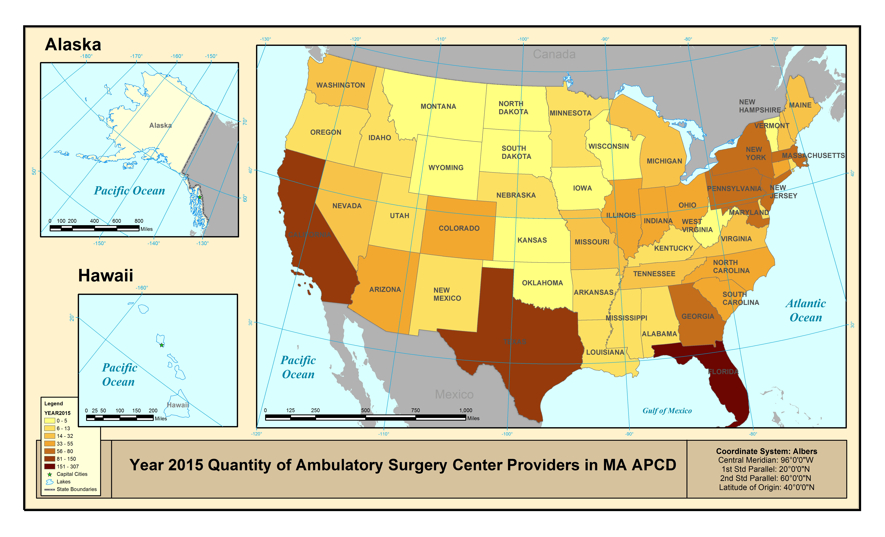
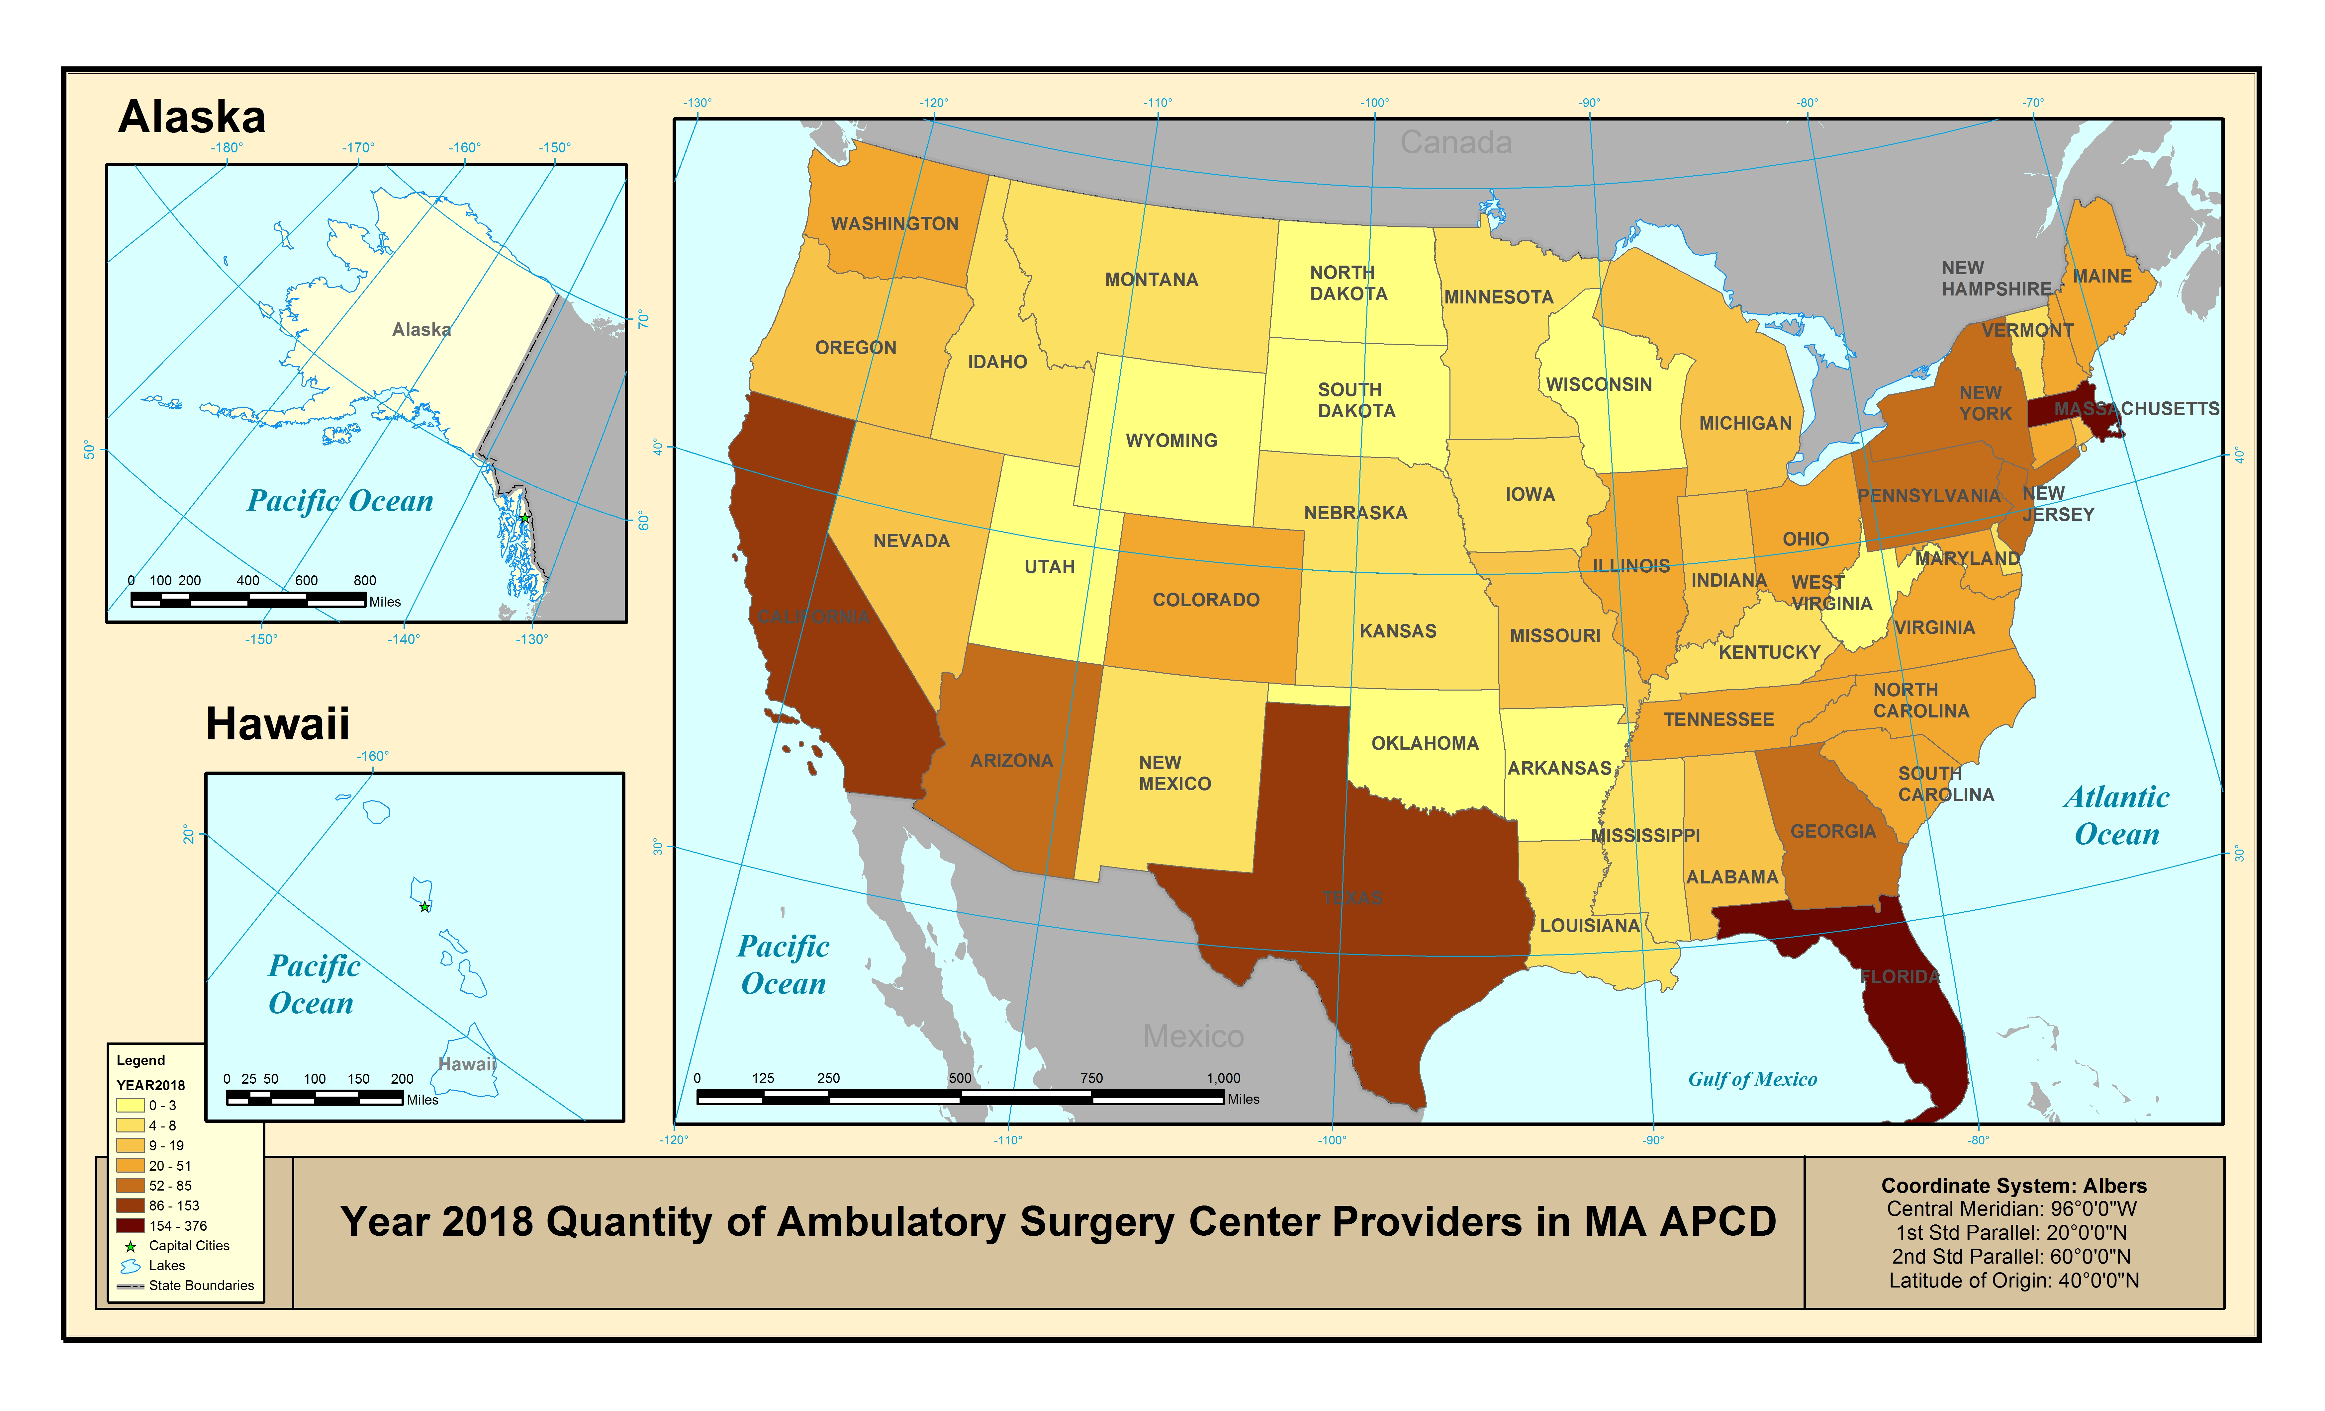
Answer (continued): While the highest volume of ambulatory surgery center medical
claims representing the largest number of people are from ambulatory surgery
centers located Massachusetts, the MA APCD nevertheless contains a certain number
of ambulatory surgery center medical claims
from every state in the U.S.
In 2015 and 2016, Florida, California, and Texas
each individually surpassed Massachusetts in
having a higher number of distinct providers with
an ambulator surgery center in the MA APCD
(defined by the taxonomy associated with unique
service provider NPIs). See Figure 1 (Year 2015).
Even though there was a reduction in medical
claims in 2016 due to Gobeille v Liberty Mutual,
in 2017 and 2018, the overall number of
ambulatory surgery center service providers in
the MA APCD increased. The number of
Massachusetts distinct NPIs with an ambulatory
surgery center taxonomy in the MA APCD
surpassed those of California and Texas in 2017,
and then surpassed Florida in 2018. The number
of ambulatory surgery center service providers in
Massachusetts more than doubled from
2015 to 2018. Compare Figure 1 (Year 2015) to
Figure 2 (Year 2018).
Ambulatory
Surgery
Centers
Figure 1. Year 2015 Ambulatory Surgery Centers in MA APCD
Figure 2. Year 2018 Ambulatory Surgery Centers in MA APCD

Slide 12

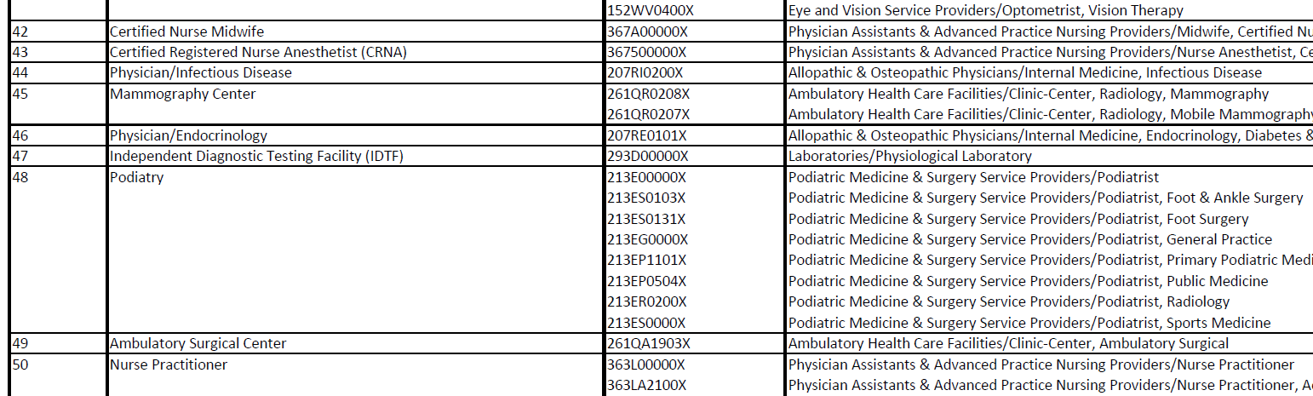
Question: I am confused by coding options for taxonomies and specialties.
The medical claims file contains one field labeled service provider specialty and the provider file contains one field for taxonomy and multiple specialty fields. What is the difference between these fields?
Specialties
Answer: The medical claims field labeled in the release as service provider specialty is in fact
MC032 Service Provider Taxonomy (where carriers report the National Uniform Claims
Committee’s (NUCC) taxonomy code https://x12.org/codes/provider-taxonomy-codes).
The NUCC defines the taxonomy code as a unique alphanumeric code, ten characters in length. The code set is structured into three distinct "Levels" including Provider Grouping, Classification, and Area of Specialization. The provider table likewise contains a taxonomy field, PV022, which uses the same NUCC taxonomy codes described above. In addition, the provider table has primary and secondary specialty fields (PV030, PV043, and PV044) where carriers report the CMS standard code, two characters in length, using the CMS specialty code set: http://www.cms.gov/Regulations-and-Guidance/Guidance/Manuals/downloads/clm104c26.pdf. The CMS specialty code set has two groups for Physician Specialty Codes and Nonphysician Practitioner, Supplier, and Provider SpecialtyCodes. CMS has published crosswalks between their two-character specialty codes and NUCC’s 10-character taxonomy codes. An example* is shown below for Ambulatory Surgical Center coding crosswalk.
EXAMPLE OF PROVIDER/SUPPLIER CMS SPECIALTY CODE to HEALTHCARE PROVIDER NUCC TAXONOMY CROSSWALK
*Source: https://www.cms.gov/medicare/provider-enrollment-and-certification/medicareprovidersupenroll/downloads/taxonomycrosswalk.pdf

Slide 13
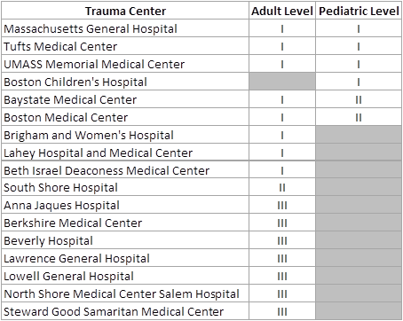
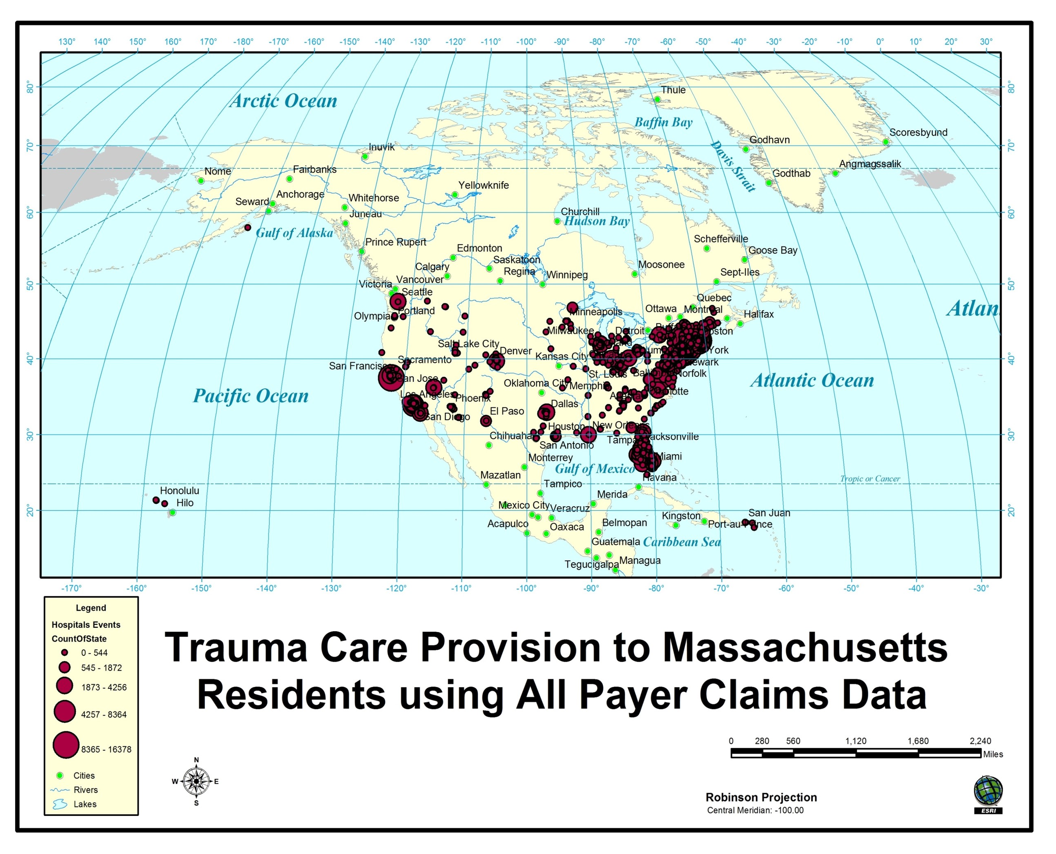
Question: The CHIA case mix data contains data from all the of the acute care hospitals
in Massachusetts. Do both the CHIA case mix data and MA APCD contain data from all
of the trauma centers verified by the American College of Surgeons?
TRAUMA CENTERS
Answer: Both the case mix data and MA APCD contain data from all Massachusetts trauma centers verified by the American College of Surgeons (ACS), see Table 1 below. However, the MA APCD contains data from trauma centers that extend beyond the Massachusetts political boundaries, see Figure 1 below. An initial release of the MA APCD was used by MDPH commercial health plan beneficiaries seeking trauma care over a 2-year period for 229,557 episodes of care needed by 91,477 MA residents analyzed for out of state inpatient trauma care seeking patterns. Investigators found that MA residents receiving care out of state constituted 9% of the patient sample with 50% of care provided in New England (NE) states bordering MA in order of the following MA patient volume ranking: RI, NH, CT, NY, ME, and VT. NE patients had increased odds of care destination through referral. Florida and Texas rank as the highest volume non-NE region sites of care. Clinically, NE patients had a higher rate of care sought for open fracture of base of skull with subarachnoid, subdural, and extradural hemorrhage, with loss of consciousness of unspecified duration than non-MA care seekers outside of the NE region.
Table 1. Massachusetts ACS Verified Trauma Centers (as of 5/25/2021)
Figure 1. Trauma Centers in the MA APCD extend beyond MA boundaries*

Slide 14
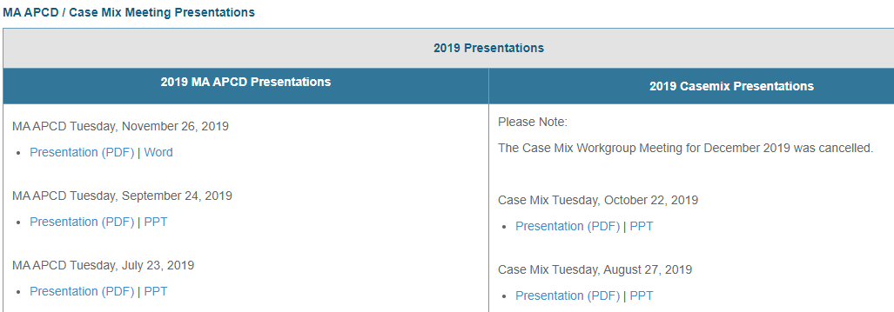
Where can I find past User Workgroup Presentations?
http://www.chiamass.gov/ma-apcd-and-case-mix-user-workgroup-information/

Slide 15
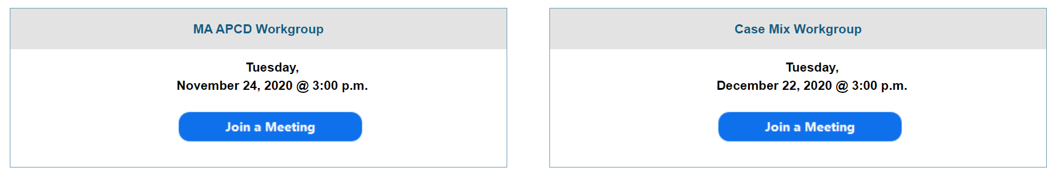
When is the next User Group meeting?
The next User Group will meet Tuesday, June 22.
http://www.chiamass.gov/ma-apcd-and-case-mix-user-workgroup-information/

Slide 16
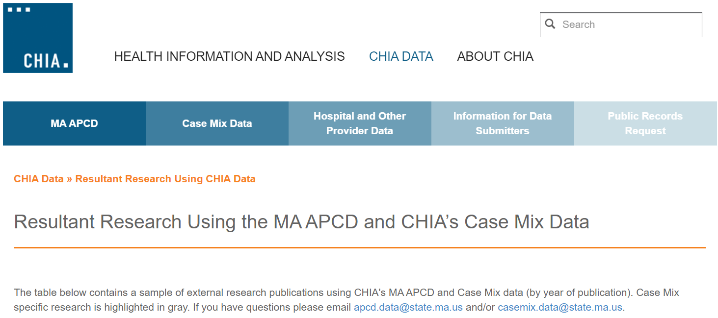
Resultant Research Using CHIA Data
https://www.chiamass.gov/resultant-research-using-chia-data

Slide 17
Questions?
Questions related to MA APCD:
apcd.data@state.ma.us
Questions related to Case Mix:
casemix.data@state.ma.us
REMINDER: Please include your IRBNet ID#, if you currently have a project using CHIA data.

Slide 18
Call for Topics and Presenters
If there is a TOPIC that you would like to see discussed at an MA APCD or Case Mix workgroup in 2020, contact Amy Wyeth [amy.wyeth@state.ma.us]
If you are interested in PRESENTING at a MA APCD or Case Mix workgroup in 2020, contact Amy Wyeth [amy.wyeth@state.ma.us]
You can present remotely, or in-person at CHIA
We may be reaching out to some data users with invitations to present, and hope you will consider this!

