Slide 1
CHIA user workgroup
Don Kirkwood (Manager of Data Release and Procurement)
Sylvia Hobbs (Manager of User Support)
Scott Curley (Manager Privacy & Compliance)
April 27, 2021
CENTER FOR HEALTH INFORMATION AND ANALYSIS

Slide 2
Agenda
Announcements:
  APCD Release 8.0 Updates
  FY19 Case Mix Release Projections
  Data Release and Application Update
Website Updates
Application Reminders
User Support Questions
  Emergency Department Data;
  Case Mix Financial Data;
  Hospital Inpatient Leave of Absence Days;
  Differences Between Case Mix Inpatient Volume and MA APCD Inpatient Volume;
Q&A

Slide 3
MA APCD Release 8.0
  Available NOW
  Applicants with approved projects that require updated APCD data (Release 8.0) should submit to CHIA a completed Exhibit B (Certificate of Continued Need and Compliance) of the Data Use Agreement. After submitting a completed Exhibit B you will receive an invoice (if applicable) for the requested data. Upon payment of the invoice the order for the data will be placed.
  Release 8.0 includes data on services from January 2014 – December 2018 with six months of claim runout (includes paid claims through 6/30/19).
  Will be linkable to Release 7.0 via crosswalk
  Additional information on highlights and enhancements will be presented in future APCD User Workgroups.

Slide 4

Case Mix FY19 Release
*CURRENT* RELEASE TIMEFRAMES FOR EACH FILE:
  Inpatient (HIDD)
  Available for request and delivery
  Emergency Department (ED)
  Available for request and delivery
  Outpatient Observation (OOD)
  Available for request and delivery
  Applicants with approved projects that require newly available year(s) of Case Mix Data (e.g., FY 19) should submit to CHIA a completed Exhibit B (Certificate of Continued Need and Compliance) of the Data Use Agreement. After submitting a completed Exhibit B you will receive an invoice (if applicable) for the requested data. Upon payment of the invoice the order for the data will be placed.

Slide 5
Data Release and Application Updates
Due to Governor Baker’s emergency actions to limit the spread of COVID-19 CHIA’s workforce will be remote, for now. This arrangement will limit CHIA’s ability to produce and deliver data extracts. At this time, CHIA is releasing data and providing extracts to requestors.
During this time, CHIA will continue to accept and review data applications for both Case Mix and All-Payer Claims Database (MA APCD) datasets. Review committees, DRC and DPC, will continue their meetings remotely as necessary.
Due to CHIA’s physical office being closed, applications will be accepted without a fee. After receipt of the application, CHIA will issue an invoice which will allow applicants to remit payment online.
If you are a Data User that has a CHIA hard drive in your possession, please keep the hard drive at this time while CHIA’s physical office is closed.

Slide 6
Website Release Updates
  Updates on the production of APCD and Case Mix databases and status of data requests are now posted to CHIA’s website!
    Aim #1 is to provide weekly or bi-weekly status update on CHIA data products as they are in development.
    Aim #2 is to provide applicants with information about expected fulfillment status for individual data requests.
    Request IDs will be communicated to Data Requestors via email.
  Please visit http://www.chiamass.gov/status-of-data-requests/ to see the current status of releases.

Slide 7
Application reminders

Slide 8
Fee Waiver Request Reminders
  If you’re submitting a request for a fee waiver, remember to include the fee remittance form in your application package on IRBNet.
  Remember to submit supporting documentation (if required).
  If you’re requesting a financial hardship waiver, remember to submit information detailing your project’s financial situation (examples: project budget, grant funding, organizational / departmental funding). Also request to pay a specific price that you reasonably believe you’re able to afford to contribute.
  CHIA generally does not offer full financial hardship fee waivers. We expect all applicants to have made an attempt to find funding to cover the full cost of the data fees.
  Fee waiver requests can take some time to process – especially financial hardship requests.

Slide 9
USER questions

Slide 10
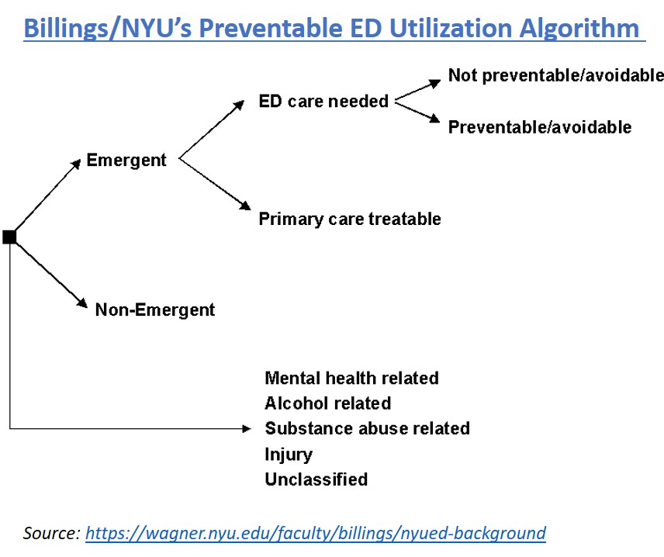
Question: Prior to ICD-10-CM implementation, academic and government
researchers used an algorithm based on ICD-9-CM diagnosis codes to
classify potentially preventable emergency department (ED) utilization.
Is an ICD-10-CM version of this classification algorithm available?
Preventable Emergency Department Visits
Answer: Yes, the technical appendix of the Massachusetts Health Policy Commission’s report on “Avoidable Hospital Use” provides a direct link to NYU’s background information on the development, by John Billings and his colleagues at NYU, of the diagnosis algorithm to classify primary care treatable and preventable ED utilization. See: https://wagner.nyu.edu/faculty/billings/nyued-background . On that page, NYU provides a link to both the ICD-9-CM (http://wagner.nyu.edu/files/faculty/NYU_ED_Algorithm_-_ICD-9_Codes_-_6.23.15.xlsx ) and ICD-10-CM (http://wagner.nyu.edu/files/faculty/NYU_ED_Algorithm_-_ICD-10_Codes_-_6.23.15.xlsx ) codes for the ED utilization algorithm.
Massachusetts Health Policy Commission’s technical
appendix explains that the main purpose of the NYU ED
Algorithm is to identify emergency department visits for
primary care treatable conditions that could have been
provided in primary care setting or emergencies that
could have been avoided if primary care had been
delivered at earlier stage of illness. The NYU algorithm
assigns the probability that each diagnosis code
associated with an ED visit falls into one of the four
categories: (1) non-emergent; (2) an emergency for a
problem requiring contact with the medical system
within 12 hours but treatable in an office visit (primary
care treatable); (3) an emergency not treatable in an
office visit but preventable or avoidable; and (4) an
emergency that is not preventable or avoidable.

Slide 11

Question: What is the difference between the ED procedure code table and the ED services table? They both appear to have an unlimited number of procedure codes, however the procedure codes table has significantly fewer procedures than the services table.
Emergency
Department
Services
and
Procedures
Answer: In the Procedure Code table, hospitals submit the patient’s significant procedures as reported in FL 74 of the UB-04 using ICD-10-PCS or Current Procedural Terminology (CPT) codes which are procedures that carry an operative or anesthetic risk. The type of procedure code hospital uses in this field is indicated in Procedure Coding Type field in the main ED Visit table. Each procedure code table is accompanied by a number beginning with 01 in the sequence field and incremented by 1 for each additional iteration.
Not all ED visits result in a procedure in the procedure code table. In FY2019, 18% of ED Visits resulted in a code in the procedure code table.
An unlimited of procedure codes can be submitted.
In FY2019, the average number of procedures for ED visits that resulted in a procedure code was 2 and the maximum number 73.
In the Services Code table, hospitals submit the patient’s services as reported in FL 44 of the UB-04 Service Line Items using CPT codes or Healthcare Common Procedure Coding System (HCPCS) codes to bill for specific items and services provided by the emergency department during the visit. In addition, the code DRUGS is used to report provision of any drugs for which there are no specific HCPCS codes available. Likewise, SPPLY is used to report any supplies for which there are no specific HCPCS codes available.
In FY2019, 100% of ED visits resulted in a service.
An unlimited of service lines can be submitted.
In FY2019, the average number of service codes for each ED Visit was 6 and the maximum number 319.
Please note: The decrease in the number of ED procedure codes from FY2018 to FY2019 was due to a hospital system and its multiple sites changing their ED coding process to only pull CPT attached to the charge codes rather than all CPT codes.

Slide 12

Question: The case mix hospital inpatient discharge data has several Charge fields. It is unclear to me what the difference is between them. For example, what are ancillary charges?
Case Mix Financial Data
Answer: The main inpatient hospital discharge table contains four charge fields:
routine charges, special charges, ancillary charges and total charges. Table 1 below
shows the sum of charges for each charge amount type for FY2015 to FY2019. Consistently
each year, ancillary charges constitute the highest proportion of the total charges.
CMS defines ancillary charges as, “professional services by a hospital or other inpatient
health program. These may include x-ray, drug, laboratory, or other services.” CMS defines routine charges as, “services included by the provider in a daily service charge--sometimes referred to as the "Room and Board" charge. They include the regular room, dietary and nursing services, minor medical and surgical supplies, medical social services, psychiatric social service.” Each year over 90% of special care charges are for different levels of intensive care utilization, including newborn ICU. In the services table which contains revenues, there is a field called type of service with two coding options ANC for ancillary and ACC for accommodations. The revenue codes associated with ancillary charges will have the code ANC. Those associated with routine charges or special charges will typically have the code ACC.
Table 1. FY2015 to FY2019 Case Mix Hospital Inpatient Charges
 | Routine Charges | Special Charges | Ancillary Charges | Total Charges
FY2019 | $6,539,530,884 | $3,016,068,410 | $19,674,237,567 | $29,229,836,861
FY2018 | $6,229,745,403 | $2,809,882,244 | $18,280,449,080 | $27,320,076,727
FY2017 | $5,887,655,148 | $2,479,900,849 | $17,405,752,503 | $25,773,308,500
FY2016 | $5,664,763,025 | $2,389,925,727 | $16,600,712,637 | $24,655,401,389
FY2015 | $5,254,785,399 | $2,260,491,102 | $15,192,788,916 | $22,708,065,417
 | Routine Charges | Special Charges | Ancillary Charges | Total Charges
FY2019 | 22.4% | 10.3% | 67.3% | $29,229,836,861
FY2018 | 22.8% | 10.3% | 66.9% | $27,320,076,727
FY2017 | 22.8% | 9.6% | 67.5% | $25,773,308,500
FY2016 | 23.0% | 9.7% | 67.3% | $24,655,401,389
FY2015 | 23.1% | 10.0% | 66.9% | $22,708,065,417

Slide 13

INPATIENT VOLUME
Question: I am attempting to use the MA APCD to track care transitions for patients before and after inpatient hospitalization and am having a problem distinguishing inpatient hospitalizations in the MA APCD that are the equivalent to the volume of hospital inpatient care episodes found in CHIA’s case mix data.
Answer: The MA APCD includes the universe of billable hospitalization settings not limited
to acute care that you would find the in case mix. In addition to acute care, the MA APCD
includes inpatient care associated, for example with with rehabilitation, nursing, eating disorders, and other specialties. Even filtering down to facility claims with a specialty codes for general acute care hospital such as “282N00000X” and using the NPIs associated with the hospitals in case mix, you should expect volume numbers 50% lower than case mix for the following reasons:
Over 85% of MA APCD medical claims are for care performed in the outpatient setting, therefore facility type and specialty codes ensure filtering for hospital inpatient acute care;
Case mix includes data for inpatient hospitalizations paid by Medicare fee for service, Worker’s Compensation and Federal Employment Payer programs not in the MA APCD;
Case mix includes data on to care provided patients regardless of payer status as tourists and non-US citizens who might not have coverage by a health insurer who submit to the MA APCD
Case mix was not impacted by the overall decrease in medical claims data for the self-insured due to Gobeille.

Slide 14
Answer continued: MA case mix data can provide a reliable and longstanding data
source for analyzing population based inpatient acute care. The following filters applied
to MA APCD can facilitate distinguishing inpatient acute care:
INPATIENT VOLUME
MEDICAL CLAIMS FILTERS TO DISTINGUISH INPATIENT ACUTE CARE
Admission Date* (is not null )
Admission Type* (Is not null)
Admission Source* (Is not null)
Entity Type (Filter by Code 2 for non-person entity)
Service Provider State (Filter by MA for Massachusetts)
Type of Bill on Facility Claims (Filter by Code 11 for Hospital Inpatient Care and exclude outpatient claims as reported in MC037 - Site of Service - on NSF/CMS 1500 Claims)
Discharge Date( (Is not null)
Type of Claim (Filter by Code 002 for Facility)
Filter for NPIs associated with Massachusetts hospitals of interest
Filter for specialty codes associated with general acute care hospital
Note: Not null within one of the claim lines associated with payer claim control number

Slide 15
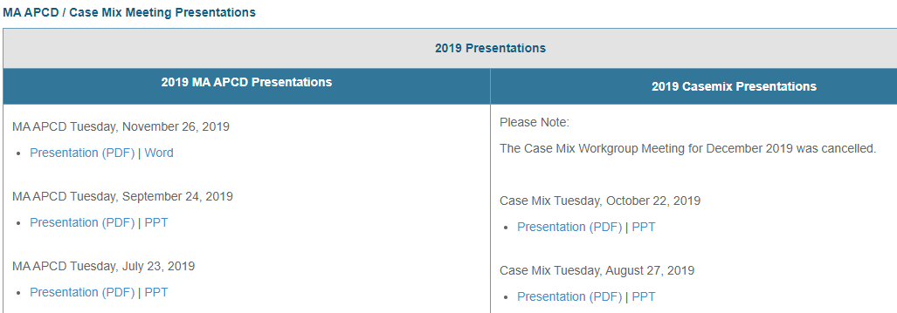
Where can I find past User Workgroup Presentations?
http://www.chiamass.gov/ma-apcd-and-case-mix-user-workgroup-information/

Slide 16
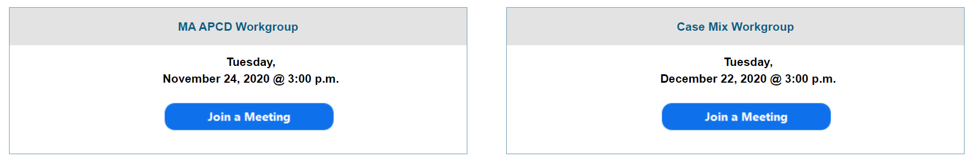
When is the next User Group meeting?
The next User Group will meet Tuesday, May 25.
http://www.chiamass.gov/ma-apcd-and-case-mix-user-workgroup-information/

Slide 17
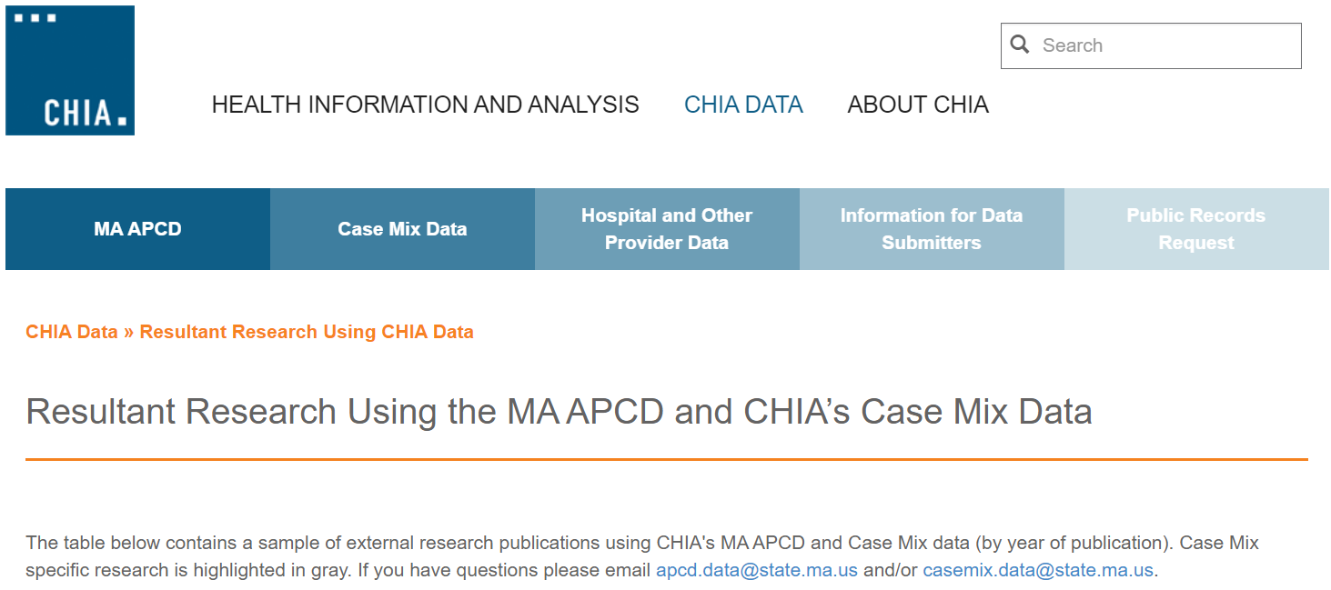
Resultant Research Using CHIA Data
https://www.chiamass.gov/resultant-research-using-chia-data

Slide 18
Questions?
Questions related to MA APCD:
apcd.data@state.ma.us
Questions related to Case Mix:
casemix.data@state.ma.us
REMINDER: Please include your IRBNet ID#, if you currently have a project using CHIA data.

Slide 19
Call for Topics and Presenters
If there is a TOPIC that you would like to see discussed at an MA APCD or Case Mix workgroup in 2020, contact Amy Wyeth [amy.wyeth@state.ma.us]
If you are interested in PRESENTING at a MA APCD or Case Mix workgroup in 2020, contact Amy Wyeth [amy.wyeth@state.ma.us]
You can present remotely, or in-person at CHIA
We may be reaching out to some data users with invitations to present, and hope you will consider this!

