Slide 1
CHIA user workgroup
Don Kirkwood (Manager of Data Release and Procurement)
Sylvia Hobbs (Associate Director of Data Strategy and User Support)
Scott Curley (Manager Privacy & Compliance)
April 25, 2023
CENTER FOR HEALTH INFORMATION AND ANALYSIS

Slide 2
Agenda
Announcements:
  APCD Release CY 2021 Updates
  FY21 Case Mix Release Projections
Website Updates
User Support Questions
  Hospital Recorded Blood Alcohol Levels
  ICD-10-Codes for Family and Social Disruption
  Comparison of Case Mix to MA APCD Hospital Identifiers
Q&A

Slide 3
MA APCD CY 2021
  Available for request
  Applicants with approved projects that require updated APCD data (CY 2021 Data) should submit to CHIA a completed Exhibit B (Certificate of Continued Need and Compliance) of the Data Use Agreement. After submitting a completed Exhibit B you will receive an invoice (if applicable) for the requested data. Upon payment of the invoice the order for the data will be placed.
  CY 2021 Data includes data on services from January 2017 – December 2021 with six months of claim runout.

Slide 4

Case Mix FY21 Release
*CURRENT* RELEASE TIMEFRAMES FOR EACH FILE:
  Inpatient (HIDD)
  Available for request
  Emergency Department (ED)
  Available for request
  Outpatient Observation (OOD)
  Available for request
  Applicants with approved projects that require newly available year(s) of Case Mix Data (e.g., FY 19) should submit to CHIA a completed Exhibit B (Certificate of Continued Need and Compliance) of the Data Use Agreement. After submitting a completed Exhibit B you will receive an invoice (if applicable) for the requested data. Upon payment of the invoice the order for the data will be placed.

Slide 5
Website Release Updates
  Updates on the production of APCD and Case Mix databases and status of data requests are now posted to CHIA’s website!
    Aim #1 is to provide weekly or bi-weekly status update on CHIA data products as they are in development.
    Aim #2 is to provide applicants with information about expected fulfillment status for individual data requests.
    Request IDs will be communicated to Data Requestors via email.
  Please visit http://www.chiamass.gov/status-of-data-requests/ to see the current status of releases.

Slide 6
USER questions

Slide 7

Question: The latest Centers for Disease Control and Prevention underlying cause of death data for Massachusetts indicates a 38% increase in the age-adjusted death rate from “alcohol-induced causes” from calendar year 2019 to 2020. The FY2016 implementation of ICD-10-CM included an update to add specific nomenclature for gradients of blood alcohol levels. To what extent are the new blood alcohol gradient codes being used in the Case Mix data?
ICD-10-CM Codes for
Blood Alcohol Levels
Answer: There are eleven new ICD-10-CM ‘Y90’ codes referencing blood alcohol levels. Nine of the codes include
specific gradients for blood alcohol levels. See Table 1 below. The codes are being used in the outpatient emergency
department (ED) visit data. The volume of patients with blood alcohol codes trended upward in FY2018,
with more than twice the number of males than females having blood alcohol codes. See Figure 1 below.
Table 1. ICD-10-CM Codes for Blood Alcohol Levels
ICD-10-CM Code | Description
Y90 | Evidence of alcohol involvement determined by blood alcohol level
Y90.0 | Blood alcohol level of less than 20 mg/100 ml
Y90.1 | Blood alcohol level of 20-39 mg/100 ml
Y90.2 | Blood alcohol level of 40-59 mg/100 ml
Y90.3 | Blood alcohol level of 60-79 mg/100 ml
Y90.4 | Blood alcohol level of 80-99 mg/100 ml
Y90.5 | Blood alcohol level of 100-119 mg/100 ml
Y90.6 | Blood alcohol level of 120-199 mg/100 ml
Y90.7 | Blood alcohol level of 200-239 mg/100 ml
Y90.8 | Blood alcohol level of 240 mg/100 ml or more
Y90.9 | Presence of alcohol in blood, level not specified
Figure 1. FY2016 to FY2021 Volume of Emergency Department Visits by Sex with Recorded Blood Alcohol Level
continued

Slide 8
Answer (continued): The higher rate of males with recorded blood alcohol levels in ED data aligns with the higher rate and upward trend in alcohol-induced deaths for males in Massachusetts. See Figure 1 below. While both the Massachusetts male and female alcohol-induced age-adjusted death rates per 100,000 trended upward, the death rate for males remains lower than the national rate for males. See Figure 2 below. However, at the height of the pandemic in calendar year 2020, the alcohol-induced death rate for Massachusetts females surpassed the national rate for females. See Figure 3 below.
ICD-10-CM Codes for
Blood Alcohol Levels
Figure 1. Massachusetts Age-Adjusted Alcohol-Induced Death Rate by Sex per 100,000
Fig. 2. Comparison of Massachusetts to National Death Rate for Males*
Fig. 3. Comparison of Massachusetts to National Death Rate for Females*
Age-Adjusted Rate per 100,000
Age-Adjusted Rate per 100,000
Massachusetts male alcohol-induced death rate remains lower than the national death rate for males
Massachusetts female alcohol-induced death rate surpassed the national death rate for females in
the single calendar year of 2020
*Source: Centers for Disease Control and Prevention, National Center for Health Statistics. National Vital Statistics System, Mortality Data on CDC Wonder
continued

Slide 9
Answer (continued): When analyzing ICD-10-CM blood alcohol levels, keep in mind that the ICD-10-CM ‘Y90’ codes for blood alcohol levels are reported in either the associated diagnosis field or the external cause field, not in the principal diagnosis field. Over the past six years (FY2016-FY2021), the top emergency department principal diagnoses for those tested for alcohol levels were alcohol abuse with intoxication and alcohol dependence with Intoxication. For those who did not have a principal diagnosis of alcohol abuse or dependence, head injuries were the leading anatomic trauma associated with high blood alcohol levels, chest pains were the leading physiologic disorder, and major depression the leading psychiatric disorder. See Table 1 below. Each year since ICD-10-CM implementation, on average 20,839 patients have ED recorded blood alcohol level and consistently, each year, the most frequent recorded level on over 40% of patients tested was the highest blood alcohol level of 240 mg/100 or more. See Figure 1 below.
ICD-10-CM Codes for
Blood Alcohol Levels
Table 1. FY2016 – FY2021 Top ED Non-Alcohol Principal Diagnoses with Recorded Blood Alcohol Levels
Rank | Anatomic Injuries | Physiologic disorders | Psychiatric/Behavioral Disorders
1 | Unspecified injury of head | Chest pain | Major depressive disorder
2 | Laceration without foreign body of scalp | Other chest pain | Suicidal ideations
3 | Laceration without foreign body of other part of the head | Syncope and collapse | Anxiety disorder
4 | Contusion of other part of head | Nausea with vomiting | Altered mental status
5 | Abrasion of other part of head | Epigastric pain | Other psychoactive substance abuse
Figure 1. FY2016 – FY2021 Most Frequent Alcohol Level of Patients with ED Recorded Blood Alcohol Level
continued

Slide 10
Answer (continued): As with the outpatient ED visit data, a higher volume of males in the inpatient
hospital care setting have recorded blood alcohol levels, paralleled by the same pronounced FY2019 increase in overall testing volume. See Figure 1 below. However, when comparing the age distribution of patients with recorded blood alcohol levels by care setting (ED vs Inpatient) for the six-year period of FY2016 through FY2019, the age distribution for females has a higher proportion of younger patients than does the male age distribution. See Figure 2 below. The inpatient hospital care setting has a higher proportion of older patients for both males and females compared to the ED visit care setting. See Figure 3 below.
ICD-10-CM Codes for
Blood Alcohol Levels
Figure 1. FY2016 to FY2021 Volume of Inpatient Hospitalizations by Sex with Recorded Blood Alcohol Level
Figure 2.
Age Distribution of ED Visit Patients with Recorded Blood Alcohol Level
Figure 3.
Age Distribution of Inpatient Discharges with Recorded Blood Alcohol Level
FY2016-FY2021
FY2016-FY2021
Higher proportion of older patients
Higher proportion of younger females

Slide 11
Question: I am applying for ED visit data to study the emotional/social sequelae of the pandemic on families,
such as the impact of loss of a loved one. I previously used ICD-9-CM ‘V-codes’ on factors influencing
health status to study forms of family disruption and wanted to determine whether the newer ICD-10-CM health status codes are consistently being used in the outpatient emergency department visit data.
Disappearance and Death of a Family Member
Answer: Yes, there are granular ICD-10-CM ‘Z-codes’ for family life disruption (See Table 1 below) and social life disruption (See Table 2). Hospitals are using these codes to report on factors influencing the health status of patients visiting the outpatient emergency. For example, even though there has been a 21% decrease in overall ED Visit volume from 2016 to 2021, the volume of patients whose health status was impacted by “the disappearance and loss of a family member” (ICD-10-CM Z634) has more than tripled. See Figure 1 below.
Table 1. ICD-10-CM Codes for Family Life Disruption
Table 2. ICD-10-CM Codes for Social Life Disruption
ICD-10-CM | Description
Z633 | Absence of family member
Z6331 | Absence of family member due to military deployment
Z6332 | Other absence of family member
Z634 | Disappearance and death of family member
Z635 | Disruption of family by separation and divorce
Z637 | Other stressful life events affecting family and household
Z6371 | Stress on family due to return of family member from military deployment
Z6372 | Alcoholism and drug addiction in family
Z6379 | Other stressful life events affecting family and household
Z63 | Other problems related to primary support group, including family circumstances
Z630 | Problems in relationship with spouse or partner
ICD-10-CM | Description
Z600 | Problems of adjustment to life-cycle transitions
Z608 | Other problems related to social environment
Z602 | Problems related to living alone
Z605 | Target of (perceived) adverse discrimination and persecution
Z603 | Acculturation difficulty
Z60 | Problems related to social environment
Z604 | Social exclusion and rejection
Z609 | Problem related to social environment, unspecified

Slide 12

Question: The Case Mix data has organization identifiers for facilities. Can those same identifiers be used in the MA APCD to identify the parallel claims data associated with the hospital submitters in the case mix data?
Provider IDs
Answer: No, the case mix hospital organization identifiers are facility IDs assigned by CHIA and
are not used in the MA APCD. However, the case mix data does include the physician license
number assigned by the Massachusetts Board of Registration of Medicine. The MA APCD Provider filing specifications does contain a field for License ID (PV06) which insurance carriers are ask to report the state license number for the provider identified in the Plan Provider ID field (PV002). For a physician, this is the medical license for a non-doctor this is the practice license. It is important to keep in mind that the Plan Provider ID is not always for a person but can be persons, facilities or other entities involved in claims transactions. The license ID reported in the Case Mix data is only for persons, not facilities. While both hospitals in the MA APCD and in Case Mix data contain the same facility names, the facility names are standardized in the Case Mix data. In the MA APCD, one carrier's data might include the full name of a facility while another carrier might abbreviate that name. Therefore, the MA APCD facility names are not reported in a standardized fashion across all carriers.
FACILITY SITE COMPARISON DATA
CASE MIX
Organization IDs Assigned by CHIA for :
Hospital Site
Hospital Filer (if the not same as Site)
Transferring Hospital
MA APCD
HIPAA Taxonomy to Classify Provider Specialty
Type of Bill on Facility Claims
CMS Assigned National Provider IDs
Site of Service on NSF/CMS 1500 Claims
Federal Tax ID
Facility License ID
SHARED
Facility Name
Address
City
State
ZIP Code

Slide 13
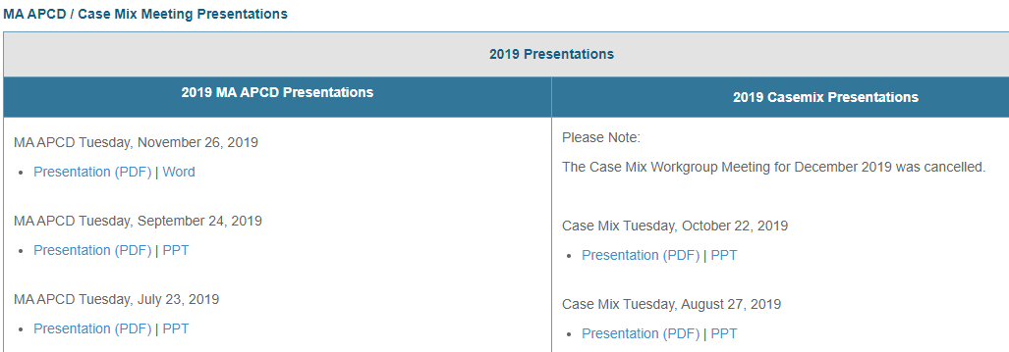
Where can I find past User Workgroup Presentations?
http://www.chiamass.gov/ma-apcd-and-case-mix-user-workgroup-information/

Slide 14
When is the next User Group meeting?
The next User Group will meet Tuesday May, 23.
http://www.chiamass.gov/ma-apcd-and-case-mix-user-workgroup-information/

Slide 15
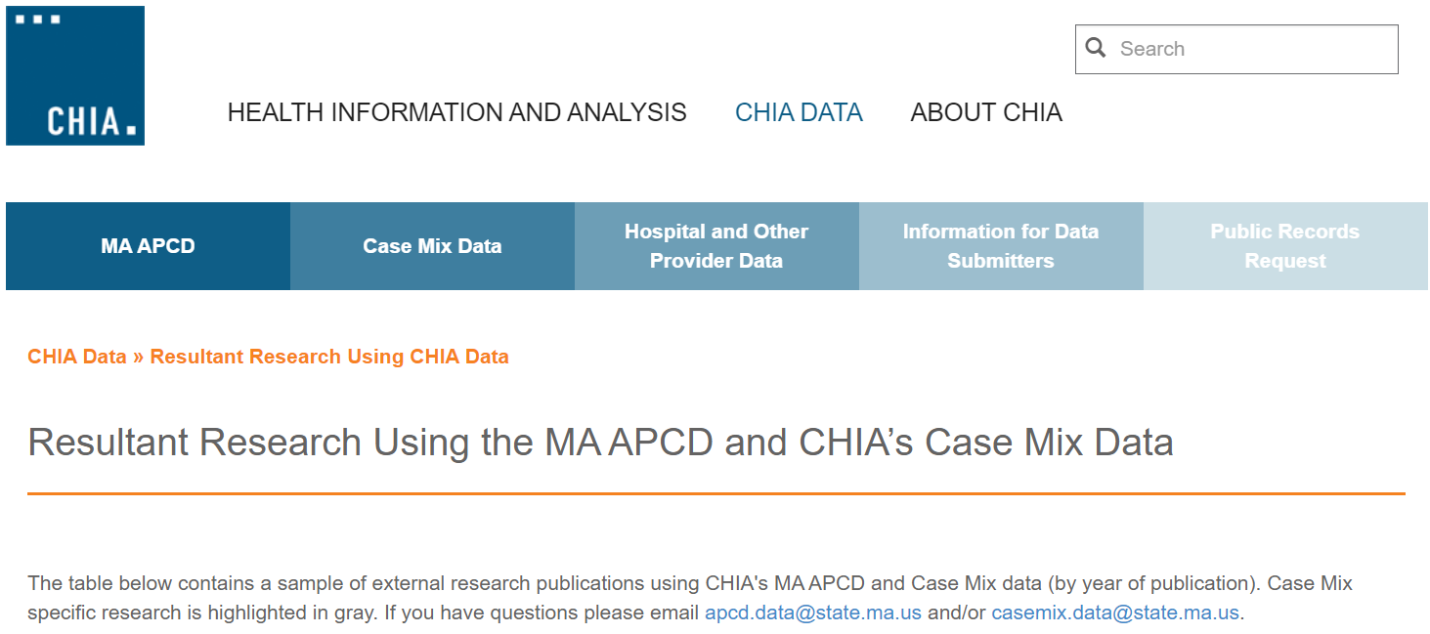
Resultant Research Using CHIA Data
https://www.chiamass.gov/resultant-research-using-chia-data

Slide 16
Questions?
Questions related to MA APCD:
apcd.data@chiamass.gov
Questions related to Case Mix:
casemix.data@chiamass.gov
REMINDER: Please include your IRBNet ID#, if you currently have a project using CHIA data.

