Slide 1
CHIA user workgroup
Don Kirkwood (Manager of Data Release and Procurement)
Sylvia Hobbs (Manager of User Support)
Scott Curley (Manager Privacy & Compliance)
December 22, 2020
CENTER FOR HEALTH INFORMATION AND ANALYSIS

Slide 2
Agenda
Announcements:
  APCD Release 8.0 Updates
  FY19 Case Mix Release Projections
  Data Release and Application Update
Website Updates
Application Reminders
User Support Questions
  Casemix Knee/Hip Replacement Volume compared to MA APCD
  Admission Source Codes
  Emergency Department Busyness
  Tracking Observation Stays
  Principal Diagnosis
  Principal Indicator
  Race, Ethnicity and Hispanic Indicator
  Visit Sequencing
Q&A

Slide 3
MA APCD Release 8.0
  Available NOW
  Applicants with approved projects that require updated APCD data (Release 8.0) should submit to CHIA a completed Exhibit B (Certificate of Continued Need and Compliance) of the Data Use Agreement. After submitting a completed Exhibit B you will receive an invoice (if applicable) for the requested data. Upon payment of the invoice the order for the data will be placed.
  Release 8.0 includes data on services from January 2014 – December 2018 with six months of claim runout (includes paid claims through 6/30/19).
  Will be linkable to Release 7.0 via crosswalk
  Additional information on highlights and enhancements will be presented in future APCD User Workgroups.

Slide 4

Case Mix FY19 Release
*CURRENT* RELEASE TIMEFRAMES FOR EACH FILE:
  Inpatient (HIDD)
  Available for request and delivery
  Emergency Department (ED)
  Available for request and delivery
  Outpatient Observation (OOD)
  Available for request
  Applicants with approved projects that require newly available year(s) of Case Mix Data (e.g., FY 19) should submit to CHIA a completed Exhibit B (Certificate of Continued Need and Compliance) of the Data Use Agreement. After submitting a completed Exhibit B you will receive an invoice (if applicable) for the requested data. Upon payment of the invoice the order for the data will be placed.

Slide 5
Data Release and Application Updates
Due to Governor Baker’s emergency actions to limit the spread of COVID-19 CHIA’s workforce will be remote, for now. This arrangement will limit CHIA’s ability to produce and deliver data extracts. At this time, CHIA is releasing data and providing extracts to requestors.
During this time, CHIA will continue to accept and review data applications for both Case Mix and All-Payer Claims Database (MA APCD) datasets. Review committees, DRC and DPC, will continue their meetings remotely as necessary.
Due to CHIA’s physical office being closed, applications will be accepted without a fee. After receipt of the application, CHIA will issue an invoice which will allow applicants to remit payment online.
If you are a Data User that has a CHIA hard drive in your possession, please keep the hard drive at this time while CHIA’s physical office is closed.

Slide 6
Website Release Updates
  Updates on the production of APCD and Case Mix databases and status of data requests are now posted to CHIA’s website!
    Aim #1 is to provide weekly or bi-weekly status update on CHIA data products as they are in development.
    Aim #2 is to provide applicants with information about expected fulfillment status for individual data requests.
    Request IDs will be communicated to Data Requestors via email.
  Please visit http://www.chiamass.gov/status-of-data-requests/ to see the current status of releases.

Slide 7
Application reminders

Slide 8
Fee Waiver Request Reminders
  If you’re submitting a request for a fee waiver, remember to include the fee remittance form in your application package on IRBNet.
  Remember to submit supporting documentation (if required).
  If you’re requesting a financial hardship waiver, remember to submit information detailing your project’s financial situation (examples: project budget, grant funding, organizational / departmental funding). Also request to pay a specific price that you reasonably believe you’re able to afford to contribute.
  CHIA generally does not offer full financial hardship fee waivers. We expect all applicants to have made an attempt to find funding to cover the full cost of the data fees.
  Fee waiver requests can take some time to process – especially financial hardship requests.

Slide 9
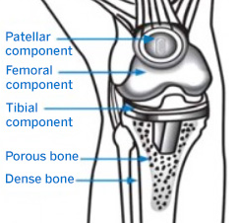
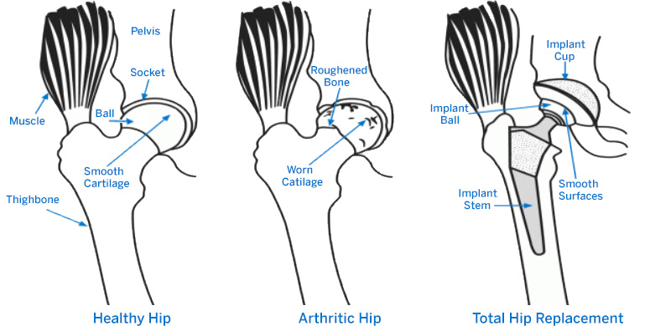

Question: We are applying for CHIA data to determine the total count of three different same day outpatient surgical procedures (knee replacement, hip replacement and PCI) by year, patient ZIP code, and facility. Before submitting our application, would it be possible to determine the trade-off in relying on just knee replacements, hip replacements and PCIs as reported in the case mix outpatient observation stay data versus outpatient procedures as reported in the MA APCD?
Answer: One year (2018) of case mix outpatient observation stay knee replacements
were compared to one year of MA APCD knee replacements. Of the 67 acute care hospitals
submitting outpatient observation stay data, 29 reported performing 301 knee replacements.
In the MA APCD, over 245 outpatient facilities (including orthopedic surgery centers, sports
medicine centers, ambulatory surgery centers and hospital outpatient medical groups)
performed over 21,000 knee replacements.
Likewise, one year of case mix observation stay hip replacements were compared to the
MA APCD. Of the 67 hospitals submitting observation stay data, 21 reported 159 hip
replacements. In the MA APCD, 342 outpatient facilities performed over 14,800 hip
replacements. As with knee replacements, using the MA APCD to analyze hip
replacements captured procedures performed at a wider variety of outpatient care
settings and therefore a higher volume of procedures.
Also, one year of observation stay PCIs were compared to the MA APCD. Of 67 hospitals,
20 reported performing 235 PCI procedures. In the MA APCD, 194 outpatient facilities
(including outpatient cardiology and cardiovascular centers, physician’s practice groups,
and hospital outpatient radiology and specialty centers) performed over 9,000 procedures.
Therefore, the case mix observation stay data alone would not allow you to achieve your
study goal to validate the outpatient volume of the three procedures of interest. The
MA APCD captures care provided in any setting for which a carrier submits claims to CHIA.
Knee Replacement
Hip Replacement

Slide 10
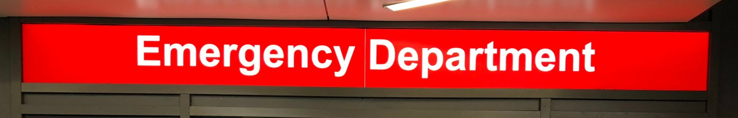
Question: In creating a flag for ED activity, we expanded on the CHIA
ED flag to include admission source = R (within hospital emergency
room transfer) and the various revenue codes you suggested in the PPT on your website. Do you also suggest incorporating ED registration date field or admission source=7 (outside hospital emergency room transfer)?
Answer: FY2018 Hospital Inpatient Discharge Data has 809,270 discharges. When you compare the fields that can be used to indicate whether a patient was admitted through the ED, the revenue code 450 (the billing code for utilization of emergency room services) appeared on 59% of the discharge records, followed by ED Registration Date on 51% of the
discharges, ED Flag Code 2 on 40%, and primary or secondary admission source 16% (See Figure 1 below). Therefore, the two most reliable indicators appear to be 450 revenue code and ED registration data. The use of admission source ‘7’ (outside hospital emergency room transfer) depends on your study. Some studies distinguish how they analyze interfacility transfers where there may a different type of delay in reaching definitive care from within hospital admissions.

Slide 11
Question: Similarly, if we wanted to analyze patients who are admitted through observation stay to inpatient hospitalization, what field should we use to ensure that we have filtered for all such patients?
Answer: Hospitals report observation room charges under revenue code 762. However, if the patient has been seen in Observation as well as another outpatient department and is then admitted, hospitals use Revenue Code 762 and use the alternate outpatient department as the admission source. Since this is frequently the case with observation stay patients, you will find a small number of discharges with source code ‘X’ for observation admission source (see Figure 2 below) and a larger number with Revenue Code 762 and Observation Stay Flag indicating ‘Yes’. It is important to note that the revenue code units of service are reported in hours and a patient might have a longer observation stay, say 48 hours, than inpatient length of say, which could be only 1 day.
Observation Stay
Patient Admitted after Observation Stay

Slide 12


Question: Is case mix data on inpatient hospitalizations (and ED use) dated in such a way that you can assess the busyness of a hospital or ED at a specific time period? ?
Answer: The emergency department registration times are not released as part of the limited data set to non-government researchers. However, in both the ED Visit data and now as part of the hospital inpatient discharge data, the ED registration date can be requested by non-government applicants.
The ED Visit data does however include a length of stay in hours and this field can be requested by non-government applicants. The length of stay in hours, date and patient visit volume does enable simulating seasonal surge models and looking at the relationship between patient volume and days on which specific patient volumes begin to hit the 24-hour ceiling. For example, while Figure 1 below shows FY2018 outpatient ED visit volume by length of stay in hours, the same annual comparison can be made by quarters, months, weeks, or days.
ED Surge Volume

Slide 13

Question: The ED data contains Visit Sequence variable and a Sequence
variable. Can you explain the difference? I only see Sequence variables
in the ED procedure and diagnosis tables, but Visit Sequence only in the
main ED Visit.
Answer: For patients who had multiple ED visits within a year, the Visit Sequence variable in the main ED visit table indicates the sequence of the patient’s visit based on the date when their specific UHIN appeared first within that year’s release. As you can see in Figure 1 below, the majority of patients just have only one visit. The term sequence in the diagnosis and procedure codes field is simply how hospitals order each subsequent associated codes after the first diagnosis and first procedure.

Slide 14
Question: We found the principal diagnosis codes is sometimes listed in both the main table and the separate diagnosis table for inpatient and ED data, but in many times on the ED side it is not listed in both places – do you know why this is the case?
Answer: Hospitals report an admitting diagnosis, principal diagnosis, and discharge diagnosis which CMS defines as follow:
    Admitting Diagnosis - patient's initial diagnosis at the time of admission
    Principal Diagnosis – the diagnosis chiefly responsible for the medical services provided
    Discharge Diagnosis – patient’s final diagnosis at the time of discharge
There are instances when the admitting diagnosis rendered before any diagnostic tests have been run, is the same at the principal diagnosis and discharge diagnosis. The admitting diagnosis and discharge diagnosis are used to generate separate DRGs.
You do typically see this duplication in ED data because the ED setting is outpatient care where the patient receives care without being admitted. DRGs are not run on ED Data.
Admitting Diagnosis
Principal Diagnosis
Discharge Diagnosis

Slide 15

Question: Can you discuss the Race, Ethnicity, Hispanic Indicator and the differences between them in the data?
Answer: Race is a system of labelling that provides a source of identity and has the following five categories provided by the CDC: American Indian or Alaska Native, Asian, Black or African American, Native Hawaiian or Other Pacific Islander, and White.
Ethnicity is a term that describes shared culture, including practices, values, and beliefs of a group. Collection of ethnicity data depends on the questions asked and the format of the questions, which in turn, depends on the system’s field capacity. CHIA adheres to the OMB guidance, using a two-question format, which includes the Hispanic ethnicity question, and then, granular ethnicity.
Hence, the Case Mix data has the Hispanic Indicator flag variable that determines whether or not a patient is Hispanic or Latino regardless of race, the majority of patients just have only one visit. The term sequence in the diagnosis and procedure codes field is simply how hospitals order each subsequent associated codes after the first diagnosis and first procedure.

Slide 16
USER questions

Slide 17
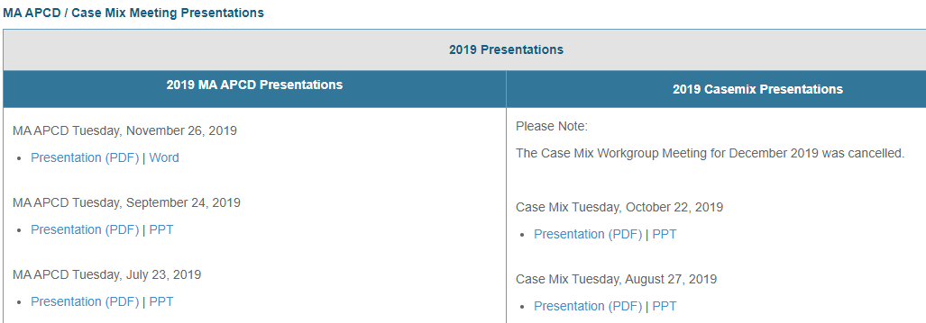
Where can I find past User Workgroup Presentations?
http://www.chiamass.gov/ma-apcd-and-case-mix-user-workgroup-information/

Slide 18

When is the next User Group meeting?
The next User Group will meet Tuesday, January 26.
http://www.chiamass.gov/ma-apcd-and-case-mix-user-workgroup-information/

Slide 19
Questions?
Questions related to MA APCD:
apcd.data@state.ma.us
Questions related to Case Mix:
casemix.data@state.ma.us
REMINDER: Please include your IRBNet ID#, if you currently have a project using CHIA data.

Slide 20
Call for Topics and Presenters
If there is a TOPIC that you would like to see discussed at an MA APCD or Case Mix workgroup in 2021, contact Amy Wyeth [amy.wyeth@state.ma.us]
If you are interested in PRESENTING at a MA APCD or Case Mix workgroup in 2021, contact Amy Wyeth [amy.wyeth@state.ma.us]
You can present remotely, or in-person at CHIA
We may be reaching out to some data users with invitations to present, and hope you will consider this!

