Slide 1
CHIA user workgroup
Don Kirkwood (Manager of Data Release and Procurement)
Sylvia Hobbs (Manager of User Support)
Scott Curley (Manager Privacy & Compliance)
February 23, 2021
CENTER FOR HEALTH INFORMATION AND ANALYSIS

Slide 2
Agenda
Announcements:
  APCD Release 8.0 Updates
  FY19 Case Mix Release Projections
  Data Release and Application Update
Website Updates
Application Reminders
User Support Questions
  Length of Stay in ED, Observation Stay, and Inpatient Hospitalization;
  Determining Emergency Department Cardiac and Ventilation Procedure Codes;
  Completeness of UHINs and Invalid UHINs in Case Mix Data;
  Differences in ED Volume in Case Mix Versus MA APCD;
  Newborn Birthweight Data.
Q&A

Slide 3
MA APCD Release 8.0
  Available NOW
  Applicants with approved projects that require updated APCD data (Release 8.0) should submit to CHIA a completed Exhibit B (Certificate of Continued Need and Compliance) of the Data Use Agreement. After submitting a completed Exhibit B you will receive an invoice (if applicable) for the requested data. Upon payment of the invoice the order for the data will be placed.
  Release 8.0 includes data on services from January 2014 – December 2018 with six months of claim runout (includes paid claims through 6/30/19).
  Will be linkable to Release 7.0 via crosswalk
  Additional information on highlights and enhancements will be presented in future APCD User Workgroups.

Slide 4

Case Mix FY19 Release
*CURRENT* RELEASE TIMEFRAMES FOR EACH FILE:
  Inpatient (HIDD)
  Available for request and delivery
  Emergency Department (ED)
  Available for request and delivery
  Outpatient Observation (OOD)
  Available for request
  Applicants with approved projects that require newly available year(s) of Case Mix Data (e.g., FY 19) should submit to CHIA a completed Exhibit B (Certificate of Continued Need and Compliance) of the Data Use Agreement. After submitting a completed Exhibit B you will receive an invoice (if applicable) for the requested data. Upon payment of the invoice the order for the data will be placed.

Slide 5
Data Release and Application Updates
Due to Governor Baker’s emergency actions to limit the spread of COVID-19 CHIA’s workforce will be remote, for now. This arrangement will limit CHIA’s ability to produce and deliver data extracts. At this time, CHIA is releasing data and providing extracts to requestors.
During this time, CHIA will continue to accept and review data applications for both Case Mix and All-Payer Claims Database (MA APCD) datasets. Review committees, DRC and DPC, will continue their meetings remotely as necessary.
Due to CHIA’s physical office being closed, applications will be accepted without a fee. After receipt of the application, CHIA will issue an invoice which will allow applicants to remit payment online.
If you are a Data User that has a CHIA hard drive in your possession, please keep the hard drive at this time while CHIA’s physical office is closed.

Slide 6
Website Release Updates
  Updates on the production of APCD and Case Mix databases and status of data requests are now posted to CHIA’s website!
    Aim #1 is to provide weekly or bi-weekly status update on CHIA data products as they are in development.
    Aim #2 is to provide applicants with information about expected fulfillment status for individual data requests.
    Request IDs will be communicated to Data Requestors via email.
  Please visit http://www.chiamass.gov/status-of-data-requests/ to see the current status of releases.

Slide 7
Application reminders

Slide 8
Fee Waiver Request Reminders
  If you’re submitting a request for a fee waiver, remember to include the fee remittance form in your application package on IRBNet.
  Remember to submit supporting documentation (if required).
  If you’re requesting a financial hardship waiver, remember to submit information detailing your project’s financial situation (examples: project budget, grant funding, organizational / departmental funding). Also request to pay a specific price that you reasonably believe you’re able to afford to contribute.
  CHIA generally does not offer full financial hardship fee waivers. We expect all applicants to have made an attempt to find funding to cover the full cost of the data fees.
  Fee waiver requests can take some time to process – especially financial hardship requests.

Slide 9
USER questions

Slide 10
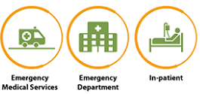
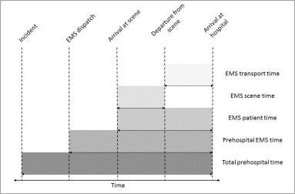
Question: I am using case mix data and would like to better understand how the data can be used to analyze length of stay across the entire continuum of care from prehospital arrival to inpatient hospitalization.
Total Length of Stay Across the
Continuum of Care
Answer: Prehospital Care: Ambulance scene and transport times are not available
in either the case mix data or the MA APCD. A few hospitals have HCPCS codes in
the case mix ED services file for ambulance ground mileage (A0425), advanced life
support level 1 (A0426) and level 2 (A0427) transport.
The case mix inpatient hospital discharge services file contains revenue code 0540 for ambulance services. These HCPCS codes and other HCPCS A-Codes associated non emergent and emergent medical transport and other prehospital emergency resources are used in the MA APCD, as are the inpatient revenue codes. In is important to note that the MA APCD also contains medical claims from ground and air ambulance service providers. This data contains more detailed billing for prehospital medical procedures and transport distance. However, it does not contain length of time for prehospital transport.
DPH’s MATRIS Prehospital Length of Time
The Department of Public Health’s (DPH)
Massachusetts Ambulance Trip Record Information
System (MATRIS) contains prehospital time data
which allows researchers to determine the
length of time from scene to hospital but does not
contain the time involved in the subsequent hospital
stay. DPH’s Trauma Registry does however contains
in one repository ambulance scene time, transport
and arrival length of time, ED length of stay, and
inpatient length of stay. This data is limited to just
Trauma patients. Information on those two data
repositories are available on DPH’s website at
https://www.mass.gov/orgs/office-of-emergency-medical-services
continued

Slide 11
Answer (continued) Emergency Department Visit: For patients who visit the ED
and are a routine departure to home, the case mix ED visit data contains a length
of stay field in hours. If those patients originate from an outside ED (Admission
Source Code 7=Outside Hospital Emergency Room Transfer) or an outside hospital’s
inpatient care (Admission Source Code 4=Transfer from Acute Care Hospital) and
those facilities are in Massachusetts, use the encrypted UHIN to link to the patient’s
prior facility record to determine the magnitude of time at outside EDs or length of
stay in outside hospital inpatient care prior to the ED visit at the final destination of definitive care.
Inpatient Hospitalization: If the patient is admitted from the within hospital ED for inpatient care (Admission Source Code R = Inside Hospital ER Transfer), the quantity of units for revenue code values of 0450-0459 (Emergency Room) in the inpatient services table indicate the hours the patient was in the ED. If the patient is admitted from Observation stay, the quantity of units for revenue code value 0762 (Specialty Services – Observation Hours) indicate hours in Observation Stay. As mentioned above, for those originating from an outside acute care facility in Massachusetts, use the encrypted UHIN to determine the magnitude of care elsewhere prior to admission. If a patient is admitted for inpatient care at the same hospital where they received care in both ED and Observation Stay, the total length of stay across the continuum of care can be determined by using both the revenue codes (in hours) plus the discharge table’s length of stay in days as depicted in the flow chart below:
It is important to keep in mind that the revenue code quantity represents hours. Therefore, if you wanted the total length of stay in days across the continuum of care in days, hours would have to be converted to days. For example, I a patient spent 5 hours in the outpatient ED, 19 hours in outpatient Observation Stay, and 4 days hospitalized for inpatient care, the total length of stay across the continuum of care in days would be 5 days.
Total Length of Stay Across the
Continuum of Care
Total Length of Stay Across the Continuum of Care in the Inpatient Discharge Data
Hours in the ED
Revenue Codes
0450-0459
Hours in Observation Stay Revenue Code
0762
Inpatient Hospitalization
Length of Stay
in Days

Slide 12
Question: I have been using the ICD-9-CM and ICD-10-CM codes for evaluating
inpatient hospital cardiac procedures. I am now using case mix outpatient ED visit
data to study cardiac procedures performed in the outpatient ED visit setting and want to know why the numbers of cardiac procedure I found in the ED visit data appear to have increased dramatically from 2013 to 2014 when I was using ICD-9-CM procedure codes '35%', '36%', '37%', '395' which are the codes for Operations on the Cardiovascular System?
Cardiac Procedures
Performed in the
Emergency Department
Answer: Unlike inpatient data, procedure codes for outpatient ED visit data can be recorded using the American Medical Association’s Current Procedural Terminology (CPT® codes) and Healthcare Common Procedure Coding System (HCPCS codes). In the FY2013 and FY2014, cardiac procedures can found in both the procedure code fields and listed in the ED services table. When you include these other coding nomenclatures, you will see that the top 10 cardiac related services and procedures in the ED were coded using CPT codes. See table below.
FY 2013 and FY2014 Top 10 Outpatient Emergency Department Visit Cardiac Related Procedures
Procedure Code | Description | 2013 Volume | 2014 Volume
93005 | Electrocardiogram, routine ECG with at least 12 leads; tracing only, without interpretation and report | 400,833 | 405,956
93010 | Electrocardiogram, routine ECG with at least 12 leads; interpretation and report only | 35,269 | 45,353
92950 | Cardiopulmonary resuscitation (e.g., in cardiac arrest) | 4,323 | 4,835
76815 | Ultrasound, pregnant uterus, real time with image documentation, limited (e.g., fetal heart beat, placental location, fetal position and/or qualitative amniotic fluid volume), 1 or more fetuses | 3,783 | 4,114
93308 | Echocardiography, transthoracic, real-time with image documentation (2D), includes M-mode recording, when performed, follow-up or limited study | 2,668 | 3,999
8951 | Rhythm electrocardiogram | 2,619 | 3,647
93017 | Cardiovascular stress test using maximal or submaximal treadmill or bicycle exercise, continuous electrocardiographic monitoring, and/or pharmacological stress; tracing only, without interpretation and report | 2,453 | 1,655
93306 | Echocardiography, transthoracic, real-time with image documentation (2D), includes M-mode recording, when performed, complete, with spectral Doppler echocardiography, and with color flow Doppler echocardiography | 1,533 | 1,351
9960 | Cardiopulmonary resuscitation, not otherwise specified | 1,196 | 1,201
93225 | External electrocardiographic recording up to 48 hours by continuous rhythm recording and storage; recording (includes connection, recording, and disconnection) | 1,143 | 1,147

Slide 13

Question: I have been using the UHIN for data linkage and noticed that some of the UHINs have hyphens or multiple zeroes. Are these valid UHINs or should these UHINs be excluded?
UHIN
Answer: CHIA enhances the case mix data submitted by the hospitals to increase its analytic value while maintaining patient privacy. An example of such an enhancement is the Unique Health Information Number (UHIN) where CHIA encrypts the patient’s social security number. The encrypted UHIN allows for tracking patients across facilities and databases. For example, if the social security is blank, a single dash (-) appears in the UHIN field. It is valid for facilities to report that the unique patient identifier is unknown. In these cases, the UHIN appears as ‘000000001’. There are instances when invalid social security numbers which are missing digits are represented by other combinations dashes. If your study involves linkage using of the UHIN, you are advised to conduct exploratory data analysis and exclude the following codes:
"", "-", "--------1“, "--------2", "--------3", "--------4", "--------5",
"--------6", "--------7", "--------8", "--------9", "-------10",
"000000001", "5YYYY5***", "J28HG!76P"

Slide 14
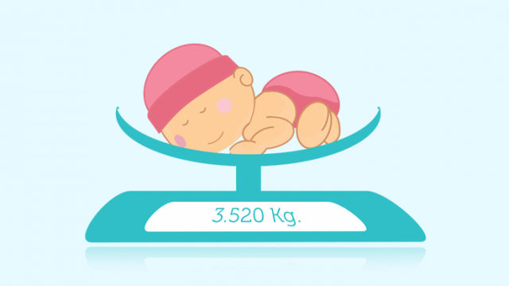
Question: I am using case mix data to study neonatal abstinence syndrome and have many noticed instances where an infant, age 0, is missing birth weight data in the birth weight field. How complete is the birth weight data?
MISSING BIRTH WEIGHT
Answer: It is very important when looking for birth weight data to pay attention to whether the infant’s newborn age in weeks. Even if the infant’s age is ‘0’, there is a dedicated field for newborn age in weeks and if the infant’s newborn age in weeks is greater than ‘0’, this is an indication that the infant was not necessarily born at the hospital where inpatient care was provided and therefore the hospital would not have the infant’s birth weight.
The birth weight data has a very high rate of completeness in case mix inpatient hospital discharge data. In FY2019, of the 71,506 infants age ‘0’ who received inpatient care and who had an age in weeks of zero, 99.04% of them had birthweight data recorded in their discharge record. Only 688 out of 71,506 did not have birth weight data.

Slide 15
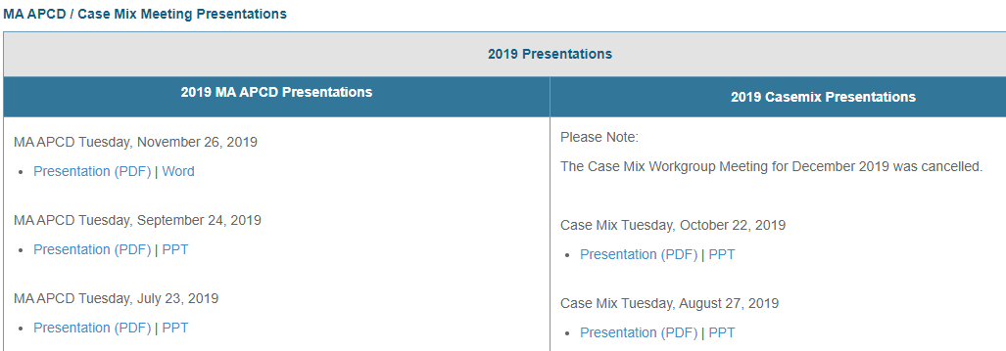
Where can I find past User Workgroup Presentations?
http://www.chiamass.gov/ma-apcd-and-case-mix-user-workgroup-information/

Slide 16
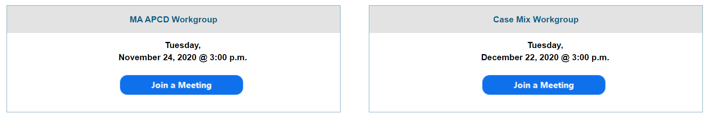
When is the next User Group meeting?
The next User Group will meet Tuesday, March 23.
http://www.chiamass.gov/ma-apcd-and-case-mix-user-workgroup-information/

Slide 17
Questions?
Questions related to MA APCD:
apcd.data@state.ma.us
Questions related to Case Mix:
casemix.data@state.ma.us
REMINDER: Please include your IRBNet ID#, if you currently have a project using CHIA data.

Slide 18
Call for Topics and Presenters
If there is a TOPIC that you would like to see discussed at an MA APCD or Case Mix workgroup in 2020, contact Amy Wyeth [amy.wyeth@state.ma.us]
If you are interested in PRESENTING at a MA APCD or Case Mix workgroup in 2020, contact Amy Wyeth [amy.wyeth@state.ma.us]
You can present remotely, or in-person at CHIA
We may be reaching out to some data users with invitations to present, and hope you will consider this!

