Slide 1
CHIA user workgroup
Don Kirkwood (Manager of Data Release and Procurement)
Sylvia Hobbs (Manager of User Support)
Scott Curley (Manager Privacy & Compliance)
February 15, 2022
CENTER FOR HEALTH INFORMATION AND ANALYSIS

Slide 2
Agenda
Announcements:
  APCD Release CY 2020 Updates
  FY20 Case Mix Release Projections
Website Updates
Application Reminders
User Support Questions
  Bariatric Surgery
  Athletic Trainers
  Gobeille Impact in MA APCD Release CY 2020
  Ambulance Mileage
Q&A

Slide 3
MA APCD CY 2020 (Release 10.0)
  Available for request
  Applicants with approved projects that require updated APCD data (CY 2020 Data) should submit to CHIA a completed Exhibit B (Certificate of Continued Need and Compliance) of the Data Use Agreement. After submitting a completed Exhibit B you will receive an invoice (if applicable) for the requested data. Upon payment of the invoice the order for the data will be placed.
  CY 2020 Data includes data on services from January 2016 – December 2020 with six months of claim runout.

Slide 4

Case Mix FY20 Release
*CURRENT* RELEASE TIMEFRAMES FOR EACH FILE:
  Inpatient (HIDD)
  Available for request
  Emergency Department (ED)
  Available for request
  Outpatient Observation (OOD)
  Available for request
  Applicants with approved projects that require newly available year(s) of Case Mix Data (e.g., FY 19) should submit to CHIA a completed Exhibit B (Certificate of Continued Need and Compliance) of the Data Use Agreement. After submitting a completed Exhibit B you will receive an invoice (if applicable) for the requested data. Upon payment of the invoice the order for the data will be placed.

Slide 5
Website Release Updates
  Updates on the production of APCD and Case Mix databases and status of data requests are now posted to CHIA’s website!
    Aim #1 is to provide weekly or bi-weekly status update on CHIA data products as they are in development.
    Aim #2 is to provide applicants with information about expected fulfillment status for individual data requests.
    Request IDs will be communicated to Data Requestors via email.
  Please visit http://www.chiamass.gov/status-of-data-requests/ to see the current status of releases.

Slide 6
Application reminders

Slide 7
Fee Waiver Request Reminders
  If you’re submitting a request for a fee waiver, remember to include the fee remittance form in your application package on IRBNet.
  Remember to submit supporting documentation (if required).
  If you’re requesting a financial hardship waiver, remember to submit information detailing your project’s financial situation (examples: project budget, grant funding, organizational / departmental funding). Also request to pay a specific price that you reasonably believe you’re able to afford to contribute.
  CHIA generally does not offer full financial hardship fee waivers. We expect all applicants to have made an attempt to find funding to cover the full cost of the data fees.
  Fee waiver requests can take some time to process – especially financial hardship requests.

Slide 8
USER questions

Slide 9

Question: I want to study how insurance coverage impacts access to bariatric
surgery. The medical claims specifications indicate wholly denied claims are
not reported and if a single procedure is within a paid claim that denied line is
reported since all lines of a claim aid with cost analysis. Given the lack of
wholly denied claims, does APCD contain any elective bariatric procedures?
Answer: When studying surgical procedures which might be deemed “elective”, keep there is a higher volume of data for elective surgical procedures in MA APCD Release 8.0 prior to the COVID-19 pandemic than in MA APCD Release 10.0 which includes the pandemic. A comparison of a distinct count of Massachusetts residents by gender who have a history of bariatric surgery (ICD-10-CM Z98.84) during a 3-year period (incurred 2016 through 2018) in Release 8.0 (see Figure 1 below) to a 3-year period (incurred 2018 through 2020) in Release 10.0 (see Figure 2 below) shows an annual upward trend in Release 8.0 versus a downward trend in Release 10.0.
A count of MA residents with a claim line for any bariatric procedure incurred from January 2016 through December 2108 averages 524 patients receiving bariatric procedures each month for the 36-month period. See Figure 3 below.
MA APCD Release 8.0 compared to Release 10.0 Count Individuals with a History of Bariatric Surgery
Figure 3. CY 2016 through 2018 Monthly Count of Massachusetts Residents receiving Bariatric Procedures

Slide 10
Answer (continued): In looking at the percent of all bariatric procedures by claim line status,
sum of charges, and sum of payments for 2016 through 2018, denied claim lines represent the
second highest proportion (20.39%) of all bariatric procedure claim lines. See Table 1 below.
Table 1. Bariatric Procedures by Claim Line Status (Incurred 2016 through 2018)
Claim Status | Percent of Claim Lines by Claim Status | Sum of Charges | Sum of Payments
Processed as Primary | 59.86% | $325,643,724.04 | $195,704,998.85
Denied | 20.39% | $139,273,137.05 | $84,028.86
Processed as Secondary | 14.70% | $87,066,857.39 | $7,064,462.21
Reversal of Previous Payment | 5.00% | $(33,476,523.63) | $(12,744,011.69)
Processed as Tertiary | 0.05% | $581,626.68 | $95,671.59
Table 2. Top 10 CPT Bariatric Procedures by Volume of Procedures (Incurred 2016 through 2018)
Rank | Description | Volume of Procedures | Sum of Charges | Sum of Payments
1 | Laparoscopy, surgical, gastric restrictive procedure; longitudinal gastrectomy (i.e., sleeve gastrectomy) | 16008 | $ 48,455,487 | $ 13,966,700
2 | Laparoscopy, surgical, gastric restrictive procedure; with gastric bypass and Roux-en-Y gastroenterostomy (roux limb 150 cm or less) | 4843 | $ 19,302,083 | $ 5,711,453
3 | Single Anastomosis Duodeno-ileal Bypass with Sleeve Gastrectomy | 2456 | $ 1,770,774 | $ 250,441
4 | Laparoscopy, surgical, gastric restrictive procedure; removal of adjustable gastric restrictive device and subcutaneous port components | 2409 | $ 6,123,474 | $ 1,761,067
5 | Revision of gastrojejunal anastomosis (gastrojejunostomy) with reconstruction, with or without partial gastrectomy or intestine resection; without vagotomy | 245 | $ 1,197,001 | $ 489,643
6 | Laparoscopy, surgical, gastric restrictive procedure; with gastric bypass and small intestine reconstruction to limit absorption | 239 | $ 861,542 | $ 171,779
7 | Gastrectomy, partial, distal; with gastrojejunostomy | 223 | $ 1,195,342 | $ 439,726
8 | Laparoscopy, surgical, gastric restrictive procedure; placement of adjustable gastric restrictive device (eg, gastric band and subcutaneous port components) | 170 | $ 674,928 | $ 296,367
9 | Laparoscopy, surgical, gastric restrictive procedure; removal of adjustable gastric restrictive device component only | 134 | $ 336,470 | $ 100,371
10 | Gastric restrictive procedure, open; removal and replacement of subcutaneous port component only | 61 | $ 123,470 | $ 45,761

Slide 11

Question: Some athletic trainers have National Provider IDs (NPIs). How is an athletic trainer defined as a medical service provider? Does the MA APCD provider file contain data on athletic trainers and does the medical claims file contain claims submitted by athletic trainers?
Answer: Healthcare Provider Taxonomy Code Set which is maintained by the National Uniform
Claim Committee has assigned the healthcare provider taxonomy code ‘2255A2300X’ to athletic trainers. Athletic trainers are defined in in the taxonomy code set and by the National Athletic Trainers’ Association as follows:
    Athletic trainers are allied health care professionals who work in consultation with or under the direction of physicians, and specialize in the prevention, assessment, treatment and rehabilitation of injuries and illnesses. National board certification is generally required as a condition of state licensure and employment. Clinical practice includes emergency care, rehabilitation, reconditioning, therapeutic exercise, wellness programs, exercise physiology, kinesiology, biomechanics, nutrition, psychology and health care administration (Source https://www.nata.org )
The MA APCD provider file contains data on 264 athletic trainers and the claims table contains medical claims submitted by athletic trainers. Table 1 below contains the 10 Ten services for which athletic trains submit medical claims found in the MA APCD.
Table 1. Top 10 Medical Claims Procedures Provided by Athletic Trainers in MA APCD
CPT Code | Description
97110 | Therapeutic procedure, 1 or more areas, each 15 minutes; therapeutic exercises to develop strength and endurance, range of motion and flexibility
97140 | Manual therapy techniques (e.g., mobilization/ manipulation, manual lymphatic drainage, manual traction), 1 or more regions, each 15 minutes
97112 | Therapeutic procedure, 1 or more areas, each 15 minutes; neuromuscular reeducation of movement, balance, coordination, kinesthetic sense, posture, and/or proprioception for sitting and/or standing activities
97530 | Therapeutic activities, direct (one-on-one) patient contact (use of dynamic activities to improve functional performance), each 15 minutes
97001 | Physical therapy evaluation
97014 | Application of a modality to 1 or more areas; electrical stimulation (unattended)
97035 | Application of a modality to 1 or more areas; ultrasound, each 15 minutes
99284 | Emergency department visit for the evaluation and management of a patient, which requires these 3 key components: A detailed history; A detailed examination; and Medical decision making of moderate complexity. Counseling and/or coordination of care with o
98940 | Chiropractic manipulative treatment (CMT); spinal, 1-2 regions
97002 | Physical therapy re-evaluation

Slide 12

Question: CHIA had previously described the reduction of self-insured beneficiaries in the MA APCD as a result of Gobeille v. Liberty Mutual. Has there been an increase in
the volume of self-insured beneficiaries in MA APCD Release 10.0?
Answer: No, the self-insured beneficiaries have continued to decrease. Figure 1 below shows the volume of Massachusetts residents with medical coverage by enrollment type in MA APCD Release 8.0 compared to Figure for MA APCD Release 10.0.

Slide 13
Answer (continued): Figure 1 below shows the calendar year 2014 pre-Gobeille Massachusetts self-insured population with medical coverage in the member eligibility table was over 2 million. Figure 2 shows the calendar 2021 post-Gobeille population decreased to 383,010.
Pre-Gobeille

Slide 14
Answer (continued): The increase in Massachusetts the census population was paralleled by an increase in MA APCD in the number of fully-insured commercial group beneficiaries. Figure 1 below shows the consistent annual increase in fully-insured. Figure 2 shows this fully-insured population increase continue to 2020. In 2020, the drop in fully-insured was paralleled by an increase in new ICO, SCO, and ACO products.
Fully-Insured
Increase
Fully-Insured
Increase

Slide 15


Question: In a previous webinar on air medical data, you discussed codes to identify in the MA APCD rotary wing versus fixed wing air medical providers located in all 50 states, including DC. Is it feasible to distinguish air medical charge and median payments amounts for only the in-network air medical rotary wing versus fixed wing claim by mileage, commercial payer and providers?
Answer: Yes, it is feasible. The MA APCD medical claims file has an in-network indicator field (MC131) where the ‘yes’ option indicates that the claim line was paid at an in-network rate agreed upon between a health care provider joining an insurance carrier’s network. From MA APCD Release 8.0, Table 1 and Table 2 below have examples of median and average charges, payments, transports and mileage for rotary wing and fixed wing air medical providers who are part of commercial insurance carrier network. The tables below only include the highest version claim lines for commercial carrier claim lines that have a ‘yes’ in the in-network field (MC131).
Table 1. Examples of Rotary Wing In Network
Charges, Payments, Transports, and Mileage
Table 2. Examples of Fixed Wing In Network
Charges, Payment, Transports, and Mileage
Provider | Median Charges | Median Paid | Median Allowed | Number of Transports
1 | $ 10,368 | $ 6,441 | $ 7,245 | 493
2 | $ 3,360 | $ 2,444 | $ 2,964 | 1,336
3 | $ 3,844 | $ 2,886 | $ 3,136 | 79
4 | $ 5,396 | $ 3,828 | $ 3,978 | 241
5 | $ 6,106 | $ 4,529 | $ 4,587 | 69
Provider | Median Charges | Median Paid | Median Allowed | Number of Transports
A | $ 7,992 | $ 7,992 | $ 7,992 | 47
B | $ 1,365 | $ 1,310 | $ 1,310 | 47
C | $ 29,338 | $ 22,280 | $ 23,736 | 9
Provider | Average Charges | Average Paid | Average Allowed | Average Miles
1 | $ 12,009 | $ 7,817 | $ 8,641 | 37
2 | $ 4,308 | $ 3,229 | $ 3,750 | 39
3 | $ 4,217 | $ 2,960 | $ 3,408 | 58
4 | $ 6,018 | $ 4,056 | $ 4,253 | 42
5 | $ 8,227 | $ 5,127 | $ 5,178 | 39
Provider | Average Charges | Average Paid | Average Allowed | Average Miles
A | $ 11,618 | $ 10,528 | $ 10,614 | 969
B | $ 3,387 | $ 2,322 | $ 2,468 | 119
C | $ 26,752 | $ 15,540 | $ 15,800 | 247

Slide 16
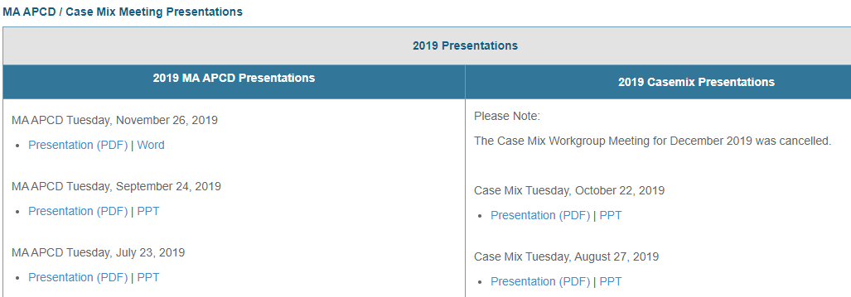
Where can I find past User Workgroup Presentations?
http://www.chiamass.gov/ma-apcd-and-case-mix-user-workgroup-information/

Slide 17

When is the next User Group meeting?
The next User Group will meet Tuesday, March 22.
http://www.chiamass.gov/ma-apcd-and-case-mix-user-workgroup-information/

Slide 18
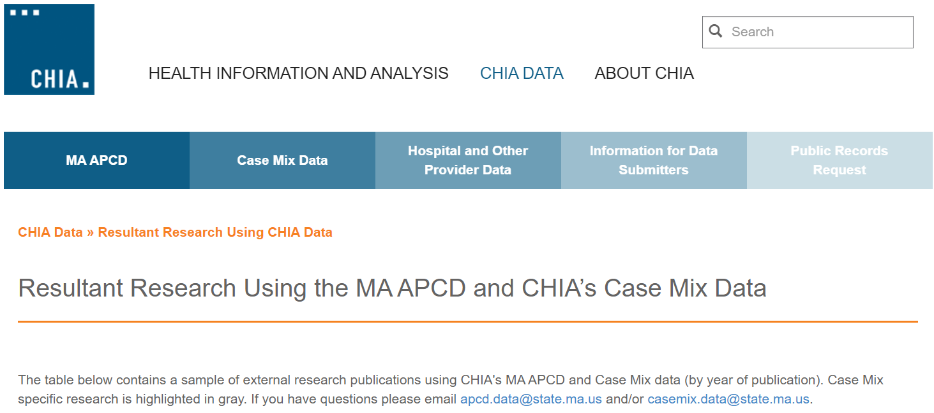
Resultant Research Using CHIA Data
https://www.chiamass.gov/resultant-research-using-chia-data

Slide 19
Questions?
Questions related to MA APCD:
apcd.data@chiamass.gov
Questions related to Case Mix:
casemix.data@chiamass.gov
REMINDER: Please include your IRBNet ID#, if you currently have a project using CHIA data.

Slide 20
Call for Topics and Presenters
If there is a TOPIC that you would like to see discussed at an MA APCD or Case Mix workgroup in 2022, contact Amy Wyeth [amy.wyeth@chiamass.gov]
If you are interested in PRESENTING at a MA APCD or Case Mix workgroup in 2022, contact Amy Wyeth [amy.wyeth@chiamass.gov]
You can present remotely.

