Slide 1
CHIA user workgroup
Don Kirkwood (Manager of Data Release and Procurement)
Sylvia Hobbs (Manager of User Support)
Scott Curley (Manager Privacy & Compliance)
July 27, 2021
CENTER FOR HEALTH INFORMATION AND ANALYSIS

Slide 2
Agenda
Announcements:
  APCD Release 9.0/10.0 Updates
  FY20 Case Mix Release Projections
  Data Release and Application Update
Website Updates
Application Reminders
User Support Questions
  Longitudinal availability of race/ethnicity data
  Unknowns in race/ethnicity data
  Source of admission codes compared to ED flags
  ED flags compared to revenue codes
Q&A

Slide 3
MA APCD Release 9.0/10.0
  Available Late Fall / Early Winter
  Applicants with approved projects that require updated APCD data (Release 9.0/10.0) should submit to CHIA a completed Exhibit B (Certificate of Continued Need and Compliance) of the Data Use Agreement. After submitting a completed Exhibit B you will receive an invoice (if applicable) for the requested data. Upon payment of the invoice the order for the data will be placed.
  Release 9.0/10.0 includes data on services from January 2015 – December 2020 with six months of claim runout.

Slide 4

Case Mix FY20 Release
*CURRENT* RELEASE TIMEFRAMES FOR EACH FILE:
  Inpatient (HIDD)
  Available for request
  Emergency Department (ED)
  Available for request
  Outpatient Observation (OOD)
  Mid-Fall 2021
  Applicants with approved projects that require newly available year(s) of Case Mix Data (e.g., FY 19) should submit to CHIA a completed Exhibit B (Certificate of Continued Need and Compliance) of the Data Use Agreement. After submitting a completed Exhibit B you will receive an invoice (if applicable) for the requested data. Upon payment of the invoice the order for the data will be placed.

Slide 5
Data Release and Application Updates
Due to Governor Baker’s emergency actions to limit the spread of COVID-19 CHIA’s workforce will be remote, for now. This arrangement will limit CHIA’s ability to produce and deliver data extracts. At this time, CHIA is releasing data and providing extracts to requestors.
During this time, CHIA will continue to accept and review data applications for both Case Mix and All-Payer Claims Database (MA APCD) datasets. Review committees, DRC and DPC, will continue their meetings remotely as necessary.
Due to CHIA’s physical office being closed, applications will be accepted without a fee. After receipt of the application, CHIA will issue an invoice which will allow applicants to remit payment online.
If you are a Data User that has a CHIA hard drive in your possession, please keep the hard drive at this time while CHIA’s physical office is closed.

Slide 6
Website Release Updates
  Updates on the production of APCD and Case Mix databases and status of data requests are now posted to CHIA’s website!
    Aim #1 is to provide weekly or bi-weekly status update on CHIA data products as they are in development.
    Aim #2 is to provide applicants with information about expected fulfillment status for individual data requests.
    Request IDs will be communicated to Data Requestors via email.
  Please visit http://www.chiamass.gov/status-of-data-requests/ to see the current status of releases.

Slide 7
Application reminders

Slide 8
Fee Waiver Request Reminders
  If you’re submitting a request for a fee waiver, remember to include the fee remittance form in your application package on IRBNet.
  Remember to submit supporting documentation (if required).
  If you’re requesting a financial hardship waiver, remember to submit information detailing your project’s financial situation (examples: project budget, grant funding, organizational / departmental funding). Also request to pay a specific price that you reasonably believe you’re able to afford to contribute.
  CHIA generally does not offer full financial hardship fee waivers. We expect all applicants to have made an attempt to find funding to cover the full cost of the data fees.
  Fee waiver requests can take some time to process – especially financial hardship requests.

Slide 9
USER questions

Slide 10

Pediatric
Question: The MA APCD pharmacy claims has a diagnosis code field. If I wanted to determine pediatric asthma rates and the types of medications asthmatics take, would the pharmacy claims diagnosis code field suffice to determine asthma diagnosis, or would I have to apply for the both the medical claims data and pharmacy claims data to obtain asthma diagnosis from medical claims?
Answer: The diagnosis code field in the pharmacy claims data has a 1% filing threshold. Of the 869,524,971 pharmacy claim lines in MA APCD Release 8.0, only 0.7% (n=5,804,916) have data in the pharmacy claim’s diagnosis code field. If you query the pharmacy claims pediatric population (age < 18 years) by ICD-10-CM diagnosis code for asthma (‘J45%’), the results would have less than 2,000 patients per year. However, if you query the medical claims for Massachusetts pediatric patients with an asthma diagnosis, there are consistently over 110,000 distinct patients per year (see Figure 1 below). If you link those asthma patients in the medical claims table to the pharmacy claims to determine use of albuterol sulfate inhaler (national drug code 59310057922), 66% of pediatric asthma patients have a prescription for albuterol (see Figure 2 below). Your best option would be to link the medical claims to the pharmacy claims. Always keep in mind that rates will be lower using the MA APCD due to reduction in the submission of self-insured data.
Fig. 1 Massachusetts Pediatric (Age < 18) distinct
Asthma Patients by Gender and Year of Service in Medical Claims
Fig. 2 Medical Claims Pediatric Asthma Patients with
Pharmacy Claims for Albuterol Sulfate

Slide 11
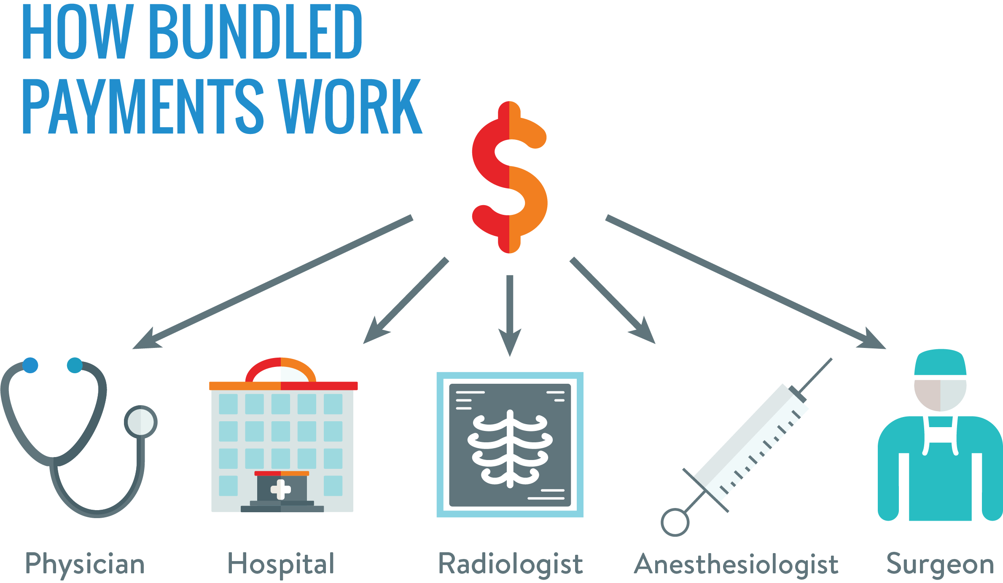
Question: I am interested in applying for the MA APCD to study alternative payments models. Both the medical claims and the pharmacy claims have a field for payment arrangement type where the carrier reports the value that defines the contracted payment methodology for this claim line. One of the coding options is bundled payment. Has the bundled payment coding option been used by the carriers on any of the claim lines?
Bundled Payment
Bun
Answer: The payment arrangement type field in the medical claims data and pharmacy claims data contains 10 coding options (see Table 1 below). To date, the bundled payment coding option has not been used on any claim lines in the MA APCD. In the pharmacy claims for MA APCD Release 8.0, 3 of the 10 available payment arrangement coding options are used (see Table 2). In the medical, 9 of the 10 available coding options are used (see Table 3).
Table 2. Payment Arrangement Type Codes in Pharmacy Claims
Value | Description | Percent of Claim Lines | Percent of Charges
01 | Capitation | 0.08% | 0.03%
02 | Fee for Service | 50.98% | 43.24%
07 | Other | 48.94% | 56.72%
Table 3. Payment Arrangement Type Codes in Medical Claims
Value | Descritpion | Percent of Claim Lines | Percent of Charges
01 | Capitation | 4.26% | 1.55%
02 | Fee for Service | 58.66% | 63.54%
03 | Percent of Charges | 1.64% | 3.18%
04 | DRG | 18.63% | 20.21%
05 | Pay for Performance | 0.07% | 0.07%
06 | Global Payment | 0.75% | 0.70%
07 | Other | 5.88% | 3.58%
09 | Payment Amount Per Episode (PAPE) (MassHealth) | 1.82% | 0.01%
10 | Enhanced Ambulatory Patient Grouping (EAPG) (MassHealth) | 1.17% | 0.91%
 | Blank | 7.13% | 6.24%
Table 1. Coding Options for Payment Arrangement Type
Value | Description
01 | Capitation
02 | Fee for Service
03 | Percent of Charges
04 | DRG
05 | Pay for Performance
06 | Global Payment
07 | Other
08 | Bundled Payment
09 | Payment Amount Per Episode (PAPE) (MassHealth)
10 | Enhanced Ambulatory Patient Grouping (EAPG) (MassHealth)

Slide 12
Question: What is the difference between the MA APCD and case mix’s geographic
data for analyzing care seeking trends in out migration of Massachusetts pediatric
patients to surrounding states and in migration of pediatric patients from surrounding
states to Massachusetts?
Pediatric Patient
Migration Patterns
Answer: Since case mix is not impacted by the reduction in self-insured claims, case mix provides more population-based data for analyzing in migration of pediatric patients from surrounding states to Massachusetts hospitals. For example, the case mix hospital inpatient discharge date for FY2016 to FY2020 shows that for the five hospitals with the highest pediatric (Age < 18 years) inpatient volume (see Table 1 below), Boston Children’s Hospital and Massachusetts General Hospital increasingly treat the highest proportion of out of state residents (see Table 2 below). Since the MA APCD is not limited to health care facilities in Massachusetts and case mix is , the MA APCD provides better information for analyzing the out migration of Massachusetts pediatric patients to other states, with hospitals in Rhode Island and New Hampshire providing the highest volume of out of state care to Massachusetts pediatric patients.
Table 1. FY2016 to FY2020 MA Hospitals with the Highest Pediatric (Age < 18 years) Inpatient Volume
Organization Name | 2016 | 2017 | 2018 | 2019 | 2020
Boston Children's Hospital | 13,674 | 12,945 | 12,343 | 11,956 | 10,868
Brigham and Women's Hospital | 6,544 | 6,525 | 6,477 | 6,534 | 6,534
Baystate Medical Center | 6,439 | 6,134 | 6,166 | 6,326 | 6,092
Massachusetts General Hospital | 6,669 | 6,398 | 6,499 | 6,577 | 5,853
Beth Israel Deaconess Medical Center | 5,482 | 5,344 | 5,413 | 5,591 | 5,454
Table 2. FY2016 to FY2020 Proportion of MA Pediatric (Age < 18 years) Inpatient Volume by Patient State of Residency
Organization Name | Patient State | 2016 | 2017 | 2018 | 2019 | 2020
Boston Children's Hospital | MA | 71.0% | 70.0% | 68.4% | 68.8% | 72.0%
Boston Children's Hospital | Non-MA | 29.0% | 30.0% | 31.6% | 31.2% | 28.0%
Brigham and Women's Hospital | MA | 95.6% | 95.9% | 95.8% | 95.7% | 96.2%
Brigham and Women's Hospital | Non-MA | 4.4% | 4.1% | 4.2% | 4.3% | 3.8%
Baystate Medical Center | MA | 96.1% | 96.3% | 96.0% | 95.8% | 95.3%
Baystate Medical Center | Non-MA | 3.9% | 3.7% | 4.0% | 4.2% | 4.7%
Massachusetts General Hospital | MA | 93.0% | 93.4% | 92.6% | 92.4% | 93.6%
Massachusetts General Hospital | Non-MA | 7.0% | 6.6% | 7.4% | 7.6% | 6.4%
Beth Israel Deaconess Medical Center | MA | 97.2% | 96.3% | 97.0% | 96.7% | 96.8%
Beth Israel Deaconess Medical Center | Non-MA | 2.8% | 3.7% | 3.0% | 3.3% | 3.2%
Continued

Slide 13
Answer continued: When comparing the proportion of out of state patient volume to Massachusetts hospitals regardless of age, the pediatric hospitals (Shriner’s and Children’s) and specialty hospitals (Dana Farber and Mass Eye and Ear) have the highest proportion of out-of-state patients. See Table 3 below.
Table 3. Top 25 FY2019 and FY2019 Hospitals with the Highest Proportion of Non-MA Patient Volume (All Ages)

Slide 14

Question: Do the linkage variables between the medical claims to the product file or between the member eligibility to the product file require the addition of any date fields? When we attempt linkage, the results appear to have lots of duplicate product records associated with the linkage. Should one assume that is the result of duplicate product submissions?
Product File Linkage
Answer: Each row in the product file represents a unique instance of a Product.
Some payers have reported products on separate rows that differ only in aspects
that are not specified in the Product File. Therefore, for some payers there may
appear to be duplicate rows when, in fact, they are distinct products. Remember in
the release the following is how Eligibility (ME) and Product (PR) tables are designed to be linked:
    ME Key: LINKORGIDPR + PRODUCTIDNUMBER (or LINKINGPRODUCTID)
    PR Key : ORGID + PRODUCTIDNUMBER (or LINKINGPRODUCTID)
The Product file also contains the Start and End Dates (PR009 and PR010) for each Product which describe the dates
the Product was active with the payer and usable by eligible members. For Products that were still active, the End Date should be Null. For Products that were not active, but may still have claims being adjudicated against them, the End Date should be the End Date reported to the Division of Insurance or the date the license was terminated.
Some researchers use as a minimum key the combined Product file fields (OrgID + ProductIdNumber + StartDate) and relate back to the most recent associated submission year month in the medical claims or member eligibility file. Before querying the MA APCD, data users are advised to read the MA APCD Documentation and MA APCD Release Notes available online at:
      https://www.chiamass.gov/ma-apcd/
These documents provide detailed information on the use of each file and information provided by the carriers on caveats associated with specific fields.

Slide 15
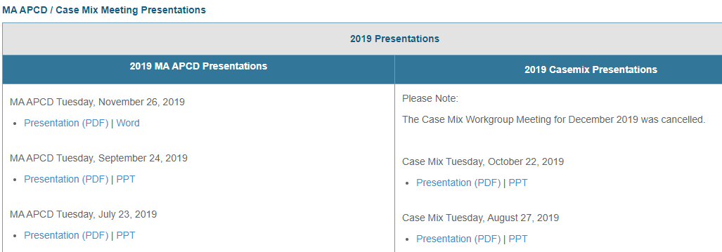
Where can I find past User Workgroup Presentations?
http://www.chiamass.gov/ma-apcd-and-case-mix-user-workgroup-information/

Slide 16
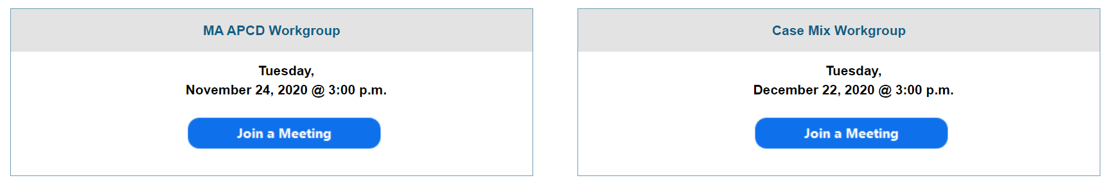
When is the next User Group meeting?
The next User Group will meet Tuesday, August 24.
http://www.chiamass.gov/ma-apcd-and-case-mix-user-workgroup-information/

Slide 17
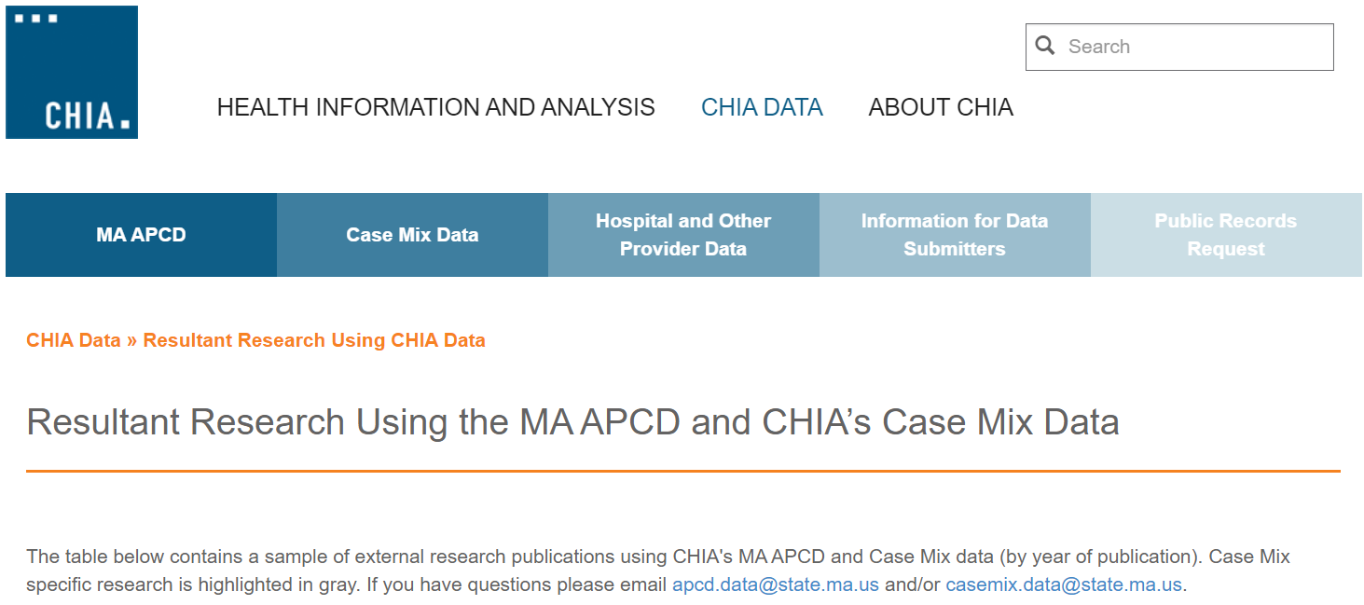
Resultant Research Using CHIA Data
https://www.chiamass.gov/resultant-research-using-chia-data

Slide 18
Questions?
Questions related to MA APCD:
apcd.data@state.ma.us
Questions related to Case Mix:
casemix.data@state.ma.us
REMINDER: Please include your IRBNet ID#, if you currently have a project using CHIA data.

Slide 19
Call for Topics and Presenters
If there is a TOPIC that you would like to see discussed at an MA APCD or Case Mix workgroup in 2020, contact Amy Wyeth [amy.wyeth@state.ma.us]
If you are interested in PRESENTING at a MA APCD or Case Mix workgroup in 2020, contact Amy Wyeth [amy.wyeth@state.ma.us]
You can present remotely, or in-person at CHIA
We may be reaching out to some data users with invitations to present, and hope you will consider this!

