Slide 1
CHIA user workgroup
Don Kirkwood (Manager of Data Release and Procurement)
Sylvia Hobbs (Manager of User Support)
Scott Curley (Manager Privacy & Compliance)
July 26, 2022
CENTER FOR HEALTH INFORMATION AND ANALYSIS

Slide 2
Agenda
Announcements:
  APCD Release CY 2020 Updates
  FY20 Case Mix Release Projections
Website Updates
User Support Questions
  Updates to Case Mix Payer Coding
  Interfacility Transfers
  Mode of Transport
  Infant Race/Ethnicity
Q&A

Slide 3
MA APCD CY 2020 (Release 10.0)
  Available for request
  Applicants with approved projects that require updated APCD data (CY 2020 Data) should submit to CHIA a completed Exhibit B (Certificate of Continued Need and Compliance) of the Data Use Agreement. After submitting a completed Exhibit B you will receive an invoice (if applicable) for the requested data. Upon payment of the invoice the order for the data will be placed.
  CY 2020 Data includes data on services from January 2016 – December 2020 with six months of claim runout.

Slide 4

Case Mix FY21 Release
*CURRENT* RELEASE TIMEFRAMES FOR EACH FILE:
  Inpatient (HIDD)
  Available for request
  Emergency Department (ED)
  August 2022
  Outpatient Observation (OOD)
  September 2022
  Applicants with approved projects that require newly available year(s) of Case Mix Data (e.g., FY 19) should submit to CHIA a completed Exhibit B (Certificate of Continued Need and Compliance) of the Data Use Agreement. After submitting a completed Exhibit B you will receive an invoice (if applicable) for the requested data. Upon payment of the invoice the order for the data will be placed.

Slide 5
Website Release Updates
  Updates on the production of APCD and Case Mix databases and status of data requests are now posted to CHIA’s website!
    Aim #1 is to provide weekly or bi-weekly status update on CHIA data products as they are in development.
    Aim #2 is to provide applicants with information about expected fulfillment status for individual data requests.
    Request IDs will be communicated to Data Requestors via email.
  Please visit http://www.chiamass.gov/status-of-data-requests/ to see the current status of releases.

Slide 6
USER questions

Slide 7

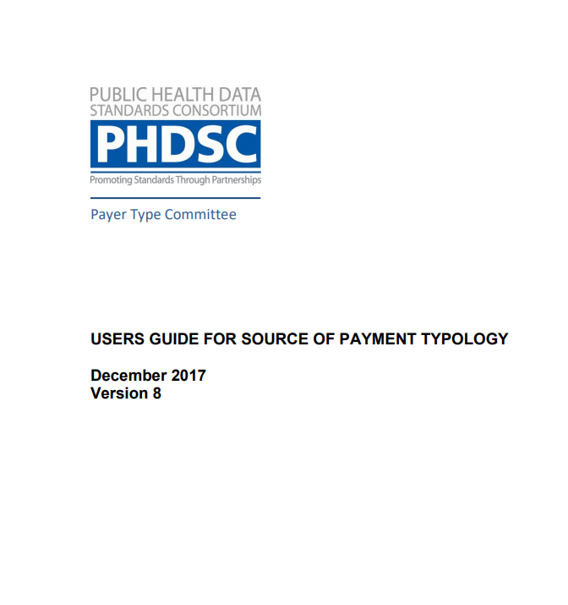
Payer Types
Question: I understand in case mix the payer code is the health plan. In 2021, there were fewer health plans associated with more payer types. Can you explain the change in payer codes and their relationship to the type codes?
Answer: In FY2021, CHIA reduced the number of case mix payer codes from 365 codes to 74 codes.
The previous codes had combined health plan names with products. Also, the payer type codes were increased from 22 to 23, eliminating Blue Cross as a payer type (maintaining it under payer code health plans) and adding two new codes payer types for accountable care organization and senior care/integrate care organization (see Table 1 below). Detailed definitions of payment typology in PHDSC’s User Guide for Payment Typology (see Figure 1 below).
Table 1. FY2021 Change in Payer Types Figure 1. PHDSC’s Payment Typology Guide
2021 Codes | Prior to 2021 | PAYER TYPE DEFINITION
0 | 0 | Other Non-Managed Care Plans
1 | 1 | Self Pay
2 | 2 | Worker's Compensation
3 | 3 | Medicare
4 | 4 | Medicaid
5 | 5 | Other Government Payment
 | 6 | Blue Cross
7 | 7 | Other Commercial Insurance not listed elsewhere
8 | 8 | HMO
9 | 9 | Free Care
A |  | Medicaid Accountable Care Organization
B | B | Medicaid Managed Care/MCO
C | C | Commercial Accountable Care Organization
D | D | Commercial Managed Care
E | E | PPO
F | F | Medicare Managed Care (includes Medicare Advantage)
H | H | Health Safety Net
J | J | Point-of-Service Plan
K | K | Exclusive Provider Organization
N | N | None (Valid only for Secondary Payer)
Q | Q | Commonwealth Care/ConnectorCare Plans
S |  | Senior Care Option/Integrated Care Organization (SCO/ICO)
T | T | Auto Insurance
Z | Z | Dental Plans
Source: https://www.nahdo.org/sites/default/files/SourceofPaymentTypologyUsersGuideVersion8_December_18_2017.pdf

Slide 8
Payer Types
Answer (continued): For example, prior to 2021 in case mix data payer coding options, there were eight different coding options for the insurance carrier Fallon. In 2021, the codes for Fallon were consolidated under one coding option. See Figure 1 below. Consequently, you will see an increase in the use of payer type codes in FY2021 to distinguish the specific types of Fallon products for the one payer code. See Table 1 below.
Figure 1. Consolidation of Fallon under one Coding Option in FY2021 Case Mix
Prior to FY2021
Fallon Community Health Plan
FY2021
Fallon Community Health
Fallon POS
Fallon Flex POS
Fallon Major Medical - Indemnity
Fallon Preferred Care - PPO
Fallon MassHealth CarePlus
Fallon ConnectorCare
Fallon Health Plan
Table 1. FY2017 - FY2021 Payer Codes for Fallon in Inpatient Hospital Discharge Data
FY2017 | FY2018 | FY2019 | FY2020 | FY2021
HMO | HMO | HMO | HMO | HMO
 |  | Commercial Managed Care | Commercial Managed Care | Commercial Managed Care
 |  |  | Medicaid Managed Care | Medicaid Managed Care
 |  |  | Medicare Managed Care | Medicare Managed Care
 |  |  | Commonwealtlh Care/ConnectorCare Plans | Commonwealtlh Care/ConnectorCare Plans
 |  |  |  | Other Non-Managed Care Plans
 |  |  |  | Other Commercial Insurance not listed elsewhere
 |  |  |  | Medicaid ACO
 |  |  |  | PPO
 |  |  |  | SCO/ICO

Slide 9

Race and Ethnicity
Question: Over the past years, approximately 25% of newborns had race reported as ‘Unknown’ in the inpatient hospital discharge data. In the past 3 years, the percent of newborns with unknown race now exceeds 30%. This data is critical for understanding health disparities among newborns. Is there any workaround for obtaining this data?
Answer: CHIA and other state agencies are working with providers to improve the quality of race/ethnicity data. While unknown race for patients age ‘0’ now exceeds 30%, for those older than age ‘0’ the unknowns are less than 5% (See Figure 1 below). The gaps in race information on newborns in administrative data is a nationwide problem. The workaround the Center’s for Disease Control’s National Center for Health Statistics has used is to impute infant race from maternal race (see https://www.cdc.gov/nchs/data/nvsr/nvsr70/nvsr70-14.pdf )

Slide 10

Question: The outpatient emergency department has a mode of transport field. However, the only patients I can determine mode of transport for are those patients who are routine discharges from the outpatient emergency department. Neither observation stay nor inpatient discharge data have those fields. I am trying to determine factors that impact timeliness of care for the most severely ill patients who have been admitted or are admitted and die. Can the ambulance revenue codes be used to garner this information?
Mode of Transport and
Interfacility Transfers
Answer: No, while the outpatient emergency department mode of transport is an indicator of how the patient arrived, the ambulance services do not bill through the hospital unless a hospital-based ambulance is used. For example, you would not see a revenue code for a fire department’s municipal ambulance service in a private hospital’s administrative discharge billing data. The ambulance service revenue codes (see Table 1 below) would tend to appear in the patient’s administrative discharge billing data if the hospital used own hospital-based ambulance service to send or receive a patient as part of an interfacility transfer.
Table 1. Ambulance Service Revenue Codes
Revenue Code | Description
0549 | AMBULANCE - OTHER AMBULANCE
0548 | AMBULANCE - EKG TRANSMISSION
0547 | AMBULANCE - PHARMACY
0546 | AMBULANCE - NEONATAL AMBULANCE SERVICES
0545 | AMBULANCE - AIR AMBULANCE
0544 | AMBULANCE - OXYGEN
0543 | AMBULANCE - HEART MOBILE
0542 | AMBULANCE - MEDICAL TRANSPORT
0541 | AMBULANCE - SUPPLIES
0540 | AMBULANCE - GENERAL CLASSIFICATION

Slide 11
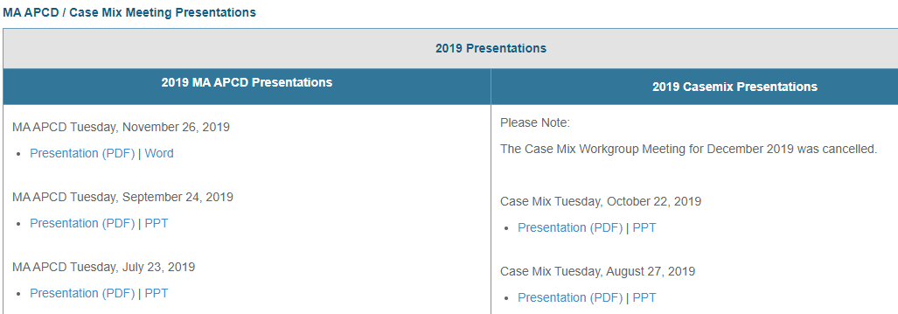
Where can I find past User Workgroup Presentations?
http://www.chiamass.gov/ma-apcd-and-case-mix-user-workgroup-information/

Slide 12

When is the next User Group meeting?
The next User Group will meet Tuesday, August 23.
http://www.chiamass.gov/ma-apcd-and-case-mix-user-workgroup-information/

Slide 13
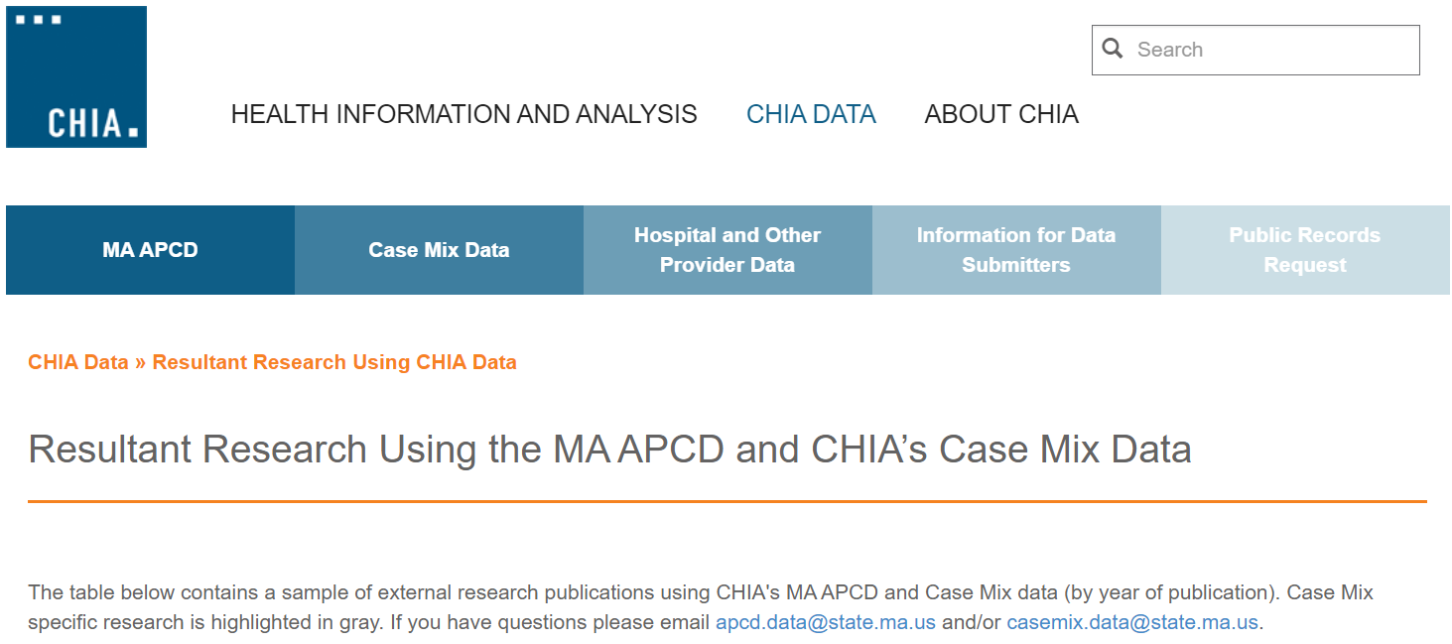
Resultant Research Using CHIA Data
https://www.chiamass.gov/resultant-research-using-chia-data

Slide 14
Questions?
Questions related to MA APCD:
apcd.data@chiamass.gov
Questions related to Case Mix:
casemix.data@chiamass.gov
REMINDER: Please include your IRBNet ID#, if you currently have a project using CHIA data.

