Slide 1
Monthly MA APCD / Case Mix User Workgroup Webinar
June 23, 2015

Slide 2
Agenda
Announcements
Common Application Issues
New & Reclassified Data Elements in Release 3.0
User Questions: Some in-depth analyses
Q&A

Slide 3
Announcement
New Fee Waiver Provision
As of June 1, 2015:
Payers, providers, and provider organizations that are required to file data with the Center pursuant to MGL c. 12C and are current with all such data filings and reporting requirements may qualify for a Full or Partial Waiver

Slide 4
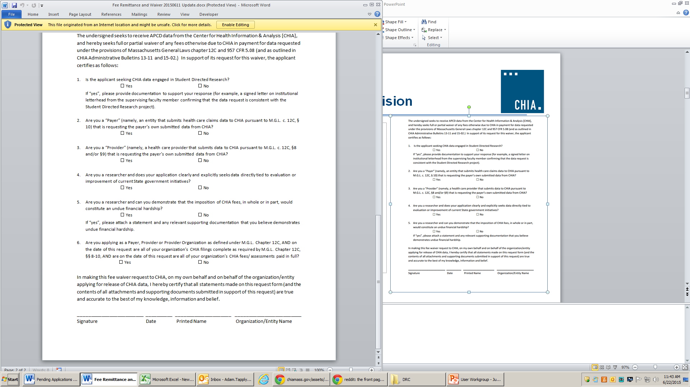
Announcement
New Fee Waiver Provision
Revised the Application Fee Remittance Form for APCD and Case Mix.
Request fee waivers on Page 2 of this form. The new provision is listed under Question #6.
Updated fee schedules:
APCD Fee Schedule
Case Mix Fee Schedule

Slide 5
Reminder
MA APCD Application Processing
CHIA will only be accepting applications for MA APCD from Massachusetts payers and providers that submit APCD and Case Mix data, as well as Massachusetts-based students and researchers.
Applications from all others will not be accepted until November 1, 2015
Applications submitted prior to May 13, 2015 will be processed
Case Mix is not impacted

Slide 6
Common Application Issues and Questions

Slide 7
Application Fees
Application Fee Remittance Form for non-government MA APCD and Case Mix requests: http://chiamass.gov/assets/Uploads/apcd-3-0/application-materials/Non-Government-APCD/1.-Fee-Remittance-or-Fee-Waiver-Request-Form.pdf
Reminders:
  Submit this form with your check
  Check the appropriate box if you are requesting a fee waiver
  Note CHIA’s address has changed to 501 Boylston
  Online payment is not currently an option

Slide 8
Application Revisions
Please remember to “lock” your application on IRBNet after you’ve finished making revisions to your application
Locking the application will send an automatic notification to CHIA staff letting them know that your revisions are complete and uploaded

Slide 9
Hard Drives
Please remember to return your hard drive to CHIA after you’ve loaded your data
CHIA has a limited number of hard drives, so help us ensure we have a steady supply ready to deliver data to the MA APCD user community

Slide 10
New and Reclassified Data Elements in Release 3.0

Slide 11
New Data Elements
(Selected)
Geocoded Data:
  Provider Census Tract (Derived-PV6)[Level 2]
  Member Census Tract (Derived-MC17/PC17/DC14/ME15) [Level 3]
Normalized Age Calculations:
  Member Age at Service (Derived-MC16/PC14/DC13)[Level 2]
  (replaces Year of Birth)
  Member Age at Enrollment (Derived-ME14)[Level 2]
  (replaces Member Age)
Present on Admission

Slide 12
What is a Present on Admission (POA) Code?
MA APCD Release 3.0 Present on Admission (POA) Code fields for the principal diagnosis and each of the 24 associated diagnosis.
DEFINITION: The POA Code is used distinguish a condition present at the time of admission from a hospital acquired condition (HAC) that developed during the hospitalization.
Present at the time of admission also includes conditions that developed in the outpatient settings, such as the emergency department and/or observation stay, that may have led to admission.
In MA APCD, POA is required when Type of Claim (MC094) = Facility (Code 002) , Admitting Diagnosis (MC039) and Principal Diagnosis (MC041) are populated and is not required when Types of Facility (MC245) is a Skilled Nursing Facility/Long Term Care Facility (Code 2), Designated Cancer Center (Code 5), Designated Inpatient Children’s Hospital (Code 6), Inpatient Rehabilitation Facility (Code 7) or Critical Access Hospital (Code 9).

Slide 13
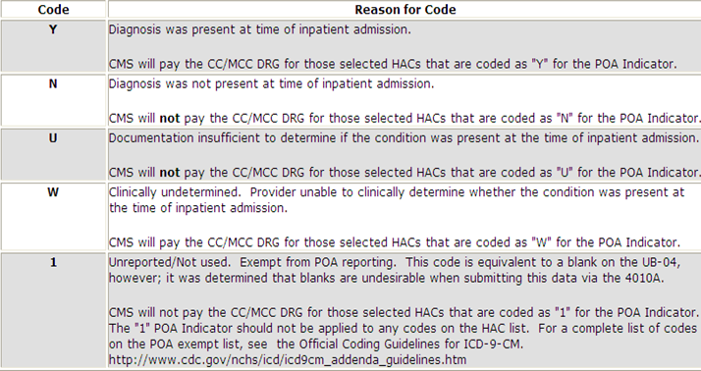
Present on Admission Coding (Continued)
In MA APCD, while some of the claims for services in 2012 and earlier have sporadic POA codes, the highest volume carriers began consistently submitting the POA codes for 2013 and later. Note that certain types of diagnoses, such as pregnancy and injuries from accidents, are exempt from POA.
Present on Admission Coding Options

Slide 14
Reclassified Data Elements
ME056 – Last Activity Date
Moved from Level 3 to Level 2
Derived-MC15/PC13/DC12/ME13 – Member Link MCL (Member Matching Confidence Level)
Moved from Level 2 to Level 3
MC068 – Patient Control Number
Moved from Level 2 to Level 3

Slide 15
User Questions

Slide 16
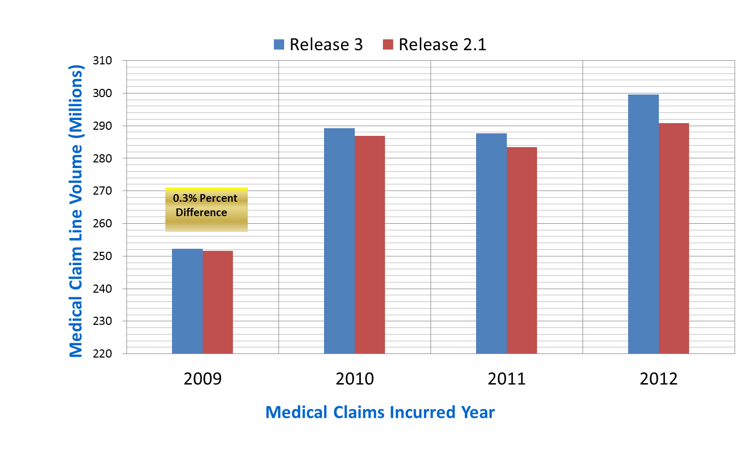
Q: If I do research using 2009-11 data in Release 2.1, would I get the same results using those same years in Release 3.0?
A: Since Release 2.1, some carriers have submitted updates to prior years data,
therefore you might see differences in the pattern incurred.
Comparison of MA APCD Releases 2.1 and 3.0 Medical Claims Volume by Year
3.0% Percent
Difference
0.9% Percent
Difference
1.5% Percent
Difference

Slide 17
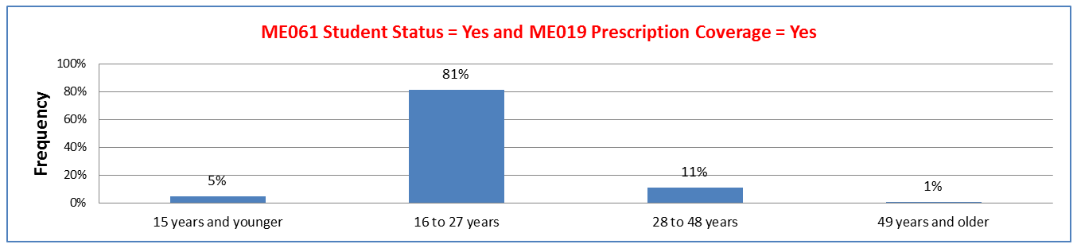
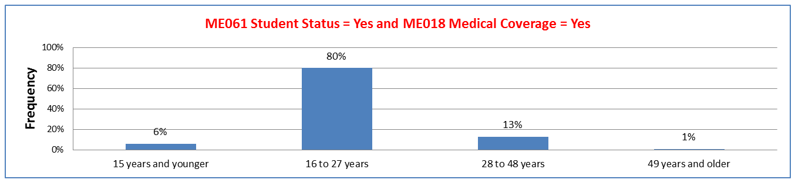
Q: The Member Eligibility File has a Student Status field (ME061). Are these students of all ages or mostly college age students and does the age range change if you filter by eligibility file coverage types?
A: The students are mainly of college age and the age range does not change significantly if you filter by coverage type.
Comparison of Student Status Age Distribution by Eligibility File Coverage Types

Slide 18
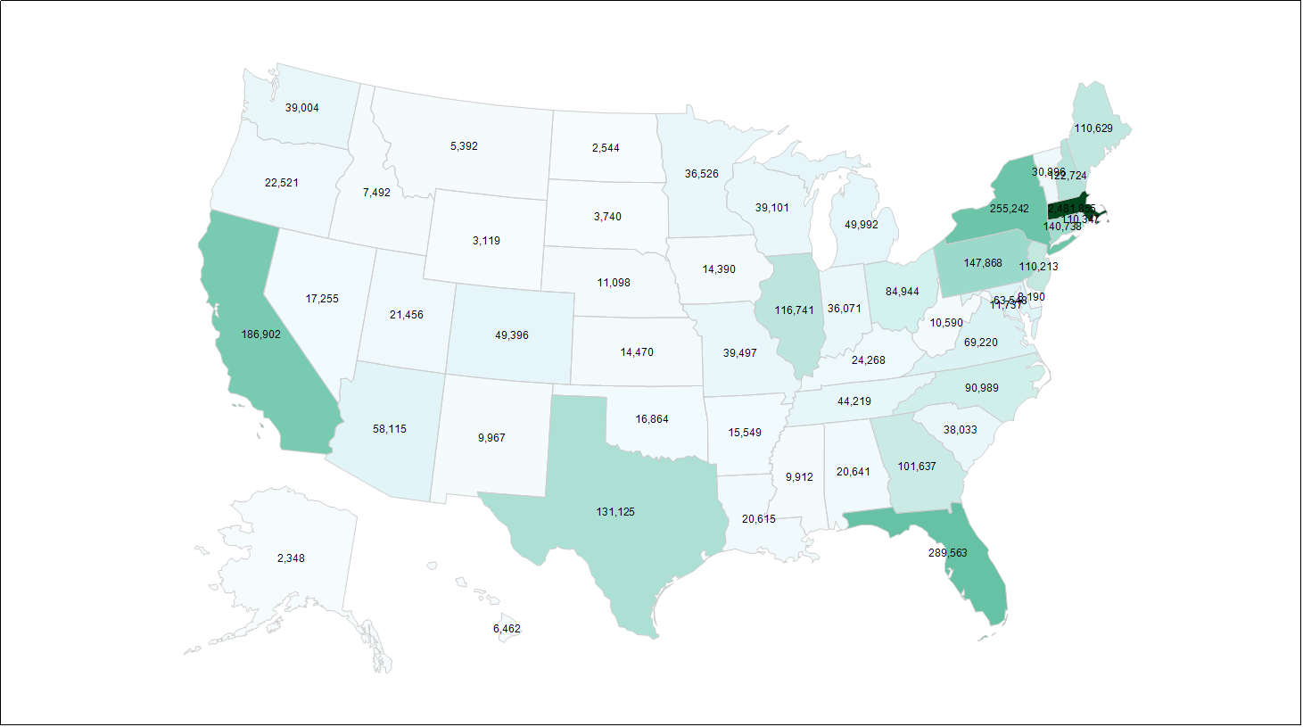
Q: If a Massachusetts resident receives care outside of Massachusetts, does the MA APCD Provider file contain data on those care providers?
A: Yes, the MA APCD Provider File should contain data on any provider regardless of geographic location which accepted payment for MA residents from carriers in MA APCD. Additionally, some national carriers provide national directories even if no payments were made.
US Distribution of Distinct National Provider IDs in MA APCD
2,481,655
Note: 46% in Massachusetts, 10 % in Other New England States (VT, ME, RI, CT, NH),
44% Outside of the New England Region

Slide 19
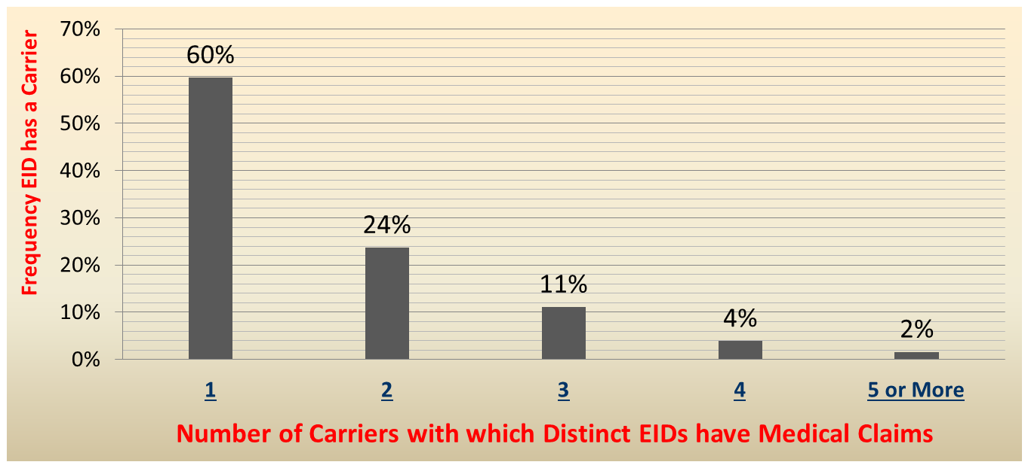
Q: Should users expect member EIDs to be associated with lots of different carriers or a few?
A: In the APCD Release 3.0 MC file, less than 6% of the EIDs have medical claims with 4 or more carriers. The largest number of EIDs (60%) have medical claims with one carrier, followed 24% with two carriers and 11% with three carriers. This is reflective of turnover generally observed in enrollment.
MA APCD 3.0: Distinct EID with Medical Claims by Number of Carriers for CY 2013

Slide 20
Q: Are the Medicare Paid and Other Insurance Paid Currency Fields Populated in MA APCD?
A: Yes. These currency fields are more frequently used by specific product types. Medicaid and Medicare Part B products have a higher amount of Medicare Paid claim lines. Indemnity Insurance and Other Non-Federal Program products and a higher amount of Other Insurance Amount Paid claim lines.
CY 2013 Medical Claims Currency Dollar Amount Frequency by Top 10 Insurance Product Types
Description | Charges | Paid | Copay | Allowed | Other Insurance Paid | Medicare Paid | Non-Covered | Excluded Expenses
Medicaid | 24.8% | 27.5% | 0.0% | 26.6% | 6.0% | 32.1% | 65.8% | 2.1%
Health Maintenance Organization (HM0) | 19.7% | 24.4% | 40.7% | 25.3% | 17.1% | 0.8% | 9.7% | 19.6%
Preferred Provider Organization (PPO) | 18.8% | 24.1% | 33.3% | 24.5% | 13.8% | 5.7% | 2.9% | 47.3%
Medicare Part B | 8.6% | 1.5% | 0.4% | 1.5% | 2.0% | 34.8% | 0.4% | 1.5%
HMO Medicare Risk | 8.0% | 8.5% | 10.9% | 7.4% | 0.1% | 0.0% | 0.1% | 1.0%
Commercial Insurance Co. | 4.9% | 0.1% | 1.0% | 0.0% | 0.0% | 0.0% | 0.0% | 0.0%
Point of Service (POS) | 3.9% | 6.0% | 6.1% | 5.5% | 6.0% | 1.6% | 0.7% | 10.5%
Indemnity Insurance | 3.4% | 2.0% | 2.7% | 2.6% | 24.1% | 14.5% | 2.4% | 12.0%
Other Non-Federal Programs | 3.3% | 0.8% | 0.2% | 2.1% | 21.0% | 8.6% | 10.8% | 0.0%
Commonwealth Care | 1.8% | 2.1% | 1.0% | 1.7% | - | 0.0% | 4.8% | 1.4%

Slide 21
Q: What proportion of people in MA APCD* are under 65 years old and what proportion are over 65 years old?
MEID Age Distribution – MA Residents Only
Member Eligibility Submission Year | Under Age 65 Years | 65 Years and Older
2009 | 89.2% | 10.8%
2010 | 89.5% | 10.5%
2011 | 88.8% | 11.2%
2012 | 88.2% | 11.8%
2013 | 89.1% | 10.9%
5-Year Average | 89.0% | 11.0%
*APCD Release 3.0

Slide 22
Questions?
General questions about the APCD:
(CHIA-APCD@state.ma.us)
Questions related to APCD applications: (apcd.data@state.ma.us)
Questions related to Casemix: (casemix.data@state.ma.us)

Slide 23
Calendar
June 25 – Data Release Committee Meeting
July 23 – Data Release Committee Meeting
July 28 – Next MA APCD / Case Mix User Workgroup

