Slide 1
CHIA user workgroup
Don Kirkwood (Manager of Data Release and Procurement)
Sylvia Hobbs (Manager of User Support)
Scott Curley (Manager Privacy & Compliance)
June 22, 2021
CENTER FOR HEALTH INFORMATION AND ANALYSIS

Slide 2
Agenda
Announcements:
  APCD Release 8.0 Updates
  FY20 Case Mix Release Projections
  Data Release and Application Update
Website Updates
Application Reminders
User Support Questions
  Longitudinal availability of race/ethnicity data
  Unknowns in race/ethnicity data
  Source of admission codes compared to ED flags
  ED flags compared to revenue codes
Q&A

Slide 3
MA APCD Release 9.0/10.0
  Available Late Fall / Early Winter
  Applicants with approved projects that require updated APCD data (Release 9.0/10.0) should submit to CHIA a completed Exhibit B (Certificate of Continued Need and Compliance) of the Data Use Agreement. After submitting a completed Exhibit B you will receive an invoice (if applicable) for the requested data. Upon payment of the invoice the order for the data will be placed.
  Release 9.0/10.0 includes data on services from January 2015 – December 2020 with six months of claim runout.

Slide 4

Case Mix FY20 Release
*CURRENT* RELEASE TIMEFRAMES FOR EACH FILE:
  Inpatient (HIDD)
  Available for request
  Emergency Department (ED)
  Late Summer 2021
  Outpatient Observation (OOD)
  Mid-Fall 2021
  Applicants with approved projects that require newly available year(s) of Case Mix Data (e.g., FY 19) should submit to CHIA a completed Exhibit B (Certificate of Continued Need and Compliance) of the Data Use Agreement. After submitting a completed Exhibit B you will receive an invoice (if applicable) for the requested data. Upon payment of the invoice the order for the data will be placed.

Slide 5
Data Release and Application Updates
Due to Governor Baker’s emergency actions to limit the spread of COVID-19 CHIA’s workforce will be remote, for now. This arrangement will limit CHIA’s ability to produce and deliver data extracts. At this time, CHIA is releasing data and providing extracts to requestors.
During this time, CHIA will continue to accept and review data applications for both Case Mix and All-Payer Claims Database (MA APCD) datasets. Review committees, DRC and DPC, will continue their meetings remotely as necessary.
Due to CHIA’s physical office being closed, applications will be accepted without a fee. After receipt of the application, CHIA will issue an invoice which will allow applicants to remit payment online.
If you are a Data User that has a CHIA hard drive in your possession, please keep the hard drive at this time while CHIA’s physical office is closed.

Slide 6
Website Release Updates
  Updates on the production of APCD and Case Mix databases and status of data requests are now posted to CHIA’s website!
    Aim #1 is to provide weekly or bi-weekly status update on CHIA data products as they are in development.
    Aim #2 is to provide applicants with information about expected fulfillment status for individual data requests.
    Request IDs will be communicated to Data Requestors via email.
  Please visit http://www.chiamass.gov/status-of-data-requests/ to see the current status of releases.

Slide 7
Application reminders

Slide 8
Fee Waiver Request Reminders
  If you’re submitting a request for a fee waiver, remember to include the fee remittance form in your application package on IRBNet.
  Remember to submit supporting documentation (if required).
  If you’re requesting a financial hardship waiver, remember to submit information detailing your project’s financial situation (examples: project budget, grant funding, organizational / departmental funding). Also request to pay a specific price that you reasonably believe you’re able to afford to contribute.
  CHIA generally does not offer full financial hardship fee waivers. We expect all applicants to have made an attempt to find funding to cover the full cost of the data fees.
  Fee waiver requests can take some time to process – especially financial hardship requests.

Slide 9
USER questions

Slide 10

Question: We are trying to determine the longitudinal number of patients that have race/ethnicity data in case mix. For example, if we looked at the last five years of case mix data, how many unique patients are in that five-year longitudinal data set, and how many of these unique patients have race ethnicity data?
Longitudinal Data on
Race/Ethnicity
Answer: For FY 2015 through FY2019, there were 12,310,500 ED visits (see Figure 1 below) and 80% (n = 9,865,400) of the ED visit records reported a valid UHIN which would enable tracking unique patients over a 5-year period (see Figure 2 below) . Aggregating a 5-year count of distinct valid UHINs represented 3,245,829 unique patients, for which only 223 (0.01%) were missing race data, 177,291 (5.46%) reported race as ‘unknown’, and surprisingly, 216,352 (6.67%) reported a different race during a different episode of care. Of the 177,291 who reported race as unknown in one episode of care, a known race could be salvaged by linking the UHIN to another episode of care for 101,584 patients (57.29% of unknowns had a reported known race in the longitudinal data) reducing the percent unknown race for all distinct valid UHINs to 2.33%.
Figure 1. 5-Year Total ED Visit Volume
ED Visit 5-Year Period (FY2015 through FY2019)
3,245,839 distinct patients with valid UHINs
233 (0.01%) Missing race data
101,584 (2.33%) Unknown race
97.6% of 3,245,839 distinct patients have race data
12,310,510 ED Visits
Figure 2. 5-Year Distinct Valid UHINs
3,245,829 Distinct UHINs
Continued

Slide 11
Longitudinal Data on
Race/Ethnicity
Answer (continued): It should also be noted that 343,381 (10.58%) unique patients
with a valid UHIN over the 5-year period of interest reported their race as ‘Other’.
To ensure that ‘Other’ is not overreported as an alternative to ‘Unknown’, the
proportion of ‘Other’ race patients can be compared to the population Census to
assess whether it is above or under the Census estimate. To do so, the 343,381
‘Other’ race patients were limited to Massachusetts residents which reduced the
number of ‘Other’ race to 326,136. The 2010 Census estimate of ‘Other’ race population
for Massachusetts was 305, 151. Table below compares the proportion of ‘Other Race’ by county for the Census 2010 population to the proportion of ED 5-Year distinct patient ‘Other Race’ based on the 2021 Census estimate. The largest differences appear to be for the smallest counties. The smallest differences are for counties with larger populations with the surprise finding that the proportion of ‘Other Race’ in the 2010 Census for Middlesex county and Plymouth county, match the proportion of ED ‘Other Race’ distinct patients based on the 2021 County population Census estimate.
‘Other Race’ by County in 2010 Census compared to ‘Other Race’ ED Distinct Patients

Slide 12

Question: I need to determine the best fields to use for analyzing patients admitted through the ED and am encountering problems using the source of admission codes. The number of hospital discharge records with a source of admission code ‘R’ (i.e., within hospital emergency room transfer) do not appear to align with an ED Flag code 2 (i.e., admitted from the ED). Why is that?
Source of Admission
Answer: That difference occurs because some hospitals with high inpatient admission through the ED either do not use the ED flags or code all of patients under one ED flag code. To improve the quality of data on patients admitted through the ED for analysis of ED boarding and timeliness of care fields have added to inpatient hospital discharge data for ED registration date and time. Hospitals that were not using the ED flag codes or single coding with the flag are using the ED registration date and time.
Even without the ED Flag or the new ED registration fields, over the years the hospitals have reliably and consistently used the Revenue Code 450 to indicate ED utilization in the inpatient discharge record. In fact, the number of patients with Revenue Code 450 tends to closely match the number of patients on the hospitals ED site summary who are indicated as admitted through the ED. In addition, when comparing the new ED registration date and time fields to the number of hours greater than zero in the Revenue Code 450, there is a close alignment between the length of ED time in the new fields and the number of hours of service in the Revenue Code 450 field. For example, in FY2018 during the first year of collecting ED Registration Date and Time, 50% of the 809,270 had ED time greater than zero hours. This proportion of patients with greater than zero hours in the Revenue Code 450 field was 52%. There has been consistently at the facility level over the year in using the Revenue Code 450 field. When we compare the case mix hospital discharge data to the MA APCD, the case mix Revenue Code 450 data aligns with data reported in the MA APCD. The revenue code field can be a useful tool in analyzing patients admitted through the ED.

Slide 13
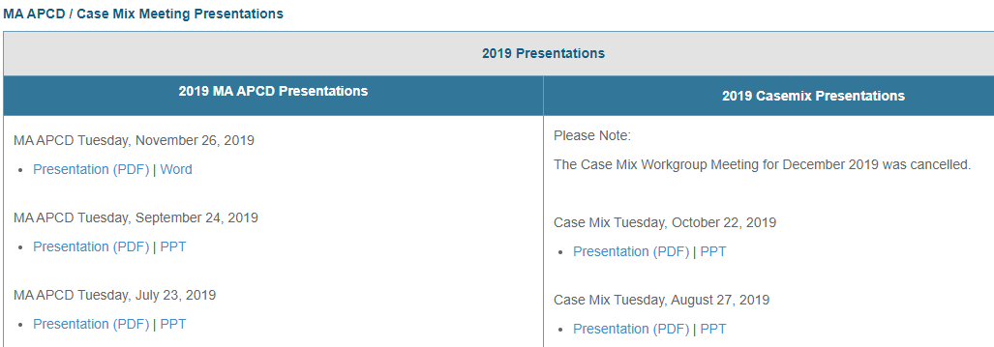
Where can I find past User Workgroup Presentations?
http://www.chiamass.gov/ma-apcd-and-case-mix-user-workgroup-information/

Slide 14

When is the next User Group meeting?
The next User Group will meet Tuesday, July 27.
http://www.chiamass.gov/ma-apcd-and-case-mix-user-workgroup-information/

Slide 15
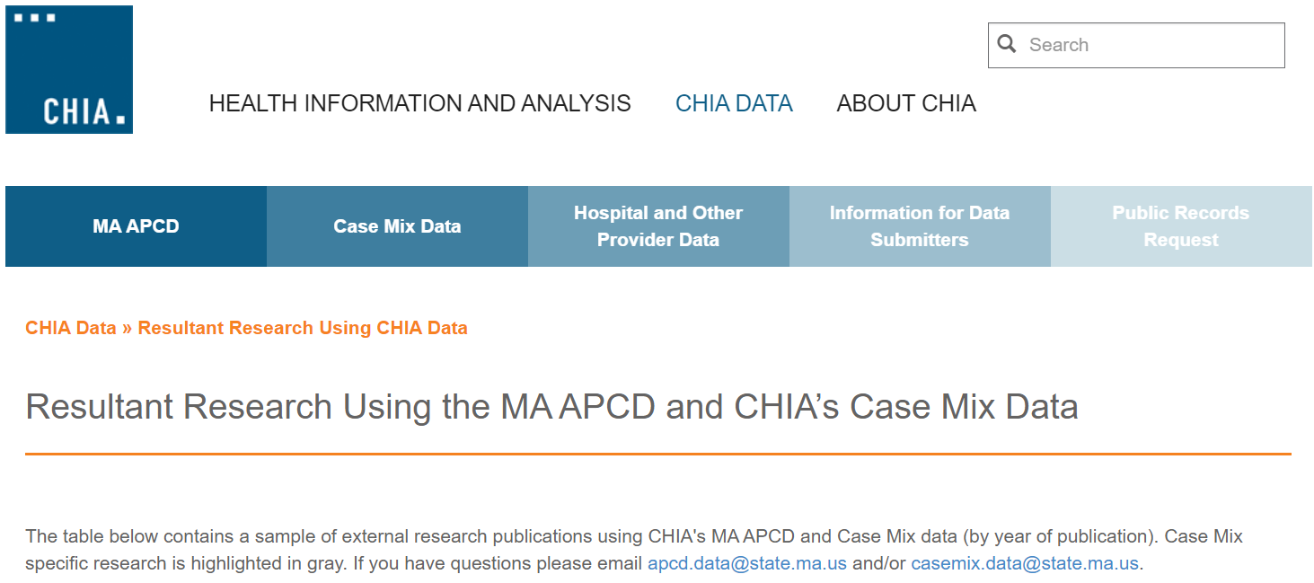
Resultant Research Using CHIA Data
https://www.chiamass.gov/resultant-research-using-chia-data

Slide 16
Questions?
Questions related to MA APCD:
apcd.data@state.ma.us
Questions related to Case Mix:
casemix.data@state.ma.us
REMINDER: Please include your IRBNet ID#, if you currently have a project using CHIA data.

Slide 17
Call for Topics and Presenters
If there is a TOPIC that you would like to see discussed at an MA APCD or Case Mix workgroup in 2020, contact Amy Wyeth [amy.wyeth@state.ma.us]
If you are interested in PRESENTING at a MA APCD or Case Mix workgroup in 2020, contact Amy Wyeth [amy.wyeth@state.ma.us]
You can present remotely, or in-person at CHIA
We may be reaching out to some data users with invitations to present, and hope you will consider this!

