Slide 1
CHIA user workgroup
Don Kirkwood (Manager of Data Release and Procurement)
Sylvia Hobbs (Manager of User Support)
Scott Curley (Manager Privacy & Compliance)
March 23, 2021
CENTER FOR HEALTH INFORMATION AND ANALYSIS

Slide 2
Agenda
Announcements:
  APCD Release 8.0 Updates
  FY19 Case Mix Release Projections
  Data Release and Application Update
Website Updates
Application Reminders
User Support Questions
  Admission Type
  Carrier Specific Subscriber ID
  Medical Coverage Codes
  Medicare Code
  Marketplace Category
  Out of Pocket Costs
Q&A

Slide 3
MA APCD Release 8.0
  Available NOW
  Applicants with approved projects that require updated APCD data (Release 8.0) should submit to CHIA a completed Exhibit B (Certificate of Continued Need and Compliance) of the Data Use Agreement. After submitting a completed Exhibit B you will receive an invoice (if applicable) for the requested data. Upon payment of the invoice the order for the data will be placed.
  Release 8.0 includes data on services from January 2014 – December 2018 with six months of claim runout (includes paid claims through 6/30/19).
  Will be linkable to Release 7.0 via crosswalk
  Additional information on highlights and enhancements will be presented in future APCD User Workgroups.

Slide 4

Case Mix FY19 Release
*CURRENT* RELEASE TIMEFRAMES FOR EACH FILE:
  Inpatient (HIDD)
  Available for request and delivery
  Emergency Department (ED)
  Available for request and delivery
  Outpatient Observation (OOD)
  Available for request and delivery
  Applicants with approved projects that require newly available year(s) of Case Mix Data (e.g., FY 19) should submit to CHIA a completed Exhibit B (Certificate of Continued Need and Compliance) of the Data Use Agreement. After submitting a completed Exhibit B you will receive an invoice (if applicable) for the requested data. Upon payment of the invoice the order for the data will be placed.

Slide 5
Data Release and Application Updates
Due to Governor Baker’s emergency actions to limit the spread of COVID-19 CHIA’s workforce will be remote, for now. This arrangement will limit CHIA’s ability to produce and deliver data extracts. At this time, CHIA is releasing data and providing extracts to requestors.
During this time, CHIA will continue to accept and review data applications for both Case Mix and All-Payer Claims Database (MA APCD) datasets. Review committees, DRC and DPC, will continue their meetings remotely as necessary.
Due to CHIA’s physical office being closed, applications will be accepted without a fee. After receipt of the application, CHIA will issue an invoice which will allow applicants to remit payment online.
If you are a Data User that has a CHIA hard drive in your possession, please keep the hard drive at this time while CHIA’s physical office is closed.

Slide 6
Website Release Updates
  Updates on the production of APCD and Case Mix databases and status of data requests are now posted to CHIA’s website!
    Aim #1 is to provide weekly or bi-weekly status update on CHIA data products as they are in development.
    Aim #2 is to provide applicants with information about expected fulfillment status for individual data requests.
    Request IDs will be communicated to Data Requestors via email.
  Please visit http://www.chiamass.gov/status-of-data-requests/ to see the current status of releases.

Slide 7
Application reminders

Slide 8
Fee Waiver Request Reminders
  If you’re submitting a request for a fee waiver, remember to include the fee remittance form in your application package on IRBNet.
  Remember to submit supporting documentation (if required).
  If you’re requesting a financial hardship waiver, remember to submit information detailing your project’s financial situation (examples: project budget, grant funding, organizational / departmental funding). Also request to pay a specific price that you reasonably believe you’re able to afford to contribute.
  CHIA generally does not offer full financial hardship fee waivers. We expect all applicants to have made an attempt to find funding to cover the full cost of the data fees.
  Fee waiver requests can take some time to process – especially financial hardship requests.

Slide 9
USER questions

Slide 10
Question: Both the MA APCD and the case mix hospital inpatient discharge data have an ‘admission type’ field. I am confused by the definitions. The filing
specifications for the MA APCD medical claims references the National Uniform Billing Committee's UB-04 data definitions for admission type. I am specifically confused about the distinction between emergency versus urgent admission type.
Emergency
Urgent
Elective
Answer: It is important not to confuse MA APCD filing specifications with case mix filing
specification definitions. The case mix filing specifications contain some legacy customized
codes that are not used in the MA APCD. There is a nuanced difference in the admission type definitions in the
two repositories. Like the MA APCD, CMS also uses the UB-04 Admission Type definitions and provides detail at the following link (see: https://www.cms.gov/Regulations-and-Guidance/Guidance/Transmittals/Downloads/R1775CP.pdf )
While both MA APCD and case mix use the same definitions for codes 1, 2, 3, 4, the definitions differ for code 5. Unlike the MA APCD, case mix does not classify an admission type for trauma separately as used in the MA APCD code 5. Also, the MA APCD and case mix use different codes to indicate information not available, MA APCD uses 9, case mix uses 5.
Differences between MA APCD and Case Mix Admission Type Codes
MA APCD Admission Type
Case Mix Inpatient Type of Admission
1 = Emergency
2 = Urgent
3 = Elective
4 = Newborn
5 = Trauma
9 = Information Not Available
1 = Emergency
2 = Urgent
3 = Elective
4 = Newborn
5 = Information Not Available
continued

Slide 11
Emergency
Urgent
Elective
Answer (continued): Table 1 below lists detailed descriptions which CMS provides of the UB-04
admission type codes used on medical claims data. Emergency admission type code
is a higher severity than an urgent admission. While both requires immediate medical
attention, emergency type is for a medical condition that is life threatening or potentially
disabling. This is evidenced by frequency of the admission type coding for patients who have
expired in MA APCD Release 8 medical claims. In Figure 1 below, patients who have expired
have the highest frequency of admission type code ‘1’ for emergency.
Table 1. Admission Type Definitions
Value | Description
1 | Emergency - The patient required immediate medical intervention as a result of severe, life threatening or potentially disabling conditions. Generally, the patient was admitted through the emergency room.
2 | Urgent - The patient required immediate attention for the care and treatment of a physical or mental disorder. Generally, the patient was admitted to the first available, suitable accommodation.
3 | Elective - The patient’s condition permitted adequate time to schedule the availability of a suitable accommodation.
4 | Newborn
5 | Trauma Center - Visits to a trauma center/hospital as licensed or designated by the State or local government authority authorized to do so, or as verified by the American College of surgeons and involving a trauma activation.
9 | Information Not Available
Figure 1. Admission Type Frequency for Patients with Discharge Status ‘Expired’
Admission Type ‘1’ (Emergency) is highest severity as indicated by high frequency of code for patients who expired.

Slide 12

Question: Is there a Subscriber ID to determine individuals enrolled together in the same plan and a Person ID to distinguish when individuals leave a shared plan for another? Does a Person ID allow following individuals across coverage changes, for example, if an individual transitions from one carrier to another?
Subscriber
Spouse and Children
Answer: Individuals on the same plan can be determined using the OrgID, Carrier Specific Unique Subscriber ID, and Carrier Specific Unique Member ID. If the individual (determined by the Carrier Specific Unique Member ID and OrgID) is on the same plan with another, they would share the same OrgID and Carrier Specific Unique Subscriber ID. CHIA generates a member link entity identifier (MEID) which enables analysis of individuals across payers. If an individual changes from a shared plan to a different plan, the MEID can be used to determine changes in any combinations and associations of OrgIDs and Carrier Specific Unique Member IDs and Carrier Specific Unique Subscriber IDs. The Member Eligibility file also has an Individual Relationship Code (ME012) where the carriers report the value that defines the member's relationship to the subscriber. For example, a relationship code of 20 (self/employee) would indicate that the subscriber and the member are the same person.
The MA APCD Release 8.0 Documentation has the following key definitions.
Term | Definition
Subscriber | The subscriber is the insurance policy holder. The individual that has opted into and pays a premium for health insurance benefits under a defined policy. In some instances, the subscriber can be the Employer, or a non-related individual in cases of personal injury.
Member | A person who holds an individual contract or a certificate under a group arrangement contracted with a Health Care Payer.
Individual Relationship Code | Indicator defining the Member/Patient's relationship to the Subscriber
Member Link EID | CHIA provides a derived element (Member Link EID) that represents a unique Enterprise ID (EID) of an individual member (person entity). This number can be used to link an individual across all filing types – Eligibility, Claims, and to analyze individuals across carriers.
continued

Slide 13
Answer (continued): The Member Eligibility file also has a benefit Coverage Level Code field (ME007) where the carrier reports the code that defines the dependent coverage using benefit coverage code levels in the table to the right. The benefit coverage code levels have a high percent of completeness. Only 9.2% of the member eligibility record coverage code levels are coded as unknown.
Coverage Code Level | Description
CHD | Children Only
DEP | Dependents Only
ECH | Employee and Children
ELF | Employee and Life Partner
EMP | Employee Only
ESP | Employee and Spouse
FAM | Family
IND | Individual
SPC | Spouse and Children
SPO | Spouse Only
UNK | Unknown
Frequency of Coverage Code Levels in Member Eligibility File

Slide 14

Question: What do each of the values for the medical coverage variable correspond to? From the documentation, I was able to figure out that ‘1’ corresponds to "yes", ‘2’ to "no", but I'm not sure about ‘3’ and ‘5’.
Answer: In the Member Eligibility file, four different coverage fields (Medical Coverage
(ME018), Prescription Drug Coverage (ME019), Dental Coverage (ME020) and the Behavioral
Health Benefit Flag (ME051)) have the same coding options: 1 (Yes), 2(No), 3 (Unknown),
4 (Other), and 5 (Not Applicable). The frequency of coding for these four coverage fields (see charts below) indicates that the coding option for ‘Other’ has not been used and the percent of records coded as unknown is low.

Slide 15

Question: What does the Medicare Code variable in the
Member Eligibility file mean and what values do its codes correspond to?
Answer: The Medicare Code variable (ME081) is used by the carrier
to report the value that defines if and what type of Medicare
coverage applies to the eligibility record using the codes shown
in the table to the right.
Part A is Inpatient/hospital coverage, Part B is outpatient/medical
coverage, Part C is Medicare coverage by private companies approved by Medicare, and Medicare Part D is prescription coverage.
MA APCD Release 8.0 Documentation Explanation of Medicare codes
ME081 Medicare Code
Value | Description
1 | Part A Only
2 | Part B Only
3 | Part A and B
4 | Part C Only
5 | Advantage
6 | Part D Only
9 | Not Applicable
0 | No Medicare Coverage
Term | Definition
Medicare Benefits (Part A & B) | Health insurance available under Medicare Part A and Part B through the traditional fee-for-service payment system. Part A is hospital insurance that helps cover inpatient care in hospitals, skilled nursing facility, hospice, and home health care. Part B helps cover medically-necessary services like doctors' services, outpatient care, durable medical equipment, home health services, and other medical services.
Medicare Advantage | A Medicare Advantage Plan (Part C) is a Medicare health plan choice offered by private companies approved by Medicare. The plan will provides all Part A (Hospital Insurance) and Part B (Medical Insurance) coverage and may offer extra coverage such as vision or dental coverage Medicare Benefits (Part A & B)
continued

Slide 16
Answer (continued): In looking at the frequency of Medicare Coding in MA APCD Release 8.0 by count of distinct MEIDs and by year for calendar years 2016 to 2019 for Massachusetts residents, while under 15% of records have a Medicare product, each year that percentage has been increasing as shown in the four charts below.
Frequency of Medicare Code (MEO81) for Massachusetts Residents by Distinct MEID Count
2019
2018
2017
2016

Slide 17

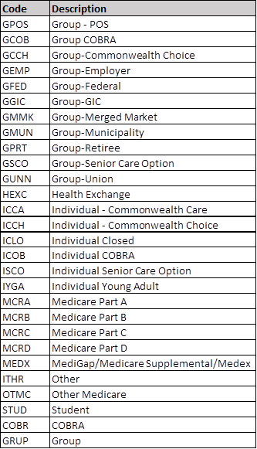
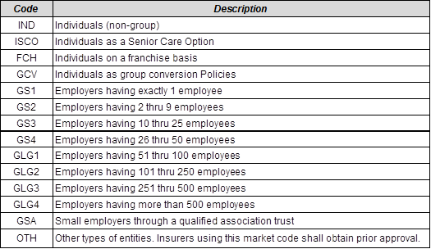
Question: Is there a way to identify non-
group vs employer sponsored plans? Market place vs off-marketplace non-group plans?
Insurance Plan Market (PR005)
Answer: Yes, the non-government limited data set Product file includes a field called Insurance Plan Market (PR005), see table to right. And the Member Eligibility file includes a field called Market Category Code (ME030), see table below.
Market Category Code (ME030)

Slide 18
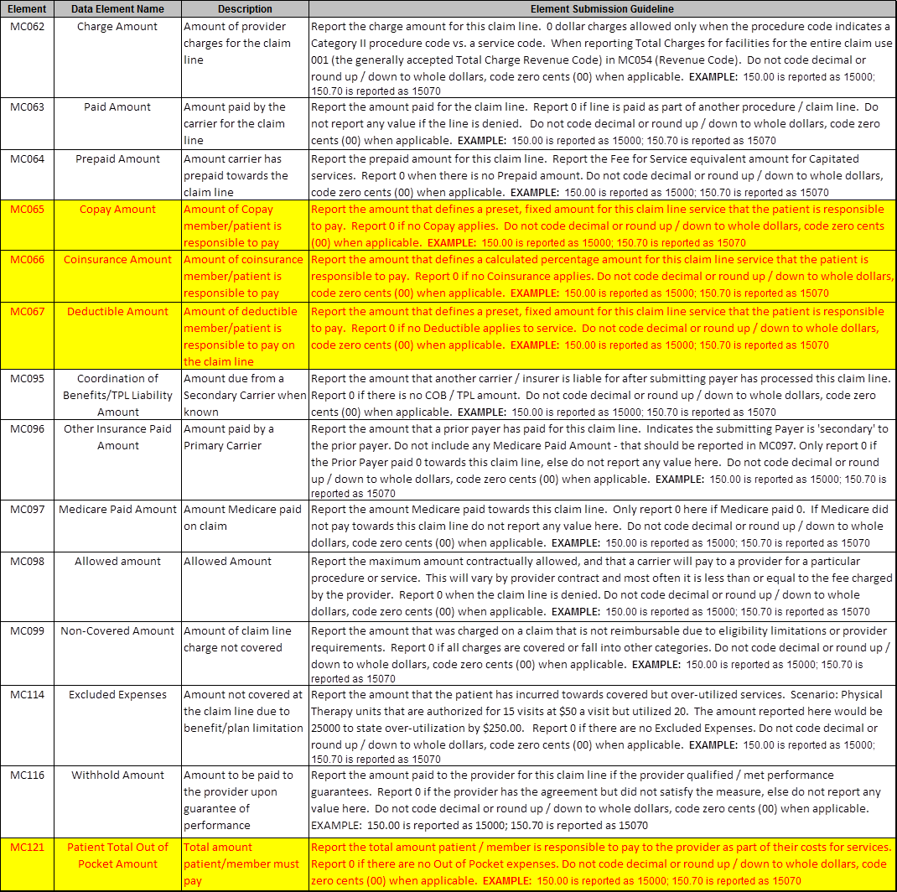
Question: What out-of-pocket cost data is available? Are these data broken down by deductible, co-pay, and co-insurance amounts? Answer: Yes, below are 14 currency fields included in the data release and their description.
The ones related to out-of-pocket costs are highlighted in yellow.

Slide 19
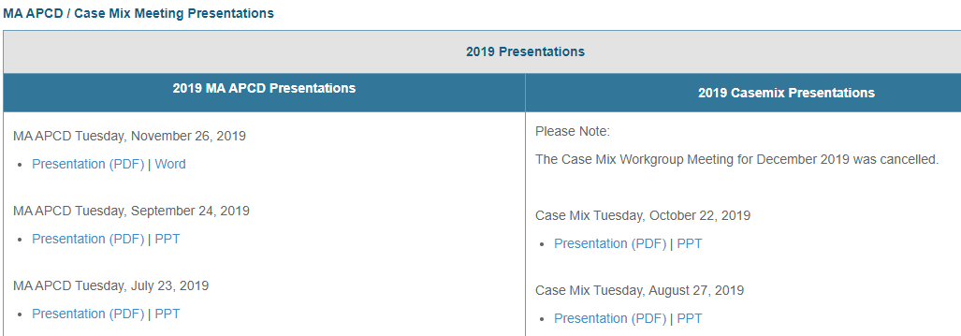
Where can I find past User Workgroup Presentations?
http://www.chiamass.gov/ma-apcd-and-case-mix-user-workgroup-information/

Slide 20

When is the next User Group meeting?
The next User Group will meet Tuesday, April 27.
http://www.chiamass.gov/ma-apcd-and-case-mix-user-workgroup-information/

Slide 21
Questions?
Questions related to MA APCD:
apcd.data@state.ma.us
Questions related to Case Mix:
casemix.data@state.ma.us
REMINDER: Please include your IRBNet ID#, if you currently have a project using CHIA data.

Slide 22
Call for Topics and Presenters
If there is a TOPIC that you would like to see discussed at an MA APCD or Case Mix workgroup in 2020, contact Amy Wyeth [amy.wyeth@state.ma.us]
If you are interested in PRESENTING at a MA APCD or Case Mix workgroup in 2020, contact Amy Wyeth [amy.wyeth@state.ma.us]
You can present remotely, or in-person at CHIA
We may be reaching out to some data users with invitations to present, and hope you will consider this!

