Slide 1
CHIA user workgroup
Don Kirkwood (Manager of Data Release and Procurement)
Sylvia Hobbs (Manager of User Support)
Scott Curley (Manager Privacy & Compliance)
May 24, 2022
CENTER FOR HEALTH INFORMATION AND ANALYSIS

Slide 2
Agenda
Announcements:
  APCD Release CY 2020 Updates
  FY20 Case Mix Release Projections
Website Updates
User Support Questions
  COVID-19 Vaccine Status Codes
  Clarification of Case Mix Between Table Linkage fields
  Observation Stay Procedures
  Expected Acute Care Inpatient Discharge Volume Differences between Case Mix and MA APCD
Q&A

Slide 3
MA APCD CY 2020 (Release 10.0)
  Available for request
  Applicants with approved projects that require updated APCD data (CY 2020 Data) should submit to CHIA a completed Exhibit B (Certificate of Continued Need and Compliance) of the Data Use Agreement. After submitting a completed Exhibit B you will receive an invoice (if applicable) for the requested data. Upon payment of the invoice the order for the data will be placed.
  CY 2020 Data includes data on services from January 2016 – December 2020 with six months of claim runout.

Slide 4

Case Mix FY21 Release
*CURRENT* RELEASE TIMEFRAMES FOR EACH FILE:
  Inpatient (HIDD)
  Available for request
  Emergency Department (ED)
  August 2022
  Outpatient Observation (OOD)
  September 2022
  Applicants with approved projects that require newly available year(s) of Case Mix Data (e.g., FY 19) should submit to CHIA a completed Exhibit B (Certificate of Continued Need and Compliance) of the Data Use Agreement. After submitting a completed Exhibit B you will receive an invoice (if applicable) for the requested data. Upon payment of the invoice the order for the data will be placed.

Slide 5
Website Release Updates
  Updates on the production of APCD and Case Mix databases and status of data requests are now posted to CHIA’s website!
    Aim #1 is to provide weekly or bi-weekly status update on CHIA data products as they are in development.
    Aim #2 is to provide applicants with information about expected fulfillment status for individual data requests.
    Request IDs will be communicated to Data Requestors via email.
  Please visit http://www.chiamass.gov/status-of-data-requests/ to see the current status of releases.

Slide 6
USER questions

Slide 7

Question: Last year, the Centers for Medicare and Medicaid (CMS) announced that new ICD-10-CM diagnosis codes would be implemented to distinguish vaccination status. Are those codes currently submitted by hospitals for patients in case mix data or by carriers for its members in the MA APCD medical claims?
Vaccination
Status
Answer: Three new diagnosis codes were implemented into ICD-10-CM for reporting COVID-19
vaccination status. The CDC notes that these codes should not be used for individuals who are not
eligible for the COVID-19 vaccines, as determined by the healthcare provider.
Two new ICD-10-CM codes have been created for underimmunization for COVID-19 status:
Z28.31 Underimmunization for COVID-19 status
Code Z28.310, Unvaccinated for COVID-19, may be assigned when the patient has not received at least one dose of any COVID-19 vaccine.
Code Z28.311, Partially vaccinated for COVID-19, may be assigned when the patient has received at least one dose of a multi-dose COVID-19 vaccine regimen, but has not received the full set of doses necessary to meet the Centers for Disease Control and Prevention (CDC) definition of “fully vaccinated” in place at the time of the encounter.
A third new code describes other underimmunization status:
Code Z28.39, Other under immunization status, includes delinquent immunization status or lapsed immunization schedule status
The implementation date of these diagnosis codes, in addition to seven new procedure codes for COVID-19 related therapeutics, was April 1, 2022 (see: https://www.cms.gov/medicare/icd-10/2022-icd-10-cm ). According to the CDC
(see: https://ftp.cdc.gov/pub/Health_Statistics/NCHS/Publications/ICD10CM/2022/icd10cm-tabular-2022-April-1.pdf )
Therefore, the codes will appear in the next FY2022 case mix data and the release of the MA APCD which will include calendar year 2022 data.
Continued

Slide 8
Vaccination
Status
Answer (continued): Three new COVID-19 diagnosis codes for underimmunization can be used in combination existing ICD-10-CM underimmunization codes which provide specificity on the reason why the immunization was not carried out. See table below. Also, the CDC advises, when applicable, these codes can be used in combination with code Z71.85 (encounter for immunization safety counseling).
ICD-10-CM Codes for Immunization Not Carried Out and Underimmunization (as of 4/2022)
﻿Diagnosis Code | Full Description
Z28 | Immunization not carried out and underimmunization status
Z280 | Immunization not carried out because of contraindication
Z2801 | Immunization not carried out because of acute illness of patient
Z2802 | Immunization not carried out because of chronic illness or condition of patient
Z2803 | Immunization not carried out because of immune compromised state of patient
Z2804 | Immunization not carried out because of patient allergy to vaccine or component
Z2809 | Immunization not carried out because of another contraindication
Z281 | Immunization not carried out because of patient decision for reasons of belief or group pressure (Immunization not carried out because of religious belief)
Z282 | Immunization not carried out because of patient decision for other and unspecified reason
Z2820 | Immunization not carried out because of patient decision for unspecified reason
Z2821 | Immunization not carried out because of patient refusal
Z2829 | Immunization not carried out because of patient decision for other reason
Z283 | Underimmunization status
Z2831 | Underimmunization for COVID-19 status
Z28310 | Unvaccinated for COVID-19
Z28311 | Partially vaccinated for COVID-19
Z2839 | Other underimmunization status
Z288 | Immunization not carried out for other reason
Z2881 | Immunization not carried out due to patient having had the disease
Z2882 | Immunization not carried out because of caregiver refusal (Immunization not carried out because of guardian refusal, or Immunization not carried out because of parent refusal Excludes (Z28.1) immunization not carried out because of caregiver refusal because of religious belief)
Z2883 | Immunization not carried out due to unavailability of vaccine (Delay in delivery of vaccine, or Lack of availability of vaccine, or Manufacturer delay of vaccine)
Z2889 | Immunization not carried out for other reason
Z289 | Immunization not carried out for unspecified reason

Slide 9

Question: I am still trying to decide whether to apply for case mix data or the MA
APCD to analyze hospital inpatient care. An explanation was already provided on the
overall reduction in commercial claims due to Gobeille. Is there information on the
specific magnitude of difference in discharge volume when comparing the Massachusetts acute care hospitals in case mix to their volume in the MA APCD?
Inpatient
Care
Answer: In comparing the monthly hospital inpatient discharge volume for acute care hospitals by month in the MA APCD for a three-year period (see Figure 1 below) to the discharge volume in case mix (see Figure 2 below), the case mix monthly discharge volume for Massachusetts acute care hospitals is on average 55% higher than the monthly discharge volume for Massachusetts acute care hospitals in the MA APCD.
Fig 1. APCD 2015 – 2018 Monthly Discharge Volume for MA Acute Care Hospitals
Fig 2. Case Mix 2015 – 2018 Monthly Discharge Volume for MA Acute Care Hospitals
Continued

Slide 10
Inpatient
Care
Answer (continued): Even with the impact of Gobeille, the age group distribution for the
case mix inpatient discharges (see Figure 1 below) and the age group distribution for the MA
APCD (see Figure 2 below) are similar. Both have a high proportion of infants and elderly.
However, the case mix data has a higher proportion of infants since there are instances in claims data where a newborn’s delivery claim might be rolled into the mother’s claim. In the case mix data, all newborns have a separate discharge record from the mother.
Fig 1. Case Mix Inpatient Discharge Age Distribution by Year for MA Acute Care Hospitals
Fig 2. MA APCD Inpatient Discharge Age Distribution by Year for MA Acute Care Hospitals

Slide 11

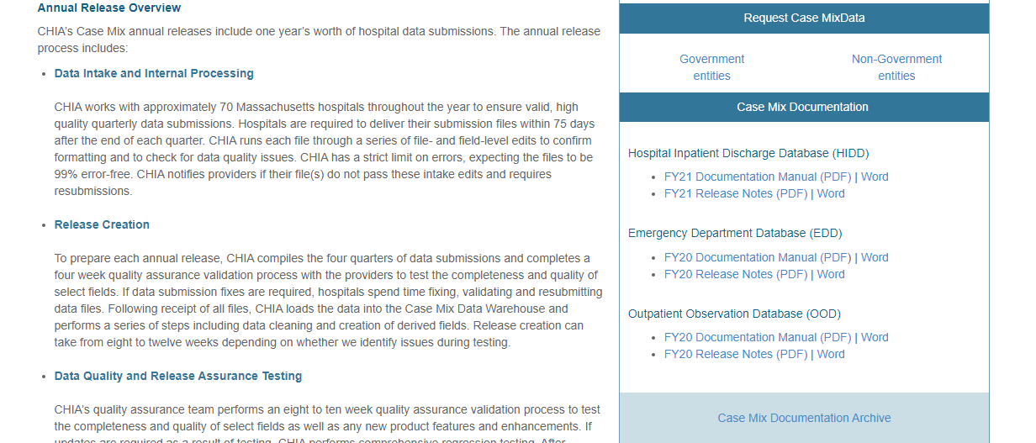
Question: I have received the case mix data and am looking for information on how to link the tables. In the discharge data and emergency department data, I noticed a Record Type 20 key field in some of the tables but not in others, and in the observation stay data a Record Type 01 key field in some tables but not in others. How do I proceed?
Answer: All information concerning the linkage of case mix data fields, their definitions, formatting and discussions of data quality can be found on the CHIA website at the following link below. This page includes a link to archived documentation on older data and a link to previous webinar slides.
https://www.chiamass.gov/case-mix-data/

Slide 12

Question: Does the outpatient observation stay data use the same coding nomenclature as the outpatient emergency department visit data (both CPT codes and HCPCS codes) or does it use the same coding nomenclature as the inpatient hospital discharge data (ICD-10-PCS codes)?
Answer: CMS has extensive documentation describing the uses of observation stay for outpatient surgery. Since certain surgical procedures are performed either in the inpatient setting or in observation stay, the observation stay data does include ICD-10-PCS codes. However, like the outpatient emergency data, observation stay also has CPT codes, with fields for up to five CPT codes.
If you are applying for inpatient hospital discharge data to study a particular surgical intervention, you may want to contact CHIA in advance to determine if a significant volume of those procedures are performed in observation stay and therefore warrant applying for both the inpatient discharge data and the observation stay data.
In addition to principal and associated procedures, the observation stay also has fields that provide information on the surgeon performing the procedures, with additional coding options if the procedure is performed by a nurse.

Slide 13
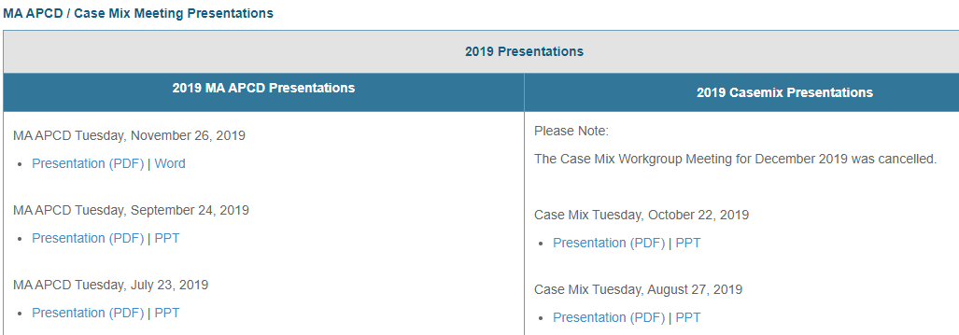
Where can I find past User Workgroup Presentations?
http://www.chiamass.gov/ma-apcd-and-case-mix-user-workgroup-information/

Slide 14
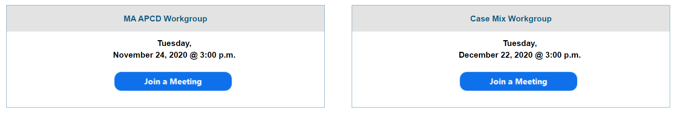
When is the next User Group meeting?
The next User Group will meet Tuesday, June 28.
http://www.chiamass.gov/ma-apcd-and-case-mix-user-workgroup-information/

Slide 15
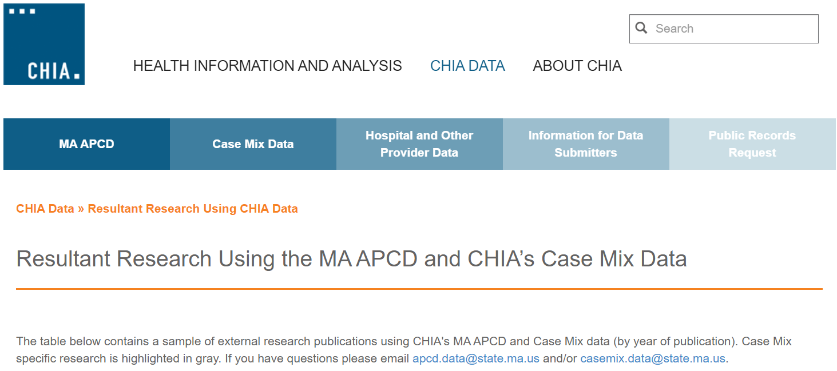
Resultant Research Using CHIA Data
https://www.chiamass.gov/resultant-research-using-chia-data

Slide 16
Questions?
Questions related to MA APCD:
apcd.data@chiamass.gov
Questions related to Case Mix:
casemix.data@chiamass.gov
REMINDER: Please include your IRBNet ID#, if you currently have a project using CHIA data.

