Slide 1
Monthly MA APCD / Case Mix User Workgroup Webinar
November 24, 2015

Slide 2
Agenda
Announcements
  MA APCD Release 4.0 – website updates & user documentation
  11/5 User Symposium Recap
Common Application Issues
User Questions
Q&A

Slide 3
MA APCD Release 4.0
Now accepting applications!
Features / Enhancements:
  Data for CY 2010-2014 as paid through June 30, 2015
  Limited Dataset (LDS) for Non-Government applicants
  Master Patient Index applied to all years
  Claim line versioning for the largest payers
  MassHealth Enhanced Eligibility Data (for Government Applicants only)

Slide 4
MA APCD Release 4.0
Updates to the CHIA Website
Today’s Overview:
Application documents posted to same place
MA APCD tab has changed
Location(s) of Documentation for Gov’t and Non-Gov’t Users
How to find the Data Submission Guides

Slide 5
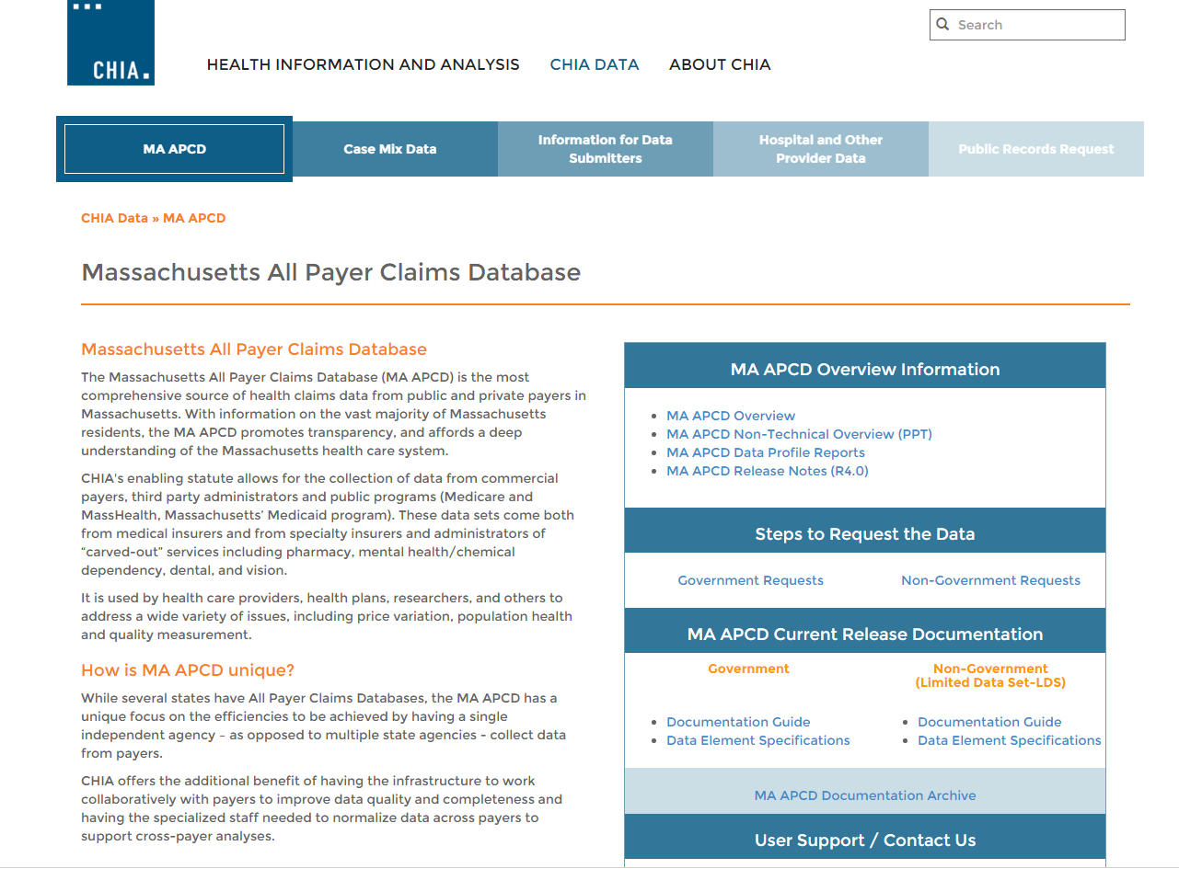
MA APCD Home Page
www.chiamass.gov/ma-apcd
This tab will bring
you to the homepage
Link to overview of the application
process and application forms
Link to Release 4.0 user documentation
(including LDS Specifications)

Slide 6
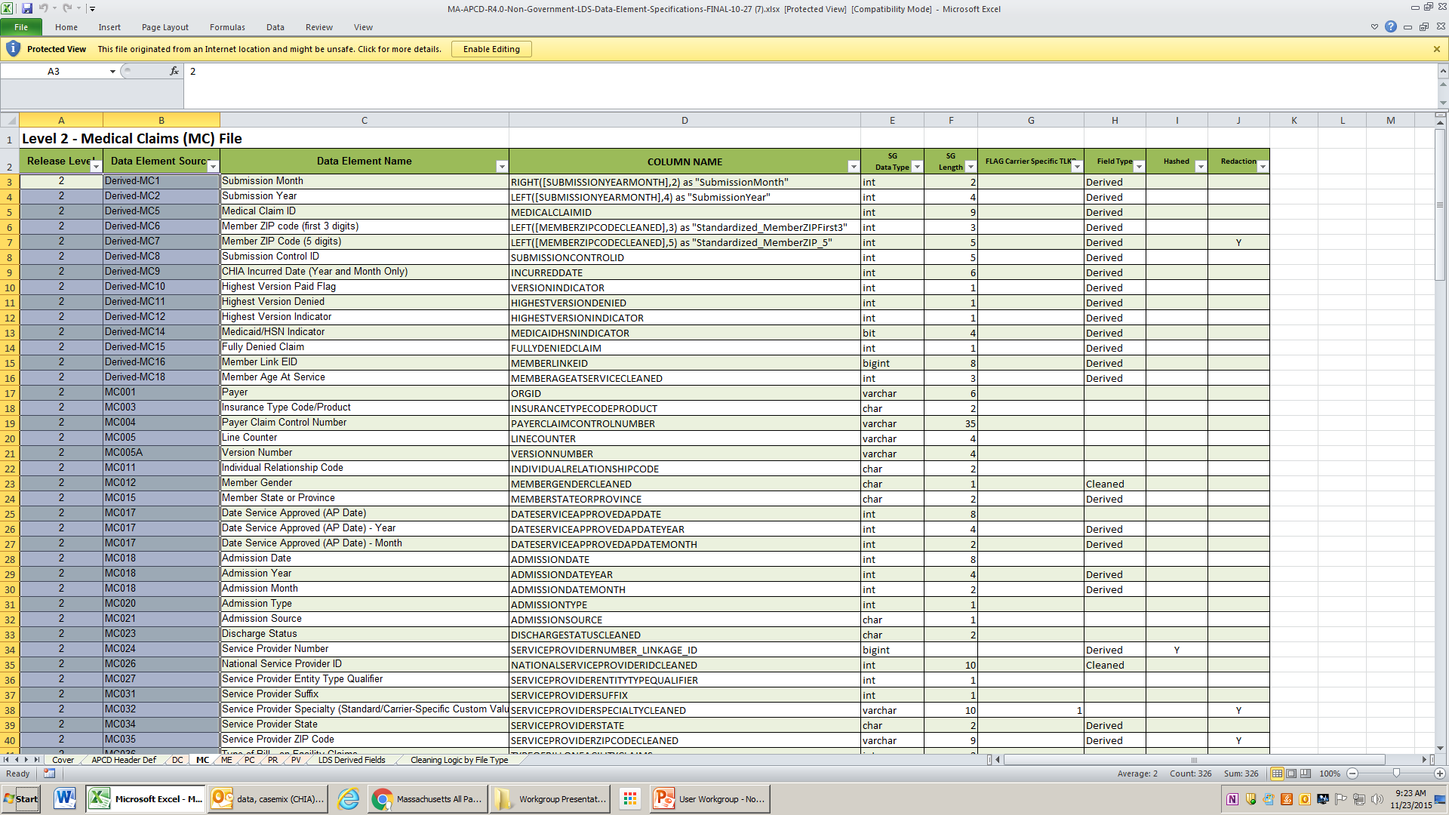
LDS Specifications

Slide 7
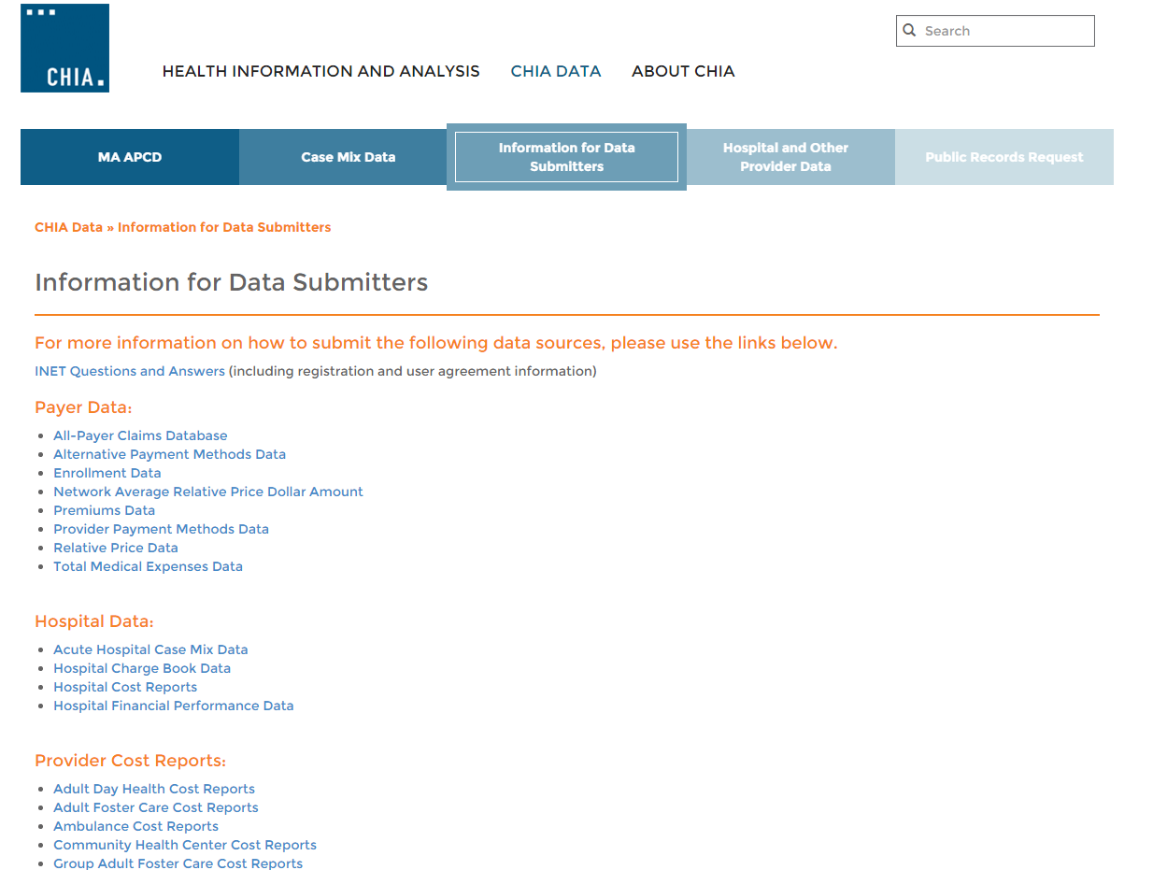
Data Submission Guides
www.chiamass.gov/information-for-data-submitters/

Slide 8
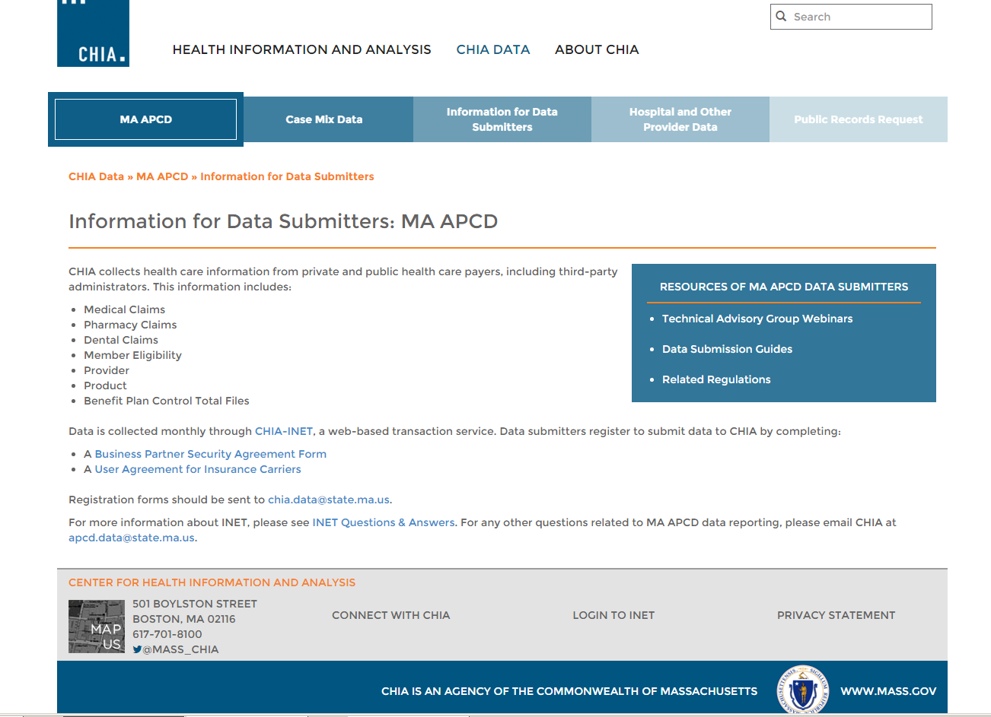
Data Submission Guides

Slide 9
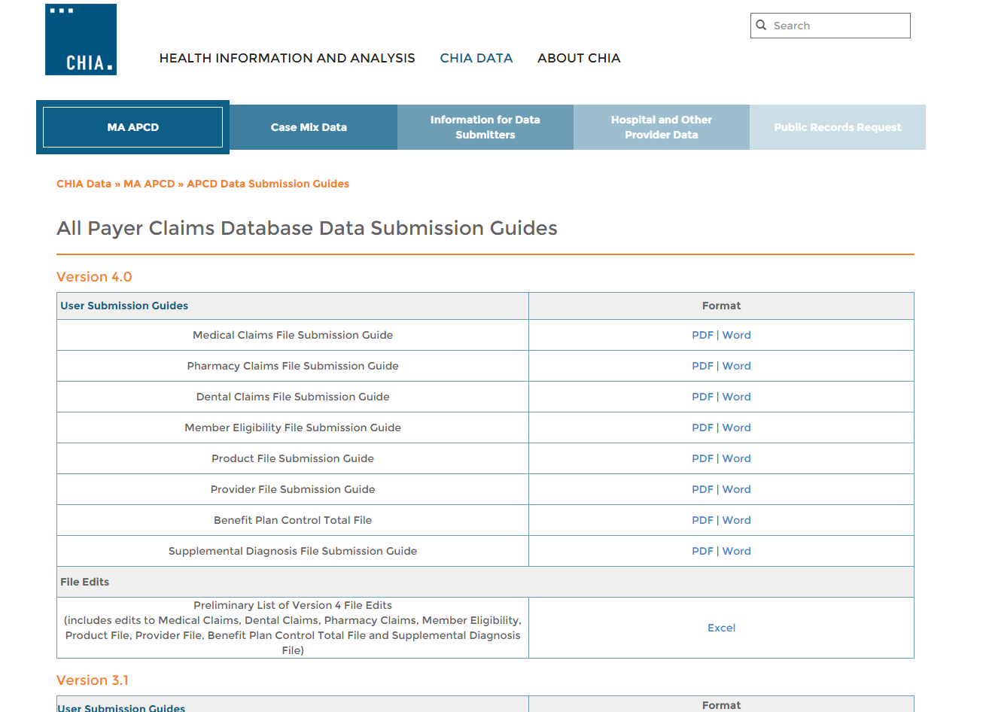
Data Submission Guides
www.chiamass.gov/apcd-data-submission-guides/

Slide 10
MA APCD User Symposium
Held November 5th in Boston
Sponsored by the Blue Cross Blue Shield Foundation of MA
Included an update on the MA APCD, a user panel and a discussion on future MA APCD enhancements
~85 attendees

Slide 11
Goals of the User Symposium
Highlight research that has been made possible as a result of the MA APCD
Provide an opportunity to share best practices in using the MA APCD
Encourage discussion about future opportunities to enhance the MA APCD in an effort to continuously support data-driven research and policy development in the Massachusetts health care sector
Inform CHIA’s efforts to foster continuous improvement in both data quality and processes for data acquisition and release

Slide 12
Key Takeaways and Recommendations
Expand and Improve Data Collection
  Increase data elements collected to enhance and expand the policy and research questions that can be addressed based on this data source
  Examples:
    Plan Design Information (including benefit design, network structure (tiered network, limited network, etc.)
    Demographic information – race/ethnicity fields, improvement in demographic data (e.g., age and gender) captured within prescription drug claims
    Ensure collection and comprehensiveness of substance use disorder data

Slide 13
Key Takeaways and Recommendations
Reduce Latency
  CHIA has recognized concerns associated with time between request for data, review process, and receipt of data (if approved)
    Developed expedited limited data set (LDS) in response to this concern
  CHIA is reducing the run-out period and enhancing its IT processes so 2015 MA APCD data will be available in June 2016

Slide 14
Key Takeaways and Recommendations
Improve Usability of the Data
  Enhance ability to link providers to practices and systems (akin to master patient index, develop master provider index)
  Identify opportunities and mechanisms to link to other state agency data (e.g., birth/death data)
  Reduce the complexity and size of the eligibility file and provide more information on MassHealth programs

Slide 15
Key Takeaways and Recommendations
Expand User Knowledge
  Continue current user workgroups, but also consider development of additional “interest groups” based on specific issues/areas of interest (e.g., prescription drugs, complex patients, methods, etc.) to identify opportunities for sharing best practices for coding, algorithm development, etc.
  Use CMS’s Research Data Assistance Center (ResDAC) as an example of a useful resource for user support and training

Slide 16
Common Application Issues and Questions

Slide 17
MEIDs for Subsequent Data Requests
If you currently have MA APCD data and are applying for a new year of data, you should request refreshes of all previous years of data that you received
  New MEIDs are generated for each release
    (example: if you previously received Release 3.0 with MEIDs for 2010-2013, those MEIDs will not match the MEIDs in Release 4.0 for the same years)
  Some data may also be more complete
  No additional cost

Slide 18
Application Revisions
Please remember to “lock” your application on IRBNet after you’ve finished making revisions to your application
Locking the application will send an automatic notification to CHIA staff letting them know that your revisions are complete and uploaded

Slide 19
Hard Drives
Please remember to return your hard drive to CHIA after you’ve loaded your data
CHIA has a limited number of hard drives, so help us ensure we have a steady supply ready to deliver data to the MA APCD user community

Slide 20
User Questions

Slide 21

Question: Why were Discharge Hour and Admission Hour excluded from the Limited Data Set?
Answer: Due to missing data from one of the high volume carriers, the discharge hour and admission hour for acute care inpatient admissions are not complete.
In checking acute care admissions/discharges for one month (January 2012), the discharge hour was 65% complete and the admission hour 74%.
In addition, inconsistencies were found in how providers define discharge hour, with some simply using computer software default time for the beginning of the day ‘0000’ hours. In speaking with providers on how they define time, some record the time of written order to admit/discharge, while others record the time the patient physically leaves the facility.
Once data quality issues are resolved, these data elements might be included in a future release of the Limited Data Set.

Slide 22

Question: Does CHIA have any data at all on Veterans?
Answer: Hospital inpatient discharge case mix data contains a Veterans Status indicator. This field code indicates the patient’s status as a United States veteran.
FY2012 to FY2014 Veterans Inpatient Discharge Volume
The recent decrease in Veteran Inpatient volume has paralleled the over decreasing trend in inpatient utilization.
 | FY2012 | FY2013 | FY2014
Distinct VA Patients | 43,423 | 42,815 | 39,807
Total VA Inpatient Discharges | 67,426 | 65,605 | 61,234
Also, MA APCD Medical Claims reflects the portion of payments made by private carriers for medical care provided at VA facilities.

Slide 23

Question: Does MA APCD cover claims for college students or other young people living in MA, but who are covered by their parent’s out-of-state payers?
Answer: Yes, it does to the extent the parents’ carriers are required to submit to MA APCD. ME012 (Individual Relationship Code) allows you to determine the Member to Subscriber Relationship and ME061 (Student Status) allows you to determine the Member’s Student Status.

Slide 24
Question: Our project includes linkage of MA APCD inpatient records to pharmacy claims to determine post discharge medication use and we are have been unable to get expected. Does the Medical Claims and Pharmacy Claims have a low linkage rate?
To answer this questions, we ran two tests:
Test 1: One month of medical claims data for beneficiaries with a principal diagnosis of V681 (Issue of Repeat Prescription) was linked to pharmacy claims. The rationale for using V681 is that if a pharmacy claims match failure occurred for a diagnosis related to refills, this would provide the best evidence of a linkage problem. In MC file, there were 454 distinct MEIDs with this V681 diagnosis. In the PC file, 95% of the MEIDs (431 distinct MEIDs) successfully linked with the MC file.
Test 2: One month of acute care hospital inpatient medical claims were linked to pharmacy claims. Rehab, nursing, mental health, and other specialty hospitals were excluded. To get an estimate of expected inpatient distinct MA APCD cases, we obtained the case mix inpatient discharge distinct count for non-Medicare patients under 65 years old for the month of interest (n = 25,814). The MA APCD inpatient distinct count was 6% less than case mix (n=24,126). In the PC file, 96% of MEIDs (23,059 distinct MEIDs) successfully linked with the MC file.
Answer: No, the MA APCD Medical Claims and Pharmacy Claims do not have a low linkage rate.

Slide 25
Questions?
General questions about the APCD:
(CHIA-APCD@state.ma.us)
Questions related to APCD applications: (apcd.data@state.ma.us)
Questions related to Case Mix: (casemix.data@state.ma.us)
REMINDER: Please include your IRBNet ID#, if you currently have a project using CHIA data

Slide 26
Calendar
December 17 – Data Release Committee Meeting
[a week early]
December 22 – Next User Workgroup Webinar

