Slide 1
CHIA user workgroup
Don Kirkwood (Manager of Data Release and Procurement)
Sylvia Hobbs (Manager of User Support)
Scott Curley (Manager Privacy & Compliance)
October 26, 2021
CENTER FOR HEALTH INFORMATION AND ANALYSIS

Slide 2
Agenda
Announcements:
  APCD Release 9.0/10.0 Updates
  FY20 Case Mix Release Projections
  Data Release and Application Update
Website Updates
Application Reminders
User Support Questions
  Observation Stay Procedures
  Interfacility Transfers
  Condition Present on Admission
  DRG Versions
Q&A

Slide 3
MA APCD Release 9.0/10.0
  Available Late Fall / Early Winter
  Applicants with approved projects that require updated APCD data (Release 9.0/10.0) should submit to CHIA a completed Exhibit B (Certificate of Continued Need and Compliance) of the Data Use Agreement. After submitting a completed Exhibit B you will receive an invoice (if applicable) for the requested data. Upon payment of the invoice the order for the data will be placed.
  Release 9.0/10.0 includes data on services from January 2015 – December 2020 with six months of claim runout.

Slide 4

Case Mix FY20 Release
*CURRENT* RELEASE TIMEFRAMES FOR EACH FILE:
  Inpatient (HIDD)
  Available for request
  Emergency Department (ED)
  Available for request
  Outpatient Observation (OOD)
  Mid-Fall 2021
  Applicants with approved projects that require newly available year(s) of Case Mix Data (e.g., FY 19) should submit to CHIA a completed Exhibit B (Certificate of Continued Need and Compliance) of the Data Use Agreement. After submitting a completed Exhibit B you will receive an invoice (if applicable) for the requested data. Upon payment of the invoice the order for the data will be placed.

Slide 5
Data Release and Application Updates
Due to Governor Baker’s emergency actions to limit the spread of COVID-19 CHIA’s workforce will be remote, for now. This arrangement will limit CHIA’s ability to produce and deliver data extracts. At this time, CHIA is releasing data and providing extracts to requestors.
During this time, CHIA will continue to accept and review data applications for both Case Mix and All-Payer Claims Database (MA APCD) datasets. Review committees, DRC and DPC, will continue their meetings remotely as necessary.
Due to CHIA’s physical office being closed, applications will be accepted without a fee. After receipt of the application, CHIA will issue an invoice which will allow applicants to remit payment online.
If you are a Data User that has a CHIA hard drive in your possession, please keep the hard drive at this time while CHIA’s physical office is closed.

Slide 6
Website Release Updates
  Updates on the production of APCD and Case Mix databases and status of data requests are now posted to CHIA’s website!
    Aim #1 is to provide weekly or bi-weekly status update on CHIA data products as they are in development.
    Aim #2 is to provide applicants with information about expected fulfillment status for individual data requests.
    Request IDs will be communicated to Data Requestors via email.
  Please visit http://www.chiamass.gov/status-of-data-requests/ to see the current status of releases.

Slide 7
Application reminders

Slide 8
Fee Waiver Request Reminders
  If you’re submitting a request for a fee waiver, remember to include the fee remittance form in your application package on IRBNet.
  Remember to submit supporting documentation (if required).
  If you’re requesting a financial hardship waiver, remember to submit information detailing your project’s financial situation (examples: project budget, grant funding, organizational / departmental funding). Also request to pay a specific price that you reasonably believe you’re able to afford to contribute.
  CHIA generally does not offer full financial hardship fee waivers. We expect all applicants to have made an attempt to find funding to cover the full cost of the data fees.
  Fee waiver requests can take some time to process – especially financial hardship requests.

Slide 9
USER questions

Slide 10


Question: I am applying for the inpatient hospital discharge data and am concerned about the magnitude of procedures I might be missing by not including the outpatient observation stay data in my request. What types of procedures are performed in observation stay and are these any of the same types of procedures that might be performed in an inpatient care setting?
Inpatient vs
Outpatient Procedures
Answer: Yes, although at a smaller volume, many of same procedures performed in the hospital inpatient care setting also appear in the outpatient observation stay data, including percutaneous transluminal coronary angioplasty, oophorectomy, prostatectomy, hysterectomy, knee arthroplasty, hip replacement, spinal fusion, to name a few. The following table shows a ranking of the top ICD-10-PCS procedures using AHRQ’s Clinical Classifications Software (CCS) Groupings for procedures performed FY2015 through FY2020.
Comparison of Top 10 CCS Procedure Code Groups in Observation Stay and Inpatient Discharge Data
Rank | Observation Stay Top 10 CCS Procedure Categories |  | Rank | Inpatient Discharge Top 10 CCS Procedure Categories
1 | Diagnostic cardiac catheterization; coronary arteriography |  | 1 | Respiratory intubation and mechanical ventilation
2 | Upper gastrointestinal endoscopy; biopsy |  | 2 | Blood transfusion
3 | Appendectomy |  | 3 | Prophylactic vaccinations and inoculations
4 | Tonsillectomy and/or adenoidectomy |  | 4 | Other procedures to assist delivery
5 | Fetal measurement and monitoring |  | 5 | Other vascular catheterization; not heart
6 | Other OR procedures on vessels other than head and neck |  | 6 | Diagnostic cardiac catheterization; coronary arteriography
7 | Other OR procedures on mouth and throat |  | 7 | Other therapeutic procedures
9 | Prophylactic vaccinations and inoculations |  | 9 | Fetal measurement and monitoring
9 | Cholecystectomy and common duct exploration |  | 9 | Upper gastrointestinal endoscopy; biopsy
10 | Insertion; revision; replacement; removal of cardiac pacemaker or cardioverter/defibrillator |  | 10 | Other therapeutic procedures on muscles and tendons
Continued

Slide 11
Inpatient vs
Outpatient Procedures
Answer (continued): While observation stay data does have many of the
same ICD-10-PCS procedures found in the inpatient care setting, as you
can see in Figure 1 below, from FY2016 to FY2020, only on small volume
of observation stays had such procedures. In Figure 2 below, you will see
that the percent of patients with such codes has trended downward from 10% in FY2016 to 6% in FY2020.
Figure 1. FY2016 to FY2020 Volume of Observation Stays with ICD-10-PCS Procedures
Continued

Slide 12
Inpatient vs
Outpatient Procedures
Answer (continued): Given the lower and moderate complexity of
many observations, the highest volume of procedures are recorded in
CPT codes for tests performed during the stay and for the stay itself.
FY2016 to FY2020 Top 10 CPT Procedure Codes in Outpatient Observation Stay Data
CPT Code | Description | 2016 | 2017 | 2018 | 2019 | 2020
99218 | Initial observation care, per day, for evaluation and management of patient which requires these 3 key components: A detailed or comprehensive history; A detailed or comprehensive exam; and Medical decision making that is straightforward or of low complexity. | 51731 | 65141 | 78877 | 92013 | 62616
36415 | Collection of venous blood by venipuncture | 68636 | 64914 | 77049 | 69620 | 52322
85025 | Blood count; complete (CBC), automated (Hgb, Hct, RBC, WBC and platelet count) and automated differential WBC count | 21731 | 29089 | 38452 | 62355 | 55727
80048 | Basic metabolic panel (Calcium, total) This panel must include the following: Calcium, total (82310) Carbon dioxide (bicarbonate) (82374) Chloride (82435) Creatinine (82565) Glucose (82947) Potassium (84132) Sodium (84295) Urea nitrogen (BUN) (84520) | 31180 | 32916 | 39461 | 47870 | 37046
80053 | Comprehensive metabolic panel This panel must include the following: Albumin (82040) Bilirubin, total (82247) Calcium, total (82310) Carbon dioxide (bicarbonate) (82374) Chloride (82435) Creatinine (82565) Glucose (82947) Phosphatase, alkaline (84075) Potassium (84132) Protein, total (84155) Sodium (84295) Transferase, alanine amino (ALT) (SGPT) (84460) Transferase, aspartate amino (AST) (SGOT) (84450) Urea nitrogen (BUN) (84520) | 28607 | 28266 | 32159 | 43636 | 36737
93005 | Electrocardiogram, routine ECG with at least 12 leads; tracing only, without interpretation and report | 16916 | 22726 | 24369 | 31959 | 26995
84484 | Troponin, quantitative | 9158 | 11085 | 16305 | 28238 | 27713
99219 | Initial observation care, per day, for evaluation and management of a patient, which requires these 3 key components: A comprehensive history; A comprehensive examination; and Medical decision making of moderate complexity. Counseling and/or coordination of care with other physicians, other health care professionals, or agencies are provided consistent with the nature of the problem(s) and the patient’s and/or family’s needs. | 15298 | 16327 | 15838 | 18559 | 14740
99285 | Emergency department visit for the evaluation and management of a patient, which requires these 3 key components within the constraints imposed by the urgency of the patient's clinical condition and/or mental status: A comprehensive history; A comprehensive examination; and Medical decision making of high complexity. | 6924 | 7966 | 12453 | 18700 | 15785
85610 | Prothrombin time; | 6357 | 7518 | 8267 | 13008 | 13215
Continued

Slide 13
Inpatient vs
Outpatient Procedures
Answer (continued): If the source of the observation stay originates from
a prior ED visit, a CPT code for that visit is in the observation stay record
(see Table 1 below). CPT code 99285 for high complexity ED visit patients
is in the top 10 of CPTs for observation stays. As you can see in Figure 1,
while the of low to moderate complexity patients admitted to observation stay from the ED has fluctuated, the number of high complexity ED patients in observation stay has more than doubled.
Table 1. CPT Codes in Observation Stay for Patients with prior ED Visit
CPT Code | Description
CPT 99281 | ED visit for the evaluation and management of a patient, which requires these 3 key components: A problem focused history; A problem focused examination; and Straightforward medical decision making.
CPT 99282 | ED visit for the evaluation and management of a patient, which requires these 3 key components: An expanded problem focused history; An expanded problem focused exam; and Medical decision making of low complexity.
CPT 99283 | ED visit for the evaluation and management of a patient, which requires these 3 key components: An expanded problem focused history; An expanded problem focused exam; and Medical decision making of moderate complexity.
CPT 99284 | ED visit for the evaluation and management of a patient, which requires these 3 key components: A detailed history; A detailed exam; and Medical decision making of moderate complexity.
CPT 99285 | ED visit for the evaluation and management of a patient, which requires these 3 key components within the constraints imposed by the urgency of the patient's clinical condition and/or mental status: A comprehensive history; A comprehensive exam; and Medical decision making of high complexity.
Table 1. CPT Codes in Observation Stay for Patients with prior ED Visit

Slide 14

Question: I am confused by how interfacility transfers are presented
in the case mix data. Specifically, is the field ‘IdOrgTransfer’ intended to represent the source from which the patient who has a discharge record has been transferred from or does it represent the destination to which the patient is being transferred?
Interfacility
Transfers
Answer: In the case mix filing specifications, hospitals are instructed to use the IdOrgTransfer field to report the transfer organization ID for the facility from which the patient has been transferred. This field is reported if the Primary or Secondary Source of Admission is any of the following:
    4 - Transfer from an Acute Hospital
    7 - Outside Hospital Emergency Room Transfer,
    5 - Transfer from an SNF Facility,
    6 - Intermediate Care Facility, or
    V - Transfer from another facility to a Medicare-approved swing bed
    9 - Other (to include Level 4 Nursing Facility) and the transfer facility is a Level 4 Nursing Facility/Rest Home
If the hospital provider, nursing facility/rest home or other facility from which the patient is transferred is outside Massachusetts, then the transfer OrgID reported must be 9999999.

Slide 15
Question: I am applying for the case mix hospital inpatient discharge data. The condition present on admission (POA) indicators are part of the LDS release product given to all approved data applicants. I only intend to import in and store the data elements relevant to my analysis. I typically quantify diagnosis codes and calculate rates without ever using the POA indicators. I had assumed that most conditions are present on admission. I am still in the process of filling out my application and would like to get a sense of the magnitude of diagnosis codes in any given year that are not present on admission and what are the conditions that those diagnosis describe.
Condition
Present on Admission
(POA)
Answer: From FY2016 to FY2020, the percent of patients discharged with a condition not present on admission has trended upward from 24.3% in FY2016 to 31.3% in FY2020 (See Figure 1 below). Each year, the conditions not present on admission only represent a small proportion of all diagnosis, from 5.1% in FY2016 to 6.0% in FY2020 (See Figure 2 below. The top 10 conditions not present on admission include diagnosis codes for delivery and neonate complications, kidney failure, anemia, palliative care and do not resuscitate. (See Table 1 below).
Table 1. Top 10 Conditions Not POA
DX Code | Description
D62 | Acute posthemorrhagic anemia
N179 | Acute kidney failure, unspecified
O701 | Second degree perineal laceration during delivery
E876 | Hypokalemia
Z515 | Encounter for palliative care
Z66 | Do not resuscitate
O76 | Abnormality in fetal heart rate and rhythm complicating labor and delivery
I959 | Hypotension, unspecified
O700 | First degree perineal laceration during delivery
P599 | Neonatal jaundice, unspecified

Slide 16
Question: CHIA releases multiple versions of the DRG groupers each year to facilitate longitudinal across year comparison using the same DRG version. In the FY2020 inpatient hospital discharge data, do different version of the APR-DRG group the diagnosis cod for COVID-19 differently?
APR
DRG
Answer: The older APR-DRG Versions 30.0 and 34.0 assign more patients with a principal diagnosis of COVID-19 to the surgical DRG (MODERATELY EXTENSIVE O.R. PROCEDURE UNRELATED TO PRINCIPAL DIAGNOSIS). The newer APR-DRGs Version 36.0 assigns those same COVID-19 patients to the medical DRG (RESPIRATORY SYSTEM DIAGNOSIS WITH VENTILATOR SUPPORT > 96 HOURS) or the medical DRG (MAJOR RESPIRATORY INFECTIONS AND INFLAMMATIONS).
The table below compares by APR-DRG version the DRG assignment of the patients with a principal DX of COVID-19 in the FY2020 HIDD for the top 10 groupings representing 12,946 of the 13,100 patients.
FY2020 Hospital Inpatient Discharge Data Comparison of COVID-19 Principal Diagnosis Cases by APR DRG Version for the Top 10 Grouping Assignments ( n= 12,946 of the total 13,100 principal DX cases)
PRINCIPAL DX COVID | APR DRG Version 36.0 | APR DRG Version 34.0 | APR DRG Version 30.0 | APR DRG Version 26.1 | APR DRG Version 20.0_ | Number of Discharges
U071 | 137 | 137 | 137 | 137 | 723 | 11531
U071 | 130 | 951 | 951 | 951 | 710 | 481
U071 | 130 | 130 | 130 | 130 | 723 | 429
U071 | 137 | 951 | 951 | 951 | 710 | 220
U071 | 005 | 004 | 004 | 004 | 004 | 138
U071 | 130 | 951 | 130 | 130 | 723 | 36
U071 | 004 | 004 | 004 | 004 | 004 | 31
U071 | 005 | 005 | 005 | 005 | 005 | 30
U071 | 951 | 951 | 951 | 951 | 710 | 27
U071 | 137 | 951 | 137 | 137 | 723 | 23

Slide 17
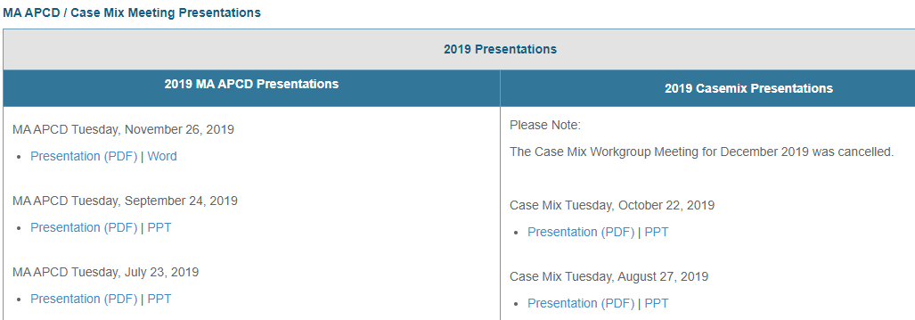
Where can I find past User Workgroup Presentations?
http://www.chiamass.gov/ma-apcd-and-case-mix-user-workgroup-information/

Slide 18

When is the next User Group meeting?
The next User Group will meet Tuesday, November 23.
http://www.chiamass.gov/ma-apcd-and-case-mix-user-workgroup-information/

Slide 19
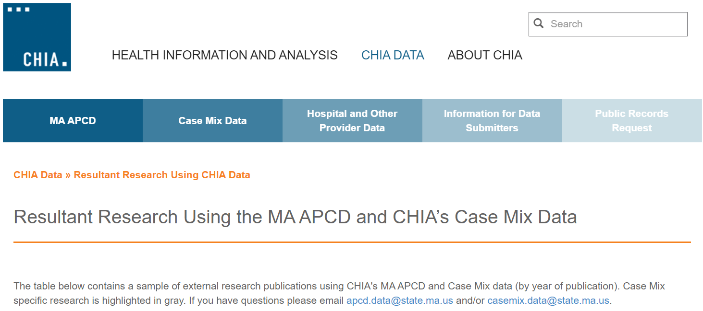
Resultant Research Using CHIA Data
https://www.chiamass.gov/resultant-research-using-chia-data

Slide 20
Questions?
Questions related to MA APCD:
apcd.data@chiamass.gov
Questions related to Case Mix:
casemix.data@chiamass.gov
REMINDER: Please include your IRBNet ID#, if you currently have a project using CHIA data.

Slide 21
Call for Topics and Presenters
If there is a TOPIC that you would like to see discussed at an MA APCD or Case Mix workgroup in 2021, contact Amy Wyeth [amy.wyeth@chiamass.gov]
If you are interested in PRESENTING at a MA APCD or Case Mix workgroup in 2021, contact Amy Wyeth [amy.wyeth@chiamass.gov]
You can present remotely, or in-person at CHIA
We may be reaching out to some data users with invitations to present, and hope you will consider this!

