Slide 1

FY2021 Case Mix Updates Webinar
August 31, 2020

Slide 2
Agenda
Welcome
FY2021 Submission Guide Highlights
Walk Through of Proposed Changes
Timeline / Next Steps
Race/Ethnicity
Compliance
Questions & Comments

Slide 3
submission guide Highlights

Slide 4
Submission Guide Change Highlights
Key Changes: Field Updates | File Types
Massachusetts Transfer Hospital Organization ID | HIDD
Principal, Admitting & Discharge Diagnosis Codes | HIDD
Condition Present on Visit | EDD
Ser_Unit | OOD
Principal Procedure & Associated Procedure Dates | OOD
Key Changes: Table Updates | File Types
Source of Admission | HIDD
Patient Status | HIDD
Payer Type | All
Payer Source | All

Slide 5
Changes & Revisions
For
Hospital inpatient

Slide 6
Hospital Inpatient Discharge Data
Record Type | Fields | New - Update | Description of requirement
20 | Massachusetts Transfer Hospital Organization ID | U | Update conditional requirement to include new Source of Admission Code “V” – Transfer from another facility to a Medicare-approved swing bed.
45 | Principal Diagnosis Code, Admitting Diagnosis Code, Discharge Diagnosis Code | N | Must not be an ICD-10 External Cause Code

Slide 7
Source of Admission
* SRCADM CODE | * SOURCE OF ADMISSION DEFINITION
J | Transfer from One Distinct Unit of the Hospital to another Distinct Unit of the Same Hospital Resulting in a Separate Claim to the Payer
K | Transfer from a Designated Disaster Alternative Care Site
U | Transfer from hospital inpatient in the same facility to a Medicare – approved swing bed
V | Transfer from another facility to a Medicare – approved swing bed

Slide 8
Patient Status
* PASTA CODE | * PATIENT STATUS DEFINITION
41 | Expired in a Medical Facility (e.g. hospital, SNF, ICF, or free standing hospice)
69 | Discharged/transferred to a Designated Disaster Alternative Care Site

Slide 9
Changes & Revisions
For
Hospital Emergency

Slide 10
Hospital Emergency Department Data
Record Type | Fields | New - Update | Description of requirement
20 | Condition Present on Visit - Principal Diagnosis Code | U | Change to May be present.
20 | Condition Present on Visit - Principal External Cause Code | U | Change to May be present

Slide 11
Changes & Revisions
For
Hospital outpatient observation

Slide 12
Hospital Outpatient Observation Data
Field No. | Fields | New - Update | Description of requirement
16 | Ser_Unit | U | Increase field length to 9 characters
34 | P_PRODATE | N | Add requirement: If P_PRODATE entered, P_PRO must be present
36 | AssocDATE1 | N | Add requirement: If AssocDATE1 entered, Assoc_PRO1 must be present
38 | AssocDATE2 | N | Add requirement: If AssocDATE2 entered, Assoc_PRO2 must be present
40 | AssocDATE3 | N | Add requirement: If AssocDATE3 entered, Assoc_PRO2 must be present
90 | ED Discharge Date | N | Add requirement: Must be less than or equal to OOD End Date
Notes:
Add Health Plan flag #92 Health Plan Member/Subscriber Flag
N
Must be present.

Slide 13
Changes & Revisions
For
PAYER TYPE & PAYER SOURCE

Slide 14
Payer Type
* PAYER TYPE CODE | * PAYER TYPE DEFINITION
1 | Self Pay
2 | Worker's Compensation
3 | Medicare
F | Medicare Managed Care (includes Medicare Advantage)
4 | Medicaid
B | Medicaid Managed Care/MCO
5 | Other Government Payment
6 | Blue Cross
C | Blue Cross Managed Care
7 | Commercial Insurance
D | Commercial Managed Care
8 | HMO
9 | Free Care
0 | Other Non-Managed Care Plans
E | PPO and Other Managed Care Plans Not Classified Elsewhere
H | Health Safety Net
J | Point-of-Service Plan
K | Exclusive Provider Organization
T | Auto Insurance
N | None (Valid only for Secondary Payer)
Q | Commonwealth Care/ConnectorCare Plans
Z | Dental Plans
S | Senior Care Options/Integrated Care Organization
A | Medicaid Accountable Care Organization
C | Commercial Accountable Care Organization

Slide 15
Payer Source
* PAYER SOURCE CODE | * HEALTH PLAN
137 | AARP/Medigap Supplement
51 | Aetna
910 | Allways Health Partners
911 | Anthem
272 | Auto Insurance
154 | BCBS Other (Not listed elsewhere)
912 | Beacon Health Partners
46 | Blue CHiP (BCBS Rhode Island)
807 | Blue Cross Blue Shield of MA
808 | Blue Cross Blue Shield of RI
288 | Boston Medical Center HealthNet
400 | Cambridge Network Health Forward
151 | CHAMPUS
26 | CHAMPUS/TriCare
996 | Charity Care
178 | Children's Medical Security Plan (CMSP)
30 | CIGNA
296 | Commonwealth Care Alliance
320 | Community Care Cooperative (ACO)
42 | ConnectiCare Of Massachusetts
185 | Connecticut General Life
4 | Fallon Community Health Plan
179 | First Health Life and Health Insurance Company
143 | Free Care
162 | Great West Life

Slide 16
Payer Source
* PAYER SOURCE CODE | * HEALTH PLAN
23 | Guardian Life Insurance Company
822 | Harvard Pilgrim Health Care
24 | Health New England
913 | Health Plans Inc.
995 | Health Safety Net Office
247 | Humana Insurance Company
914 | Insurance Programmers
57 | John Hancock Life Insurance
40 | Kaiser Foundation
915 | Key Benefit
85 | Liberty Mutual
916 | Lifetime Benefit Solutions
118 | Mass Behavioral Health Partnership
103 | Medicaid ( MassHealth)
121 | Medicare
134 | Medicare HMO - Other (not listed elsewhere)
249 | MEGA Life and Health Insurance Company
295 | Meritain
209 | Mid-West National Life Insurance Company of Tennessee
917 | Nationwide
47 | Neighborhood Health Plan
207 | Network Health
159 | None (Valid only for Secondary Source of Payment)
311 | Other ACO
147 | Other Commercial (not listed elsewhere)

Slide 17
Payer Source
* PAYER SOURCE CODE | * HEALTH PLAN
156 | Out of state BCBS
120 | Out-of-State Medicaid
228 | Oxford Health Plans
322 | Partners Healthcare Choice (ACO)
84 | Private Healthcare Systems
918 | QCC Insurance Company
145 | Self-Pay
922 | Senior Whole Health
919 | State Farm
323 | Steward Health Choice (ACO)
7 | Tufts Associated Health Plan
920 | UMR Inc.
97 | UniCare
826 | United Concordia
226 | United Health Care of New England, Inc.
74 | United Healthcare Insurance Company
903 | Unlisted International Source
102 | Wausau Insurance Company
328 | Wellforce Care Plan (ACO)
146 | Worker's Compensation
921 | Zenith

Slide 18
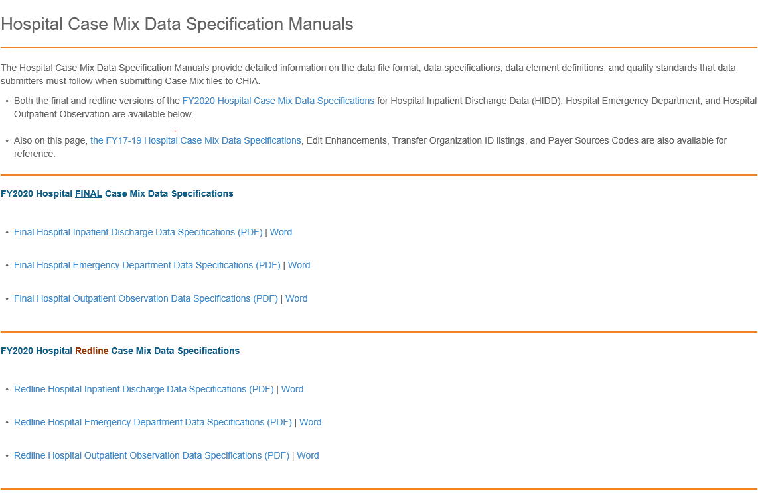
Submission Guides Will Be Published to
CHIA Website http://www.chiamass.gov/hospital-data-specification-manuals/

Slide 19
Timeline / Next Steps
FY 2021 Case Mix Intake Process | Draft Timeline
Provider Comment Period Ends | September 18, 2020
Administrative Bulletin and Guides Adopted | September 2020
CHIA and Providers Update Systems | October 2020 – January 2021
Provider Testing Period | February 2021
Quarter 1 Submission | March 16, 2021

Slide 20
Race/Ethnicity
Race Codes
Race Code | Patient Race Definition
R1 | American Indian/Alaska Native
R2 | Asian
R3 | Black/African American
R4 | Native Hawaiian or other Pacific Islander
R5 | White
R9 | Other Race
UNKNOW | Unknown/not specified
Ethnicity Codes – Utilize full list of standard codes, per Center for Disease Control, and those listed below: http://www.cdc.gov/nchs/data/dvs/Race_Ethnicity_CodeSet.pdf
Ethnicity Code | Ethnicity Definition
AMERCN | American
BRAZIL | Brazilian
CVERDN | Cape Verdean
CARIBI | Caribbean Island
PORTUG | Portuguese
RUSSIA | Russian

Slide 21
Compliance
FY 2020 Submittal Schedule | Due Date
Quarter 1 & Quarter 2 Case Mix files | Currently Due
Quarter 3 Case Mix files | September 13, 2020
Quarter 4 Case Mix files | December 14, 2020
* Reminder: Data from Field Hospitals should be submitted

Slide 22

Questions & Comments

Slide 23
Follow-up Contacts
Kathy Hines, Senior Director of Partner Operations and Data Compliance Kathy.Hines@MassMail.State.MA.US
Catherine Houston, Manager – Hospital Data Compliance Catherine.Houston2@MassMail.State.MA.US
Hospital Liaisons:
Linda Stiller, Senior Health Care Data Liaison Linda.Stiller@MassMail.State.MA.US
Hadish Gebremedhin, Health Care Data Liaison Hadish.Gebremedhin@MassMail.State.MA.US

