Slide 1

Case Mix Data collection
Behavioral Health Inpatient Data
(BHID)
September 20, 2018
Notes:
Hello.
Welcome to CHIA’s Technical Advisory Group Meeting to Review the Draft Submission Guide for Collecting Inpatient Discharge Data from Behavioral Health Facilities.
My name is Betty Harney and I’m the Data Curator at CHIA.

Slide 2
Webinar Agenda
Introductions
Project Status: Milestones
Tools: System Access
Submission Guide: Business Rule Updates
Session Wrap-Up

Slide 3
Project Status: CHIA High-Level Project Steps
Step 1
Gather Business Requirements
Step 2
Adopt Submission Guidelines
Step 3
Develop Supporting Systems
Step 4
Step 5
Collect Test Data from Facilities
Collect Production Data from Facilities

Slide 4
Project Status: Project Milestones
Provider Test Environment Target Date
Submit Quarterly File Test Data | October 31, 2018
Provider Production Schedule by Reporting Period Due Dates
FY18 (Quarterly Files: October 1, 2017 - September 30, 2018) | TBD
FY19 Quarter 1 (October 1, 2018-December 31, 2018) | March 15, 2019
FY19 Quarter 2 (January 1, 2019 – March 31, 2019) | June 17, 2019
FY19 Quarter 3 (April 1, 2019 – June 30, 2019) | September 16, 2019
FY19 Quarter 4 (July 1, 2019 – September 30, 2019) | December 16, 2019

Slide 5
Testing Notes:
Before October 31: Access to FileSecure and CHIA Submissions (End of Sept-October)
    FileSecure testing can help identify issues with 250 record length issues
    File uploads will be possible through CHIA Submissions
    CHIA Compliance team will support Error Detail Reporting (via Interchange secure encrypted email)
  After October 31: CHIA will work with each Provider to test edits at a Record Type level. (e.g. edit focus will be specific to Record Type 20 fields first, then 25 etc…)
      CHIA will attempt to manage and communicate edit updates (either found by Provider, or by CHIA, based on submitted data)

Slide 6
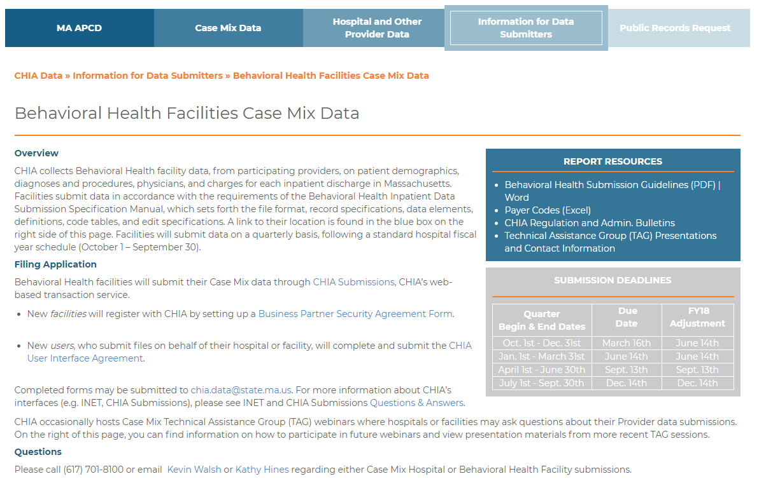
System Access: Request Forms
  http://www.chiamass.gov/behavioral-health-facilities-case-mix-data/

Slide 7
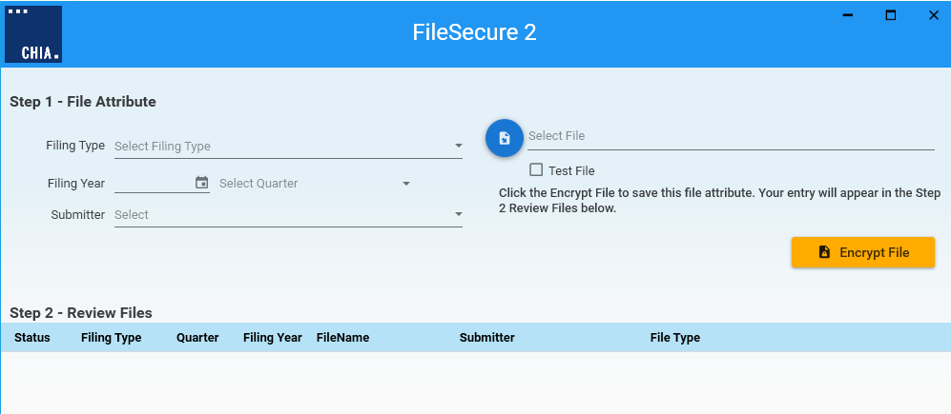
File Submission Tools: File Secure
Submission File Encryption/Hashing
Update: Address information was previously reported among hashed data elements within the File Secure application. CHIA will encrypt the data in File Secure, and hash the data when received at CHIA for analytical use and storage. This allows CHIA to utilize address standardization rules prior to hashing. (e.g. – “St.” and “street” entries dramatically impact hash algorithms.)

Slide 8
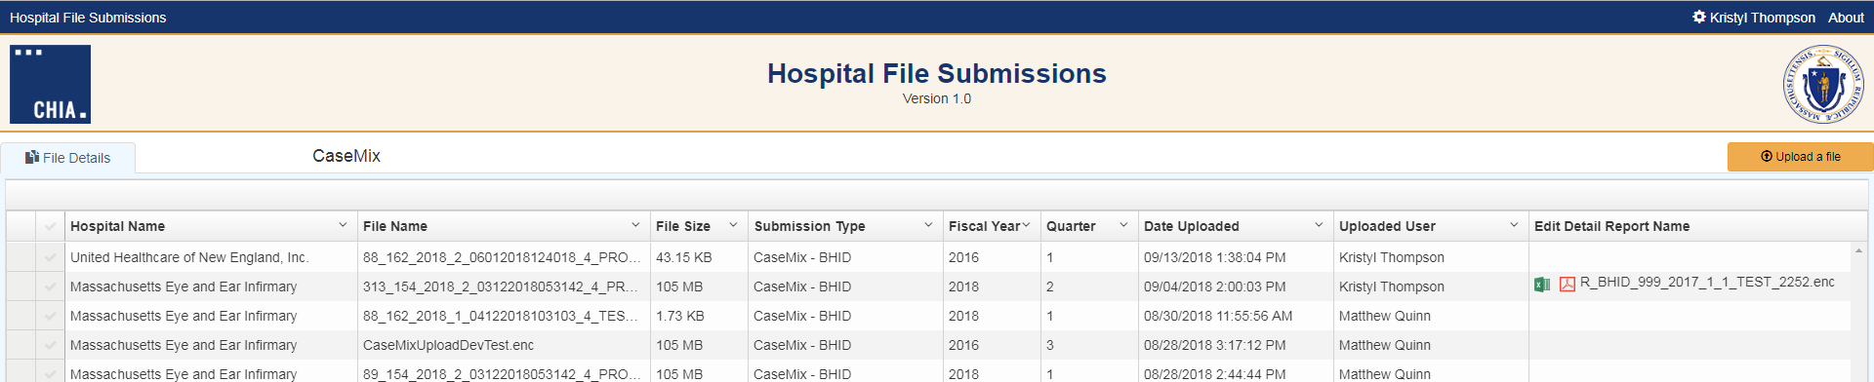
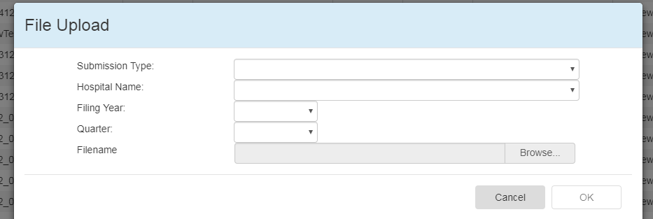
File Submission Tools: CHIA Submissions
File Upload / Edit Detail Report Download / Tracking
After logging in CHIA Submissions, choose the Upload a File command.
File tracking by Hospital, Fiscal Year, Quarter and Date Uploaded.
Encrypted Edit Detail Reports are downloadable to your workstation for
decryption in File Secure.

Slide 9
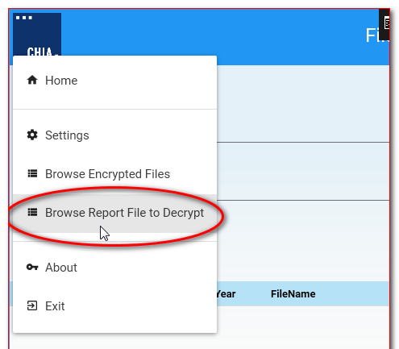
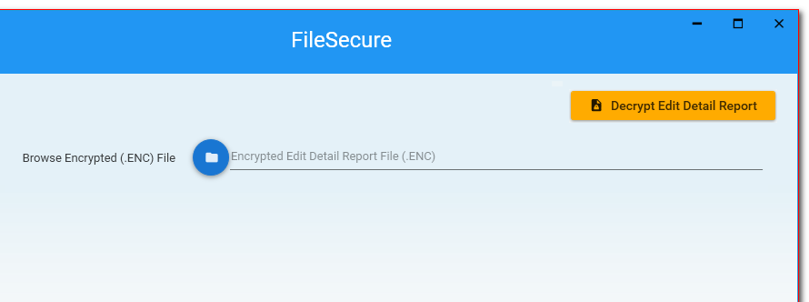
File Submission Tools: File Secure
Edit Detail Report Decryption
Log back into File Secure in order to decrypt your saved Edit Detail Reports (changes the file extension from .enc to .xls/.pdf)

Slide 10
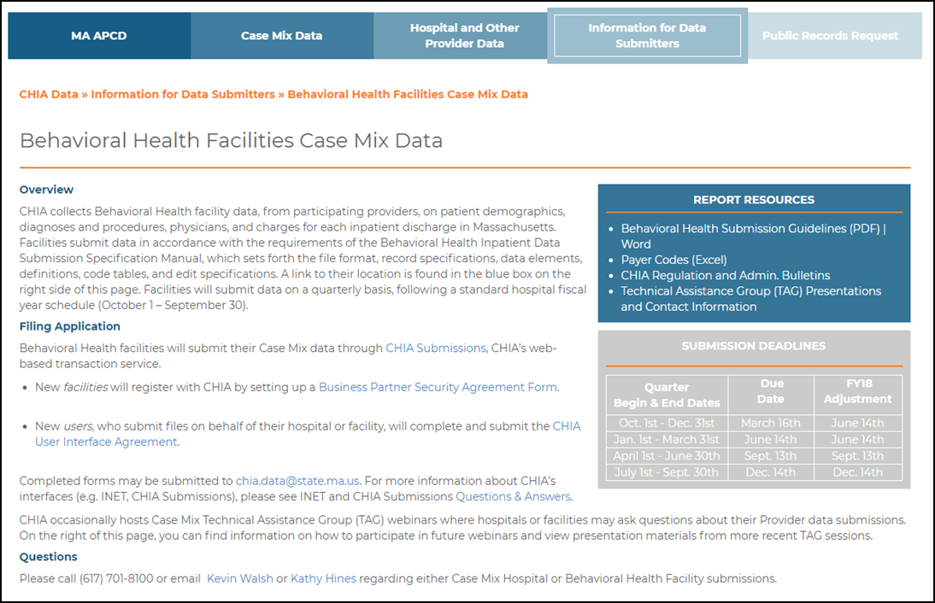
Tools: Guides / Resources
  http://www.chiamass.gov/behavioral-health-facilities-case-mix-data/
10

Slide 11
Submission Guide: Reference Table Updates
Case Mix reference tables are shared resources between all Hospital Provider teams (Acute Care and Behavioral Health). Recent updates include:
Source of Payment / Payer Type Codes: (Posted to Web)
New codes have been added that recognize ACO plans recently adopted in March 2018 by MassHealth.
Transfer Organization IDs (Org IDs): (Coming Soon)
As part of regular administration, a table update will be posted soon that has Behavioral Health Facility codes and updated Rest Home, Nursing Home facility detail.

Slide 12
Session Wrap-Up: Next Steps
New User Information? Contact Linda Stiller.
TAG Session Information:
  - All Webinar materials will be posted to the CHIA website http://www.chiamass.gov/behavioral-health-facilities-case-mix-data/
Open Discussion – Questions - Comments

Slide 13
CHIA Contact Information:
Kathy Hines, Senior Director of Partner Operations and Data Compliance
Kathy.Hines@MassMail.State.MA.US
    Data Compliance and Support Team
      Kevin Walsh, Manager
      Kevin.P.Walsh@MassMail.State.MA.US
      Linda Stiller, Sr. Health Care Data Liaison
      Linda.Stiller@MassMail.State.MA.US
      Cynthia Dukes-Reed, Sr. Health Care Data Liaison
      Cynthia.Dukes-Reed@MassMail.State.MA.US
Application Support Help Desk (CHIA Submissions System Access)
CHIA-DL-Data-Submitter-HelpDesk@MassMail.State.MA.US / 617-701-8217

Slide 14
THANK YOU FOR
JOINING US TODAY!

