Slide 1
MA Center for Health Information & Analysis
Case Mix User Workgroup
March 28, 2017

Slide 2
Agenda
Announcements
  Update on the status of Case Mix FY15/FY16
Recap of Case Mix changes for 2017
User Questions
Q&A

Slide 3
Case Mix FY15 Release Update
  *CURRENT* RELEASE TIMEFRAMES FOR EACH FILE:
  Inpatient (HIDD)
  COMPLETE
  Emergency Department (ED)
    COMPLETE
  Outpatient Observation (OOD)
    FULFILLMENT IN PROCESS

Slide 4
Case Mix FY16 Release Calendar
  *CURRENT* RELEASE TIMEFRAMES FOR EACH FILE:
  Inpatient (HIDD)
  JUNE
  Emergency Department (ED)
    AUGUST
  Outpatient Observation (OOD)
    SEPTEMBER

Slide 5
Case Mix Application Process
Recap of Changes for 2017:
Now charge per year of data requested
Small changes to fee waiver provisions/definitions
[per Admin Bulletin 16-14]
Can now request future years of data
Can request to use data for one project for a subsequent project
Comprehensive DUAs for each organization (will cover all projects instead of multiple DUAs for each specific project)
Revised forms to account for all the changes above

Slide 6
Revised Data Release Process
Applicants can now request FUTURE YEARS OF DATA
Initial project requires Data Privacy Committee and Data Release Committee review
Additional years (up to 5 years) or release versions of data will be released upon availability and the Recipient’s completion of a Certificate of Continued Need (Exhibit B of the revised DUA)
No additional review required for these additional years of data
Normal data fees still apply

Slide 7
Revised Data Release Process
Applicants will now be able to request authorization to use the data they have received for one project for SUBSEQUENT PROJECTS
Must complete new application for subsequent project – will require Data Privacy Committee and Data Release Committee review
If approved, will not require a new extract – can begin using data already in possession immediately (upon execution/amendment of DUA)
Normal data fees still apply

Slide 8
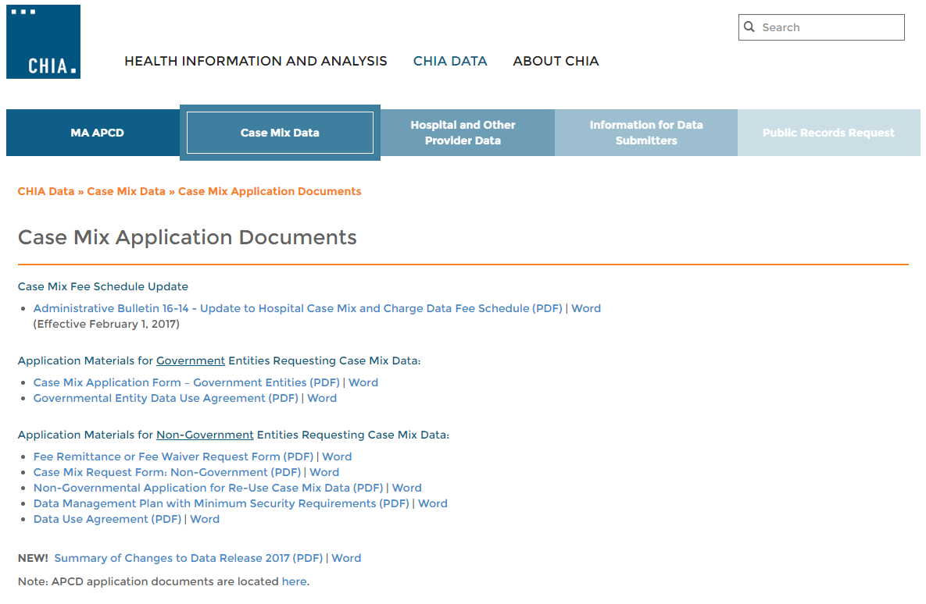
Revised Non-Gov’t Application Forms
Posted here: http://www.chiamass.gov/case-mix-application-documents/

Slide 9
Revised Non-Gov’t Application Forms
Revised Data Use Agreement: http://www.chiamass.gov/assets/Uploads/data-apps/Non-Government-Data-Use-Agreement.pdf
Revised Case Mix Request Form: http://www.chiamass.gov/assets/Uploads/data-apps/Non-Government-Case-Mix-Application.docx
NEW Application for Re-Use of Case Mix Data: http://www.chiamass.gov/assets/Uploads/data-apps/Non-Government-Re-Use-Case-Mix-Application.docx

Slide 10
QUESTIONS?

Slide 11
QUESTIONS SUBMITTED BY USERS

Slide 12
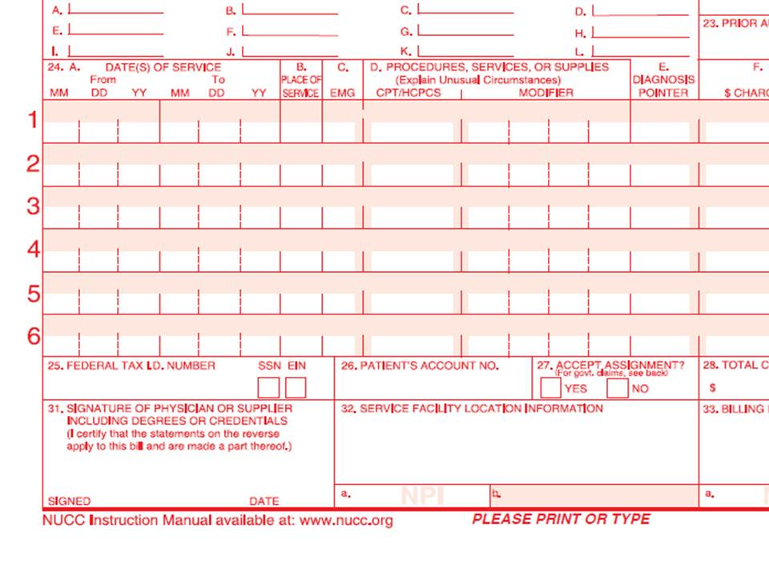
Change to File Structure for FY2016
Outpatient Emergency Department Data
The current release of FY2015 Outpatient Emergency Department Data lists a Principal Procedure in the main table. A field named “Principal Procedure” is used in data for patients who are admitted, as seen on the UB-04 CMS-1450 (see Figure 1 below) and on electronic medical record display dashboards . The first listed procedure will not be called “Principal Procedure “ in the FY2016 ED data but aligned with how it is reported on CMS-1500 outpatient data (see Figure 2 below). The FY2016 Outpatient Emergency Department Data change in file structure will to list all procedures in the procedure table and the sequence number without designation of a principal procedure.
Figure 1. Locator 74 from Inpatient UB-04 CMS-1450
Figure 2. Section 24D from Outpatient CMS-1500
Outpatient CMS-1500 data does not designate a Principal Procedure Code
Section 24D: Procedure Codes
Principal Procedure Code Code Date
Inpatient Hospital CMS-1450 data designates a
Principal Procedure Code
Locator 74: Principal Procedure Code

Slide 13
Question: Does the Outpatient Emergency Department Data include all Dead on Arrivals (DOAs)?
Answer: The DOAs in Case Mix ED data only represent the DOAs from 72 Massachusetts Acute Care Hospitals and may not include determinations updated from autopsy information and does not include DOAs from care provided in surrounding states. For example, a Massachusetts resident fatally injured a Motor Vehicle Crash in Rhode Island could be DOA at Rhode Island Hospital. That death would could as a DOA in our State’s Death Data but would not appear in our case mix data.
Jan 2011 to Sept 2015 Comparison of DOAs in State Death Data and Case Mix ED Data for Massachusetts Residents

Slide 14
Question: How do I identify newborns? There appears to be some redundancy in the source of admission codes.
Table 1. Source of Admission Codes
SRCADM CODE | * Source of Admission Definition |  | SRCADM CODE | FOR NEWBORN:
0 | Information Not Available |  | 0 | Information not Available
1 | Direct Physician Referral |  | 1 | Normal Delivery
2 | Within Hospital Clinic Referral |  | 2 | Premature Delivery
3 | Direct Health Plan Referral/HMO Referral |  | 3 | Sick Baby
4 | Transfer from an Acute Hospital |  | 4 | Extramural Birth
5 | Transfer from a Skilled Nursing Facility
6 | Transfer from Intermediate Care Facility
7 | Outside Hospital Emergency Room Transfer
8 | Court/Law Enforcement
9 | Other (to include level 4 Nursing Facility)
F | Transfer from a Hospice Facility
L | Outside Hospital Clinic Referral
M | Walk-In/Self Referral
R | Within Hospital Emergency Room Transfer
T | Transfer from Another Institution’s Ambulatory Surgery
W | Extramural Birth
X | Observation
Y | Within Hospital Ambulatory Surgery Transfer
Answer: The source of admission codes (see Table 1) can be used in combination with the Type of Admission Code (see Table 2) to identify newborns. In addition, newborns have the birthweight field and encrypted Mother’s SSN populated.
Table 2. Type of Admission
TYPADM CODE | Type of Admission Definition
1 | Emergency
2 | Urgent
3 | Elective
4 | Newborn
5 | Information Unavailable

Slide 15
Question: I would like to study Percutaneous coronary intervention (PCI) and PCI readmissions and would like to know what data do I need?
Ensure you have the right variables:
-UHIN, UHIN Sequence#, YYYYMMDD of Admission and Discharge, UPN, Days between stays, Procedures, and Diagnosis Codes, Patient Status
Ensure you have the right databases
You will need both the Inpatient and Outpatient Observation data
Reason: PCI can be performed in both Inpatient and Outpatient observation settings as Inpatient PCI and Outpatient PCI.
Ensure PCI measures (see AHRQ measures)
The variables you use depend on the measure
PCI Volume
PCI Rate
PCI Mortality Rate

Slide 16
Questions?
Questions related to APCD : (apcd.data@state.ma.us)
Questions related to Case Mix: (casemix.data@state.ma.us)
REMINDER: Please include your IRBNet ID#, if you currently have a project using CHIA data

Slide 17
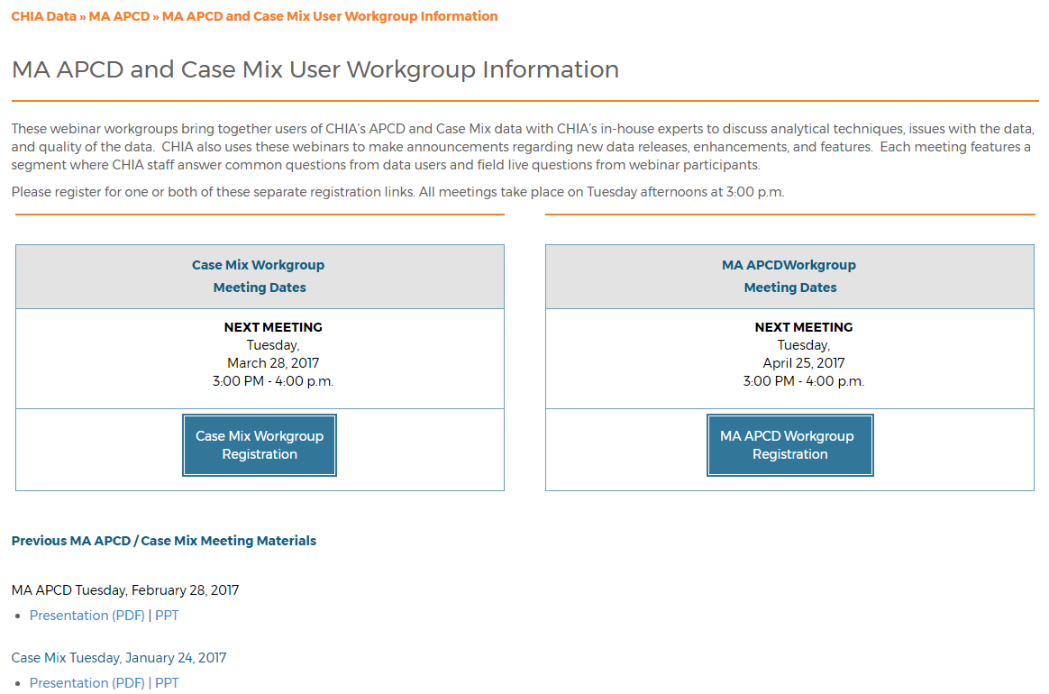
Where can I find old User Workgroup presentations?
http://www.chiamass.gov/ma-apcd-and-case-mix-user-workgroup-information/

Slide 18
Call for Topics and Presenters
If there is a TOPIC that you would like to see discussed at an MA APCD or Case Mix workgroup, contact Adam Tapply [adam.tapply@state.ma.us]
If you are interested in PRESENTING at an MA APCD or Case Mix workgroup, contact Adam Tapply [adam.tapply@state.ma.us]
  You can present remotely from your own office, or in-person at CHIA.

