Slide 1
ANNUAL PREMIUMS DATA REQUEST
2015
Payer Consultative Session
December 9, 2014
2:00PM

Slide 2
Agenda
Introductions
Overview of 2014 Data Request
How 2014 Data were Used
Lessons Learned & Payer Feedback
Potential Changes
Timeline

Slide 3
Introductions
Center for Health Information and Analysis
Oliver Wyman Actuarial Consulting
Deb Schiel, Director of Analytics (HSP)
Kathy Hines, Director of Data Compliance and Support (HIT)
Paul Smith, Manager of Data Compliance (HIT)
Kevin McAvey, Manager of Analytics (HSP)
Kevin Meives, Senior Health System Policy Analyst (HSP)
Ashley Storms, Health System Policy Analyst (HSP)
Dianna Welch, Principal
Peter Scharl, Consultant

Slide 4
Introductions
Payer Representatives
Aetna
Blue Cross Blue Shield of Massachusetts
CIGNA
Fallon Community Health Plan
Harvard Pilgrim Health Care & Health Plans, Inc.
Health New England
Massachusetts Association of Health Plans (MAHP)
Neighborhood Health Plan
Tufts Health Plan
United Healthcare
WellPoint (UniCare)

Slide 5
Overview of 2014 Data Request
Purpose
To assess cost and coverage trends in the Massachusetts commercial market, based on contract-membership (fully- and self-insured)
Data
Aggregated member months, premiums, and claims data
Breakouts by Market Sector, Managed Care Type, and Product Type
Covers last three years (2011, 2012, 2013)

Slide 6
Overview of 2014 Data Request
Timeline
  Data Request Specifications and Excel template sent (February 2014)
  Post-Request TAG sessions (March, April 2014)
    FAQs distributed (March, April 2014)
  Data submitted to Oliver Wyman (May 2014)
    Excel workbooks
  Oliver Wyman Data Verification & Payer Follow-up (May-June 2014)
  CHIA Annual Report analysis and drafting (July-August 2014)
  CHIA Annual Report publication (September 2014)
  CHIA Annual Report Briefs (December 2014 - January 2015)

Slide 7
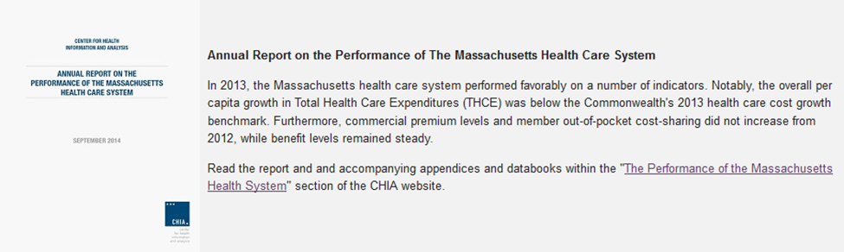
How 2014 Data were Used
  Annual Report and Supplements
  Describe the trends in cost and enrollment for commercial health insurance in Massachusetts, broken down by market sector, payer, managed care type, and product type.
  Briefing Series
  Will provide more detailed information on Managed Care and
  Tiered Network adoption in Massachusetts.

Slide 8
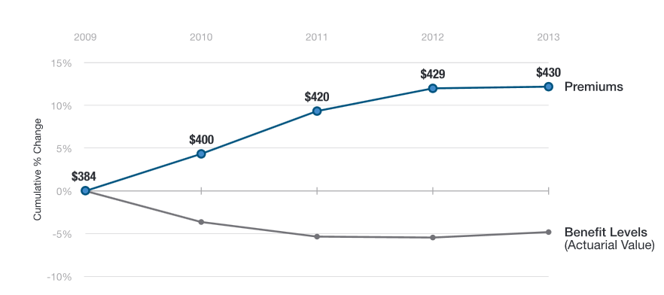
How 2014 Data were Used
  Overall Market Analysis
  Example: Trends in premiums and benefit levels
  Source: 2014 Annual Report, Figure 5 (p. 10)

Slide 9
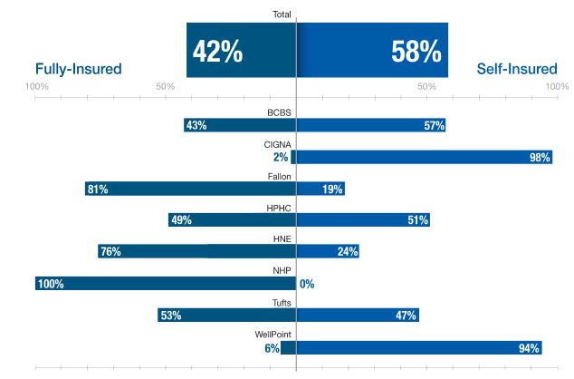
How 2014 Data were Used
  Analysis by Payer
  Example: Fully-insured vs. self-insured membership rates
  Source: Annual Report Supplement #10, Figure 10.2 (p. 4)

Slide 10
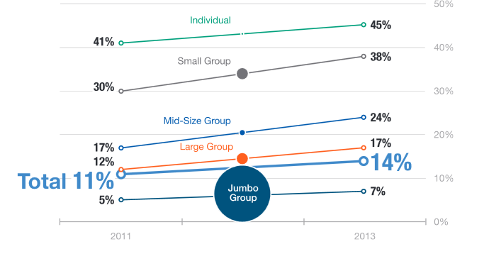
How 2014 Data were Used
  Analysis by Market Sector
  Example: High Deductible Health Plan (HDHP) membership rates
  Source: 2014 Annual Report, Figure 7 (p. 12)

Slide 11
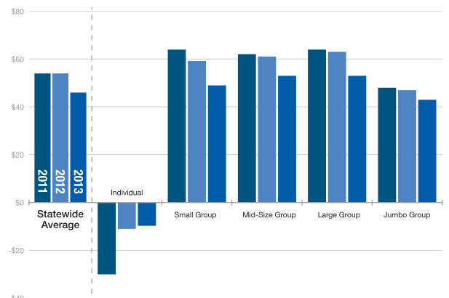
How 2014 Data were Used
  Analysis by Market Sector
  Example: Premium retention 2011 - 2013
  Source: 2014 Annual Report Supplement #6, Figure 6.2 (p. 3)

Slide 12
Lessons Learned & Payer Feedback
  Lessons Learned
  Consistency
    Internal
    To outside sources (e.g. financial statements)
    To benchmarks (e.g., PMPM, loss ratio)
Clarity in definitions
    Entities and members included
    Market sectors, product type, managed care type
  Payer Feedback
  What information would you like to see from our reporting?

Slide 13
Potential Changes
  Elimination of some elements that are not part of the core analyses
  Addition of Elements to Fulfill Reporting Goals
    Premium Equivalents
    In-network vs. Out-of-network Claims
    Average Deductible / Coinsurance

Slide 14
Timeline
Annual Premiums Data Request: 2015 Timeline
Month(s) | Milestone
January 2015 (early) | Draft 2015 Request shared
January 13, 2015 | All Payer TAG Call: Premiums & TME (2pm)
February 2015 | Finalized Data Request distributed
March - April 2015 | Follow-up TAGs for technical questions
May 2015 (early) | Data due to Oliver Wyman
May - June 2015 | Data verification
July - August 2015 | CHIA “Annual Report” analysis
September 2015 (early) | “Annual Report” publication

Slide 15
Contact Information - General
General Questions:
Kevin McAvey
Manager of Analytics
CHIA Health System Performance Analytic Team
(617) 988-3237
Kevin.McAvey@state.ma.us
Ashley Storms
Health Policy Analyst
CHIA Health System Performance Analytic Team
(617) 988-3269
Ashley.Storms@state.ma.us
Kevin Meives
Senior Health Policy Analyst
CHIA Health System Performance Analytic Team
(617) 988-3208
Kevin.Meives@state.ma.us

Slide 16
Contact Information - Technical
Technical Questions:
Dianna Welch
Principal
Oliver Wyman Actuarial Consulting, Inc.
(414) 277-4657
Dianna.Welch@oliverwyman.com
Peter Scharl
Consultant
Oliver Wyman Actuarial Consulting, Inc.
(414) 277-4620 Peter.Scharl@oliverwyman.com

