Slide 1
Statewide Quality Advisory Committee (SQAC) Meeting
September 22, 2014

Slide 2
Agenda
Welcome and Approve Minutes 9:00
Review of proposed measures – Tim Prinz, Lewin Group 9:05
Updates 10:30
PSI 19 – OB trauma without instrument
Obstetrical Measure Study
DOI Tiering Letter
Next Steps 10:50

Slide 3
New SQMS Measure Evaluation: Overview
Reviewed 35 proposed measures, and 10 Leapfrog measures
Followed SQAC priorities:
1) Behavioral Health 3) End of Life Care
2) Pediatric Care 4) Patient-Centered Care
Built on 2013 work assessing 2012 and 2013 measures
Notes:
Tim Prinz: SQMS Evaluation Overview 9:05 – 9:15

Slide 4
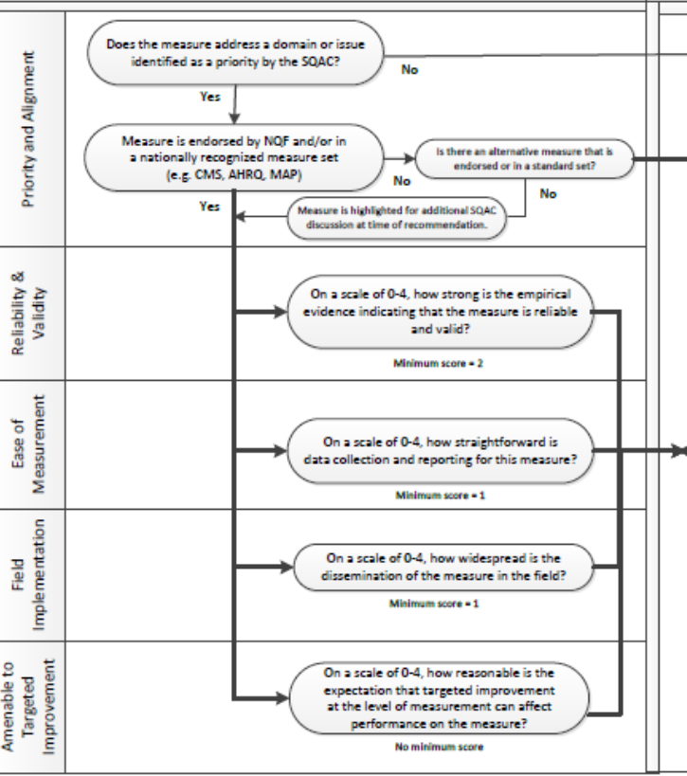
METHOD
Overall: Search & Research
Four Dimensions:
Ease of Measurement
Reliability & Validity
Field Implementation
Amenable to Targeted Improvement
Team
4 Reviewers
Individual scoring/Team meeting
Consensus
Notes:
Tim Prinz: SQMS Evaluation Overview 9:05 – 9:15

Slide 5
Applying the Measure Evaluation Criteria
Ease of Measurement
Collection
Reporting
Reliability & Validity
Nature of evidence (mixed/good/strong)
Field Implementation
Evidence of implementation, and how widespread
Amenable to Targeted Improvement
Current use
Amenability
Notes:
Tim Prinz: SQMS Evaluation Overview 9:05 – 9:15

Slide 6
Challenging Measures
Several measures posed challenges:
Clinical Survey Questionnaires
Leapfrog
Hospice Item Set
Patient Engagement
Notes:
Tim Prinz: SQMS Evaluation Overview 9:05 – 9:15

Slide 7
Challenges: Clinical Survey Questionnaires
Measure Name | Ease of Measurement | Reliability and Validity | Field Implementation | Amenable to Targeted Improvement | Score | Preliminary Evaluation
Patient Health Questionnaire: the PHQ-9 (NQF 712) | 2 | 3 | 3 | 3 | 2.75 | Good
Generalized Anxiety Disorder 7-item (GAD-7) | 1 | 3 | 2 | 2 | 2.0 | Good
Columbia Suicide Severity Rating Scale | 1 | 3 | 2 | 2 | 2.0 | Good
Alcohol Use Disorder Identification Test (AUDIT) | 1 | 4 | 3 | 3 | 2.75 | Good

Slide 8
Challenges: Leapfrog
Measure Name | Ease of Measurement | Reliability and Validity | Field Implementation | Amenable to Targeted Improvement | Score | Preliminary Evaluation
High-risk Newborn Deliveries (PC-03) | 2 | 3 | 4 | 3 | 3 | Good
Newborn Bilirubin Screening & DVT Prophylaxis in Women Undergoing Cesarean Section | 3 | 4 | 2 | 2 | 2.75 | Good
Incidence of Episiotomy | 3 | 2 | 4 | 1 | 2.5 | Good
Aortic Valve Replacement | 2 | 3 | 1 | 3 | 2.25 | Good
Pancreatic Resection | 3 | 2 | 3 | 2 | 2.5 | Good
Abdominal Aortic Aneurysm Repair | 3 | 1* | 0* | 1 | 1.25 | Weak
Esophagectomy | 3 | 1* | 1 | 2 | 1.75 | Weak

Slide 9
Challenges: Hospice Item Set
Measure Name | Ease of Measurement | Reliability and Validity | Field Implementation | Amenable to Targeted Improvement | Score | Preliminary Evaluation
HIS: Pain Screening | 3 | 2 | 3 | 3 | 2.75 | Good
HIS: Pain Assessment | 3 | 2 | 1 | 2 | 2.0 | Good
HIS: Dyspnea Screening | 2 | 2 | 1 | 2 | 1.75 | Moderate
HIS: Dyspnea Treatment | 2 | 2 | 1 | 2 | 1.75 | Moderate
HIS: Patients Treated with an Opioid who are Given a Bowel Regimen | 2 | 1* | 1 | 2 | 1.5 | Weak

Slide 10
Challenges: Patient Engagement
Measure Name | Ease of Measurement | Reliability and Validity | Field Implementation | Amenable to Targeted Improvement | Score | Preliminary Evaluation
Use and Quality of Shared Decision-Making | 1 | 2 | 1 | 2 | 1.5 | Moderate
Active Patient Engagement | 0 | 0* | 1 | 1 | 0.5 | Weak

Slide 11
Recommendations: Behavioral Health
Measure Name | Ease of Measurement | Reliability and Validity | Field Implementation | Amenable to Targeted Improvement | Score | Preliminary Evaluation
Post discharge continuing care plan created | 1 | 2 | 4 | 3 | 2.5 | Good
Post discharge continuing care plan transmitted to next level of care provider upon discharge | 1 | 3 | 4 | 3 | 2.75 | Good
Maternal Depression Screening | 3 | 2 | 2 | 3 | 2.5 | Good
CHIA Recommends inclusion of the above measures that received “Good” or “Strong” preliminary evaluations

Slide 12
Recommendations: Pediatric Care/Behavioral Health
Measure Name | Ease of Measurement | Reliability and Validity | Field Implementation | Amenable to Targeted Improvement | Score | Preliminary Evaluation
Depression screening by 18 years of age | 2 | 3 | 2 | 3 | 2.5 | Good
Diagnosis of ADHD in primary care for school-aged children and adolescents | 2 | 3 | 1 | 1 | 1.75 | Moderate
Developmental Screening in first 3 years of life | 3 | 0* | 3 | 3 | 2.25 | Weak
CHIA Recommends inclusion of the above measures that received “Good” or “Strong” preliminary evaluations

Slide 13
Recommendations: End-of-Life Care/Patient-Centered Care
Measure Name | Ease of Measurement | Reliability and Validity | Field Implementation | Amenable to Targeted Improvement | Score | Preliminary Evaluation
Proportion admitted to hospice for less than 3 days | 3 | 4 | 4 | 3 | 3.5 | Strong
Beliefs/Values Addressed (if desired by the patient) | 2 | 3 | 3 | 3 | 2.75 | Good
Advance Care Plan | 2 | 2 | 4 | 3 | 2.75 | Good
Palliative and End of Life Care: Dyspnea Screening & Management | 3 | 3 | 3 | 1 | 2.5 | Good
CARE - Consumer Assessments and Reports of End of Life | 1 | 2 | 1 | 3 | 1.75 | Moderate
Family Evaluation of Palliative Care | 1 | 1* | 0 | 0 | 0. 5 | Weak
CHIA Recommends inclusion of the above measures that received “Good” or “Strong” preliminary evaluations

Slide 14
Recommendations: Other Measures
Measure Name | Ease of Measurement | Reliability and Validity | Field Implementation | Amenable to Targeted Improvement | Score | Preliminary Evaluation
PC-02 Cesarean Section | 3 | 3 | 4 | 3 | 3.25 | Strong
Patient Safety Composite | 4 | 3 | 4 | 3 | 3.5 | Strong
Pneumonia 30-day mortality rate | 3 | 3 | 4 | 3 | 3.25 | Strong
Heart failure 30-day mortality rate | 3 | 3 | 4 | 3 | 3.25 | Strong
AMI 30-day mortality rate | 3 | 3 | 4 | 3 | 3.25 | Strong
Hospital-onset methicillin resistant staphylococcus bacteremia aureus (MRSA) | 4 | 3 | 3 | 3 | 3.25 | Strong
CHIA Recommends inclusion of the above measures that received “Good” or “Strong” preliminary evaluations

Slide 15
Recommendations: Other Measures (cont’d)
Measure Name | Ease of Measurement | Reliability and Validity | Field Implementation | Amenable to Targeted Improvement | Score | Preliminary Evaluation
Central-Line Associated Bloodstream Infection | 2 | 3 | 4 | 3 | 3 | Good
Hospital-onset C. difficile | 2 | 3 | 4 | 3 | 3 | Good
Catheter-Associated Urinary Tract Infections | 2 | 2 | 4 | 3 | 2.75 | Good
SSI Surgical Site Infection: SSI colon, SSI-abdominal hysterectomy | 2 | 2 | 4 | 2 | 2.5 | Good
CHIA Recommends inclusion of the above measures that received “Good” or “Strong” preliminary evaluations

Slide 16
PSI 19 – Obstetric Trauma w/o Instrument
Issue Summary
CHIA Process
Recommendation

Slide 17
SQAC 2014 Agenda
Annual Recommendation due Nov 1
TODAY
#1
February 10
#2
April 14
#3
June 16
#4
September 22
#6
October 20
#7
December 15
Hospital measures for public reporting
Straw model for SQMS by population
HPC Update on PCMH/ACO certification
SQMS for behavioral health
Provider tiering using SQMS
Discuss measures for end-of-life care
Determine which of the proposed measures to assess
Review preliminary assessments of proposed measures
Review and approve final report and recommendation
Review priorities for 2015
Solicitation of Nominations for Proposed SQMS Measures

Slide 18
Next meeting
Monday, October 20
3:00-5:00 p.m.
2 Boylston Street, 5th Floor
Boston, MA 02116
For more information
www.mass.gov/chia/sqac
sqac@state.ma.us

