Slide 1
Massachusetts All-Payer Claims Database:
Technical Assistance Group (TAG)
January 14, 2014

Slide 2
AGENDA
IT Update
Field Edit Report
Version 3 Update/Questions
Claims Versioning

Slide 3
IT UPDATE

Slide 4
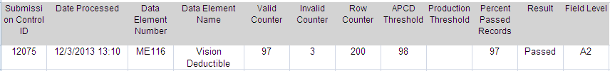
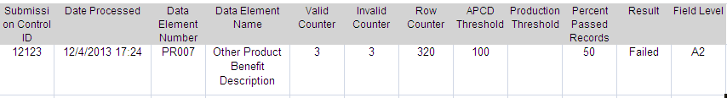
FIELD EDIT REPORT
Percent Passed Calculation
ME116 is required when ME118 = 1
PR007 is required when PR006 = 0

Slide 5
PRESENT ON ADMISSION
MC154 - 178 | Present on Admission (POA) – 1 through 24
Code Based Exemptions
Provider Based Exemptions
Utilize ‘ 1’ to Signify Exempt
Utilize Variance Rationale to Denote High Level of Exempt Usage

Slide 6
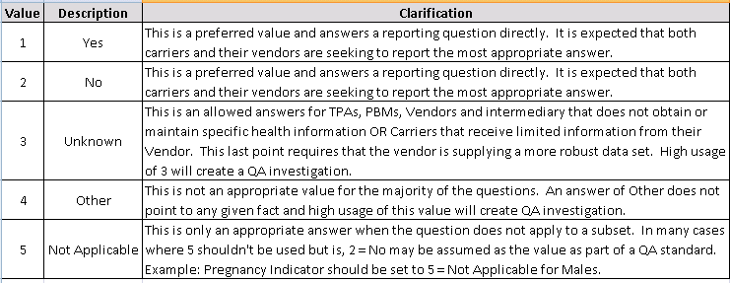
FLAG INDICATOR FIELDS
Expect 100% compliance on Flag Indicator fields
Expect high usage of Unknown/Other/Not Applicable will be explained in the Variance Rationale column

Slide 7
FLAG FIELDS
PV047 | Uses Electronic Health Records
PV049 | Accepting New Patients
PV050 | Offers e-Visits
END DATES

Slide 8
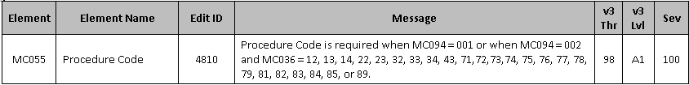
PROCEDURE CODE
Outpatient Facility Revenue Code Exception
Examples:
  0250 Pharmacy – General
  0270-0273 Medical/Surgical Supplies
  0370-0372 Anesthesia…etc

Slide 9
TOOTH NUMBER
Leading zeros will be allowed.

Slide 10
TME PROVIDER ID
ME124 Attributed PCP
ME125 Physician Group of Member’s PCP
Required in December Filing
Edits
New Physician Groups

Slide 11
RISK ADJUSTMENT FIELDS
ME126 | Risk Adjustment Covered Plan (RACP) | Member Enrolled in RACP Indicator | Non-grandfathered individual and small group plans underwritten and filed in the Commonwealth of Massachusetts are subject to risk adjustment. Large group plans, self-insured plans, and plans underwritten and filed in states other than Massachusetts are not subject to risk adjustment. Report RACP status as of the 15th of the month. EXAMPLE: 1 = Yes, the Member was enrolled in RACP as of the 15th of the month.
 |  | Value | Description
 |  | 1 | Yes
 |  | 2 | No
 |  | 3 | Mock
ME120 | Actuarial Value
ME121 | Metal Level
ME127 | Billable Member
ME128 | Benefit Plan Contract ID
ME129 | Member Benefit Plan Contract Enrollment Start Date
ME130 | Member Benefit Plan Contract Enrollment End Date

Slide 12
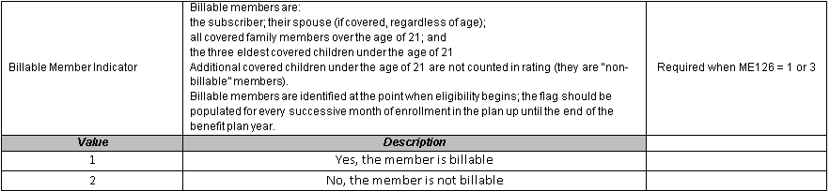
BILLABLE MEMBER
Spouse under 21 (Final Market Reform Rules preamble (p. 13409)
New family member (Final Market Reforms Rules -- p. 13412)

Slide 13
BENEFIT PLAN CONTROL TOTALS
BP005 | Monthly Claims Paid Number for the Benefit Plan | Total Number of Claims Paid | Report the total number of claim lines that correspond to the Benefit Plan Contract ID in BP001 and Monthly Net Dollars Paid in BP006. (Note that not all will be “paid” claim lines). Use Claims Paid Date MC089 or PC063. If no claims were paid for this BP Contract ID, report 0. Do not use a 1000 separator (commas).
BP006 | Monthly Net Dollars Paid for the Benefit Plan | Total Paid Amount | Report the monthly aggregate Total Plan Paid Amount that corresponds to the Benefit Plan Contract ID in BP001 and the Claim Type in BP004. For the medical claims, the Paid Amount is MC063 and for pharmacy claims the Paid Amount is PC036. Calculate the total based on Paid Date (MC089 or PC063). Include fee-for-service equivalent paid amount for services that have been carved out. Do not code decimal or round up / down to whole dollars, code zero cents (00) when applicable. EXAMPLE: 150.00 is reported as 15000; 150.70 is reported as 15070
BP007 | Total Monthly Eligible Members by Benefit Plan ID Period Date | Total Eligible Members | Number of eligible members enrolled on the 15th of the month for the Benefit Plan Contract ID reported in BP001, including billable and non-billable members.

Slide 14
BENEFIT PLAN CONTROL TOTALS
Control totals on the BP file should be bucketed under the plan they were covered under irrespective of which plan the member was enrolled on during the 15th of that month.
The claims and eligibility files should not “speak” to each other for the control total files:
1. BP007 - Count up the members by plan that are enrolled on the 15th
2. BP005/BP006 -Sum up the # of claims and dollars by plan (without looking at eligibility)
This way the claim dollars will line up with the claims files (eligibility might not match claims if someone enrolls after the 15th or disenrolls before the 15th).
BP007 will match up with the number of members in the ME file where the RACP Flag is YES. (ME126 = 1)

Slide 15
VERSION 3.0 VARIANCES
LIAISON/MANAGER REVIEW
VERSION 2 AS BASE NOT STANDARD
CONDITIONAL ELEMENT VARIANCES

Slide 16
TEST System now accepts December files
Document Updates

Slide 17
CLAIMS VERSIONING

Slide 18
Claims Versioning Update
  Goal: Use the highest version claim lines to produce accurate cost and utilization measures for each payer and for the Commonwealth
  Background: CHIA has standard versioning logic, based on the APCD data submission guides:
      Applies cleaning logic
      Identifies duplicates, voids/back-outs, and replacements/amendments
      Sets highest version flag

Slide 19
Claims Versioning Update
  Since last summer, CHIA’s liaisons and QA analysts have been working closely with selected carriers to
      Review if the CHIA standard logic apply and if any deviations
      Examine deviations and assess potential impact. For example,
          Consistency in submitting PCCN (MC004)
          Former Claim Number (MC139)
          Denied Flag (MC123)
      Find agreeable solutions
      Implement and validate carrier-specific versioning logic

Slide 20
Claims Versioning Update
  Medical claims versioned for the following seven carriers (included in Release 2.0):
    Blue Cross Blue Shield of Massachusetts
    Boston Medical Center HealthNet Plan
    ConnectiCare of Massachusetts, Inc.
    Fallon Community Health
    Harvard Pilgrim Health Care
    Network Health
    Tufts Health Plan
Future releases will include versioning for pharmacy and dental claims and for other large carriers.

Slide 21
WRAP-UP
QUESTIONS?

Slide 22
TAG SCHEDULE
February 11at 2:00 PM
March 11 at 2:00 PM

Slide 23
QUESTIONS
Questions emailed to APCD Liaisons
Questions emailed to CHIA
(CHIA-APCD@state.ma.us).
Questions on the Data Release and Application emailed to CHIA (apcd.data@state.ma.us)

