Slide 1

Massachusetts All-Payer Claims Database:
Technical Assistance Group (TAG)
April 8, 2014

Slide 2
Agenda
Project Update
Qualified Health Plans (QHPs)
ICD-10
Version 3 Notes

Slide 3
Projects
MA Health Connector Risk Adjustment
CHIA – Total Medical Expenses (TME)
Division of Insurance
Group Insurance Commission

Slide 4
Qualified Health Plans
Product Line of Business Code (PR004) of QH
Guidance for Risk Adjustment fields
> RACP Indicator (ME126)
> Benefit Plan Contract ID (ME128 & BP01)
> Actuarial Value (ME120 & BP03)
> Total Monthly Premium (ME132)

Slide 5
ICD-10

Slide 6
Version 3 Notes
ME124/ME125
Premiums
Compliance

Slide 7
ME124/ME125
ME124 – Attributed PCP
ME125 – Physician Group of Member’s PCP
Adjusted edits to accurate subset of TME OrgIDs
Error Summary Report to report accurate percentages
ME125 Update Needed
Notice to CHIA

Slide 8
Premiums
ME123 – Monthly Premium – subscriber amount
ME132 – Total Monthly Premium – subscriber + employer amt
Specific guidance on Connector’s Risk Adjustment
Do not include subsidies, cost-sharing reduction or administrative fees
Self-Insured Accounts do not report administrative fees in lieu of total monthly premium

Slide 9
COMPLIANCE

Slide 10
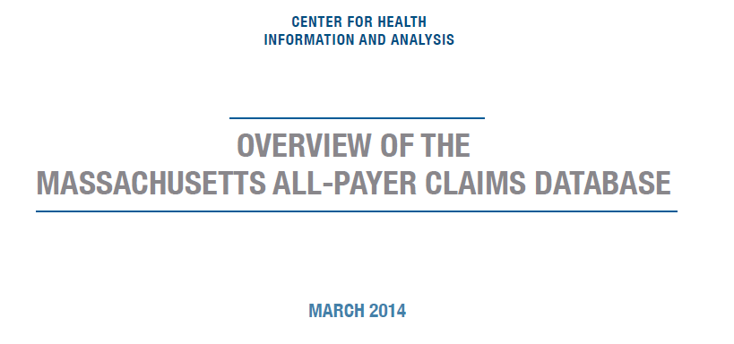
Available at: http://www.mass.gov/chia/
Notes:
I wanted to mention that CHIA has published a white paper on the MA APCD. It is available on our website. Please feel free to take a look!

Slide 11
QUESTIONS?

Slide 12
Next Meetings
Tuesday, May 13th at 2:00 pm
Tuesday, June 10th at 2:00 pm

Slide 13
Questions emailed to APCD Liaisons
Questions emailed to CHIA
(CHIA-APCD@state.ma.us).
Questions on the Data Release and Application emailed to CHIA (apcd.data@state.ma.us)

