Slide 1
Massachusetts All-Payer Claims Database: Technical Assistance Group (TAG)
May 13, 2014

Slide 2
Agenda
ME124/ME125 Update
ME107/ME117 Update
V2 to V3 Profiles
ACA Membership Reporting
QHP Key Data Elements
CHIA/DOI Data Validation
Questions

Slide 3
ME124/ME125
ME124 – Attributed PCP ME125 – Physician Group of Member’s PCP
Adjusted edits to accurately reflect subset of TME OrgIDs
Error Summary Report to report accurate percentages
ME125 Update Needed
Notice to CHIA

Slide 4
Subscriber ID/Member ID
ME107 – Carrier Specific Unique Member ID
ME117 – Carrier Specific Unique Subscriber ID
Expectation that ME117 = ME107 when the subscriber is the member
ME132 – Total Monthly Premium looking at Employment Status (ME060)

Slide 5
V2 to V3 Profiles

Slide 6
Version 3 Compliance
We are looking to have all carriers in full compliance by July with production data through June 2014.

Slide 7
Goals of Membership Reporting
Quarterly report to be shared broadly, including:
Governors office, A & F
CCA Board of Directors
CHIA website
Monitor changes in enrollment due to ACA, including
Enrollment through Exchange and directly through carriers
Insured as well as self-insured

Slide 8
Game Plan
Carriers requested to submit overall commercial membership counts
Through September 2014
After September, data to be sourced from MA APCD provided that plans can populate three data elements:
ME045– Purchased through Exchange or Not
PR004– Qualified Health Plan
ME126- Risk Adjustment Covered Plan (RACP)

Slide 9
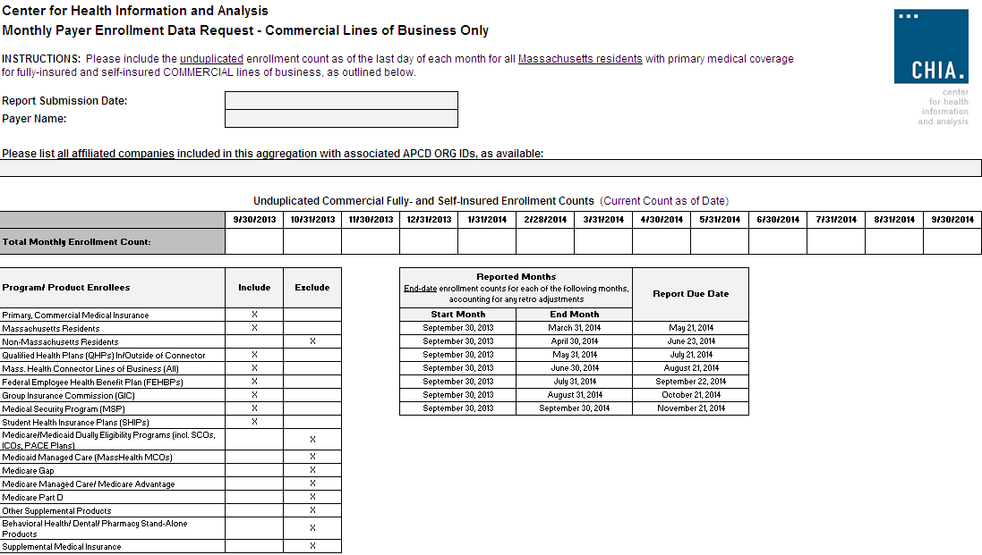

Slide 10
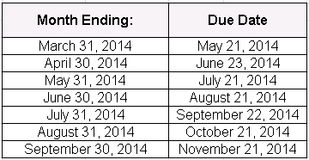
Timeline
n
Note: Retroactivity should be reflected in your submissions. Meaning March membership reported in the June submission may be different than enrollment reported in May.

Slide 11
Submission to CHIA
Spreadsheet submitted monthly
SENDS+ not needed
Aggregate data - no encryption needed
Submit directly to liaison

Slide 12
QHP Key Data Elements in MA APCD
Three fields are needed to determine whether a plan is a Qualified Health Plan, purchased inside/outside the MA Connector:
Product Line of Business (PR004)
Purchased Through MA Exchange Flag (ME045)
Risk Adjustment Covered Plan (ME126)

Slide 13
Key Data Elements – June 2014 Guidelines
Data Element | Level | Threshold
PR004 - Product Line of Business | A0 | 100%
ME045 - Purchased Through MA Exchange Flag | B | 100%
ME126- Risk Adjustment Covered Plan (RACP) | AO | 100%

Slide 14
How CHIA Will Use MA APCD Data Elements to Capture Enrollment On/Off of Exchange
 | ME045 - Purchased Thru Exchange - YES | ME045 - Purchased Thru Exchange – NOT YES
PR004- Product Line - QHP | ME126 (RACP Flag) is 1* | ME126 (RACP Flag) is 1*
PR004- Product Line – NOT QHP | N/A | ME126 (RACP Flag) is 1* or 2
* Will use values of 1 or 3 per Connector. ME126 is used as a QA check for those
involved in Risk Adjustment.

Slide 15
MA APCD Data Validation
Insured lives for carriers reporting to DOI
DOI/CHIA visits scheduled for May-June as part of reconciliation of MA APCD with DOI Quarterly Membership report submissions.

Slide 16
QUESTIONS?

