Slide 1

Massachusetts All-Payer Claims Database:
Technical Assistance Group (TAG)
June 10, 2014

Slide 2
Agenda
ACA Membership Reporting
CHIA/DOI Data Validation
Connector/Risk Adjustment
V2 to V3 Profiles
Compliance
Retaining Copies of Data
Questions

Slide 3
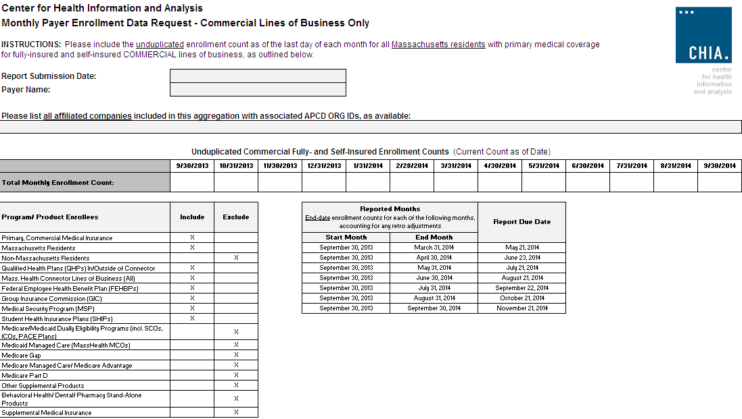

Slide 4
QHP Key Data Elements in MA APCD
Three fields are needed to determine whether a plan is a Qualified Health Plan, purchased inside/outside the MA Connector:
  Product Line of Business (PR004) – (Updated to include QH for Qualified Health Plan)
  Purchased Through MA Exchange Flag (ME045)
  Risk Adjustment Covered Plan (ME126)

Slide 5
CHIA/DOI Data Validation
DOI Quarterly HMO Membership Reports
Compared to MA APCD Submissions
Joint Site Visits by CHIA and DOI
Lessons Learned

Slide 6
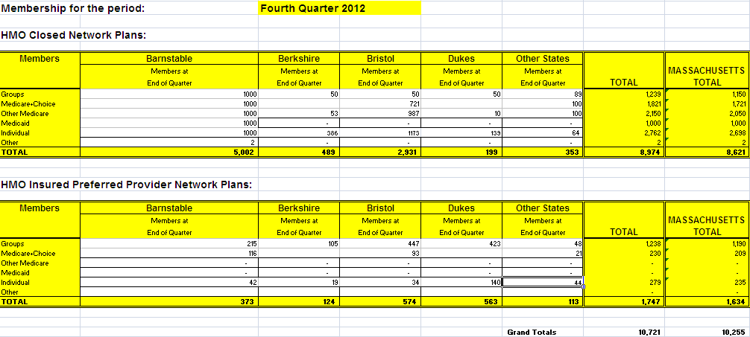
CHIA/DOI Data Validation

Slide 7
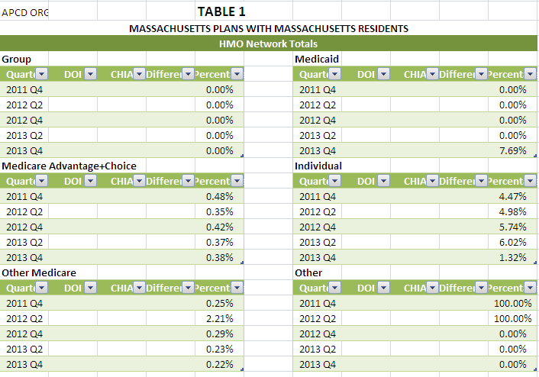
CHIA/DOI Data Validation

Slide 8
CHIA/DOI Data Validation
Lessons Learned:
Report Timing
Bucketing
Membership Missing
NAIC Codes
Situs of Account
End Result:
Better Data! Better Reporting!
Onward Administrative Simplification!

Slide 9
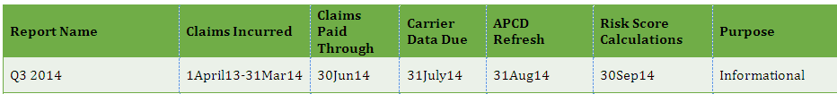
Connector/Risk Adjustment
Next Simulation:

Slide 10
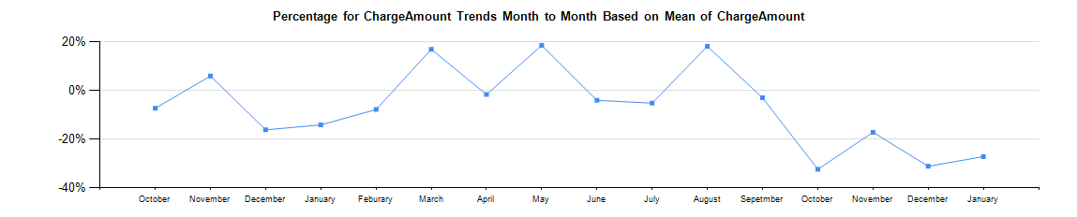
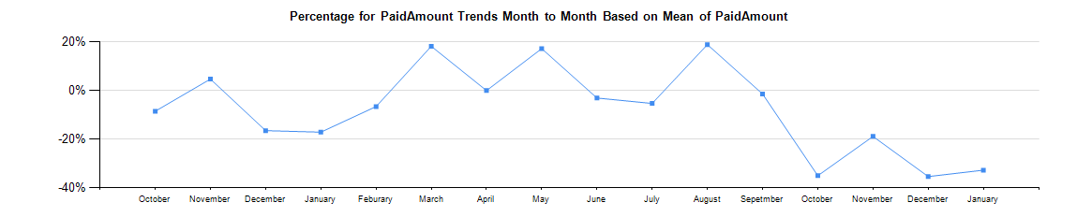
V2 to V3 Profiles

Slide 11
Version 3 Compliance
We are looking to have all carriers in full compliance by July with production data through June 2014.

Slide 12
Retaining Copies of Data
Carriers should maintain copies of the data sent to CHIA

Slide 13
QUESTIONS?

Slide 14
Next Meetings
July 8, 2014 at 2:00 pm
August 12, 2014 at 2:00 pm

