Slide 1
Massachusetts All-Payer Claims Database: Technical Assistance Group (TAG)
July 8, 2014

Slide 2
Agenda
ACA Membership Reporting
NAIC Code (PR017)
Connector/Risk Adjustment
QA Profile Reports
Compliance
Retaining Copies of Data
Questions

Slide 3
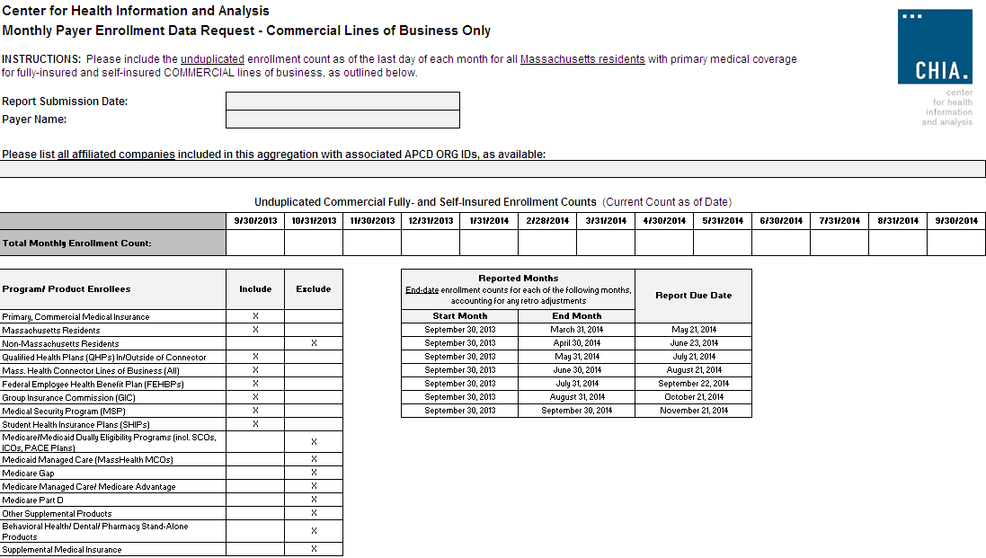

Slide 4
NAIC Code (PR017)
National Association of Insurance Commissioners’ Code NOT the North American Industry Classification System (NAICS)
Will be used by Division of Insurance and the Connector

Slide 5
Connector/Risk Adjustment
Next Simulation:

Slide 6
V2 to V3 Profiles

Slide 7
Additional QA Profile Reports
CHIA is planning to share new profile reports with carriers next month for review before publishing on CHIA’s website. These profiles are based on 2012 incurred data and will be sent to the top submitters based on medical claims volume.

Slide 8
Version 3 Compliance
We are looking to have all carriers in full compliance by July with production data through June 2014.

Slide 9
Retaining Copies of Data
Carriers should maintain copies of the data sent to CHIA

Slide 10
Upcoming Events
End July/Early August – APCD Membership comparison to aggregate monthly reporting to CHIA
August – Profile Reports – will preview on August TAG call and then send to carriers
August/September – Connector Risk Assessment Simulation

Slide 11
QUESTIONS?

Slide 12
Next Meetings
August 12, 2014 at 2:00pm
September 9, 2014 at 2:00pm

