Slide 1

Massachusetts All-Payer Claims Database:
Technical Assistance Group (TAG)
August 12, 2014

Slide 2
Agenda
Compliance
Housekeeping Items
ACA Membership Reporting
Profile Reports
Substance Abuse Denial Study
Questions

Slide 3
Compliance
THANK YOU!

Slide 4
Housekeeping Items
Payer Associations
V2 to V3 Profiles
Risk Adjustment Update
NAIC Codes (PR017)
QHP fields (PR004, ME045, ME126)
Student Health Plans

Slide 5
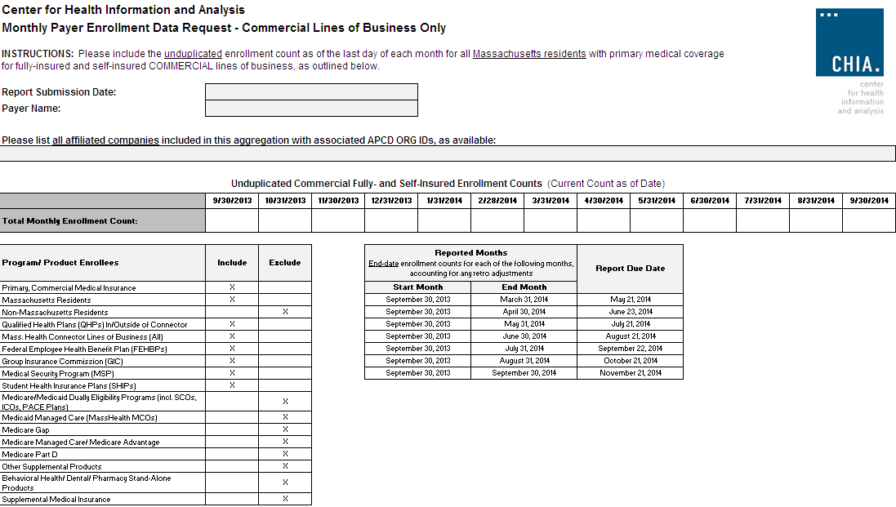

Slide 6
Profile Reports

Slide 7
New Profile Reports
CHIA recently contracted with a vendor to produce profile reports of Release 2.1 data for the following submitters:
(Aetna (select ids), Celticare, CIGNA (select ids), Connecticare, BCBS of MA, BMC HealthNet, Fallon, Harvard Pilgrim Health Care, Health Plans Inc., MassHealth, Neighborhood Health Plan, Network Health, Tufts Health Plan, United (select ids), WellPoint, Inc.)
CHIA intends to post the profiles to its website in September to help APCD users understand the richness of the dataset. The reports do not contain protected health information or cost information.

Slide 8
New Profile Reports
The reports were produced for two file types:
Medical Claims and Member Eligibility.
The reports are based on Release 2.1 data:
2012 incurred claims submitted as of September 2013,
2012 eligibility data submitted as of September 2013.
The profiles have been assembled in EXCEL workbooks with multiple tabs.

Slide 9
New Profile Reports: Valid Values Summary
Variable | Data Element | Number of Records with Missing Values | % Records with Missing Values | Number of Records with Valid Values | % Records with Valid Values | Number of Records with Unrecognized Values | % Records with Unrecognized Values | Carrier Proposed Threshold | APCD Standard Threshold
AccidentIndicator | MC126 | 0 | 0% | 12,568,572 | 100% | 0 | 0% |  | 100%
AdmissionSource | MC021 | 8,323,016 | 66% | 4,244,944 | 34% | 612 | 0% |  | 80%
AdmissionType | MC020 | 8,334,753 | 66% | 4,233,787 | 34% | 32 | 0% |  | 98%
AdmittingDiagnosisCleaned | MC039 | 11,877,835 | 95% | 690,737 | 5% | 0 | 0% |  | 98%
AuthorizationNeeded | MC117 | 0 | 0% | 12,568,572 | 100% | 0 | 0% |  | 100%
CapitatedEncounterFlag | MC081 | 0 | 0% | 12,568,572 | 100% | 0 | 0% |  | 100%
ClaimLineType | MC138 | 0 | 0% | 12,568,572 | 100% | 0 | 0% |  | 90%
ClaimStatus | MC038 | 0 | 0% | 12,568,572 | 100% | 0 | 0% |  | 98%
DenialReason | MC124 | 11,489,238 | 91% | 1,077,227 | 9% | 2,107 | 0% |  | 80%
DeniedFlag | MC123 | 0 | 0% | 12,568,572 | 100% | 0 | 0% |  | 100%
DischargeDiagnosisCleaned | MC136 | 12,568,572 | 100% | 0 | 0% | 0 | 0% |  | 80%

Slide 10
New Profile Reports: Missing Summary
Variable | Data Element | Number of Records with Missing Values | Number of Records with Non-Missing Values | % Records with Missing Values | % Records with Non-Missing Values | Carrier Proposed Threshold | APCD Standard Threshold
PaymentArrangementTypeCleaned | MC113 | 0 | 30,631,112 | 0% | 100% |  | 90%
PlanRenderingProviderIdentifier_Linkage_ID | MC134 | 26 | 30,631,086 | 0% | 100% |  | 100%
PrincipalDiagnosisCleaned | MC041 | 216,430 | 30,414,682 | 1% | 99% |  | 99%
ProcedureCodeCleaned | MC055 | 2,213,420 | 28,417,692 | 7% | 93% |  | 92%
ProcedureCodeType | MC130 | 2,323,372 | 28,307,740 | 8% | 92% |  | 80%
ProcedureModifier1 | MC056 | 10,026,401 | 20,604,711 | 33% | 67% |  | 20%
ProcedureModifier2 | MC057 | 30,334,405 | 296,707 | 99% | 1% |  | 3%
ProcedureModifier3 | MC108 | 30,611,871 | 19,241 | 100% | 0% |  | 0%
ProcedureModifier4 | MC109 | 30,630,412 | 700 | 100% | 0% |  | 0%
ProductIDNumber_Linkage_ID | MC079 | 0 | 30,631,112 | 0% | 100% |  | 100%
ProviderLocation_Linkage_ID | MC135 | 26 | 30,631,086 | 0% | 100% |  | 98%
ReferralIndicator | MC118 | 0 | 30,631,112 | 0% | 100% |  | 100%

Slide 11
New Profile Reports: Frequency Summary
Variable | Data Element | Value | Label | Frequency | Percent | Cumulative Frequency | Cumulative Percent
AccidentIndicator | MC126 | Number_of_Levels |  | 2
AccidentIndicator | MC126 | 2 | No | 11,850,754 | 94% | 11,850,754 | 94%
AccidentIndicator | MC126 | 1 | Yes | 717,818 | 6% | 12,568,572 | 100%
AdmissionSource | MC021 | Number_of_Levels |  | 19
AdmissionSource | MC021 |  |  | 8,323,016 | 66% | 8,323,016 | 66%
AdmissionSource | MC021 | 1 | Non-Health Care Facility Point of Origin | 3,430,863 | 27% | 11,753,879 | 94%
AdmissionSource | MC021 | 2 | Clinic or Physician's Office | 660,725 | 5% | 12,414,604 | 99%
AdmissionSource | MC021 | 9 | Information not Available | 59,271 | 0% | 12,473,875 | 99%
AdmissionSource | MC021 | 4 | Transfer from Hospital | 42,180 | 0% | 12,516,055 | 100%
AdmissionSource | MC021 | 5 | Transfer from a Skilled Nursing Facility (SNF), Intermediate Care Facility (ICF) or Assisted Living Facility (ALF) | 37,475 | 0% | 12,553,530 | 100%
AdmissionSource | MC021 | 6 | Transfer from another Health Care Facility | 7,057 | 0% | 12,560,587 | 100%

Slide 12
New Profile Reports
The liaison for each carrier will send instructions via e-mail for accessing the reports on CHIA’s on-line system in the next week.
If you have questions about the reports or comments you would like CHIA to consider including in the posted reports, please contact your APCD Liaison by September 15, 2014.

Slide 13
Substance Abuse Denial Study
Required by Chapter 258 of the Acts of 2014,
Section 35
“An Act to increase opportunities for long-term substance abuse recovery"

Slide 14
Substance Abuse Denial Study
Report Specifications:
Incurred in CY 2013 and adjudicated thru 6/30/14.
Insured lines of business only.
Carrier is primary insured.
Based on final disposition of claim.
Definition of Substance Abuse will be attached.

Slide 15
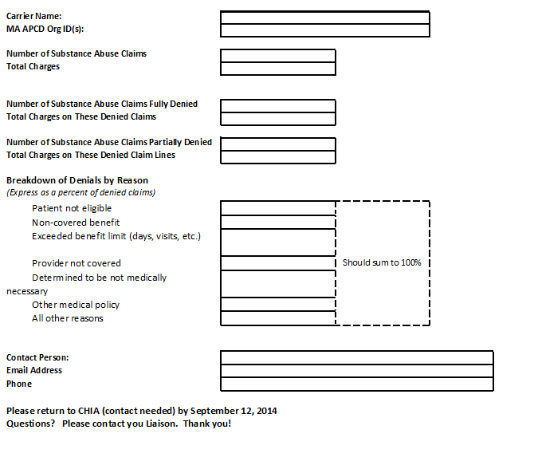

Slide 16
Substance Abuse Study Key Dates
Today, August 12th – Announcement at TAG Webinar
Monday, August 18th – Request Data via Liaisons
Week of August 25th – Follow Up Conference Call
Friday, September 12th – Submission Deadline

Slide 17
Upcoming Events
August – APCD Membership comparison
August/September – Profile Reports
August/September – Connector Risk Assessment Simulation
September/October – Substance Abuse Study

Slide 18
QUESTIONS?

Slide 19
Next Meetings
September 9, 2014 at 2:00pm
October 14, 2014 at 2:00pm

