Slide 1

Massachusetts All-Payer Claims Database:
Technical Assistance Group (TAG)
September 9, 2014

Slide 2
Agenda
Housekeeping Items
Review of Common Issues
Eligibility Guidance
Risk Adjustment – Supplemental Diagnoses
Data Intake/APCD Submission Guide Ver 4.0
Questions

Slide 3
Housekeeping Items
ACA Membership Reporting
Substance Abuse Survey
Profile Reports
Pharmacy Versioning

Slide 4
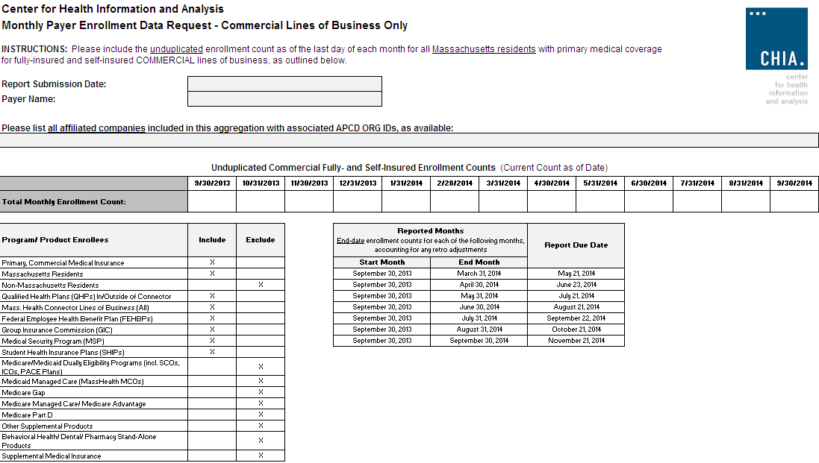
Membership Reporting

Slide 5
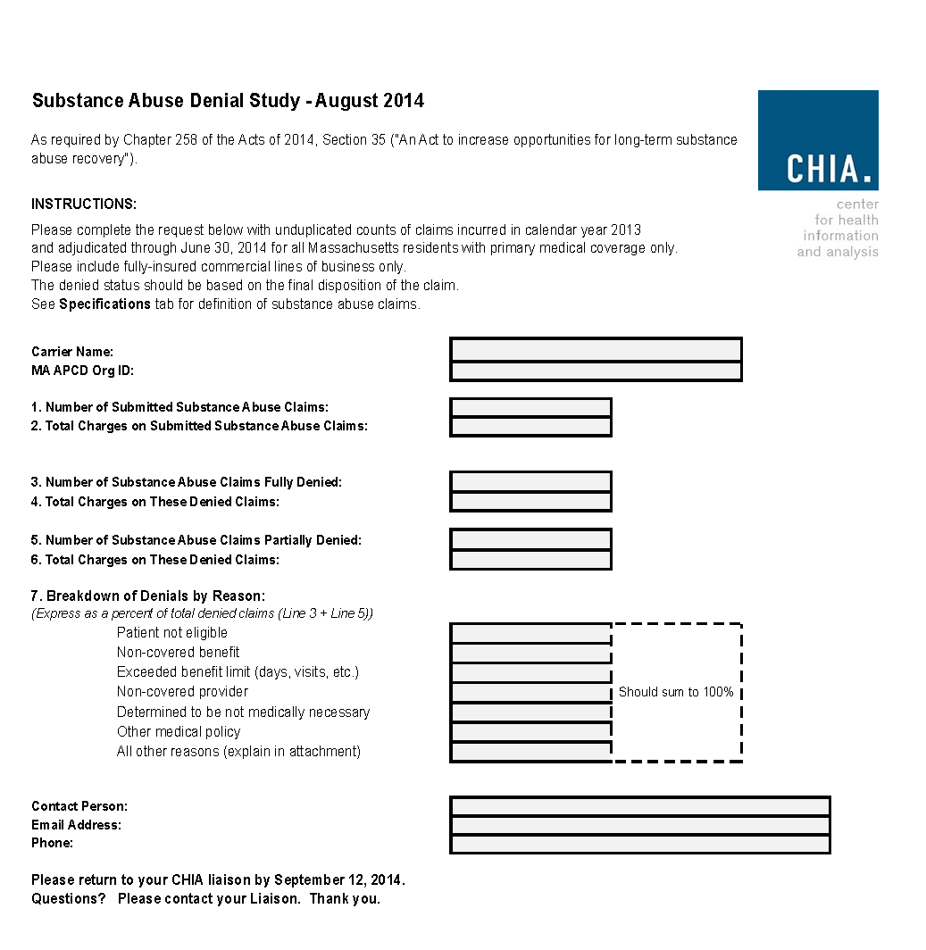
Substance Abuse Denial Study
SUBSTANCE ABUSE SURVEY DUE BY FRIDAY SEPTEMBER 12.

Slide 6
Profile Reports
Carriers: Aetna, Celticare, CIGNA, Connecticare, BCBS of MA, BMC HealthNet, Fallon, Harvard Pilgrim Health Care, Health Plans Inc., MassHealth, Neighborhood Health Plan, Tufts Health Plan, United, WellPoint
The reports were produced for two file types:
Medical Claims and Member Eligibility.
The reports are based on Release 2.1 data:
2012 incurred claims submitted as of September 2013,
2012 eligibility data submitted as of September 2013.
COMMENTS DUE BY MONDAY SEPTEMBER 15.

Slide 7
Review of Common Errors
Fluctuations in number of lines submitted
Review of error rates/edit patterns
Data review

Slide 8
Line Number Fluctuations
Medical Claim Lines Per Month

Slide 9
Line Number Fluctuations
Provider Lines Per Month

Slide 10
Review of Error Rates/Patterns
*WARNING - Actuarial Value indicates no cost sharing by the plan; AV reported as = 0.

Slide 11
Data Review
Count Category | 201212 |  | 2012
 | # By PlanProvID | % By PlanProvId Current / Above | # By PlanProvID | % By PlanProvId Current / Above
12. # of PCs | ######### |  | #########
13. # of PCs matched to providers | - |  | -

Slide 12
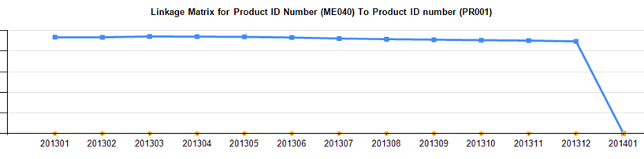
Data Review
Organization Name | Submission Year Month | Number of Products | NAIC Code
Carrier A | 201312 | 10 | XYZ
Carrier A | 201312 | 100 | QRS
Carrier A | 201403 | 11 | XYZ
Carrier A | 201403 | 99 | QRS

Slide 13
Eligibility Guidance
Posted on our website:
“Member Eligibility Elements and When to Add a Line vs. Change a Line”
Current:
Update:

Slide 14
Risk Adjustment
Supplemental Diagnoses

Slide 15
Data Intake/APCD Submission Guide V4.0*
Data Element/Change | Agency Requesting
Make Member PCP ID (ME 046) an A2 category | CHIA
Require Attributed PCP Provider ID (ME124) from all medical carriers, not just TME carriers | CHIA
New Field - Cost Sharing Reduction | Connector
Update Look Up Table for Drug Unit of Measure (PC075) | Carriers
Update Look up Table for State Medicare Code (MC130) | Carriers
Make Purchased Thru MA Exchange (ME045) to an A category | Connector
Advice on how to code SCOs | DOI
Confirm member address fields are residential and not billing | DOI
New field – County for Medicare Advantage Premium | DOI
New field – Situs (where account is based) | DOI
Add additional “spans” for more attributes, notably address | DOI
New fields for MassHealth Enrollment Categories | Several
Make Select NPI fields an A category | CHIA (MDM)
New Field for consideration - Flag for inclusion/exclusion in HEDIS quality measures | Carriers
New flag for consideration – Paid Flag (Yes / No) | Carriers
*List is representative of suggested updates, not comprehensive

Slide 16
Version 4.0 Submission Guide
Tentative Timeframe
September – Finalize business requirements
October – Admin Bulletin
November – Technical Advisory Group
May – targeted implementation (6 months)

Slide 17
Upcoming Events
September – rerun APCD Membership comparison
– publish Profile Reports
– Connector Risk Assessment Simulation
September/October – Substance Abuse Study
October – MA APCD Administrative Bulletin
November – TAG on version 4.0 intake updates
December – MA APCD Data Release

Slide 18
QUESTIONS?

Slide 19
Next Meetings
October 14, 2014 at 2:00pm
November 18, 2014 at 2:00pm*
*NOTE – off a week

