Slide 1
Monthly MA APCD User Workgroup Webinar
September 23, 2014

Slide 2
Agenda
Announcements
  Process for Communicating and Documenting Known Data Issues
  Payer Profiles to be Published on CHIA Website
Common Application Issues / Questions
Questions from Applicants
Questions from Current APCD Users

Slide 3
Announcement – Known Data Issues
Process when a data issue is found:
  Issue is noted in release documentation
    Which OrgID(s) have issues
    Which files / data elements are affected
    Timeframe
    Implications
    Possible workarounds as identified by payer and CHIA
  Affected users are identified and sent an email with the information above
  Presentation at User Group webinar

Slide 4
Known Data Issues
Example – MassHealth Issue:
  Issue: Missing Small Percent of Outpatient claim lines
  OrgID: MassHealth (OrgID #3156)
  Files / Data Elements Affected: Medical Claims File
  Timeframe: Submissions from July 2012 through the Present
  Implications: TBD
  Resolution: TBD

Slide 5
Announcement – Payer Profiles
Profiles of Release 2.1 data published on CHIA’s website!
Reports based on the following:
Top Sixteen submitters
2012 Incurred Medical Claims (MC file)
2012 Member Eligibility (ME file)
Link:
http://www.mass.gov/chia/researcher/hcf-data-resources/apcd/apcd-data-volume-reports.html

Slide 6
Announcement – Payer Profiles
Intended Purposes of Profiles:
Support users by:
  providing applicants insight into the structural quality of the data
  providing benchmarks for data profiling work done by users.
Showcase comprehensiveness and quality of the
MA APCD data.

Slide 7
Announcement – Payer Profiles
Sample Profiles Presented
Link:
http://www.mass.gov/chia/researcher/hcf-data-resources/apcd/apcd-data-volume-reports.html

Slide 8
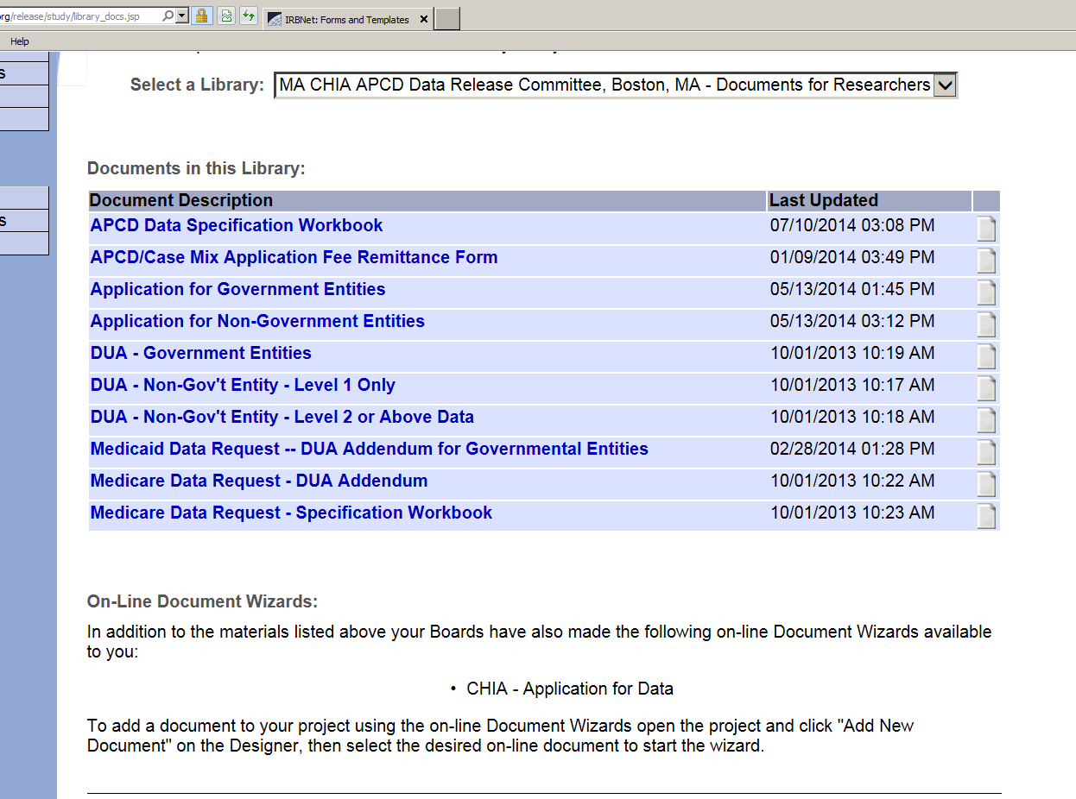
Common Application Issues
Submitting applications on IRBNet:
  Do not fill out the SMART Form – this a work in progress

Slide 9
Common Application Issues
Submitting applications on IRBNet:
  When submitting a revised document, please indicate this in the description.
  IRBNet will likely be implementing a system that saves all versions of submitted application materials, but it is not ready yet.

Slide 10
Questions from Applicants
QUESTION #1
Does my entire system need to be encrypted or only the portion on which CHIA data (APCD/Case Mix) is being stored?
ANSWER
No. Only the portion on which CHIA data is being stored.

Slide 11
Questions from Applicants
QUESTION #2
Is the MA APCD linkable to other datasets?
ANSWER
Yes, all types of linkages are feasible.
Please note, all proposed linkages to other datasets must be approved by CHIA.

Slide 12
Questions from MA APCD Users
QUESTION #1
Will I be able to identify nurse practitioners as plan rendering providers from data element MC134?
Will I have to use this element to link to the element PV002 on the provider file to obtain this information?

Slide 13
Questions from MA APCD Users
QUESTION #1 - Answer
You need to link to PV002 in order to get information from the field PV022 (Taxonomy) which allows you to distinguish Nurse Practitioners.
However, CHIA MA APCD profiling of Provider IDs in Medical Claims suggests that NPs may bill under the Attending Physician’s ID since the Physician IDs exceeds NPs.

Slide 14
Questions from MA APCD Users
QUESTION #2
Having looked through the Provider File, it seems as if, for a given National Provider ID, there may be multiple LinkingProviderID’s.
Is this because the LinkingProviderID is reported uniquely by each carrier, such that the same provider might have n LinkingProviderIDs from n carriers?

Slide 15
Questions from MA APCD Users
QUESTION #2 - Answer
Correct. Each carrier assigns a unique provider identifier (PV002) for every service provider in its system (person or entity).
CHIA is working to create a master provider list that would link physician records across payers.

Slide 16
Questions from MA APCD Users
QUESTION #3
Do you know if it's possible in the Product File to see Medicaid plans within an OrgID?

Slide 17
Questions from MA APCD Users
QUESTION #3 – Answer
Within the Product File, PR004 (Product Line of Business Model), contains the following codes for Medicaid:
MC = Medicaid FFS
MO = Medicaid Managed Care Organization
PC = Medicaid Primary Care Clinician Plan
Also ME003 (Insurance Type Code/Product) has the coding option “MO” for Medicaid Managed Care Organization. It is important to check both the eligibility and product file because there are instances where a carrier might not have indicated the “MO” option in the product file but did do so in the eligibility file and vice versa.

Slide 18
Upcoming Workgroup Topics
Tutorials on E-Codes and DRGs
Lessons learned from CHIA’s analysis of the Member Eligibility file
Additional Suggestions?

Slide 19
Calendar for Applications
No Sept Data Release Meeting
10/9 – Data Privacy Committee Meeting
10/23 – Data Release Committee Meeting
10/28 – User Workgroup Webinar

Slide 20
Questions?
General questions about the APCD:
(CHIA-APCD@state.ma.us)
Questions related to APCD applications: (apcd.data@state.ma.us)
Questions related to Casemix: (casemix.data@state.ma.us)

