Slide 1
Massachusetts All-Payer Claims Database: Technical Assistance Group (TAG)
October 14, 2014

Slide 2
Agenda
Housekeeping Items
Data Intake/APCD Submission Guide Ver 4.0
Risk Adjustment Topics
Questions

Slide 3
Housekeeping Items
Substance Abuse Survey
Profile Reports
Pharmacy Versioning
Mandated Benefit Review

Slide 4
Submission Guide Version 4.0
File Type | Data Element/Change | Agency Requiring | Notes
PR | New field – Situs (where account is based) | DOI | ADDED PR019
PC | Update Look Up Table for Drug Unit of Measure (PC075) | Carriers | ADDED: Mg Milligram MEQ Milliequivalent MM Millmieter UG Microgram UN Unit
ME | Make Member PCP ID (ME 046) an A2 category | CHIA | ADDED*
ME | Require Attributed PCP Provider ID (ME124) from all medical carriers, not just TME carriers | CHIA | ADDED
ME | Make Purchased Thru MA Exchange (ME045) to an A category | Connector | ADDED
ME | Confirm member address fields are residential and not billing | DOI | ADDED Clarifying language

Slide 5
Submission Guide Version 4.0
File Type | Data Element/Change | Agency Requiring | Notes
MC,PC,DC,ME, | Advice on how to code SCOs | DOI | ADDED APCD ID CODE on MC,DC,PC,ME 6 – ICO or SCO
MC,PC,DC | Make Select NPI fields an A category | CHIA (MDM) | ADDED
MC,PC,DC | New flag for consideration – Paid Flag (Yes / No) | Carriers | ADDED
MC | Update Look up Table for State Medicare Code (MC130) | Carriers | ADDED: 7 - CPT Level III Code
MC | Benefit Plan ID on MC | Connector | ADDED
MC | Plan Rendering NPI on MC | CHIA (MDM) | ADDED
MC | Type of Facility for POA Reporting on MC | Carriers | ADDED
MC | Supplemental Diagnoses for Risk Adjustment | Carriers | ADDED

Slide 6
Submission Guide Version 4.0
File Type | Data Element/Change | Agency Requiring | Notes
MC | Adjust inpatient edits from: Required when MC094 = 002 and MC039 is populated” to: “Required when MC094 = 002 and MC036 = 11, 18, 21, 28, 41, 65, 66, 84, 86 or 89 (type of bill indicates an inpatient visit)” | Carriers | ADDED
BP | Benefit Plan Start/End Dates on BP | Connector | ADDED
 | New field – County for Medicare Advantage Premium | DOI | TBD
 | Add additional “spans” for more attributes, notably address | DOI | TBD
 | New fields for MassHealth Enrollment Categories | Several | TBD

Slide 7
Submission Guide Version 4.0
Additional minor updates:
Submit “null” values for selected B and C fields (ex. PV048 EMR Vendor)
Wording/clarifications
Additions of items already in effect (ex. RACP Flag and Billable Member Updates)
Edit/Condition updates from carriers

Slide 8
Submission Guide Version 4.0
FOOD FOR THOUGHT FOR DEVELOPMENT TEAM:
RECOMMENDATION: Version 4 will go into effect on May 1, 2015 and as of that date Version 3 is no longer active. This means all submissions/resubmissions for October 2013 onward must adhere to the version 4 specifications and edits.
ALTERNATIVE: Version 4 would start at a certain submission year month (201504 due in May) and as of that month all months going forward are only acceptable in Version 4 format and edits. Resubmissions of Version 3: 201310 – 201503 would be required to be in Version 3 format and edits.

Slide 9
Version 4.0 Submission Guide Tentative Timeframe
October 14 – Draft Guides Published
October 21 – Special TAG to review guides
October (TBD) – Admin Bulletin
November 18 – Technical Advisory Group
May 2015 – targeted implementation (6 months)

Slide 10
Risk Adjustment
Q3 Simulation Meetings
Supplemental Diagnoses
Important Risk Adjustment Fields
Monthly Member Month Reports

Slide 11
RA Q3 Simulation Meetings
October 24th – Meeting hosted by the Connector
Individual Carrier Meetings:
At Carrier Request
MA APCD Bi-Weekly Schedule

Slide 12
RA Supplemental Diagnoses
Responses to Draft Proposal Due: October 17, 2014
Process:
Must follow all rules for a claim line submission to the MA APCD – all formatting and edits
Utilize the MC080 Payment Reason field:
SUPPADD A supplemental diagnosis has been added SUPPDELETE A supplemental diagnosis has been deleted

Slide 13
RA Fields
Data Element | FIELD | Data Element | FIELD
OrgID |  | Payer Claim Control Number | MC004
Member Gender | ME013 | Line Counter | MC005
Member Date of Birth (for age) | ME014 | Admission/Discharge Dates
Member Zip Code | ME017 | Service Provider Specialty | MC032
Market Category Code | ME030 | Type of Bill | MC036
Last Activity Date | ME056 | Site of Service | MC037
Actuarial Value | ME120 | Claim Status | MC038
Metal Level | ME121 | All Diagnosis fields
Risk Adjustment Covered Plan (RACP) | ME126 | Revenue Code | MC054
Billable Member | ME127 | All Procedure Code fields
Benefit Plan Contract ID | ME128 | Procedure Modifiers
Member Benefit Plan Contract Enrollment Dates | ME129 | Dates of Service
Total Monthly Premium | ME132 | Amount/Dollar fields
CarrierSpecificUniqueMemberID | ME107 | Capitated Encounter Flag | MC081
CarrierSpecificUniqueSubscriberID | ME117 | Paid Date | MC089
 |  | Claim Processed Date | MC110
All Fields in the Benefit Plan Control Total File |  | Denied Flag | MC123
 |  | CarrierSpecificUniqueMemberID | MC137
 |  | Claim Line Type | MC138
 |  | CarrierSpecificUniqueMemberID | MC137
 |  | Claim Line Type | MC138

Slide 14
RA Fields
RACP FLAG – ME126
ME126 = 1 or 3 determines who is in the simulation
ME126 = 1 determines who is in the final calculation
CommCare should always be ME126 = 3
Premium – ME132
Required for next quarterly simulation run

Slide 15
RA Fields
Last Activity Date – ME056
Required to determine last iteration of eligibility as well as timing of changes in premium
Actuarial Value – ME120
Must be accurate
ME120 = 0 will not be included in the Risk Adjustment
Metal Level – ME121
Must be appropriate for Actuarial Value

Slide 16
Member Month Tracking

Slide 17
Member Month Methodology
Data was extracted from the APCD by the following criteria:
 | Data Element | Element Name | Element Constraint
 | ME126 | Risk Adjustment Covered Plan | Equal to 1 or 3
 | ME129 | Member Benefit Plan Contract Enrollment Start Date | NULL or Less Than or Equal To the 15th of the Month
 | ME130 | Member Benefit Plan Contract Enrollment End Date | NULL or Greater Than or Equal To the 15th of the Month
Data was sorted by the following order**:
 | Sort Order | Data Element | Element Name | Sequence
 | 1 | ME001 | OrgID | ASCENDING | Member Months were de-duped on these fields
 | 2 | ME128 | Benefit Plan Contract ID | ASCENDING
 | 3 | ME107 | Carrier Specific Unique Member ID | ASCENDING
 | 4 | ME056 | Last Activity Date | DESCENDING
 | 5 | ME018 | Medical Coverage | ASCENDING
 | 6 | ME028 | Primary Insurance Indicator | ASCENDING
 | 7 | ME029 | Coverage Type | DESCENDING
 | 8 | Derived Element | Member Eligibility ID | DESCENDING
**Duplicate member months on other fields (i.e. Premium) were randomly de-duped based on the sort order

Slide 18
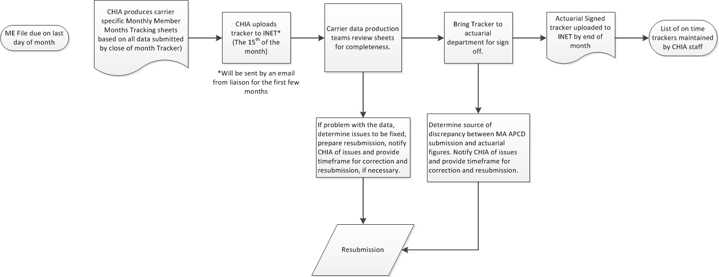
Member Month Validation Workflow

Slide 19
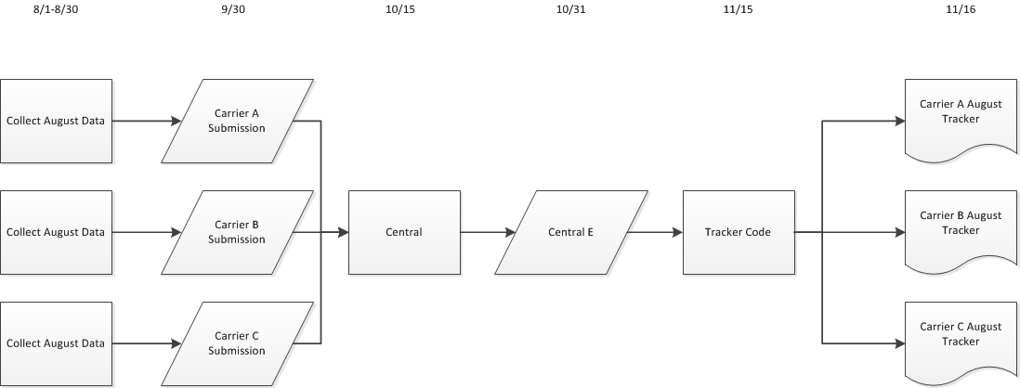
Member Month Validation Workflow (continued)

Slide 20
Upcoming Events
October – Connector RA Simulation Review
October – Substance Abuse Study
October – TAG on MA APCD Version 4 Review
October - MA APCD Version 4 Administrative Bulletin
November – TAG
December – MA APCD Data Release

Slide 21
QUESTIONS?

Slide 22
Next Meetings
November 18, 2014 at 2:00pm*
*NOTE – off a week
December 9, 2014 at 2:00 pm

