Slide 1
Massachusetts All-Payer Claims Database:
Technical Assistance Group (TAG)
April 9, 2013

Slide 2
AGENDA
Administrative Bulletin Published
Variance Update
MA Health Connector Risk Assessment Update
Flag Indicator Fields
Usage of ‘Other’ in non-Flag Fields

Slide 3
ADMINISTRATIVE BULLETIN
TOTAL MEDICAL EXPENSES (TME) UPDATES
HEALTH CONNECTOR RISK ADJUSTMENT PROGRAM UPDATES
ICD-10 UPDATES

Slide 4
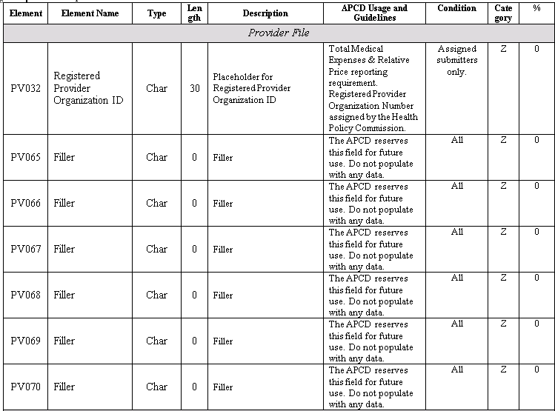
BULLETIN: PV UPDATES

Slide 5
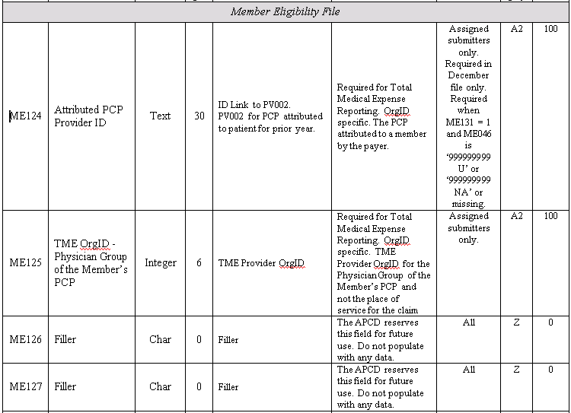
BULLETIN: ME UPDATES

Slide 6
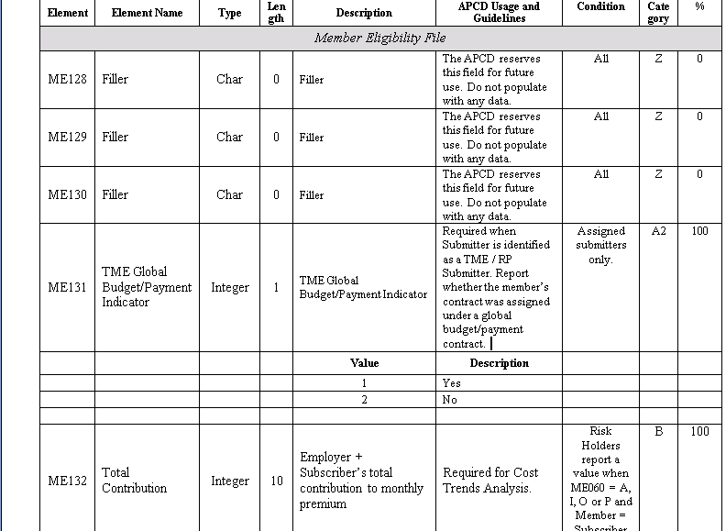
BULLETIN: ME UPDATES cont’d

Slide 7
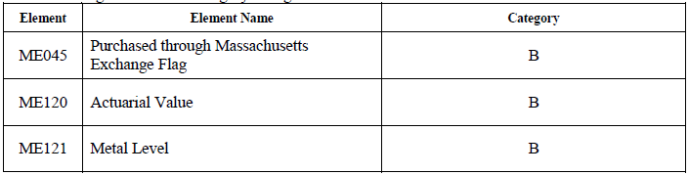
BULLETIN: RISK ADJUSTMENT

Slide 8
BULLETIN UPDATE
The Center is reinstating the requirement that payers submitting claims and encounter data on behalf of an employer group submit claims and encounter data for employees who reside outside of Massachusetts.

Slide 9

BULLETIN UPDATE: ICD-10

Slide 10
VARIANCE UPDATE
VERSION 2.1 CERTIFIED
VERSION 3.0 PENDING

Slide 11
RISK ADJUSTMENT
RISK ASSESSMENT SIMULATION
ADMINISTRATIVE BULLETIN

Slide 12
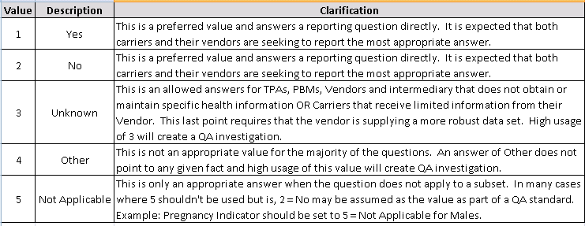
FLAG INDICATOR FIELDS
Expect 100% compliance on Flag Indicator fields
Expect high usage of Unknown/Other/Not Applicable will be explained in the Variance Rationale column

Slide 13
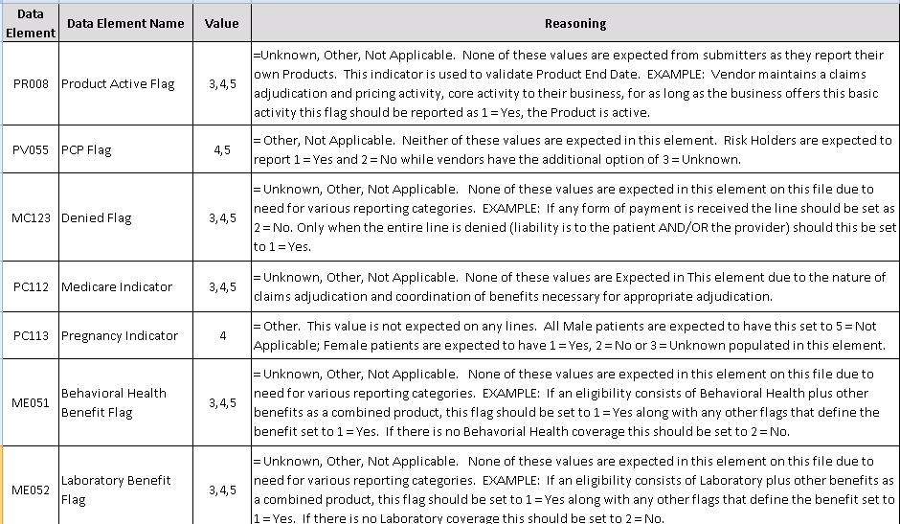
FLAG INDICATOR EXAMPLES

Slide 14
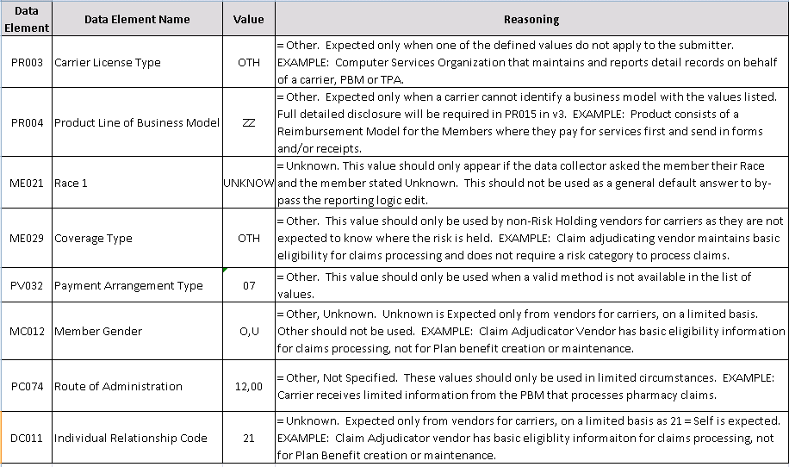
USAGE OF ‘OTHER’ ETC.

Slide 15
WRAP-UP
QUESTIONS?

Slide 16
APCD Version 3.0 Schedule
Production Due
August 2013

Slide 17
QUESTIONS
Questions emailed to APCD Liaisons
Questions emailed to DHCFP
(CHIA-APCD@state.ma.us).
Questions on the Data Release and Application emailed to DHCFP (apcd.data@state.ma.us)

Slide 18
TAG SCHEDULE
MAY 14, 2013 at 2:00PM
JUNE 11, 2013 at 10:00 AM Please note time change

