Slide 1


Slide 2
Massachusetts All-Payer Claims Database:
Technical Assistance Group (TAG)
February 12, 2013

Slide 3
AGENDA
General Updates
Administrative Bulletin
Schedule for Version 3.0 Changes
Variance Process
MA Health Connector Risk Assessment
Volume Reports
TME Update

Slide 4
General Updates
Question and Answer Document Published
TME Document Published
Upcoming TAG webinar changes:
  March 5, 2013 at 2:00
  June 11, 2013 at 10:00

Slide 5
Administrative Bulletin
TME Changes
Tobacco Use Flag (ME119)
ICD Procedure Codes (MC084-MC089)

Slide 6
Schedule
APCD Version 3.0 Schedule Update
Production Due
August 2013

Slide 7
Variance Process
Certify Version 2 by February 28, 2013
Creation of Version 3.0

Slide 8
MA Health Connector Risk Assessment

Slide 9
Volume Reports

Slide 10
TME Update

Slide 11
TME Update
The APCD monthly submissions will not require the reporting of the Non-Claims Payment information (PV065 – PV070) or the Health Status Adjustment Tool information (ME124 – ME130) (see attached).
Two APCD data fields will be re-purposed to allow the collection of:
  Attributed PCP Provider ID (Included when Payment Type is Global and there is no assigned PCP Provider.)
  TME OrgID for the Physician Group of the Member’s PCP on eligibility
A third field will be repurposed – at later date to allow collection of Registered Provider Organization Number that will be assigned by the Health Policy Commission.

Slide 12
TME Update
Implement quarterly TME reporting and collect this data through a new APCD file. The information collected will be based on date of service as is the current TME practice.
Data will be submitted quarterly with year to date cumulative information with a four-month lag. In other words, the second quarter data that ends June 30th will include year to date thru June 30th and will submit to the Center by November 1st. Payers will also need to submit the final TME data for a given calendar year fourteen months after the end of the TME reporting year. For example, the final CY 2013 data will be due March 1, 2015.

Slide 13
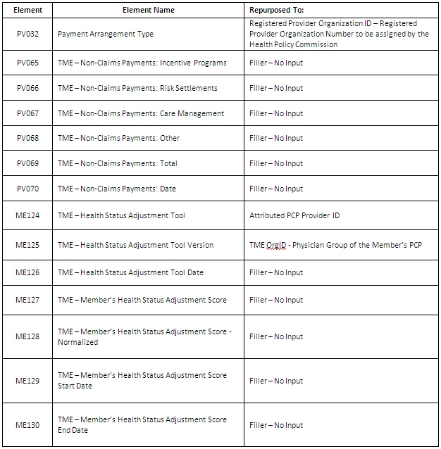

Slide 14
Questions

Slide 15
Administrative Simplification
Connector/Risk Adjustment for ACA
Indicator Purchased thru HIX, Actuarial Value, Tobacco Use
Division of Insurance
NAIC Code
Group Insurance Commission
GIC ID
CHIA for Total Medical Expense, Cost Trends and Relative Pricing
Non Claims Payments, Payment Arrangement Type
Connector and DOI
Monthly Premium, Employer ZIP, Family Size
Connector, DOI and GIC
Market Category Code
Connector, CHIA and DOI
Employer Contribution
All Payer Claims Data Base
Private and Public Payers

Slide 16
Questions
Questions emailed to APCD Liaisons
Questions emailed to DHCFP
(CHIA-APCD@state.ma.us).
Questions on the Data Release and Application emailed to DHCFP (apcd.data@state.ma.us)

