Slide 1
Massachusetts All-Payer Claims Database:
Technical Assistance Group (TAG)
May 14, 2013

Slide 2
AGENDA
Administrative Bulletin 13-04 Published
APCD Version 3.0 Submission Timeline
Submission Guide and Variance Update
Testing Update
Field Highlights of the Month

Slide 3
ADMINISTRATIVE BULLETIN
HEALTH CONNECTOR RISK ADJUSTMENT PROGRAM UPDATES
  New fields on Member Eligibility
  New file type
EFFECTIVE NOVEMBER 2013 FOR SUBMISSIONS OF OCTOBER DATA

Slide 4
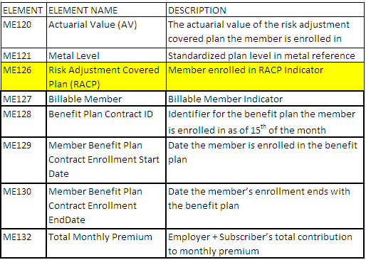
BULLETIN: ME UPDATES

Slide 5
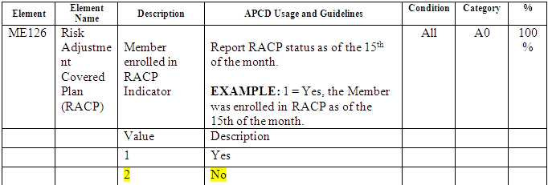
BULLETIN: ME UPDATES
Plans not involved in Risk Adjustment will code ME126 = 2.
ME120, ME121, ME127 – ME130 require no input when ME126 = 2.

Slide 6
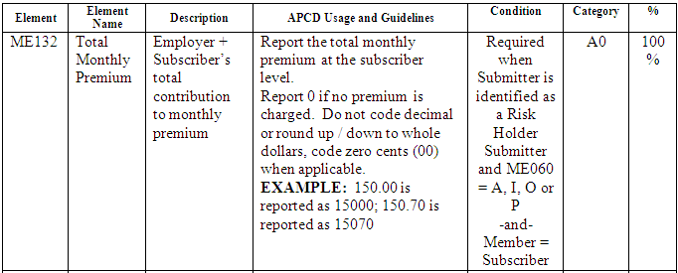
BULLETIN: ME UPDATES

Slide 7
BULLETIN: BENEFIT PLAN CONTROL TOTAL FILE
REQUIRED FOR RISK ADJUSTMENT PROGRAM PLANS ONLY
EFFECTIVE NOVEMBER 2013 FOR SUBMISSIONS OF OCTOBER DATA

Slide 8
VERSION 3.0 SUBMISSION TIMELINE
PRODUCTION DATA NOW DUE NOVEMBER 2013 FOR OCTOBER 2013 DATA
THIS WILL ALLOW:
  ADDITIONAL TIME FOR UPDATES
  ADDITIONAL TIME FOR TESTING
  DECREASE NEED FOR VARIANCES
  DECREASE BURDEN ON PAYERS REQUESTED TO MEET OTHER DEADLINES AS WELL

Slide 9
UPDATES
SUBMISSION GUIDE UPDATE
VARIANCE FORM UPDATE

Slide 10
TESTING UPDATE
TESTING PROCESS
FORMAT TESTING ONLY
FULL EDIT TESTING
Notes:
Testing Process: We are currently running format testing for carriers. We will be sending out a document

Slide 11
FIELD HIGHLIGHTS
Product File requirements
Specific Field Requirements
  Delegated Benefit OrgID
  Risk Type
QA Specific Fields
  Insured Group or Policy Number (DC/MC/ME/PC006)
  Patient Control Number
  Payer Claim Control Number (DC/MC/PC004)

Slide 12
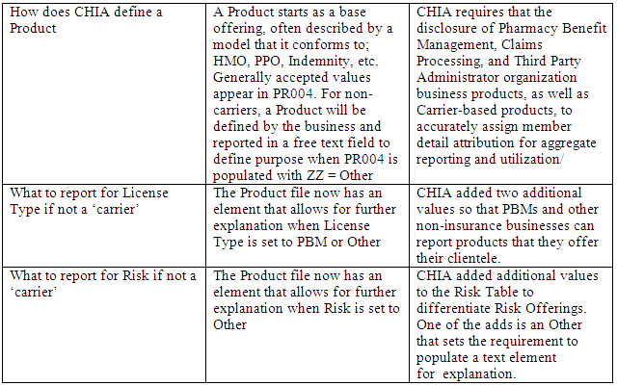
PRODUCT FILE
PRODUCT FILE IS REQUIRED FROM TPA/PBM/DBAs

Slide 13
DELEGATED BENEFIT ORGID
DELEGATED BENEFIT ORGID: MC100, PC072, DC025
REQUIRED FROM BOTH THE RISK HOLDER AND THE TPA/PBM/DBA
USED FOR LINKAGE TO ENABLE COMPLETE CLAIM ANALYSIS

Slide 14
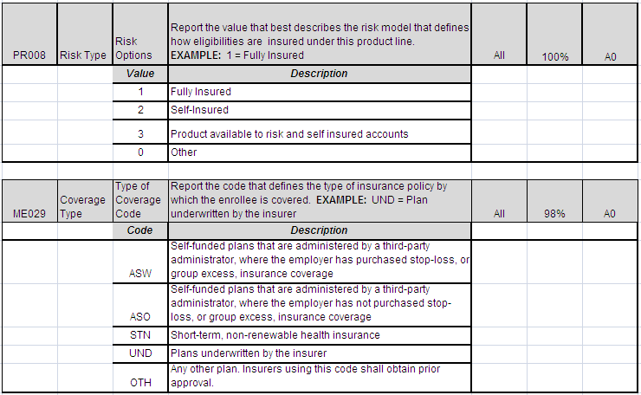
RISK TYPE

Slide 15
QA SPECIFIC FIELDS
ELEMENT | DATA ELEMENT NAME | LENGTH
DC006 | Insured Group or Policy Number | 30
MC006 | Insured Group or Policy Number | 30
ME006 | Insured Group or Policy Number | 30
PC006 | Insured Group or Policy Number | 30
MC068 | Patient Control Number | 20
DC004 | Payer Claim Control Number | 35
MC004 | Payer Claim Control Number | 35
PC004 | Payer Claim Control Number | 35

Slide 16
WRAP-UP
QUESTIONS?

Slide 17
TAG SCHEDULE
JUNE 11, 2013 at 10:00 AM Please note time change
JULY 9, 2013 at 2:00 PM

Slide 18
APCD Version 3.0 Schedule
Production Due
November 2013

Slide 19
QUESTIONS
Questions emailed to APCD Liaisons
Questions emailed to DHCFP
(CHIA-APCD@state.ma.us).
Questions on the Data Release and Application emailed to DHCFP (apcd.data@state.ma.us)

