Slide 1
Massachusetts All-Payer Claims Database:
Technical Assistance Group (TAG)
July 9, 2013

Slide 2
AGENDA
General Update
Testing Version 3.0
Data Release
Data Intake Governance Committee
Highlight of the Month – Preliminary ETG Results

Slide 3
General Update
Benefit Plan Control Total Submission Guide Published
Reminder: Out-of-State Members of MA Employer Groups
Reminder: Versioning and Unique Member ID Edits

Slide 4
Out-of-State Members of MA Employer Groups
Non-Massachusetts Resident
Under Administrative Bulletin 13-02, the Center is reinstating the requirement that payers submitting claims and encounter data on behalf of an employer group submit claims and encounter data for employees who reside outside of Massachusetts.
CHIA requires data submission for employees that are based in Massachusetts whether the employer is based in MA or the employer has a site in Massachusetts that employs individuals. This requirement is for all payers that are licensed by the MA Division of Insurance, are involved in the MA Health Connector’s Risk Adjustment Program, or are required by contract with the Group Insurance Commission to submit paid claims and encounter data for all Massachusetts residents, and all members of a Massachusetts employer group including those who reside outside of Massachusetts.

Slide 5
Versioning Edits
Line Failures
Fail Line when DC005A (Version) = 0 and DC059 (Claim Line Type) = V, R, B, or A
Edit Language: Claim Line Type (DC059) must be O when Version (DC005A) is 0.
Fail Line when MC005A (Version) = 0 and MC094 (Claim Line Type) = V, R, B, or A
Edit Language: Claim Line Type (MC094) must be O when Version (DC005A) is 0.
Fail Line when PC005A (Version) = 0 and PC110 (Claim Line Type) = V, R, B or A
Edit Language: Claim Line Type (PC110) must be O when Version (DC005A) is 0.
Fail Line when DC060 (Former Claim Number) is populated and DC005A (Version) = 0
Edit Language: Former Claim Number (DC060) must be blank when Version (DC005A) is 0.
Fail Line when MC139 (Former Claim Number) is populated and MC005A (Version) = 0
Edit Language: Former Claim Number (MC139) must be blank when Version (DC005A) is 0.
Fail Line when PC111 (Former Claim Number) is populated and PC005A (Version) = 0
Edit Language: Former Claim Number (PC111) must be blank when Version (DC005A) is 0.

Slide 6
Versioning Edits cont’d
Line Failures
Fail Line when DC031 (Claim Status) = 22 (Reversal of Payment) and DC059 (Claim Line Type) = O, R or A
Edit Language: A reversal claim cannot be listed as an original. (Review DC031 DC059)
Fail Line when MC038 (Claim Status) = 22 (Reversal of Payment) and MC094 (Claim Line Type) = O, R or A
Edit Language: A reversal claim cannot be listed as an original. (Review MC038 MC094)
Fail Line when PC025 (Claim Status) = 22 (Reversal of Payment) and PC110 (Claim Line Type) = O, R or A
Edit Language: A reversal claim cannot be listed as an original. (Review PC025 PC110)
Fail Line when MC123 (Denied Flag) = 1 and MC124 (Denial Reason) is null
Edit Language: Claim Denial reason (MC124) is missing and Denied Flag (MC123) = 1
Fail Line when MC123 (Denied Flag) = 2 and MC124 (Denial Reason) is populated
Edit Language: Claim Denial reason (MC124) is present and Denied Flag (MC123) = 2

Slide 7
Versioning Edits cont’d
File Failures
Fail File when 100% of DC059 (Claim Line Type) = V and/or B
Edit Language: File contains only Void or Back Out claims. (DC059 = V or B)
Fail File when 100% of MC094 (Claim Line Type) = V and/or B
Edit Language: File contains only Void or Back Out claims. (MC094 = V or B)
Fail File when 100% of PC110 (Claim Line Type) = V and/or B
Edit Language: File contains only Void or Back Out claims. (PC110 = V or B)
Fail File when 100% of MC123 (Denied Flag) = 1
Edit Language: File contains only denied claims. (MC123 = 1)

Slide 8
Versioning Edits cont’d
File Warnings
Warning (Level Z) when 100% of DC059 (Claim Line Type) = R and/or A
Edit Language: File contains only replacement/amended claims. (DC059 = R or A)
Warning (Level Z) when 100% of MC094 (Claim Line Type) = R and/or A
Edit Language: File contains only replacement/amended claims. (MC094 = R or A)
Warning (Level Z) when 100% of PC110 (Claim Line Type) = R and/or A
Edit Language: File contains only replacement/amended claims. (PC110 = R or A)

Slide 9
MemberID Edits
The CarrierSpecificUniqueMemberID should be distinct for a certain percentage.
The Member Last Name should be consistent across the same CarrierSpecificUniqueMemberID.
The Member First Name should be consistent across the same CarrierSpecificUniqueMemberID.
The Member Identification Code (SSN) should be consistent across the same CarrierSpecificUniqueMemberID.
The Member Date of Birth should be consistent across the same CarrierSpecificUniqueMemberID.

Slide 10
TESTING VERSION 3.0
TESTING PROCESS
FORMAT TESTING
EDIT TESTING
  Category A Edits
  Category B and C Edits
VARIANCE TESTING

Slide 11
APCD DATA RELEASE
2009 – 2011 Data Release on Schedule
  Based on Dates of Service
CHIA Website Updates
  Release Notes
  Application
  Data Element Workbook
  Data Use Agreement
  Documentation
  Fee Schedule
  Release Regulations

Slide 12
APCD: DATA EVOLUTION
INTAKE
2010 – 2012
2013 – V. 3.0
STRUCTURAL
QUALITY
2012 - 2013
PROFILE REPORTS
DATA DICTIONARY
VALIDATION
2013 - 2014
TOTAL MEDICAL EXPENSES
FILE LEVEL REVIEW
FIELD EDITS
THRESHOLDS/VARIANCES
VOLUME REPORTS
TAGS/LIAISON PARTNERSHIPS
QA FIELD REVIEW BY YEAR
QA CROSS FILE REVIEW
MA HEALTH CONNECTOR
DIVISION OF INSURANCE
HEALTH POLICY COMMISSION
GROUP INSURANCE COMMISSION

Slide 13
APCD Data Intake Governance Committee
Advance the goal of administrative simplification
Provide a forum to discuss possible future data needs and monitor data quality
Give key APCD users a role in APCD data governance

Slide 14
APCD Data Intake Governance Committee Responsibility
Field requests for new/modified data elements
Seek consensus on definitions of data elements common across state agencies
Review drafts of Administrative Bulletins and Data Submission Guidelines
Receive periodic reports on compliance and data validation, as well as APCD operational status and future plans
Review variance and exemption requests from payers and recommend approval/disapproval to CHIA staff

Slide 15
PRELIMINARY ETG RESULTS
From work with The Lewin Group, the following slides contain the preliminary ETG results for the APCD data by payer
The results were generated using the three year study period from July 1, 2009 – June 30, 2011
The results are reported for complete episodes with a clean beginning period and clean end period
Outlier episodes have been excluded from the analysis
Missing some eligibility spans thus preliminary

Slide 16
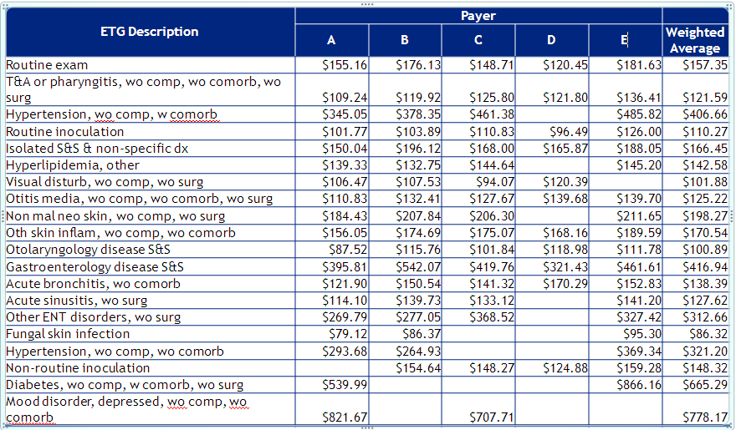
TOP 20 ETGs
Average Cost by Payer - Preliminary

Slide 17
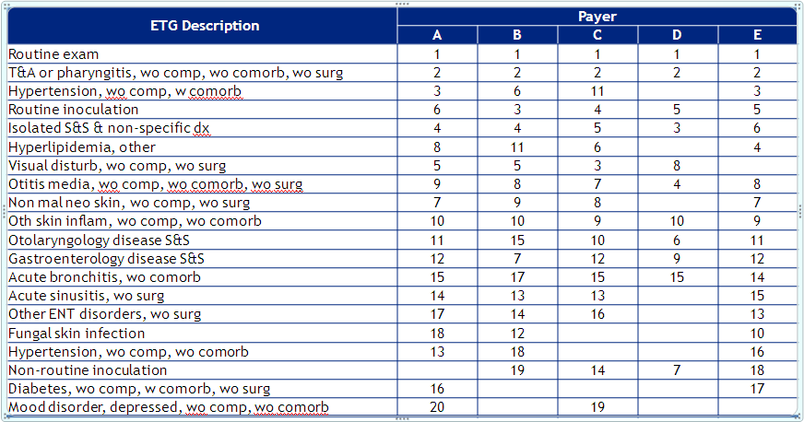
TOP 20 ETGs
Comparative Rank by Payer – Preliminary

Slide 18
WRAP-UP
QUESTIONS?

Slide 19
TAG SCHEDULE
AUGUST 13 at 2:00 PM
SEPTEMBER 10 at 10:00 AM

Slide 20
QUESTIONS
Questions emailed to APCD Liaisons
Questions emailed to DHCFP
(CHIA-APCD@state.ma.us).
Questions on the Data Release and Application emailed to DHCFP (apcd.data@state.ma.us)

