Slide 1
Massachusetts All-Payer Claims Database:
Technical Assistance Group (TAG)
August 13, 2013

Slide 2
AGENDA
Staff Update
Testing Version 3.0
Data Intake Governance Committee
Highlight of the Month – Health Policy Commission Cost Trends Project

Slide 3
Staff
Updates

Slide 4
TESTING VERSION 3.0
TESTING PROCESS
FORMAT TESTING
EDIT TESTING
  Category A Edits
  Category B and C Edits
VARIANCE Reporting

Slide 5
APCD
Data Intake
Governance Committee

Slide 6
APCD Data Intake Governance Committee
Advance the goal of administrative simplification
Provide a forum to discuss possible future data needs and monitor data quality
Give key APCD users a role in APCD data governance

Slide 7
APCD Data Intake Governance Committee Participants
  MA Health Connector
  Department of Public Health
  Division of Insurance
  Group Insurance Commission
  Health Policy Commission
  State Auditor
  Administration and Finance
  CHIA – Health Finance and Analysis
  CHIA – Health System Performance

Slide 8
APCD Data Intake Governance Committee Responsibility
Field requests for new/modified data elements
Field requests on data resubmissions for prior years
Seek consensus on definitions of data elements common across state agencies
Review drafts of Administrative Bulletins and Data Submission Guidelines
Receive periodic reports on compliance and data validation
Review variance and exemption requests from payers and recommend approval/disapproval to CHIA staff

Slide 9
APCD Data Intake Governance
Data Intake: New fields/edits
Data Compliance
Data Validation

Slide 10
Data Validation – Multi-prong Approach
Today
Jan 14
Jun 14
Connector
Risk Adjustment
Extracts for
Model
Development
Dry Run
Begin
Operations
Simulation
Data Validation
ACA Level II
GIC
Data Warehouse
Replacement
ISA
Signed
GIC Data
Begins to Flow
Data Validation
-Two Phases
HPC
Cost Trend
Data Validation
Initial Report
Consulting Contract: Lewin Group
CHIA
Dollar Fields Validation
Data Validation

Slide 11
Highlight of the Month:
Health Policy Commission
Cost Trends

Slide 12
HIGHLIGHT: HPC COST TRENDS
APCD: DATA EVOLUTION
INTAKE
2010 – 2012
2013 – V. 3.0
STRUCTURAL
QUALITY
2012 - 2013
PROFILE REPORTS
DATA DICTIONARY
VALIDATION
2013 - 2014
TOTAL MEDICAL EXPENSES
FILE LEVEL REVIEW
FIELD EDITS
THRESHOLDS/VARIANCES
VOLUME REPORTS
TAGS/LIAISON PARTNERSHIPS
QA FIELD REVIEW BY YEAR
QA CROSS FILE REVIEW
MA HEALTH CONNECTOR
DIVISION OF INSURANCE
HEALTH POLICY COMMISSION
GROUP INSURANCE COMMISSION

Slide 13
HIGHLIGHT: HPC COST TRENDS
Partnership
HPC, CHIA, Lewin Group
Kick-Off Meeting 8/6/13
Timeline
APCD Data Evaluation – Sept 2013
Medical Cost Trends & Utilization – Dec 2013
Outcome
Discussions with payers on findings
Final Report and Analytics

Slide 14
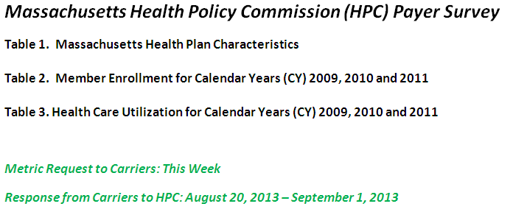
HIGHLIGHT: HPC COST TRENDS
DATA VALIDATION

Slide 15
Administrative Simplification At Work
Selected Data Elements in the APCD
Connector/Risk Adjustment for ACA
Indicator Purchased thru HIX, Actuarial Value, Tobacco Use
Division of Insurance
NAIC Code
Health Policy Commission
Total Medical Expense
Group Insurance Commission
GIC ID
CHIA for Total Medical Expense, Cost Trends
Non Claims Payments, Payment Arrangement Type
Connector and DOI
Monthly Premium, Employer ZIP, Family Size
Connector, DOI and GIC
Market Category Code
Connector, CHIA and DOI
Employer Contribution
All Payer Claims Data Base
Private and Public Payers
18

Slide 16
WRAP-UP
QUESTIONS?

Slide 17
TAG SCHEDULE
SEPTEMBER 10 at 10:00 AM
OCTOBER 8 at 2:00 PM

Slide 18
QUESTIONS
Questions emailed to APCD Liaisons
Questions emailed to CHIA
(CHIA-APCD@state.ma.us).
Questions on the Data Release and Application emailed to CHIA (apcd.data@state.ma.us)

