Slide 1
Massachusetts All-Payer Claims Database: Technical Assistance Group (TAG) September 10, 2013

Slide 2
AGENDA
TME Update
Edit Update Review
Testing Version 3.0
Data Validation Projects
Highlight of the Month – Member Eligibility Elements: When to Add a Line vs. Change a Line

Slide 3
TME UPDATE: ME125 & PV031
In accordance with the TME current submission standards, the APCD will also allow the usage of the generic codes 999996 and 999997 under the following circumstances:
Data must be reported in aggregate for all practices in which the Local Practice Group’s member months are below 36,000 and the practice has no parent Physicians’ Group. This group is to be identified as “Groups below minimum threshold” with an ORGID of 999996.
For Local Practice Groups below the 36,000 member month threshold that are part of a larger Physicians’ Group, payers will report the data on a separate line within the parent group data section (“Other [name of physician group] Aggregate Data”) using an ORGID of 999997.

Slide 4
TME UPDATE: ME125 & PV031cont’d
Phase out usage of 999997 by April 2014
Utilize the orgid of the Parent Physician Group
Example: Local Practice Group is part of Beth Israel Deaconess or Steward
Allows linkage of these providers to their parent physician groups

Slide 5
TME UPDATE: ME125 cont’d

Slide 6
EDIT UPDATE REVIEW
Versioning Edits
Member Eligibility Edits
Flag Indicator Edits
Delegated Benefit Administrator Orgid Edits

Slide 7
EDIT REVIEW: VERSIONING JULY 2013 TAG
Line Failures
Fail Line when DC005A (Version) = 0 and DC059 (Claim Line Type) = V, R, B, or A
Edit Language: Claim Line Type (DC059) must be O when Version (DC005A) is 0.
Fail Line when MC005A (Version) = 0 and MC094 (Claim Line Type) = V, R, B, or A
Edit Language: Claim Line Type (MC094) must be O when Version (DC005A) is 0.
Fail Line when PC005A (Version) = 0 and PC110 (Claim Line Type) = V, R, B or A
Edit Language: Claim Line Type (PC110) must be O when Version (DC005A) is 0.
Fail Line when DC060 (Former Claim Number) is populated and DC005A (Version) = 0
Edit Language: Former Claim Number (DC060) must be blank when Version (DC005A) is 0.
Fail Line when MC139 (Former Claim Number) is populated and MC005A (Version) = 0
Edit Language: Former Claim Number (MC139) must be blank when Version (DC005A) is 0.
Fail Line when PC111 (Former Claim Number) is populated and PC005A (Version) = 0
Edit Language: Former Claim Number (PC111) must be blank when Version (DC005A) is 0.

Slide 8
EDIT REVIEW: ELIGIBLITY AUGUST 2012 TAG
The Member Last Name should be consistent across the same CarrierSpecificUniqueMemberID.
The Member First Name should be consistent across the same CarrierSpecificUniqueMemberID.
The Member Identification Code (SSN) should be consistent across the same CarrierSpecificUniqueMemberID.
The Member Date of Birth should be consistent across the same CarrierSpecificUniqueMemberID.

Slide 9
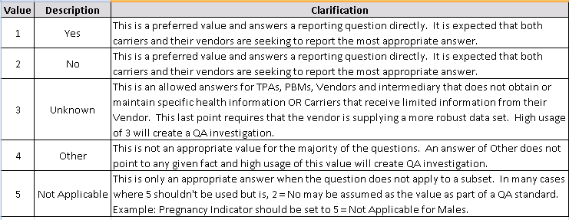
EDIT REVIEW:FLAG INDICATOR APRIL 2013 TAG
Expect 100% compliance on Flag Indicator fields
Expect high usage of Unknown/Other/Not Applicable will be explained in the Variance Rationale column

Slide 10
EDIT REVIEW: DELEGATED BENEFIT ADMINSTRATOR
Delegated Benefit Administrator Organization ID is a CHIA defined and maintained ID for linking across submitters
Risk holders report the OrgID of the DBA here. DBAs report the OrgID of the insurance carrier here.

Slide 11
EDIT REVIEW: OTHER
TME Fields
GIC Fields
DOI Fields
Connector Fields

Slide 12
TESTING VERSION 3.0
TESTING PROCESS
FORMAT TESTING
EDIT TESTING
Category A Edits
Category B and C Edits
VARIANCE Reporting

Slide 13
DATA VALIDATION PROJECTS
Data Intake: New fields/edits
Data Compliance
Data Validation

Slide 14
DATA VALIDATION PROJECTS
Versioning of highest claim line
Linkage between file types
Health Policy Commission
The Connector
Warning Edit Messages

Slide 15
Data Validation – Multi-prong Approach
Today
Jan 14
Jun 14
Connector Risk Adjustment
Extracts for Model Development
Dry Run
Begin Operations
Simulation
Data Validation
ACA Level II
GIC Data Warehouse Replacement
ISA Signed
GIC Data
Begins to Flow
Data Validation -Two Phases
HPC Cost Trend
Data Validation
Initial Report
Consulting Contract: Lewin Group
CHIA Dollar Fields Validation
Data Validation

Slide 16
HIGHLIGHT OF THE MONTH
Member Eligibility Elements:
When to Add a Line
vs.
Change a Line

Slide 17
MEMBER ELIGIBILITY ELEMENTS
Add/New Line
Last Activity Date (ME056)
29 Elements: Benefit Changes
Update/Change Line
Last Activity Date (ME056)
89 Elements:
Attribute Changes

Slide 18
HIGHLIGHT: ELIGIBILITY
Update/Change Eligibility Line
Add/New Eligibility Line
89 and growing
29 and decreasing

Slide 19
HIGHLIGHT: ELIGIBILITY

Slide 20
WRAP-UP
QUESTIONS?

Slide 21
TAG SCHEDULE
OCTOBER 8 at 2:00 PM
NOVEMBER 12 at 2:00 PM

Slide 22
QUESTIONS
Questions emailed to APCD Liaisons
Questions emailed to CHIA
(CHIA-APCD@state.ma.us).
Questions on the Data Release and Application emailed to CHIA (apcd.data@state.ma.us)

