Slide 1
Monthly MA APCD / Case Mix User Workgroup Webinar
October 28, 2014

Slide 2
Agenda
Announcements
Common Application Issues / Questions
Presentation on DRGs
Presentation on E-Codes
Questions from Current APCD Users

Slide 3
Announcement – APCD Webcast
NEHI will convene national experts and thought leaders to explore the opportunities, challenges and lessons learned in accessing and leveraging APCDs to advance health services research.
The discussion will highlight existing models, the opportunities and challenges for expanded data access and use, and the potential for these systems to evolve over time.
Register Here: http://www.nehi.net/events/59-all-payer-claims-databases-unlocking-the-potential/view

Slide 4
Announcement – APCD Symposium
CHIA is in the preliminary stages of planning a research symposium featuring APCD research
Please contact Adam Tapply [adam.tapply@state.ma.us] if you are interested in getting involved

Slide 5
Common Application Questions
Question:
When can I apply for 2013 APCD data?
Answer:
Release 3.0 application materials are expected to be ready in December 2014
Will be announced at this workgroup and via eblast
[NOTE: 2013 Case Mix data is available now]

Slide 6
Reminders Re: Application Revisions
Please title revised documents in the following format “Name of Revised Document _ Date” (i.e. “Revised Application Form 10.24.14)
If application form is revised, it must be re-signed with the date of the revision
Please bold or highlight changes in application form and data spec workbook
Please send an IRBNet message or “lock your package” once you are finished with revisions

Slide 7
What DRG versions available in
CHIA Inpatient Case Mix Data?

Slide 8
Review: Definition of DRG Diagnosis Related Group
A classification system that groups patients according to diagnosis, type of treatment, age, and other relevant criteria. Under the prospective payment system, hospitals are paid a set fee for treating patients in a single DRG category, regardless of the actual cost of care for the individual. Source: CMS http://www.cms.gov/apps/glossary/default.asp

Slide 9
Over the Past 30 years Multiple Versions of DRGs have been Created and Refined
The Three Most Commonly Used DRGs Decade (2004-2013) in HDD
All Patients Diagnosis Related Groups AP-DRG
All Patients Refined Diagnosis Related Groups APR-DRG
Medicare (CMS) Diagnosis Related Groups CMS-DRG

Slide 10
13 Year (2001-2013) History of Diagnosis Related Group (DRG) Versions in Massachusetts Inpatient Hospital Discharge Data (HDD)
HDD Fiscal Year | AP-DRG Version 12 | AP-DRG Version 14.1 | AP-DRG Version 18 | AP-DRG Version 21 | AP-DRG Version 25.1 | APR-DRG Version 15 | APR-DRG Version 20 | APR-DRG Version 26.1 | APR-DRG Version 30 | VHAF- DRG Version 24 | VHAF-DRG Version 25 | CMS-DRG Version 26 | CMS-DRG Version 27 | CMS-DRG Version 28 | CMS-DRG Version 29 | CMS-DRG Version 30
2013 |  |  |  | X | X |  | X | X | X |  |  |  |  |  |  | X
2012 |  |  |  | X | X |  | X | X | X |  |  |  |  |  | X
2011 |  |  |  | X | X |  | X | X | X |  |  |  |  | X
2010 |  |  |  | X | X |  | X | X | X |  |  |  | X
2009 |  |  |  | X | X |  | (available soon) | X | X |  |  | X
2008 | X |  |  | X |  |  | X |  |  |  | X
2007 | X |  |  | X |  |  | X |  |  | X
2006 | X | X | X | X |  | X
2005 | X | X | X |  |  | X
2004 | X | X | X |  |  | X
2003 | X | X | X |  |  | X
2002 | X | X | X |  |  | X
2001 | X | X | X |  |  | X

Slide 11
What is the difference between the DRG versions?

Slide 12
AP-DRG History and Massachusetts HDD Use Timeline
All Patients Diagnosis Related Groups (AP-DRG) was developed in 1987 through agreement between New York State Department of Health and 3M Health Information Systems Software in conjunction with the National Association of Children’s Hospitals and Related Institutions. AP-DRGs are similar to original DRGs developed by Yale University for CMS, but also include a more detailed DRG breakdown for non-Medicare patients, particularly newborns and children. Its development was driven by legislation instituting DRG-prospective payment for all non-Medicare patients and evaluated to ensure its applicability to neonatal, pediatric patients and patients with HIV. The features of AP-DRG categories recognize resource intensity* associated with:
Six Distinct Neonate Birth Weight Ranges
HIV in the presence or absence of 12 related infections
Complications and Comorbidities / Transplant Status
Differentiation of Forms of Substance Abuse
Pediatric modifications associated with, for example, lead poisoning and congenital anomalies
Timeline of AP-DRG Use in Massachusetts HDD
AP-DRG
Version 12
1989 - 2008
AP-DRG
Version 14.1
1994 - 2006
AP-DRG
Version 18
1994 - 2006
AP-DRG
Version 21
2006 - 2013
AP-DRG
Version 25.1
2009 - 2013
Definition of Resource Intensity - The relative volume and types of diagnostic, therapeutic, and bed services used in the management of a particular disease. (source: AHRQ https://www.hcup-us.ahrq.gov/db/nation/nis/APR-DRGsV20MethodologyOverviewandBibliography.pdf)

Slide 13
APR-DRG History and Massachusetts HDD Use Timeline
All Patients Refined Diagnosis Related Groups (APR-DRG), developed in 1990, shifts focus of DRGs from institutional resource intensity to case mix demographics, clinical complications and comorbidities, and multiple diagnoses. Existing resource intensity DRGs did not address severity of illness, risk of mortality, and the impact and interaction of multiple diagnoses on treatment difficulty. While CMS later created an MS-DRG severity adjustment to CMS-DRG, it only adjusts for single complicating factors while APR-DRG is more effective in grouping by the true complexity of multiple additional comorbidities or complications with and without their added impact on resource use. The APR-DRG includes:
Four severity of illness subgroups (Minor, Moderate, Major, Extreme)
Four risk of mortality subgroups (Minor, Moderate, Major, Extreme)
Each of the above subgroup assignments take into consideration secondary diagnosis, interaction between secondary diagnosis, age, principal diagnosis, complications, comorbidities, OR and non-OR procedures.
Focus of APR-DRG on interaction of factors
Patient Characteristics
Clinical Aspects
ICD-9-CM Diagnoses
Age
Gender
Surgical Procedures
Discharge Status
Comorbidity
Complications
Principal Diagnosis
Secondary Diagnoses
More than 50% of U.S. hospitals use APR-DRG. CMS contracted with RAND to evaluate severity-adjusted of 5 different DRG systems APR-DRG ranked superior to all other DRG classification systems.*
Timeline of APR-DRG Use in Massachusetts HDD
APR-DRG
Version 12
1990 - 1999
APR-DRG
Version 15
1994 - 2006
APR-DRG
Version 20
2007 - 2013
APR-DRG
Version 26.1
2009 - 2013
APR-DRG
Version 30
2009 - 2013
* Wynn BO, Scott M: Evaluation of Severity-Adjusted Systems. Prepared for the CMS July 2007, RAND Health.

Slide 14
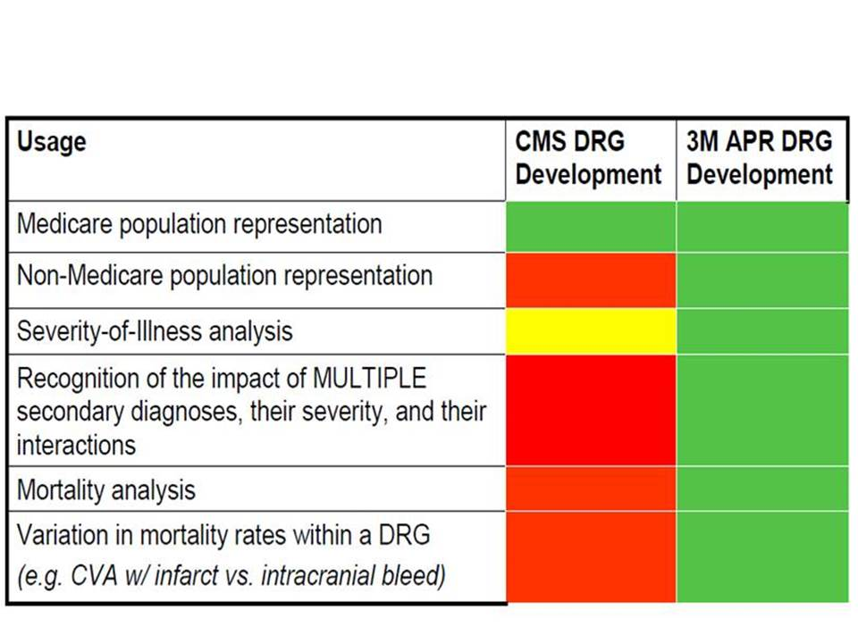
CMS-DRG History and Massachusetts HDD Use Timeline
The Health Care Financing Administration (HCFA), the predecessor agency to the Centers for Medicare and Medicaid Services, implemented HCFA-DRGs in 1983 to measure inpatient resource consumption by the Medicare population. The core of their DRG system was the healthcare “product” supplied by hospital care of a patient. The initial architects of the CMS-DRG system established 23 major diagnostic categories (MDCs) as the first level of categorizing these products.* The MDCs were then subdivided into DRGs based on factors such as surgical status, organ system, age, symptoms, comorbidities, and discharge status. While subsequent modifications to the Medicare DRGs included non-Medicare patients, the key focus of modifications has been on problems relating primarily to the elderly population. The Veterans Health Administration VHAF-DRG is based on the CMS-DRG with refinements by 3M for severity in the veterans population and non-veteran population.
How CMS-DRGs differ from APR-DRGs?**
Timeline of HCFA, VHAF, and CMS DRG Use in Massachusetts HDD
HCFA-DRG
Version 2
1988 - 1991
Annual Updates
HCFA-DRG
Version 8
1988 - 2000
VHAF-DRG Versions
24 25
CMS-
DRG
Versions
26 27 28 29 30
* Source: Dr. Brandon Bushnell: The Evolution of DRGs. American Academy of Orthopedic Surgeons, http://www.aaos.org/news/aaosnow/dec13/advocacy2.asp
** Source: All Patient Refined DRGs, a Methodology Overview, 2006, 3M HIS, https://msmedicaid.acs-inc.com/trainingMaterials/MSAPR-Methodology.pdf

Slide 15
Comparison of Some Structural* Differences between Medicare-DRG, AP-DRG, APR-DRG Versions 12
Medicare DRG
Multiple Complications and Comorbidities not recognized
Newborn Birthweight not Used
AP-DRG
Multiple Complications and Comorbidities not recognize
Newborn Birthweight Used
APR-DRG
Multiple Complications and Comorbidities recognized
Newborn Birthweight Used
No Risk of Mortality Subgroup
National Association of Children’s Hospitals Pediatric Modifications Not Included
No Risk of Mortality Subgroup
Complete use of HIV Infection MDC
Includes Risk of Mortality Subgroup
Complete Inclusion of National Association of Children’s Hospitals Pediatric Modifications
Limited Inclusion of National Association of Children’s Hospitals Pediatric Modifications
Limited use of HIV Infection MDC
Complete use of HIV Infection MDC
* Source: 3M Health Information Systems Research Report No. 5-98

Slide 16
If I want to identify the potential delivery records, which DRG is the best for me?

Slide 17
Comparison of Differences in CMS DRG Version 30 and APR DRG Version Top Ranking Delivery Groupings by Charges for Massachusetts HDD
CMS DRG | CMS Version 30 DRG
766 | Cesarean section w/o CC/MCC
775 | Vaginal delivery w/o complicating diagnoses
765 | Cesarean section w CC/MCC
774 | Vaginal delivery w complicating diagnoses
767 | Vaginal delivery w sterilization &/or D&C
776 | Postpartum & post abortion diagnoses w/o O.R. procedure
781 | Other antepartum diagnoses w medical complications
794 | Neonate w other significant problems
982 | Extensive O.R. procedure unrelated to principal diagnosis w CC
782 | Other antepartum diagnoses w/o medical complications
768 | Vaginal delivery w O.R. proc except steril &/or D&C
792 | Prematurity w/o major problems
789 | Neonates, died or transferred to another acute care facility
791 | Prematurity w major problems
793 | Full term neonate w major problems
769 | Postpartum & post abortion diagnoses w O.R. procedure
APR DRG | APR DRG* Version 30 DRG
540 | Cesarean delivery
560 | Vaginal delivery
541 | Vaginal delivery w sterilization &/or D&C
561 | Postpartum & post abortion diagnoses w/o procedure
566 | Other antepartum diagnoses
640 | Neonate birthwt >2499g, normal newborn or neonate w other problem
542 | Vaginal delivery w complicating procedures exc sterilization &/or D&C
950 | Extensive procedure unrelated to principal diagnosis
625 | Neonate bwt 2000-2499g w other significant condition
614 | Neonate bwt 1500-1999g w or w/o other significant condition
546 | Other O.R. proc for obstetric diagnoses except delivery diagnoses
639 | Neonate birthwt >2499g w other significant condition
633 | Neonate birthwt >2499g w major anomaly
544 | D&C, aspiration curettage or hysterotomy for obstetric diagnoses
626 | Neonate bwt 2000-2499g, normal newborn or neonate w other problem
621 | Neonate bwt 2000-2499g w major anomaly
580 | Neonate, transferred <5 days old, not born here
* Note: APR DRG includes additional Subclass
groupings by Category for Severity of Illness and
Risk of Mortality

Slide 18
Comparison of CMS-DRG to APR-DRG for 4 Single Liveborn Cases*
 | PDX V3000: Single liveborn, born in hospital, delivered without mention of cesarean section Admission age in days: 0 Discharge status: Home Birthweight: 500G
 | Case 1 | Case 2 | Case 3 | Case 4 | Description
Secondary Diagnoses |  | 748.4 | 748.4 770.8 | 748.4 770.8 753.0 | Congenital Cystic Lung Respiratory Failure of NB Renal Agenesis
CMS DRG APR DRG | 391 591 Subclass 1 | 390 591 Subclass 2 | 389 591Subclass 3 | 389 591 Subclass 4 | Normal Newborn/ Newborn with other significant problems/Full Term Neonate w/ Maj. Prob.
 |  |  |  |  | Neonate, birth weight 500-749G, without major procedure
CMS DRG APR DRG | 0.2560 0.1134 | 0.2892 2.6320 | 0.6430 12.8901 | 0.6430 23.1141 | Payment weights**
* Source: Lisa Lyons, An Overview of 3MTM All Patient Refined Diagnostic Related Groups (3M APR DRG), July 13, 2012, 3M HIS ** Payment weights are budget neutral and computed from a national database

Slide 19
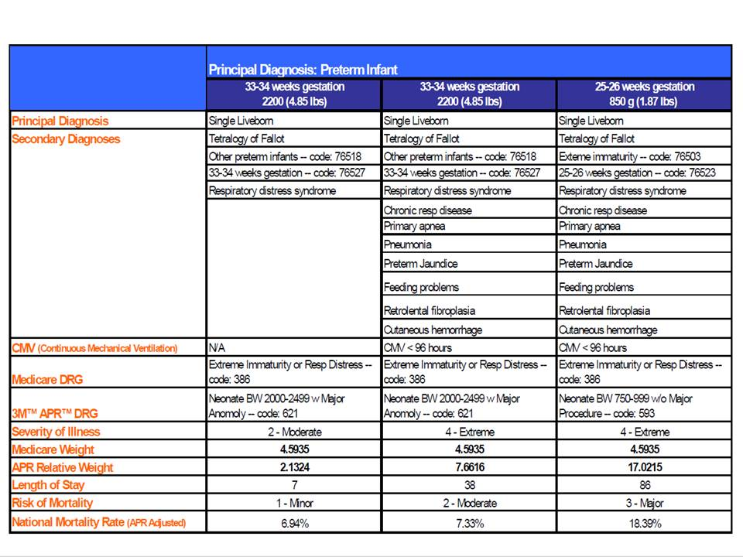
Comparison of CMS-DRG to APR-DRG for Preterm Infant*
* Source: All Patient Refined DRGs, a Methodology Overview, 2006, 3M HIS, https://msmedicaid.acs-inc.com/trainingMaterials/MSAPR-Methodology.pdf

Slide 20
How complete are the External Cause of Injury Codes (MC040) in APCD?

Slide 21
2009-2012 MA APCD Injury Diagnoses and External Cause of Injury Codes
All Injury Principal Diagnosis E-Codes
8.7% have an E-Code in the Dedicated E-Code Field (MC040)
Accident Related Injury E-Codes
10% of All Injury Principal Diagnoses have Yes (Code 1) for Accident Indicator (MC126)
3% have an E-Code populating an Other Diagnosis Code Field
11.7% of all APCD Injury Principal Diagnosis Claim Lines have an accompanying E-Code
40% of these claim lines have an E-Code in the E-Code field or Other Diagnosis Code Field
Employment Related Injury E-Codes
2% of All Injury Principal Diagnoses have a Yes (Code 1) for Employment* Related (MC128)
88% of these claim lines have an E-Code in the E-Code field or Other Diagnosis Fields
* Note: MA APCD does
not include Workers’
Compensation, Auto Insurance and other claims not paid by Medical Insurance.
Case Mix includes data
regardless of payment
source.

Slide 22
Questions from MA APCD Users
QUESTION
The “Service Provider Number” (MC024) is listed as a linkage element but many of the records have a NULL value. We cannot link elements with NULL values.
ANSWER
For MassHealth and Health Safety Net, the Service Provider Number (MC024) is always as the Billing Provider (MC076), so they did not populate the field MC024.
There are other carriers where that scenario is also true but they did redundantly populate the service provider number with the billing provider number.

Slide 23
QUESTION
Is there an identifier for patients that is NOT their SSN? We would like to track patients across plans and over time, but would like to avoid accessing high-level identifying info such as SSNs.
ANSWER
CHIA has created in APCD an MEID that allows you to track patients across plans and over time.
For more information, refer to our Master Patient Index presentation from last April: http://www.mass.gov/chia/docs/p/apcd/workgroup-meetings/2014-04-22-apcd-user-group-presentation.pdf

Slide 24
QUESTION
Is it possible to determine race/ethnicity of a patient?
ANSWER
In the APCD, the eligibility file has race and ethnicity data but the completeness of that varies across carriers.
[Thresholds for Race and Ethnicity are both 3%]
Case mix data has more complete race and ethnicity data

Slide 25
QUESTION
Are payments to the Department of Mental Health or Department of Corrections included in APCD?
ANSWER
Yes.

Slide 26
QUESTION
We are interested in learning more about high-deductible health plans. Can we determine whether a plan is a HDHP in the product type field? (or is there another indicator that we could use?)
ANSWER
The Product File has field PR012 Annual Per Person Deductible Code which defines the Total Per Person Deductible for all benefits under this product using the following coding options
000 No per person deductible
001 Deductible Total under $1,000
002 Deductible Total of $1,000 thru $1,999
003 Deductible Total of $2,000 thru $2,999
004 Deductible Total greater than $3000
999 Not Applicable

Slide 27
QUESTION
If a claim is denied, we understand that it is not reflected in APCD. Are there any instances where a denied claim might appear (i.e., initially denied but later paid, partially paid, or other circumstances)?
ANSWER
Yes, if a claim was originally paid then later denied or partially paid with specific claim lines denied.

Slide 28
Upcoming Schedule
11/13 – Data Privacy Committee Meeting
11/20 – Data Release Committee Meeting
[a week early due to Thanksgiving]
11/25 – User Workgroup Webinar

Slide 29
Questions?
General questions about the APCD:
(CHIA-APCD@state.ma.us)
Questions related to APCD applications: (apcd.data@state.ma.us)
Questions related to Casemix: (casemix.data@state.ma.us)

