Slide 1
Monthly MA APCD / Case Mix User Workgroup Webinar
March 24, 2015

Slide 2
Agenda
Announcements
Updates on the APCD / Case Mix Application and Review Process
IRBNet Smart Form Demo / Poll
APCD Data Profiles
Questions from Current APCD Users

Slide 3
MA APCD Release 3.0
Now accepting applications!
Application forms for Release 3.0 have been posted to the CHIA website and IRBNet
  New Government application should be posted soon
    (If you are waiting on this form and have a pressing need to access the data, please send an email to adam.tapply@state.ma.us)
PLEASE READ – Important information for Non-Government applicants:
  http://chiamass.gov/assets/Uploads/apcd-3-0/Important-Info-Non-Govt-Data-Requests-2015.02.17.pdf
  Explains new process and minimum security requirements

Slide 4
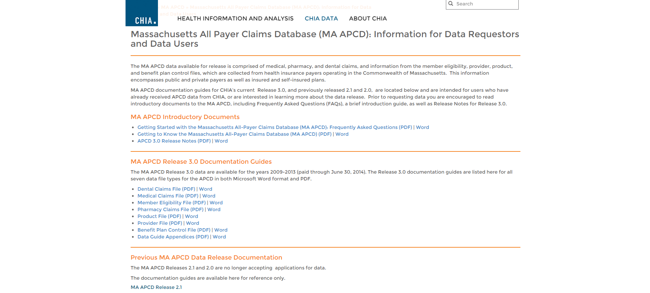
MA APCD Release 3.0
Now accepting applications!
MA APCD Release 3.0 Release Notes and Documentation Guides can be found here: http://chiamass.gov/ma-apcd-information-for-data-requestors-and-users/

Slide 5
What’s in the Application Package?
The Data Request
  Includes the Main Application form, the Data Specification Worksheet (APCD only), and all other supporting documentation (CVs, MassHealth forms, etc.)
The Data Management Plan
The Data Use Agreement
  No longer submitted at the beginning of the application process

Slide 6
Modified Application Review Process
Stage 1: Application Intake
  CHIA’s Account Management team will ensure the application package is complete
  The Manager of User Support will ensure that you are requesting the appropriate data elements (for APCD) and/or Case Mix levels
  Final application package will be sent to CHIA’s Technical Specialists for Data Privacy Committee (DPC) consideration

Slide 7
Modified Application Review Process
  Stage 2: Compliance Review Overseen by CHIA Legal
    Technical Specialist review for privacy
    Review of Data Management Plan
    Data Privacy Committee review
    Data Release Committee review (non-gov’t Level 2+ requests)
    MassHealth review (MassHealth data requests)
    Stage 3: Fulfillment

Slide 8
IRBNet Smart Form Demo
Smart Form would allow you to fill out our main application form online
  Would be available to both Gov’t and Non-Gov’t applicants
  What makes it “Smart”? It will automatically skip over questions that don’t apply to you
    Example: If you are a non-gov’t applicant, it won’t ask you if you want to request Medicare data
    POLL: Would you be interested in having this option available to you?
    (just type your answer into the Question box)

Slide 9
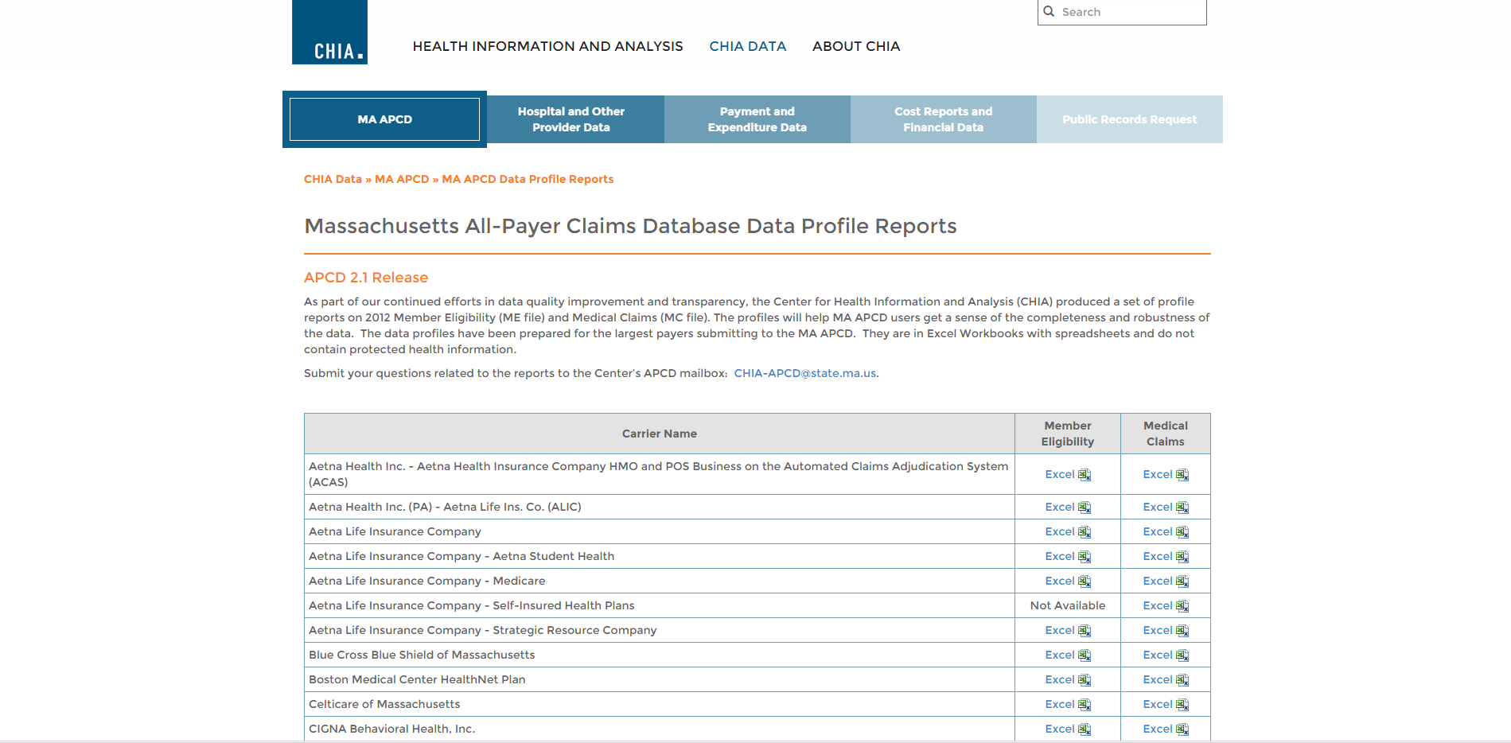
APCD Data Profiles
Available on the CHIA website here: http://chiamass.gov/individual-apcd-data-profile-reports/

Slide 10
APCD Data Profiles
POLL: Would you be interested in seeing data profiles for MA APCD Release 3.0?

Slide 11
User Questions

Slide 12
User Question: Date Fields
Question:
Many date fields have three entries, one for the date itself, and then year only or month only (e.g MC017). I assume that by requesting the first listed date field without a "year" or "month" qualifier, I'll be getting the full MMDDYYYY field?
Answer:
CHIA requires minimum data use and therefore parses the date field for researchers who simply require aggregation by month or year without the full date. If you request the full date, it will be in YYYYMMDD format.

Slide 13
User Question: Former Claim Number
Question:
MC139- Former Claim Number - is there a utility to this field for grouping claims for researchers?
Answer:
Yes. Smaller payers have been versioned by CHIA. This field allows versioning of claims and removal of duplicates if approved for that use by CHIA. It is also of value to researchers studying claims adjudication.
Some carriers have a temporary variance on reporting the former claim number because the data element isn’t currently integrated into the system from which they generate the APCD .

Slide 14
User Question: Lack of Discharge Date in Outpatient Observation (OOA File)
Question:
Observation data doesn't have a "Discharge date" variable, but has Begin_date and End_date.
Answer:
Observation Stay Data doesn’t use discharge date because patients are not admitted to Observation Stay. It is an just an outpatient stay with legally different payment rules. So the dates you would analyze for the beginning of the stay is Begin_date and the end of the stay End_date.

Slide 15
User Question: Significant Procedures in Case Mix Files
Question:
Do Significant Procedures when described on the Case Mix data application for Level 5 data denote that the dates of admission and discharge are provided for the significant procedure only (and not the associated procedure) or does it denote something else?

Slide 16
User Question: Significant Procedures in Case Mix Files
Answer:
In addition to admission date and discharge date, inpatient case mix contains distinct date fields for every procedure field. The date field is the date when the procedure was actually performed.
The rule for procedure dates is that they must not be earlier than 3 days prior to date of admission date unless admission source code is ambulatory surgery or observation stay.
The difference between the principal procedure and the associated significant procedures is that the principal procedure the procedure most related to the principal diagnosis and performed for definitive treatment of the principal diagnosis rather than for diagnostic or exploratory purposes, or necessary to treat a complication of the principal diagnosis.
The significant procedures are procedures which carry an operative or anesthetic risk or require highly trained personnel, special equipment or facilities.

Slide 17
Questions?
General questions about the APCD:
(CHIA-APCD@state.ma.us)
Questions related to APCD applications: (apcd.data@state.ma.us)
Questions related to Casemix: (casemix.data@state.ma.us)

