Slide 1
Monthly MA APCD / Case Mix User Workgroup Webinar
July 28, 2015

Slide 2
Agenda
Announcements
Common Application Issues
CHIA Enrollment Trends Presentation
User Questions
Q&A

Slide 3
Announcement
2014 Case Mix Availability
Inpatient data is available now
Emergency Department data is scheduled for August
Outpatient data is schedule for September
You may apply for ALL files now and CHIA will fulfill requests for the unavailable files as they become available.

Slide 4
Announcement
New Fee Waiver Provision
As of June 1, 2015:
Payers, providers, and provider organizations that are required to file data with the Center pursuant to MGL c. 12C and are current with all such data filings and reporting requirements may qualify for a Full or Partial Waiver

Slide 5
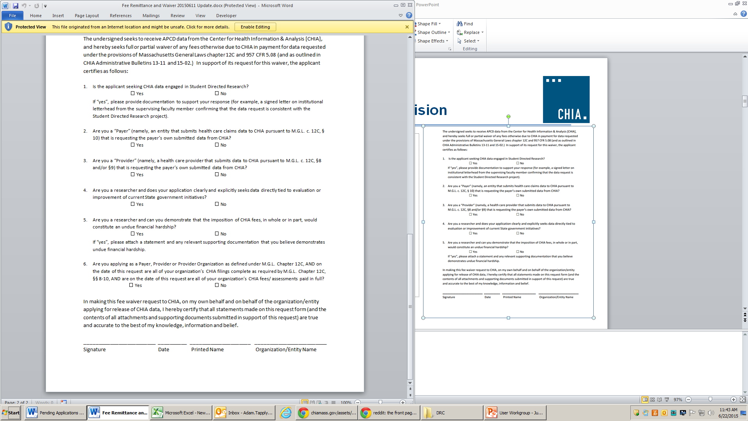
Announcement
New Fee Waiver Provision
Revised the Application Fee Remittance Form for APCD and Case Mix.
Request fee waivers on Page 2 of this form. The new provision is listed under Question #6.
Updated fee schedules:
APCD Fee Schedule
Case Mix Fee Schedule

Slide 6
Reminder
MA APCD Application Processing
CHIA will only be accepting applications for MA APCD from Massachusetts payers and providers that submit APCD and Case Mix data, as well as Massachusetts-based students and researchers.
Applications from all others will not be accepted until November 1, 2015
Applications submitted prior to May 13, 2015 will be processed
Case Mix is not impacted

Slide 7
Common Application Issues and Questions

Slide 8
APCD Amendments
An amendment request for additional MA APCD data elements must contain the following documents:
  Amendment Request Form (which you can request from Adam Tapply)
  Specification Workbook showing which elements you need and your justifications for each element
  REMINDER: The specification workbook you submit must be from the same release of the data that you received
  (if you received Release 2.1, you must submit a 2.1 worksheet)

Slide 9
MEIDs for Subsequent Data Requests
If you currently have data and are applying for a new year of data, you should request refreshes of all previous years of data that you received
  New MEIDs are generated for each release
  (example: if you get Release 3.0 with MEIDs for 2010-2013, those MEIDs will not match the MEIDs in Release 4.0 for the same years)
  Some data may also be more complete
  No additional cost

Slide 10
Application Fees
Application Fee Remittance Form for non-government MA APCD and Case Mix requests: http://chiamass.gov/assets/Uploads/apcd-3-0/application-materials/Non-Government-APCD/1.-Fee-Remittance-or-Fee-Waiver-Request-Form.pdf
Reminders:
  Submit this form with your check
  Check the appropriate box if you are requesting a fee waiver
  Note CHIA’s address has changed to 501 Boylston
  Online payment is not currently an option

Slide 11
Application Revisions
Please remember to “lock” your application on IRBNet after you’ve finished making revisions to your application
Locking the application will send an automatic notification to CHIA staff letting them know that your revisions are complete and uploaded

Slide 12
Hard Drives
Please remember to return your hard drive to CHIA after you’ve loaded your data
CHIA has a limited number of hard drives, so help us ensure we have a steady supply ready to deliver data to the MA APCD user community

Slide 13
CHIA Enrollment Trends
Sourced from the MA APCD
Member Eligibility File
Presented by:
Ashley Storms, Business Lead
Cathy Ho, Technical Lead

Slide 14
Agenda
Enrollment Trends Overview
Data Specifications
Methodology
Data Groupings
Challenges
  Methodology Development
  APCD Data
Questions

Slide 15
Enrollment Trends Overview
Recent transition to MA APCD-based enrollment reporting
Analysis based on most recent available Member Eligibility (ME) submission file
Quarterly enrollment for five time points (March 2014 – March 2015)
    Commercial enrollment broken out by:
        Market sector (employer group size)
        Funding type (fully- or self-insured)
        Product type (e.g. HMO, PPO, Indemnity)
    Public managed care enrollment broken out by program
          Commonwealth Care, Medical Security Program (MSP),
          MassHealth Managed Care Organization (MCO), OneCare,
          Senior Care Options, Medicare Advantage
3

Slide 16
Enrollment Trends Overview
Payer/Program | Data Source
Commercial Payers
Aetna | Supplemental Report
Anthem | MA APCD
Blue Cross Blue Shield of MA | MA APCD + Supplemental Report
Boston Medical Center HealthNet | MA APCD
CeltiCare Health Plan of MA | MA APCD + Supplemental Report (MMCO only)
CIGNA | MA APCD
ConnectiCare | Supplemental Report
Fallon Health | MA APCD (Public Managed Care Only) + Supplemental Report
Harvard Pilgrim Health Care | MA APCD
Health Plans Inc. | Supplemental Report
Health New England | MA APCD
Minuteman Health | MA APCD
Neighborhood Health Plan | MA APCD
Tufts Health Plan | MA APCD
Tufts Health Plan -Network Health | MA APCD
United Healthcare | MA APCD + Supplemental Report
Massachusetts Public Programs
MassHealth | MassHealth
Commonwealth Care | MA APCD
Medical Security Program | MA APCD
Medicare
Medicare Parts A and/or B | CMS
Medicare Advantage | CMS
Massachusetts Health Care Coverage: Enrollment Trends Technical Notes http://www.chiamass.gov/assets/Enrollment-Trends-Technical-Notes.pdf
4

Slide 17
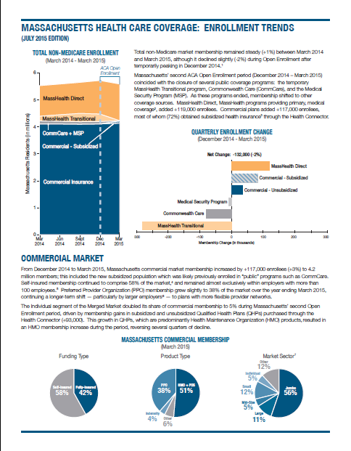
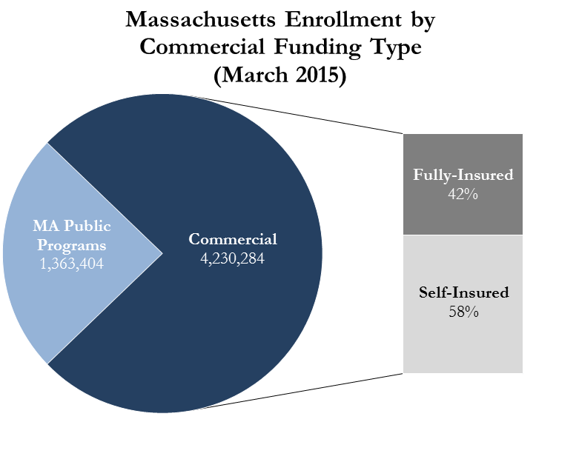
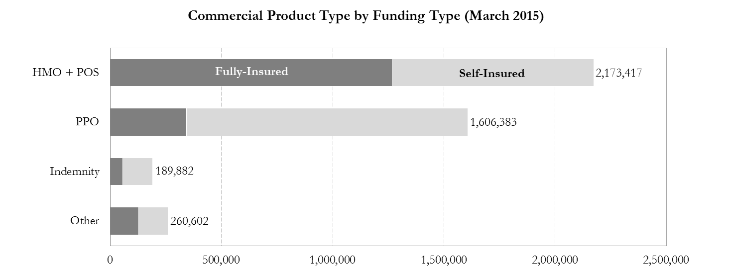
Enrollment Trends Overview
5
Massachusetts Health Care Coverage: Enrollment Trends http://www.chiamass.gov/enrollment-in-health-insurance/

Slide 18
Data Specifications
Population of Interest: Massachusetts residents with primary, medical coverage provided by the top 16 commercial payers, MassHealth, and Medicare
MA APCD data used within this report was filed by commercial payers
Sourced from MA APCD: Enrollment in commercial insurance, Commonwealth Care, Medical Security Program (MSP), MassHealth Managed Care Organizations (MCOs)
Snapshot Date: Membership as of the last day of each quarter (e.g. 12/31/14)
6

Slide 19
Methodology
A member is considered enrolled if the last day of the quarter (Snapshot Date) is within the Product Enrollment Start Date (ME041) and Product Enrollment End Date (ME042) of the eligibility record (i.e., ME041 ≤ Snapshot Date ≤ ME042). A member record with NULL values for either ME041 or ME042 is considered actively enrolled.
Members are distinguished using the Hash Carrier Specific Unique Member ID (ME107) by Org ID (ME001). A unique member record is selected according to the following criteria, in order of significance:
Subset records by the following:
    Massachusetts resident (ME016 = MA)
    Medical coverage (ME018 = 1)
    Primary insurance¹ (ME028 = 1)
Where more than one record exists for a member, de-duplicate records in the following order:
Funding type² (ME029)
  ME029 = (ASO, ASW) for Self-Insured
  ME029 = (UND) for Fully-Insured
  ME029 = (STN, OTH) for Other
Last activity date (ME056)
Member Eligibility ID (Derived-ME05)
¹ Include ME028=(3, 4) if the payer stores primary insurance as such in its system.
² This selection hierarchy is to ensure that self-insured plans are given preference over fully-insured plans for members with concurrent enrollment in both self-insured and fully-insured coverage.
7

Slide 20
Data Groupings
COMMERCIAL MARKET
Market Sector APCD Code (ME030)
Individual ME030 = “IND” or “ISCO” or “GCV”
Small Group (1-25) ME030 = “GS1” or “GS2” or “GS3”
Small Group (26-50) ME030 = “GS4”
Mid-Size Group (51-100) ME030 = “GLG1”
Large Group (101-500) ME030 = “GLG2” or “GLG3”
Jumbo-Size Group (501+) ME030 = “GLG4”
Qualified Association ME030 = “GSA”
Other ME030 = “OTH” or “FCH”
Funding Type APCD Code (ME029)
Fully-Insured ME029 = “UND”
Self-Insured ME029 = “ASO” or “ASW”
Other ME029 = “STN” or “OTH”
Product Type APCD Code (ME003)
HMO ME003 = “HM”
PPO ME003 = “12”
POS ME003 = “13”
Indemnity ME003 = “15”
EPO ME003 = “14”
Commonwealth Choice ME003 = “CE”
Other ME003 = All else not listed above or
in Public Market Product Types
PUBLIC MARKET
Product Type APCD Code (ME003)
Commonwealth Care ME003 = “CC”
Medicare (Advantage) ME003 = “16” or “20” or “HN”
Medicaid ME003 = “MC” or “MO”
Senior Care Options ME003 = “SC”
Legend
ME003 Insurance Type Code/Product
ME029 Coverage Type
ME030 Market Category Code
8

Slide 21
Challenges
Development of methodology
  MA APCD data element selection
  Subset and de-duplication criteria
  Understanding individual payer submissions
    Massachusetts resident (ME016 = MA)
    Medical coverage (ME018 = 1)
    Primary insurance (ME028 = 1)
Manual payer-specific modifications / accommodations
  Funding Type classifications
  Product Type codes
9

Slide 22
Challenges
Reporting market sector (ME030) changes over time
  Employer group size changes may not be reflected in 24-month rollback
Membership groups which may not be reported to MA APCD
  Host membership
  Some self-insured membership
  Some public managed care membership
10

Slide 23
Questions?
Ashley Storms
Health System Policy Analyst
CHIA Health System Performance Analytic Team
Ashley.Storms@state.ma.us
Cathy Ho
Senior Health Informatics Analyst
CHIA Health System Performance Analytic Team
Cathy.Ho@state.ma.us
Massachusetts Health Care Coverage: Enrollment Trends
http://www.chiamass.gov/enrollment-in-health-insurance/

Slide 24
User Questions

Slide 25
Question: When analyzing inpatient acute care hospital admissions, the APCD inpatient admission fields do not appear to be well populated. What should I do?
Answer: Filtering by MC036 Type of Bill on Facility Claims = ‘11’ for Inpatient Facility, and MC094 Type of Claim = ‘002’ for Facility and MC027 Entity Type = ‘2’ for non-person entity improves the accuracy in identifying an inpatient admissions.
Completeness of Inpatient Acute Care Hospital Admission
Related Fields after applying MC036, MC094, and MC027 Filters
Code | Description | Completeness
MC018 | Admission Date | 100%
MC018 | Admission Year | 100%
MC018 | Admission Month | 100%
MC023 | Discharge Status | 99.3%
MC020 | Admission Type | 98.5%
MC022 | Discharge Hour | 93.3%
MC021 | Admission Source | 91.7%
MC019 | Admission Hour | 79.7%
Also when linking to the provider file by MC076 Billing Provider, the provider attributes can be filtered by PV013 – Entity Code = ’12’ for acute hospital and PV034 Provider ID Code = ‘2’ for Facility)

Slide 26
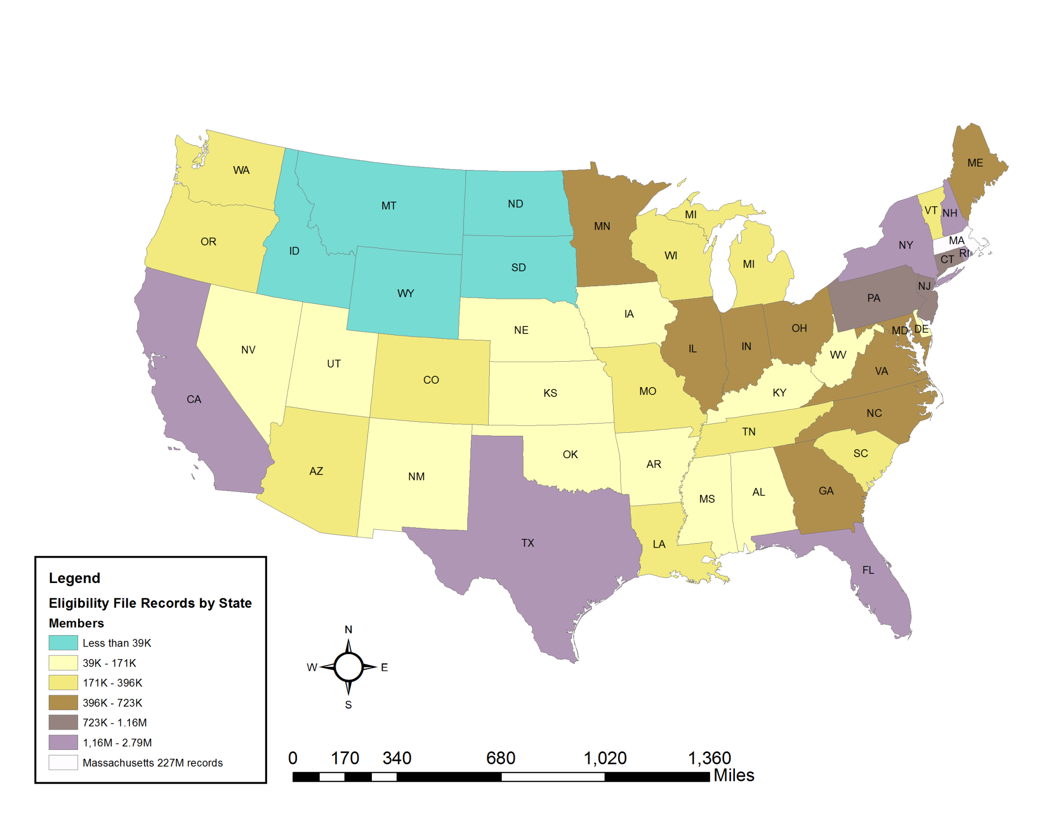
United States Geographic Distribution of Release 3.0 Eligibility Record Volume
Filter by State if your Project Focuses only on those who Reside in Massachusetts
(9.8% of Eligibility Records (24 million) are Outside of Massachusetts)
Count of States = 51
Number of Records
Minimum = 13,479 (AK)
Maximum = 227,867,403 (MA)
Total Eligibility Records in Release 3.0 = 252,462,501

Slide 27
Questions?
General questions about the APCD:
(CHIA-APCD@state.ma.us)
Questions related to APCD applications: (apcd.data@state.ma.us)
Questions related to Case Mix: (casemix.data@state.ma.us)
REMINDER: Please include your IRBNet ID#, if you currently have a project using CHIA data

Slide 28
Calendar
August 25 – Next MA APCD / Case Mix User Workgroup
August 27 – Data Release Committee Meeting

