Slide 1
APCD User Workgroup Webinar
September 24, 2013

Slide 2
Agenda
Announcements
IRBNet Training Videos
Q&A

Slide 3
CHIA posted RFI on Comm-PASS: Massachusetts APCD Product Planning
Purpose: to engage researchers, health information technology firms/experts, health analytics consultants/firms, and others as CHIA plans for the APCD Enterprise Data Warehouse
Topics: include a wide range of questions related to:
data validation, standardization and enhancement;
Master Physician Index and other Master Data Management issues;
benchmarking and “best practices” from other multi-payer databases;
data movement; and tool sets.

Slide 4
CHIA posted RFI on Comm-PASS: Massachusetts APCD Product Planning
Complete background and documentation can be found on the Commonwealth of Massachusetts procurement website Comm-PASS (http://www.comm-pass.com/ ).
Title: RFI: Massachusetts All-Payer Claims Database Product
Related Solicitation Number: 2014-002
Responses are due by October 15th.

Slide 5
IRBNet: Researcher Training
Video 1: New Project Submission
This instructional video (9 min.) walks researchers and study coordinators through the five steps of submitting a new project.

Slide 6
IRBNet: Researcher Training
Video 2: Post-Submission Advanced Topics
This instructional video (7 min.) demonstrates the IRBNet messaging structure, how to successfully update project documents and submit a subsequent (ex. Modifications Required) package to a committee and other advanced topics

Slide 7
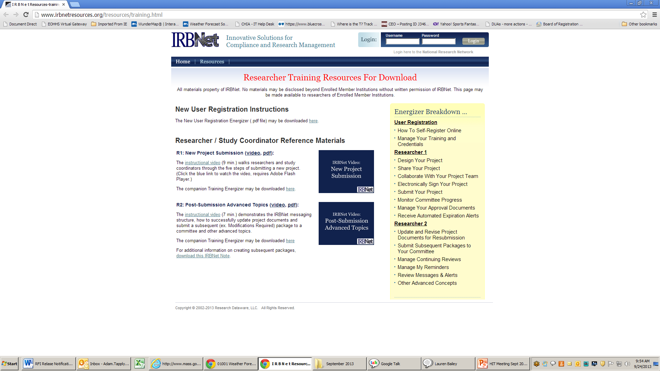
IRBNet: Researcher Training http://www.irbnetresources.org/tresources/training.html
Username: machia
Password: training

Slide 8
Questions?
An additional training session will be held in October (date TBD).
IRBNet goes live October 1st.
Specific instructions on how to submit your application to CHIA will be posted to our website (www.mass.gov/chia/apcd) on the “Accessing the APCD” portion on Oct. 1st.

Slide 9
Questions?
General questions about the APCD:
(CHIA-APCD@state.ma.us)
Questions related to APCD applications: (apcd.data@state.ma.us)
Questions related to Casemix: (casemix.data@state.ma.us)

Slide 10
Calendar
9/26 – Data Release Committee Meeting
9/30 – Last day to submit APCD applications via email
10/1 – IRBNet goes live
10/8 – Monthly TAG Meeting
10/22 – October User Workgroup Webinar

