Slide 1

APCD Analytical Workgroup
February 26, 2013

Slide 2
Objectives of the APCD Analytic Webinar
Provide a forum where you can learn about APCD updates and ask questions
  APCD Application Process
  APCD Data Fulfillment
  Data Definitions, Compliance and Availability
  Tools and methodologies
Share questions and answers that come into CHIA with a broader audience
Solicit input for improvements to the APCD

Slide 3
Agenda for Today
Profile of Webinar Participants
Summary of APCD Projects and Applications
APCD Basics
QA Insights
News from APCD

Slide 4
Participants on January 22, APCD Analytical Webinar
77 Participants
  43 Massachusetts participants
  34 Participants from 13 other states
Of the 77 Participants
  37 Insurance industry representatives
  13 Massachusetts State Agencies
  7 Universities
  20 Other (hospitals, associations, researchers, consulting firms,etc)

Slide 5
Current Projects using APCD Data
Organization | Study Topic
MA Connector Authority | Risk Adjustment per the Affordable Care Act
MA Division of Insurance | Aggregate Data Reporting Project Cost Trends Analysis Project
CHIA Internal Projects | Total Medical Expense (TME) Cost Trends

Slide 6
Summary of APCD Approved Applications to Date
Organization | Study Topics
MA Department of Public Health | Utilization of Tobacco Treatment in Massachusetts to Quit Smoking Evaluation of Mass in Motion and the Community Transformation Grants Substance Abuse Treatment Needs and Services Gap Analysis STD, HIV, and Viral Hepatitis Testing, Treatment and Screening Trends
University of MA Medical School | Massachusetts Patient Centered Medical Home Initiative Evaluation Child Health Care Quality Measurement – Core Measure Set Testing
MA Department of Public Health and U Mass Medical School | Health Care Reform and Disparities in the Care and Outcomes of Trauma Patients
Yale & University of Pennsylvania Bureau of Econ Research | The Effects of Fragmentation in Health Care
Mass Health Quality Partners | Practice Pattern Variation Analysis (PPVA) Program
Harvard School of Public Health | Will the Academic Innovations Collaborative Increase the Value of Primary Care and Improve Providers’ and Trainees’ Experiences?

Slide 7
Listing of APCD Applications for Review at the
2.28.13 DRC Meeting
Applicant Organization | Study Topic
Yale University and the National Bureau of Economic Research | Maternal and Paternal Health and Children’s Healthcare Access and Use
University of MA Medical School | Massachusetts Patient Centered Medical Home Initiative Shared Savings Methodology
Kyruus | Understanding Provider Expertise and Behavior

Slide 8
APCD Basics: Files and Submission Information
The APCD starts out with payers creating and sending files
The files are encrypted prior to being transmitted to INET,
CHIA’s secure web server
File | Unique Aspects | Submission Reporting
Membership File | Rolling 2 years | Monthly
Medical, Pharmacy & Dental Claims | Paid in prior month | Monthly
Provider File | All authorized service providers | Monthly
Product File | Products offered in this market | Quarterly

Slide 9



Quality Assurance
Quality Profiles
Shared with Payers
Production

Slide 10
Edits
Edits run on each file submission
  Expected format (alpha vs numeric, etc.)
  Invalid characters (negative values, future dates)
  Missing values (nulls)
  Data type errors will fail a file automatically
  Levels reflect relative analytic value
  Documentation Guide (on CHIA website) lists edit level by data element

Slide 11
Reporting Thresholds
Levels of edits reflect relative analytic value
- A Levels – must meet APCD Threshold (within 2%)
- Other levels – monitored but not enforced
Assigned to each data element
  Expected level of completion
  2% (Service Provider Middle Name) to 100%
CHIA works cooperatively with payers
  Annual variances
  Goal more complete data in the future
Documentation Guide (on CHIA website) has details of variances by data element

Slide 12
Insights from the QA Team
Member Language Preference
Behavioral Health Benefit Flag
APCD Data Dictionary Update

Slide 13
ME033 – Member Language Preference
Definition: Member's self-disclosed verbal language preference. Carriers report
the spoken language preference of the member. Unknown/ Not Specified
are only be used when patient/client answers unknown or refuses to answer.
Frequency Ranking | Language Preference | Eligibility Records | Frequency |  | Frequency Ranking | Language Preference | Eligibility Records | Frequency
1 | Unknown / not specified | 18,653,628 | 48.719% |  | 13 | Korean | 5,682 | 0.015%
2 | English | 18,264,490 | 47.702% |  | 14 | Hindi | 5,221 | 0.014%
3 | Spanish | 612,226 | 1.599% |  | 15 | Greek | 4,798 | 0.013%
4 | Other Language | 319,787 | 0.835% |  | 16 | Polish | 4,602 | 0.012%
5 | Portuguese | 140,452 | 0.367% |  | 17 | Italian | 3,879 | 0.010%
6 | Chinese | 101,207 | 0.264% |  | 18 | German | 3,720 | 0.010%
7 | Vietnamese | 49,597 | 0.130% |  | 19 | African | 3,669 | 0.010%
8 | Haitian Creole | 33,746 | 0.088% |  | 20 | Japanese | 1,413 | 0.004%
9 | Russian | 22,971 | 0.060% |  | 21 | Urdu | 560 | 0.001%
10 | Cape Verdean Creole | 22,201 | 0.058% |  | 22 | Tagalog | 468 | 0.001%
11 | Arabic | 21,984 | 0.057% |  | 23 | Hebrew | 316 | 0.001%
12 | French | 11,700 | 0.031% |  | 24 | Persian | 257 | 0.001%
Note: Carriers do not report language data if they do not have it. For 45,625,414 eligibility records submitted in August 2012, 84% of records had language data. Filing Specifications inform carriers that MA APCD is expecting a 3% base percentage in reporting volume of data in regards to condition requirements. Category B Reporting margin.

Slide 14


ME034 – Member Language Preference: Other
Definition: Member's Other Language Preference. Carriers report the other language the member / subscriber has identified. Do not report any value If no other language identified. If Chinese if reported as the Member’s Preferred Language, the Other Language Preference Field is used to describe the variety of Chinese.
TOP TEN OTHER LANGUAGES
Frequency Ranking | Language Preference
1 | Armenian
2 | Thai
3 | Cambodian (Khmer)
4 | Burmese
5 | Lithuanian
6 | Gujarati
7 | Turkish
8 | Bengali
9 | Romanian
10 | Indonesian
TOP TWO CHINESE LANGUAGES
Frequency Ranking | Language Preference
1 | Mandarin
2 | Cantonese
Note: Unlike Member Language Preference, Other Language Preference is a free text field. Worldwide over 6,000 different languages are spoken. MA APCD contains over 300 different languages and it is estimated that the number will be reduced to under 200 after the field is cleaned for spelling and typographical errors.

Slide 15

Member Language Preference
18,653,628 Records Unknown/Not Specified
Unknown/Not Specified are only be used when patient/client answers unknown or refuses to answer their language preference.
The Largest Percent of Unknown/Not Specified
Member Language Preference Records Is Limited to Eight Carriers
 | Unknowns | Percent of Total Unknowns
Carrier One | 4,691,399 | 25%
Carrier Two | 4,315,762 | 23%
Carrier Three | 2,247,217 | 12%
Carrier Four | 1,119,370 | 6%
Carrier Five | 1,112,318 | 6%
Carrier Six | 998,984 | 5%
Carrier Seven | 806,364 | 4%
Carrier Eight | 793,796 | 4%
All Other Carriers | 2,568,418 | 14%
Total | 18,653,628

Slide 16

ME051 – Behavioral Health Benefit Flag
Definition: Carrier uses the flag to report whether Behavioral/Mental Health is a covered benefit using coding options for Yes (1), No (2), Unknown (3), Other (4), Not Applicable (5).
Behavioral Health Benefit Flag | Total Flags | Flag Frequency
Invalid Code | 53,391 | 0%
Yes | 18,743,238 | 42%
No | 10,326,220 | 23%
Unknown | 3,563,119 | 8%
Not Applicable | 11,818,853 | 27%
Total | 44,504,821
Note: Filing Specifications inform carriers that MA APCD is expecting a 100% base percentage in reporting volume of data in regards to condition requirements. As of August 2012, 97.5% (44,504,821) of the eligibility records (45,625,414) contain data on Behavioral Health Benefit Flag status.

Slide 17
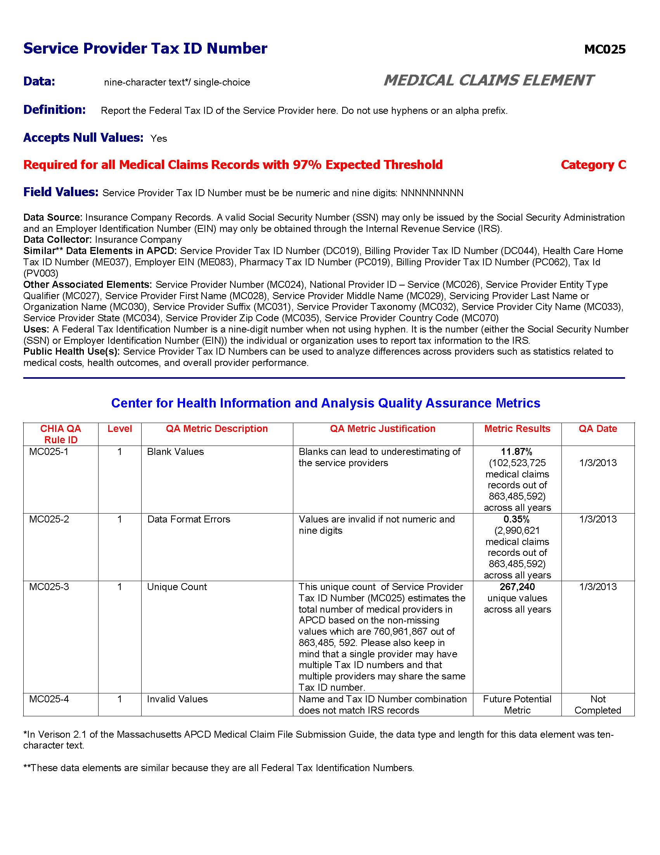
Sample
Data Dictionary Page
based on all APCD Data
as of December 2012

Slide 18
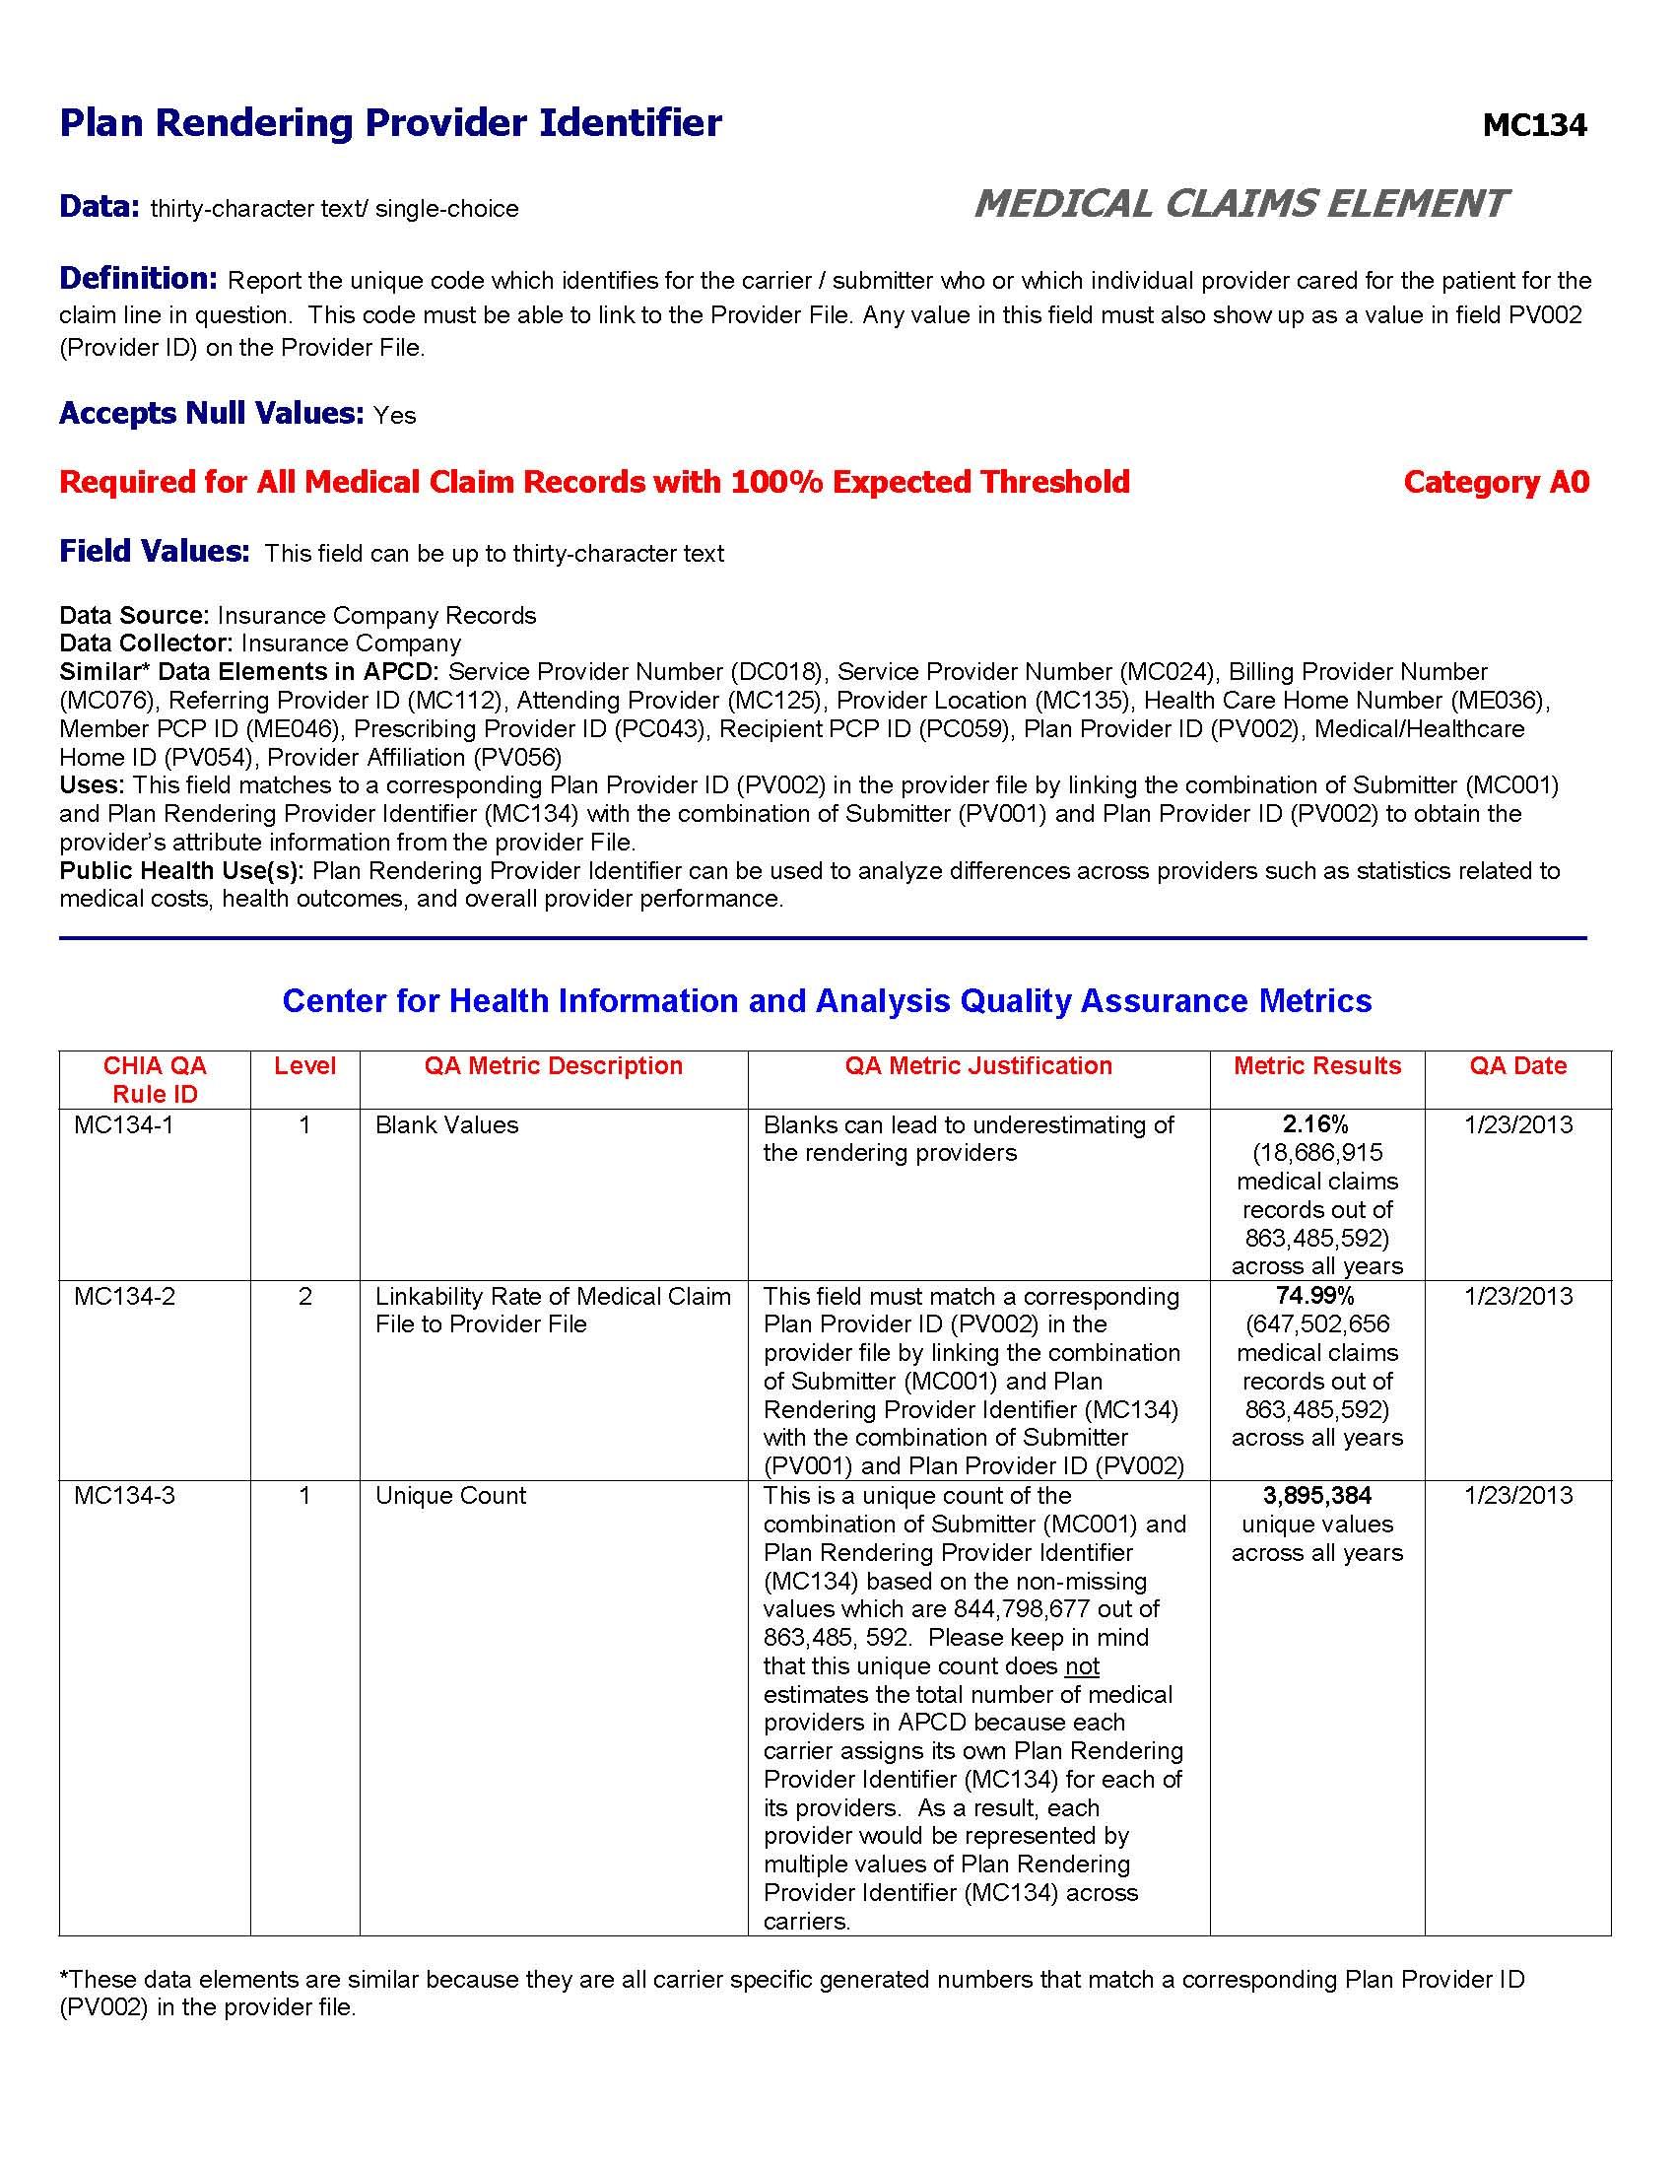
Sample
Data Dictionary Page
based on all APCD Data
as of December 2012

Slide 19
Status of Developments and Enhancements
As of February 2013
We are on track with the 2011 and 2012 public releases
2011 Public Release will be available in June 2013
  2009-2011 Dates of Service
  MassHealth
  Medicare (state agencies only*)
2012 Public Release will be available in December 2013
  Master Member Index
* In discussions with CMS about possible re-release by CHIA

Slide 20
Master Member Index
Files arrive monthly from more than 90 payers, each using their own unique member IDs
  IDs may change as a member switches products within a payer
  Rolling 24 months in each monthly submission so there are many duplicate records
Master Patient Index will create a unique identifier so members can be tracked – across products and payers
Preliminary runs (de-duping) have compressed member file from 25M to 9M records; target is approximately 6M
Plan to have in December 2013 release

Slide 21
APCD Received Two Grants
Which will help build out its infrastructure
ACA Implementation (CCIIO)
  Risk adjustment
  Master Member
State Innovation Models (CMS)
  Provider portal to the APCD
  Master provider
  http://innovation.cms.gov/initiatives/State-Innovations-Model-Testing/index.html

Slide 22
The APCD User Group
The next group of APCD users will receive their extracts in the coming weeks (3 extracts have been delivered to date)
An APCD User Group will be established once we have 3-5 users ready to proceed (To date that includes DPH and UMMS)
The purpose of this group is to:
- Answer questions about using APCD data
- Facilitate exchange of “know how” among users
- Provide CHIA feedback on data quality

Slide 23
Topics for March APCD Analytic Webinar
Please submit questions and topics for our March Webinar
Questions?
sabine.hedberg@state.ma.us
Thank you for your interest in the Massachusetts
All Payer Claims Database

