Slide 1
FY 2025 BEHAVORIAL HEALTH
SUBMISSION GUIDE Updates
Webinar
December 10, 2024

Slide 2
Agenda
Welcome
FY 2025 Submission Guide Updates – Key Changes
Review of Proposed Changes
Timeline / Next Steps
Questions & Comments

Slide 3
submission guide UPDATES

Slide 4
Submission Guide Updates
Key Changes: File Format
NEW! Asterisk Delimiter Format
Remove Filler fields, DSM Diagnosis (RT45), Sequence (RT65)
Key Changes: New Fields
Transfer Hospital Organization ID
Spoken Language
Operating Physician/Clinician-Significant HCPCS/CPT Procedure I National Provider Identifier (NPI)
Key Changes: Field Updates
Medical Record Number (MRN): Increase length to 25
Physician License Number (BORIM): Increase length to 25
Other assorted field/edit updates
Key Changes: Table Updates
Type of Admission, Source of Admission: Add new code values
Sexual Orientation, Gender Identity, Race, Ethnicity, Hispanic Indicator: Update code values
Patient Sex at Birth, Homeless Indicator, Spoken Language: Add new code values
Payer Type and Source of Payment: Update code values

Slide 5
Changes & Revisions
For
BH inpatient DISCHARGE DATA (BHID)

Slide 6
BH Inpatient Discharge Data
Record Type | Field | New / Update | Description of requirement
All | Medical Record Number (MRN) | U | Change field size to 25
01, 99 | Submitter EIN | U | Change field size to 9
01, 10 | Submitter Name, Provider Name, Provider Address | U | Change field size to 100
20 | Patient Sex | U | Rename to Patient Sex at Birth, change field size to 8; add new codes values
20 | Billing Number | U | Change field size to 25
20 | Homeless Indicator | U | Change field size to 8; add new code values
20 | Medicaid Claim Certificate Number (MMIS ID/MassHealth ID) | U | Require ID for MassHealth/HSN payer ONLY (not MCO/ACO)
20 | Patient’s Sexual Orientation | U | Change field size to 8; update code values; change to “Must be present”
20 | Patient’s Gender Identity | U | Change field size to 15; update code values; change to “Must be present”
20 | Transfer Hospital Organization ID | N | Add new field

Slide 7
BH Inpatient Discharge Data
Record Type | Field | New / Update | Description of requirement
25 | Permanent Patient Street Address | U | Change field size to 100
25 | Race 1, Race 2, Hispanic Indicator, Ethnicity 1, Ethnicity 2 | U | Change field size to 8; update code values; change to “Must be present”
25 | Spoken Language | N | Add new field and code values
30 | Accommodations 1-5 | U | Change field size to 20
30 | Units of Service (Accom. Days) | U | Change field size to 6
30 | Total Charges (Accom.) | U | Whole numbers only, no decimals
40 | Ancillaries 1-5 | U | Change field size to 20
40 | Units of Service (Ancillary) | U | Change field size to 6
40 | Total Charges (Service) | U | Whole numbers only, no decimals
45 | Principal External Cause Code | U | Update Edit Specifications *

Slide 8
BH Inpatient Discharge Data
Record Type | Field | New / Update | Description of requirement
45 | Condition Present on Admission - Principal External Cause Code | U | Change to “May be present”
45 | Condition Present on Admission - Principal Diagnosis Code | U | Change to “May be present”
45 | DSM Diagnosis | U | Remove field
50 | Associated Diagnosis Codes I-XIV | U | Update Edit Specifications *
50 | Condition Present on Admission - Associated Diagnosis Codes I-XIV | U | Change to “May be present”
65 | Sequence | U | Remove field
80 | Physician License Number (BORIM) | U | Change field size to 25; disallow “BORIM7”
80 | Operating Physician/Clinician for Significant HCPCS/CPT Procedure I National Provider Identifier (NPI) | N | Add new field
90, 95 | Total Charges | U | Whole numbers only, no decimals
95 | Number of Discharges | U | Change field size to 6
95 | Total Days | U | Change field size to 10

Slide 9
BH Inpatient Discharge Data
Field Name | Edit Specifications *
Principal External Cause Code | Must be present if principal diagnosis is an ICD-10-CM S-code (S00-S99), May be present if principal diagnosis is an ICD-10-CM T-code (T00-T88), If present, must be a valid ICD-10-CM external cause code (V00-Y89). Additional (V00-Y89) and Supplemental (Y90-Y99) ICD external cause codes shall be recorded in associated diagnosis fields.
Field Name | Edit Specifications *
Assoc. Diagnosis Code | Only permitted if prior diagnosis is entered Must be a valid ICD-10-CM code Sex of patient must agree with diagnosis code for sex specific diagnosis May be an ICD external cause code (V00-Y99) Must agree with ICD Indicator

Slide 10
Table changes & code Revisions

Slide 11
Patient Sex at Birth
Patient Sex at Birth Code | Patient Sex at Birth Definition
M | Male
F | Female
DONTKNOW | Don’t know
ASKU | Choose not to answer
UNK | Unknown
UTC | Unable to collect this information on patient due to lack of clinical capacity of patient to respond

Slide 12
Type of Admission
* TYPEADM CODE | * TYPE OF ADMISSION DEFINITION
6 | Trauma
Source of Admission
* SRCADM CODE | * SOURCE OF ADMISSION DEFINITION
J | Transfer from One Distinct Unit of the Hospital to another Distinct Unit of the Same Hospital Resulting in a Separate Claim to the Payer

Slide 13
Homeless Indicator
Homeless Indicator Code | Homeless Indicator Definition
Y | Patient is known to be homeless
N | Patient is not known to be homeless
DONTKNOW | Don’t know
ASKU | Choose not to answer
UNK | Unknown
UTC | Unable to collect this information on patient due to lack of clinical capacity of patient to respond

Slide 14
Patient’s Sexual Orientation
Sexual Orientation Code | Patient’s Sexual Orientation Definition
20430005 | Straight or Heterosexual
38628009 | Gay or Lesbian
42035005 | Bisexual
QUEER | Queer, Pansexual, and/or Questioning
OTH | Something Else
DONTKNOW | Don’t know
ASKU | Choose not to answer
UNK | Unknown
UTC | Unable to collect this information on patient due to lack of clinical capacity of patient to respond

Slide 15
Patient’s Gender Identity
Gender Identity Code | Patient’s Gender Identity Definition
446151000124109 | Male
446141000124107 | Female
407376001 | Transgender man / trans man
407377005 | Transgender woman / trans woman
446131000124102 | Genderqueer/ gender nonconforming / non-binary, neither exclusively Male nor Female
OTH | Additional gender category or other
DONTKNOW | Don’t know
ASKU | Choose not to answer
UNK | Unknown
UTC | Unable to collect this information on patient due to lack of clinical capacity of patient to respond

Slide 16
Race
Race Code | Patient Race Definition
1002-5 | American Indian/Alaska Native
2028-9 | Asian
2054-5 | Black/African American
2076-8 | Native Hawaiian or other Pacific Islander
2106-3 | White
OTH | Other
DONTKNOW | Don’t know
ASKU | Choose not to answer
UNK | Unknown
UTC | Unable to collect this information on patient due to lack of clinical capacity of patient to respond

Slide 17
Hispanic Indicator
Hispanic Indicator Code | Hispanic Indicator Definition
2135-2 | Patient is Hispanic
2186-5 | Patient is not Hispanic
DONTKNOW | Don’t know
ASKU | Choose not to answer
UNK | Unknown
UTC | Unable to collect this information on patient due to lack of clinical capacity of patient to respond

Slide 18
Ethnicity Utilize codes below and full list per CDC:
Ethnicity Code | Patient Ethnicity Definition
AMER | American
BRAZ | Brazilian
CANADA | Canadian
CAPE-V | Cape Verdean
CARIB | Caribbean Islander
E-EUR | Eastern European
PORT | Portuguese
RUSSN | Russian
OTH | Other
UNK | Unknown
DONTKNOW | Don’t know
ASKU | Choose not to answer
UTC | Unable to collect this information on patient due to lack of clinical capacity of patient to respond

Slide 19
Spoken Language Utilize the codes included in the BHID Spoken Language Codes file posted on CHIA’s website.

Slide 20
Changes & Revisions
For
PAYER TYPE & PAYER SOURCE

Slide 21
Payer Type
PAYER TYPE CODE | PAYER ABBREVIATION | PAYER TYPE DEFINITION
1 | SP | Self Pay
2 | WOR | Worker's Compensation
3 | MCR | Medicare
F | MCR-MC | Medicare Managed Care (includes Medicare Advantage)
4 | MCD | Medicaid
B | MCD-MC | Medicaid Managed Care/MCO
5 | GOV | Other Government Payment
6 | BCBS | Blue Cross
C | BCBS-MC | Blue Cross Managed Care
7 | COM | Commercial Insurance
D | COM-MC | Commercial Managed Care
8 | HMO | HMO
9 | FC | Free Care
0 | OTH | Other Non-Managed Care Plans
E | PPO | PPO and Other Managed Care Plans Not Classified Elsewhere
H | HSN | Health Safety Net
J | POS | Point-of-Service Plan
K | EPO | Exclusive Provider Organization
T | AI | Auto Insurance
N | None | None (Valid only for Secondary Payer)
Q | CommCare | Commonwealth Care/ConnectorCare Plans
Z | DEN | Dental Plans
S | SCO/ICO | Senior Care Option/Integrated Care Organization (SCO/ICO)
A | Medicaid ACO | Medicaid ACO
C | Commercial ACO | Commercial ACO
P | PACE | Program of All-Inclusive Care for the Elderly (PACE)

Slide 22
Payer Source
PAYER SOURCE CODE | HEALTH PLAN
137 | AARP/Medigap Supplement
51 | Aetna
910 | Allways Health Partners
911 | Anthem
272 | Auto Insurance
154 | BCBS Other (Not listed elsewhere)
912 | Beacon Health Partners
46 | Blue CHiP (BCBS Rhode Island)
807 | Blue Cross Blue Shield of MA
808 | Blue Cross Blue Shield of RI
400 | Cambridge Network Health Forward
151 | CHAMPUS
26 | CHAMPUS/TriCare
996 | Charity Care
178 | Children's Medical Security Plan (CMSP)
30 | CIGNA
296 | Commonwealth Care Alliance
320 | Community Care Cooperative (ACO)
42 | ConnectiCare Of Massachusetts
185 | Connecticut General Life
4 | Fallon Health
179 | First Health Life and Health Insurance Company
143 | Free Care
162 | Great West Life
23 | Guardian Life Insurance Company

Slide 23
Payer Source
PAYER SOURCE CODE | HEALTH PLAN
822 | Harvard Pilgrim Health Care
24 | Health New England
913 | Health Plans Inc.
995 | Health Safety Net Office
247 | Humana Insurance Company
914 | Insurance Programmers
57 | John Hancock Life Insurance
40 | Kaiser Foundation
915 | Key Benefit
85 | Liberty Mutual
916 | Lifetime Benefit Solutions
118 | Mass Behavioral Health Partnership
103 | Medicaid ( MassHealth)
322 | Mass General Brigham (ACO)
121 | Medicare
134 | Medicare HMO - Other (not listed elsewhere)
249 | MEGA Life and Health Insurance Company
295 | Meritain
209 | Mid-West National Life Insurance Company of Tennessee
917 | Nationwide
47 | Neighborhood Health Plan
207 | Network Health
159 | None (Valid only for Secondary Source of Payment)
311 | Other ACO

Slide 24
Payer Source
PAYER SOURCE CODE | HEALTH PLAN
147 | Other Commercial (not listed elsewhere)
156 | Out of state BCBS
120 | Out-of-State Medicaid
228 | Oxford Health Plans
84 | Private Healthcare Systems
918 | QCC Insurance Company
145 | Self-Pay
922 | Senior Whole Health
919 | State Farm
323 | Steward Health Choice (ACO)
7 | Tufts Health Plan
328 | Tufts Medicine (ACO)
920 | UMR Inc.
97 | UniCare
826 | United Concordia
226 | United Health Care of New England, Inc.
74 | United Healthcare Insurance Company
903 | Unlisted International Source
102 | Wausau Insurance Company
288 | Wellsense Health Plan
146 | Worker's Compensation
921 | Zenith
930 | VA Benefits (not listed elsewhere)
931 | Other Government Program (not listed elsewhere)
932 | Other Third-Party Programs (not listed elsewhere) (ex. Vision, TPA, Hospice, Transplant programs)

Slide 25
Timeline / Next Steps:
FY 2025 BHID Intake Process | Draft Timeline
Provider Comment Period Ends | December 20, 2024
Administrative Bulletin and Guides Adopted | December 23, 2024
CHIA and Hospitals Update Systems | December 2024 – November 2025
Hospital Testing Period | October/November 2025
Quarterly Submissions Due Dates: Q1 (Oct 1, 2024 – Dec 31, 2024) Q2 (Jan 1, 2025 – Mar 31, 2025) Q3 (Apr 1, 2025 – Jun 30, 2025) Q4 (Jul 1, 2025 – Sep 30, 2025) | December 14, 2025 December 14, 2025 December 14, 2025 December 14, 2025

Slide 26
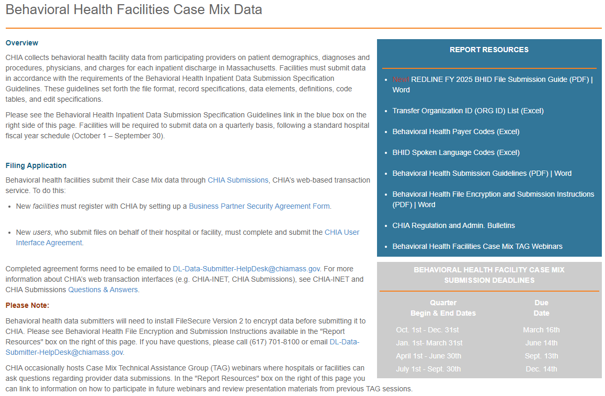
Submission Guide & Documentation – Published to CHIA Website http://www.chiamass.gov/behavioral-health-facilities-case-mix-data/

Slide 27
Questions & Comments

Slide 28
Follow-up Contacts
Cathy Houston, Associate Director of Hospital Data Intake & Compliance Catherine.Houston@CHIAMass.gov
Linda Stiller, Manager, Data Intake and Compliance Linda.Stiller@CHIAMass.gov
CHIA Liaisons:
Hadish Gebremedhin, Senior Health Care Data Liaison Hadish.Gebremedhin@CHIAMass.gov
Jillian Petrie, Health Care Data Liaison
Jillian.Petrie@CHIAMass.gov

