Slide 1
FY 2025 Case Mix Updates Webinar
May 16, 2024

Slide 2
Agenda
2:00 Welcome
2:05 FY 2025 Submission Guide Highlights
2:10 Review of Proposed Changes
2:30 Data Quality - EHRD
2:35 Transition to CHIA Submissions
2:40 Timeline / Next Steps
2:45 Questions & Comments

Slide 3
submission guide Highlights

Slide 4
Submission Guide Changes - Highlights
Key Changes: File Format | File Type
NEW! Asterisk Delimiter Format (All Filler fields removed) | HIDD/EDD
Remove Record Type 21 | EDD
Key Changes: New Fields | File Type
National Provider Identifier (NPI): Other Physician/Clinician and ED Physician/Clinician | EDD
Key Changes: Field Updates | File Type
Medical Record Number (MRN): Increase length to 25 | All
Physician License Number (BORIM): Increase length to 25 | All
Other assorted field/edit updates | All
Key Changes: Table Updates | File Type
Type of Admission: Add “Trauma” as valid code | HIDD/EDD/OOD
Race, Ethnicity, Hispanic Indicator: Match EHRD code set | HIDD/EDD/OOD
Homeless Indicator: Add new code values | All

Slide 5
Changes & Revisions
For
Hospital inpatient DISCHARGE DATA

Slide 6
Hospital Inpatient Discharge Data
Record Type | Field | New / Update | Description of requirement
All | Medical Record Number (MRN) & Mother’s Medical Record Number | U | Change field size to 25
01, 99 | Submitter EIN | U | Change field size to 9
01, 10 | Submitter Name, Provider Name, Provider Address | U | Change field size to 100
20 | Patient Sex | U | Rename to Patient Sex at Birth, change field size to 8; add new code values
20 | Billing Number | U | Change field size to 25
20 | Patient Birthday | U | Disallow “99” as valid month & day when unknown; report “01”
20 | Homeless Indicator | U | Change field size to 8; add new code values
25 | Permanent and Temporary Patient Street Address | U | Change field size to 100
25 | Race 1, Race 2, Hispanic Indicator, Ethnicity 1, Ethnicity 2 | U | Change field size to 8; change code values to match EHRD code set
30 | Accommodations 1-5 | U | Change field size to 20

Slide 7
Hospital Inpatient Discharge Data
Record Type | Field | New / Update | Description of requirement
30 | Units of Service (Accom. Days) | U | Change field size to 6
30 | Total Charges (Accom.) | U | Change field size to 10
40 | Ancillaries 1-5 | U | Change field size to 20
40 | Units of Service (Ancillary) | U | Change field size to 6
40 | Total Charges (Service) | U | Change field size to 10
45 | Number of hours in ED | U | Change field size to 10
80 | BORIM license number | U | Change field size to 25; Remove “BORIM7”
95 | Number of Discharges | U | Change field size to 6
95 | Total Days | U | Change field size to 10
99 | No. of Providers on File, Count of Batches, Batch Type Counts | U | Change field size to 1

Slide 8
Changes & Revisions
For
Emergency DEPARTMENT DATA

Slide 9
Hospital Emergency Department Data
Record Type | Fields | New - Update | Description of requirement
All | Medical Record Number (MRN) | U | Change field size to 25
10 | Provider Name, Provider Address | U | Change field size to 100
10 | Provider City | U | Change field size to 15
20 | Billing Number | U | Change field size to 25
20 | Medicaid Claim Certificate Number (New MMIS ID/Medicaid ID) | U | Change field size to 12
20 | Date of Birth | U | Disallow “99” as valid month & day when unknown, report “01”; change field size to 8
20 | Sex | U | Rename to Patient Sex at Birth, change field size to 8; add new code values
20 | Registration Date | U | Change field size to 8
20 | Discharge Date | U | Change field size to 8

Slide 10
Hospital Emergency Department Data
Record Type | Field | New / Update | Description of requirement
20 | Other Physician Number and ED Physician Number (BORIM) | U | Change field size to 25; remove “BORIM7”
20 | Ambulance Run Sheet | U | Rename to EMS Patient Care Report Number; Change field size to 50
20 | Homeless Indicator | U | Change field size to 8; add new code values
20 | Other Physician or Clinician National Provider Identifier (NPI) | N | New field
20 | ED Physician or Clinician National Provider Identifier (NPI) | N | New field
25 | Permanent and Temporary Patient Street Address | U | Change field size to 100
25 | Race 1, Race 2, Hispanic Indicator, Ethnicity 1, Ethnicity 2 | U | Change field size to 8; change code values to match EHRD code set
25 | Other Ethnicity | U | Change field size to 20
60 | Group Element: Service Line Items 2 – 30 | U | Change field size to 16
94 | Group Element: Site Summaries 2 - 4 | U | Change field size to 48

Slide 11
Changes & Revisions
For
outpatient observation DATA

Slide 12
Hospital Outpatient Observation Data
Field No. | Field | New / Update | Description of requirement
All | MR_N (Medical Record Number) | U | Change field size to 25
5 | Acct_N | U | Change field size to 25
7 | MMIS_ID | U | Change field size to 12
8 | DOB | U | Disallow “99” as valid month & day when unknown; report “01”
9 | Sex |  | Rename to Patient Sex at Birth, change field size to 8; add new code values
10, 56, 55, 58, 59 | Race 1, Race 2, Hispanic Indicator, Ethnicity1, Ethnicity2 | U | Change field size to 8; change code values to match EHRD code set
24 | Surgeon | U | Change field size to 25; remove “BORIM7”
25 | Att_MD | U | Change field size to 25; remove “BORIM7”
47, 51 | Permanent and Temporary Patient Street Address | U | Change field size to 100
67 | Homeless Indicator | U | Change field size to 8; add new code values
69-71 | Surgeon for Associated Procedure 1-3 (BORIM) | U | Change field size to 25; remove “BORIM7”
87 | Number of hours in ED | U | Change field size to 10; allow decimal and round to 2 places for partial hours
Notes:
Add Health Plan flag #92 Health Plan Member/Subscriber Flag
N
Must be present.

Slide 13
Table Changes & Revisions
For
All Case MIX data submissions (HIDD/EDD/OOD)

Slide 14
Patient Sex at Birth
Patient Sex at Birth Code | Patient Sex at Birth Definition
M | Male
F | Female
DONTKNOW | Don’t know
ASKU | Choose not to answer
UNK | Unknown
UTC | Unable to collect this information on patient due to lack of clinical capacity of patient to respond

Slide 15
Type of Admission
* TYPEADM CODE | * TYPE OF ADMISSION DEFINITION
6 | Trauma

Slide 16
Race
Race Code | Patient Race Definition
1002-5 | American Indian/Alaska Native
2028-9 | Asian
2054-5 | Black/African American
2076-8 | Native Hawaiian or other Pacific Islander
2106-3 | White
OTH | Other
DONTKNOW | Don’t know
ASKU | Choose not to answer
UNK | Unknown
UTC | Unable to collect this information on patient due to lack of clinical capacity of patient to respond

Slide 17
Hispanic Indicator
Hispanic Indicator Code | Hispanic Indicator Definition
2135-2 | Patient is Hispanic
2186-5 | Patient is not Hispanic
DONTKNOW | Don’t know
ASKU | Choose not to answer
UNK | Unknown
UTC | Unable to collect this information on patient due to lack of clinical capacity of patient to respond

Slide 18
Ethnicity Utilize Full list per CDC http://www.cdc.gov/nchs/data/dvs/Race_Ethnicity_CodeSet.pdf] and those below:
Ethnicity Code | Ethnicity Definition
AMER | American
BRAZ | Brazilian
CANADA | Canadian
CAPE-V | Cape Verdean
CARIB | Caribbean Islander
E-EUR | Eastern European
PORT | Portuguese
RUSSN | Russian
OTH | Other
UNK | Unknown
DONTKNOW | Don’t know
ASKU | Choose not to answer
UTC | Unable to collect this information on patient due to lack of clinical capacity of patient to respond

Slide 19
Homeless Indicator
Homeless Indicator Code | Homeless Indicator Definition
Y | Patient is known to be homeless
N | Patient is not known to be homeless
DONTKNOW | Don’t know
ASKU | Choose not to answer
UNK | Unknown
UTC | Unable to collect this information on patient due to lack of clinical capacity of patient to respond

Slide 20
Changes & Revisions
For
ELECTRONIC HEALTH RECORD DATA

Slide 21
Electronic Health Record Data
Record Type | Field | New / Update | Description of requirement
1 | Hospital Name | U | Change field size to 100
2 | Medical Record Number (MRN) | U | Change field size to 25
2 | Permanent Patient Street Address | U | Change field size to 100
2 | Temporary Patient Street Address | U | Change field size to 100
2 | Patient Homeless Indicator | U | Change field size to 8; add new code values

Slide 22
Homeless Indicator
Homeless Indicator Code | Homeless Indicator Definition
Y | Patient is known to be homeless
N | Patient is not known to be homeless
DONTKNOW | Don’t know
ASKU | Choose not to answer
UNK | Unknown
UTC | Unable to collect this information on patient due to lack of clinical capacity of patient to respond

Slide 23
Data Quality - EHRD
Field | Description
Body Weight | Reported measurement = Kilograms Field size =10 Decimal allowed with 2 decimal places [ex., 90.95]
Body Height | Reported measurement = Centimeters Field size =8 Decimal allowed with 2 decimal places [ex., 167.42]
Race | Reported data should be consistent with HIDD/EDD/OOD

Slide 24
Case Mix Data Submissions (HIDD/EDD/OOD) Transition from INET to CHIA Submissions
FY 2024 Q3 Preliminary files (Apr-Jun) due 7/31/24
to be submitted in CHIA Submissions
FileSecure must be downloaded and installed to
encrypt file and decrypt edit error detail report
If FileSecure is already installed, a new version
must be downloaded
Installation instructions will be posted to CHIA website
INET application will be decommissioned

Slide 25
Timeline / Next Steps:
FY25 Case Mix Intake Process | Draft Timeline
Provider Comment Period Ends | May 29, 2024
Administrative Bulletin and Guides Adopted | June 2024
CHIA and Hospitals Update Systems | June – December 2024
Hospital Testing Period | January 2025
Quarter 1 Submission (Oct – Dec) Preliminary HIDD/EDD/OOD EHRD Final HIDD/EDD/OOD | January 31, 2025 January 31, 2025 March 16, 2025

Slide 26
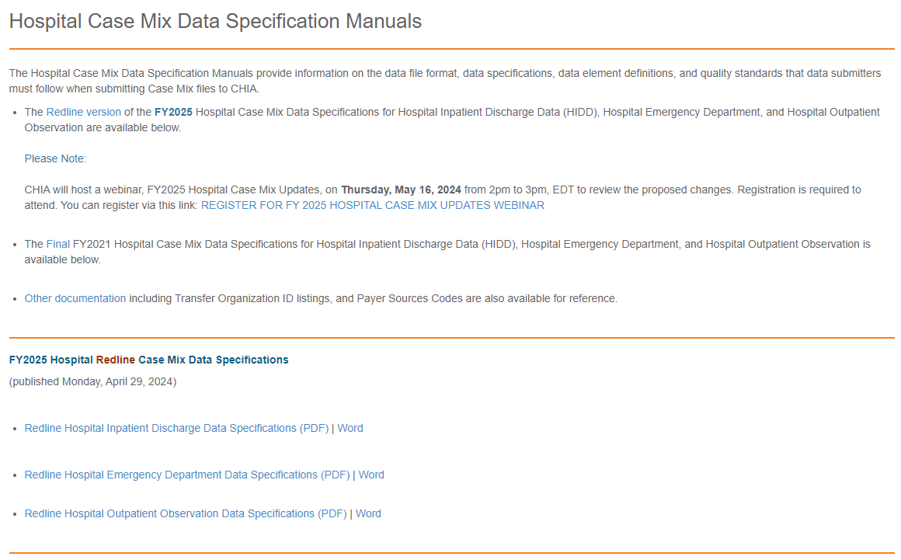
Submission Guides – Published to CHIA Website http://www.chiamass.gov/hospital-data-specification-manuals/

Slide 27
Questions & Comments

Slide 28
Follow-up Contacts
Cathy Houston, Associate Director of Hospital Data Intake & Compliance Catherine.Houston@CHIAMass.gov
Linda Stiller, Manager, Data Intake and Compliance Linda.Stiller@CHIAMass.gov
Hospital Liaisons:
Hadish Gebremedhin, Senior Health Care Data Liaison Hadish.Gebremedhin@CHIAMass.gov
Jillian Petrie, Health Care Data Liaison
Jillian.Petrie@CHIAMass.gov
Hospital Email: HospitalData@CHIAMass.gov

