Slide 1
Behavioral Health & Readmissions in Massachusetts Acute Care Hospitals
November 17, 2016

Slide 2
Overview
Introduction
Why behavioral health?
What are some of the key findings?
What are some of the implications for practice and quality improvement?
Questions & Answers
2

Slide 3
CHIA’s All-Payer Readmission Analyses
Medicare Fee-For-Service vs. all-payer population
CHIA’s adaptation of the Yale/CMS hospital-wide all cause unplanned readmission for the all-payer population – first public reporting in June 2015
Statewide reports and hospital-specific readmissions profiles
Expansion to include primary psychiatric discharges to look at behavioral health comorbidity
3

Slide 4
Overview
Introduction
Why behavioral health?
What are some of the key findings?
What are some of the implications for practice and quality improvement?
Questions & Answers
4

Slide 5
Why Behavioral Health?
One in four adults suffers from a behavioral health condition.
One-third of all hospitalizations involved individuals with a comorbid behavioral health diagnosis.
New discharge planning requirements to include behavioral health for all Medicare and Medicaid patients.
First statewide, all-payer examination of the prevalence of behavioral health comorbidities and readmissions among hospitalized adults in Massachusetts acute care hospitals.
5

Slide 6
Counting “Eligible” Discharges (FY2014 #’s)
HDD Adult Discharges 677,379
Missing/invalid SSN
Transfers
Deaths in hospital
Against medical advice
Remove discharges that don’t make sense to include
Remove discharges for certain specialized types of care
Obstetric
Cancer
Rehabilitation
Eligible Discharges
515,353
Unique Patients
347,747
6

Slide 7
Behavioral Health Comorbidity
Using a modified AHRQ methodology, both primary and secondary diagnoses across all discharges for patients within the one-year study period were used to classify patients into four mutually exclusive groups:
Mental health disorders (MD) only
Substance use disorders (SUD) only
Both MD and SUD or co-occurring disorders (COD)
No mention of MD or SUD (None)
7

Slide 8
Overview
Introduction
Why behavioral health?
What are some of the key findings?
What are some of the implications for practice and quality improvement?
Questions & Answers
8

Slide 9
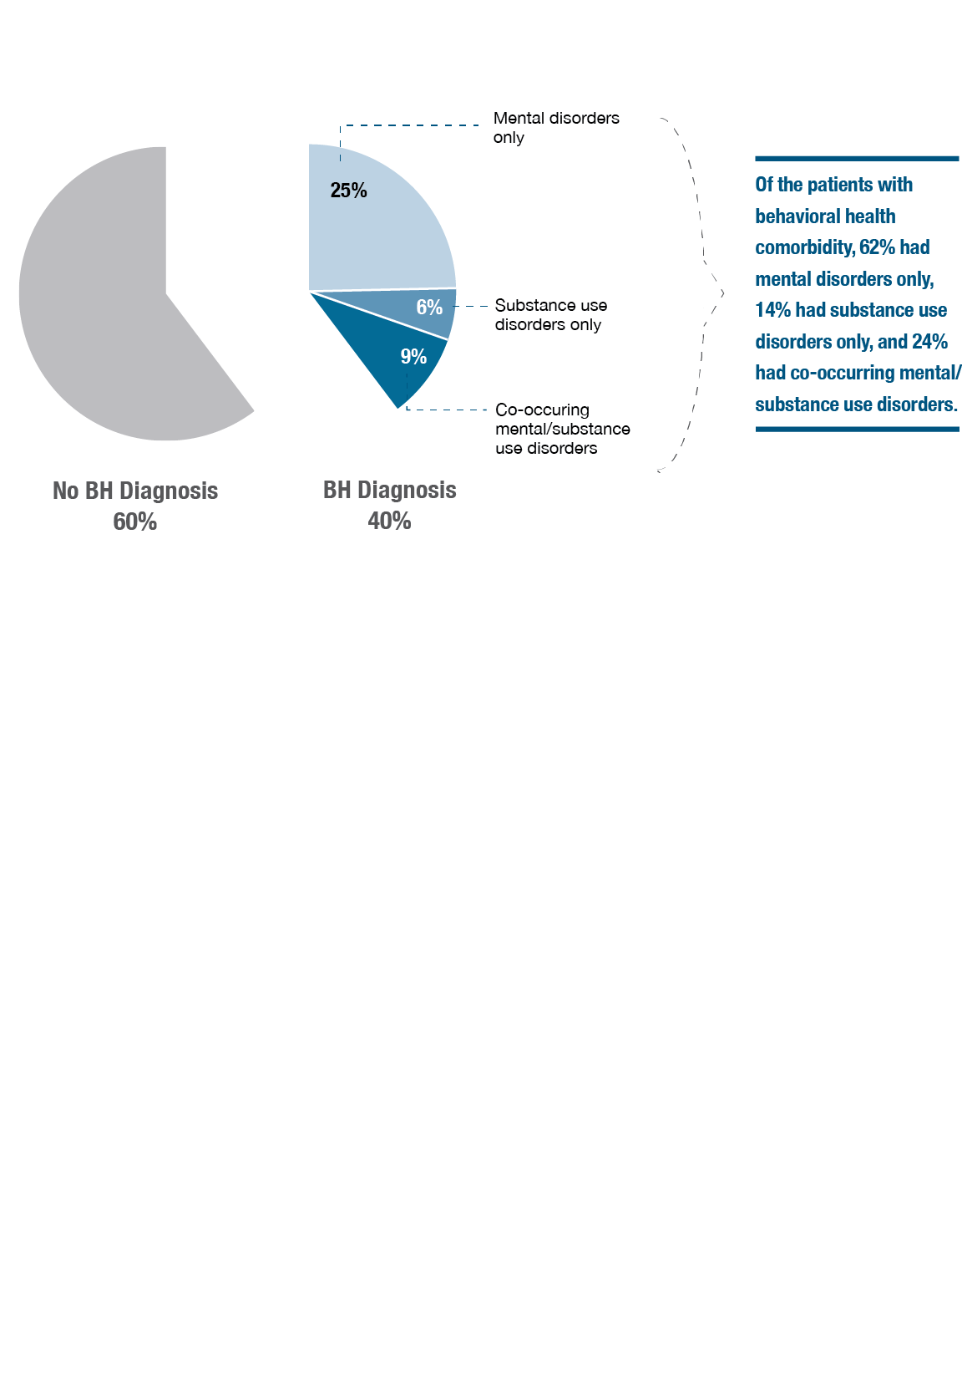
Statewide Prevalence of Behavioral Health Comorbidity among Patients in Acute Care Hospitals
9

Slide 10
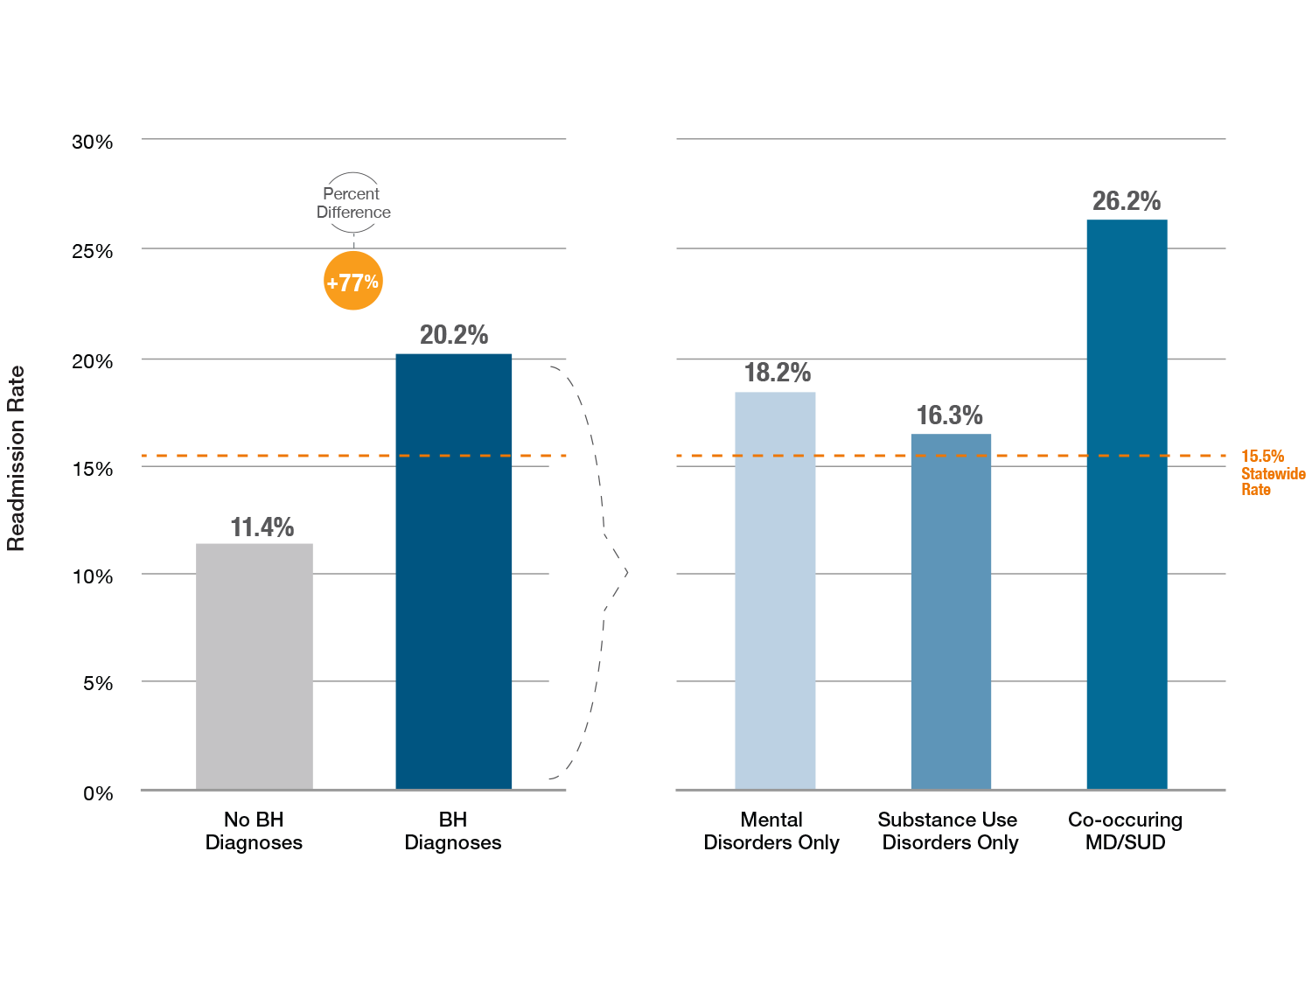
Statewide Readmission Rates and Behavioral Health Comorbidity
10

Slide 11
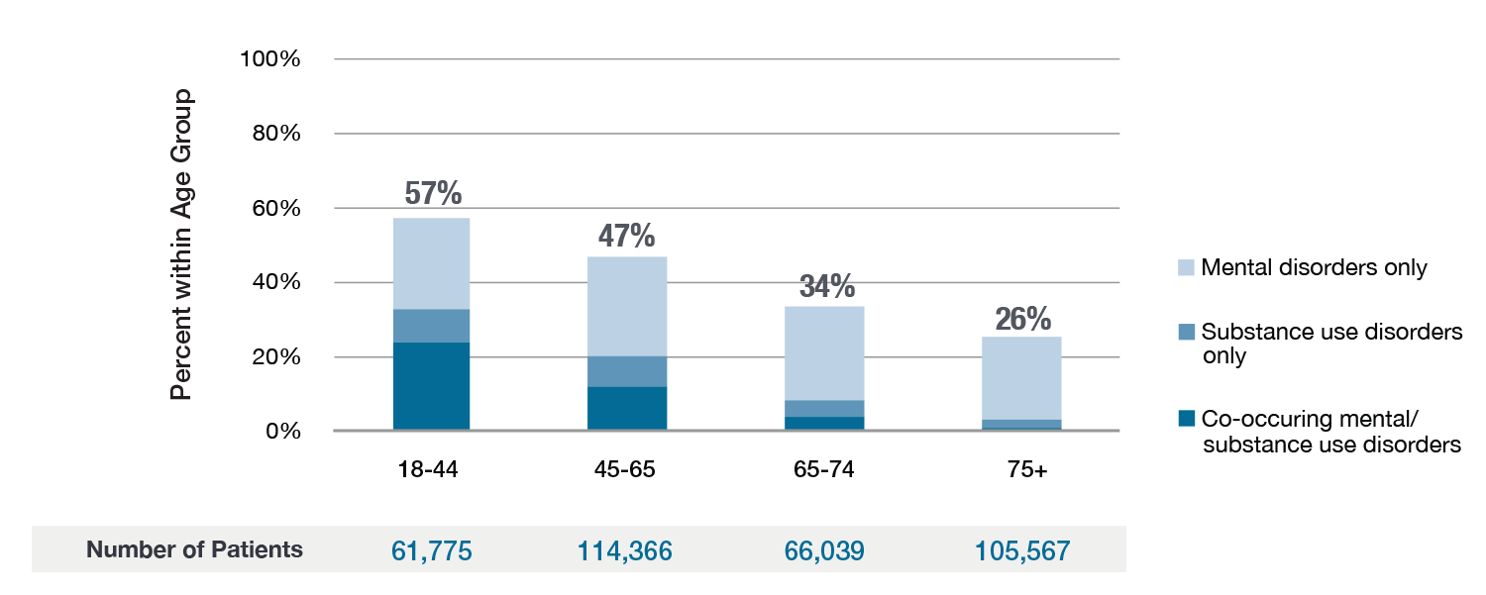
Prevalence of Behavioral Health Comorbidity by Age Group
11

Slide 12
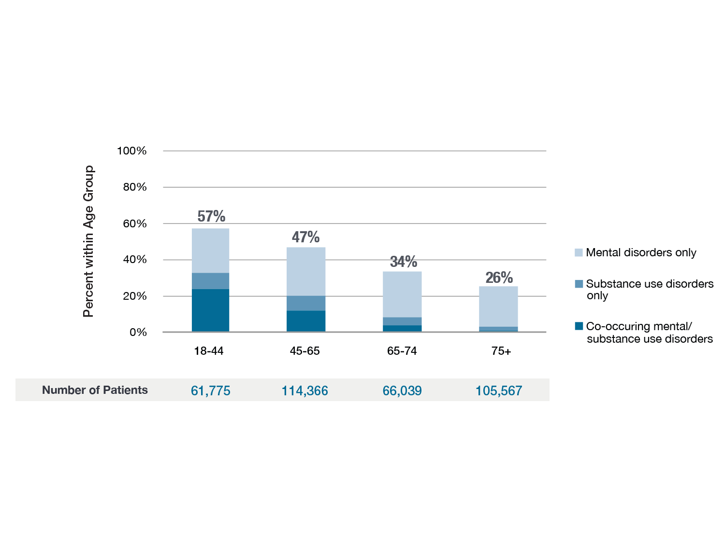
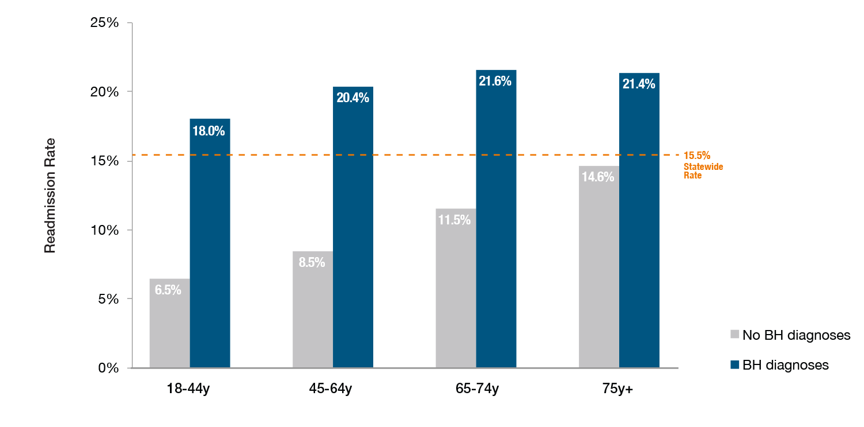
Readmission Rates and Behavioral Health Comorbidity by Age Group
12

Slide 13
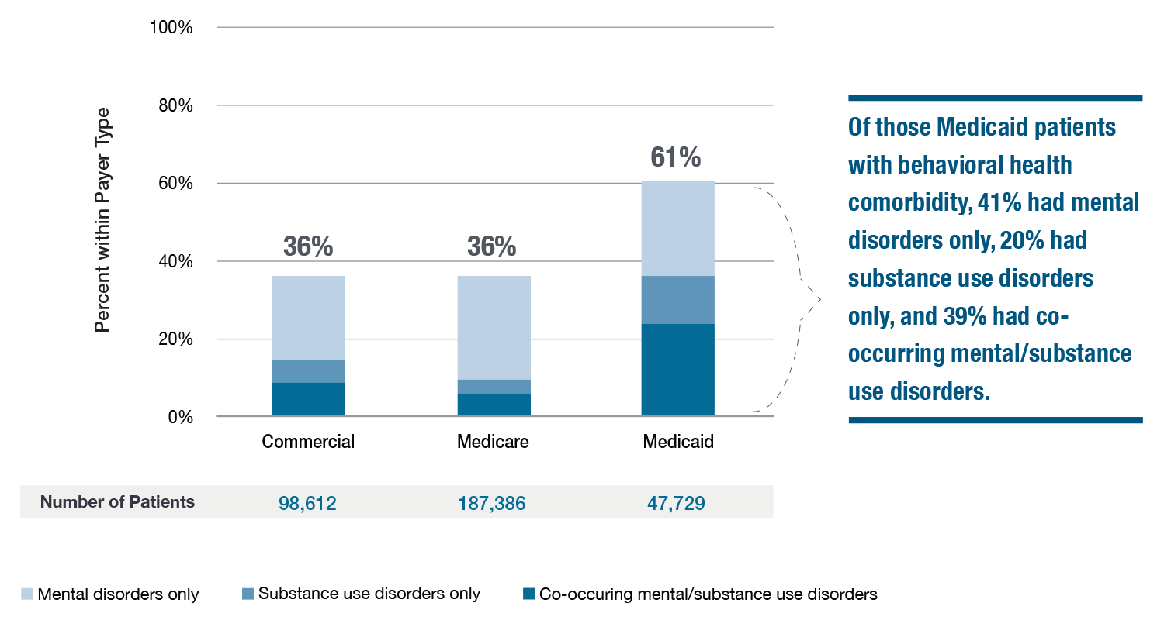
Prevalence of Behavioral Health Comorbidity
by Payer Type
13

Slide 14
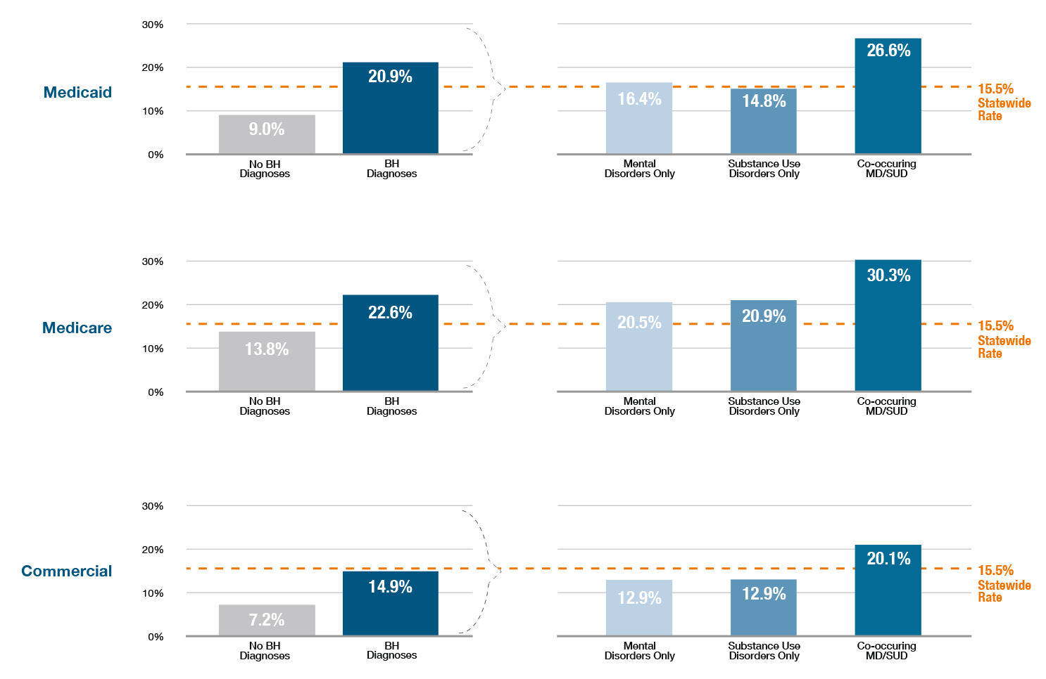
Readmission Rates and Behavioral Health Comorbidity by Payer Type
14

Slide 15
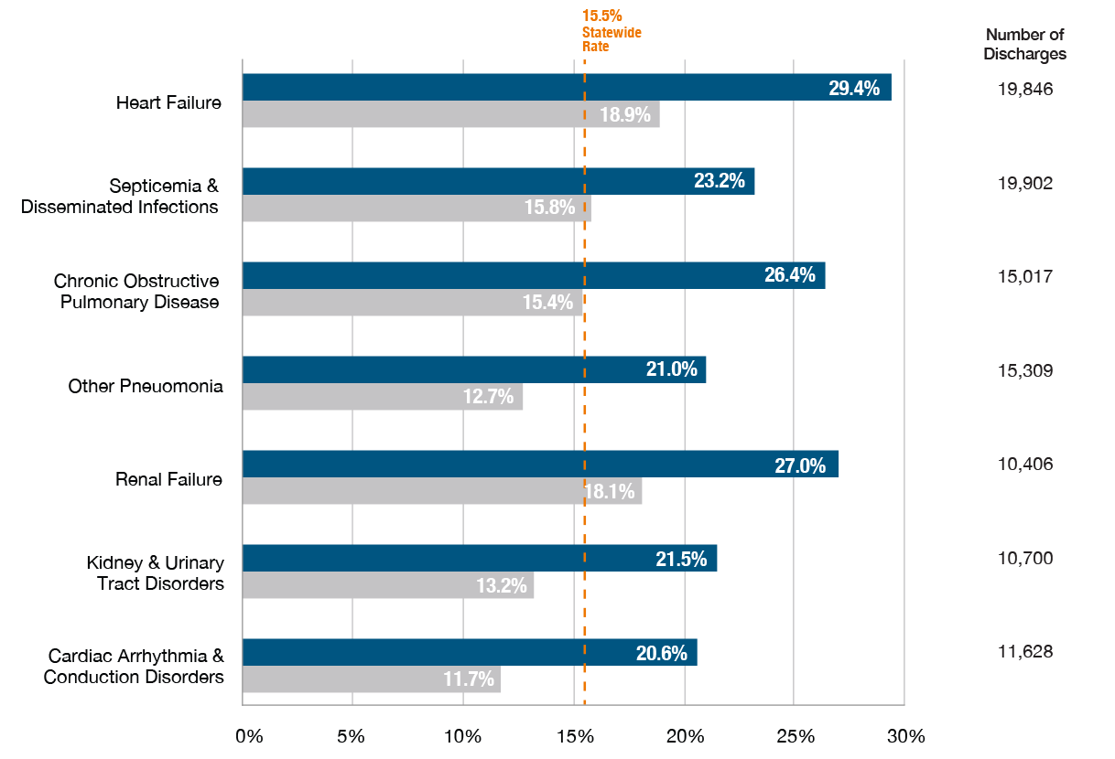
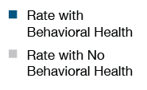
Readmission Rates and Behavioral Health Comorbidity by Common Discharge Diagnosis
15

Slide 16
Summary of Findings
40% of hospitalized patients had at least one comorbid behavioral health condition.
Patients with behavioral health comorbidity 77% more likely to be readmitted than those without any behavioral health comorbidity (20.2% vs. 11.4%).
61% of hospitalized Medicaid patients had a comorbid behavioral health condition.
Medicaid patients with comorbid co-occurring mental and substance use conditions were three times more likely to be readmitted than those without any behavioral health comorbidity (26.6% vs. 9.0%).
Young adults (age 18-44) with a behavioral health comorbidity were nearly three times more likely to be readmitted than those without any behavioral health comorbidity (18.0% vs. 6.5%).
Among patients discharged with heart failure, the presence of a behavioral health comorbidity was associated with a readmission rate that was 56% higher than those without any behavioral health comorbidity (29.4% vs. 18.9%).
16

Slide 17
Overview
Introduction
Why behavioral health?
What are some of the key findings?
What are some of the implications for practice and quality improvement?
Questions & Answers
17

Slide 18
Implications for Practice & Quality Improvement
Amy E. Boutwell, MD, MPP

Slide 19
Why are these findings important?
61 man with 8 hospitalizations for shortness of breath.
“Oh honey, I’m in here every couple of weeks and it always takes about 5 days to tune me up”
32M with lifetime of uncontrolled diabetes.
“I need housing, not a shelter. I need someone to help make sure I take my medicines. In a shelter they don't do that and they kick you out every morning. I need a stable residence and no one is able to help with that."
2

Slide 20
AHRQ Reducing Medicaid Readmissions Project
Identify the similarities & differences in readmission patterns for Medicare v. Medicaid patients
Explore whether the “best practices” to reduce readmissions apply to the Medicaid population as well
Create a guide for hospitals to increase awareness of the unique issues in reducing Medicaid readmissions
3

Slide 21
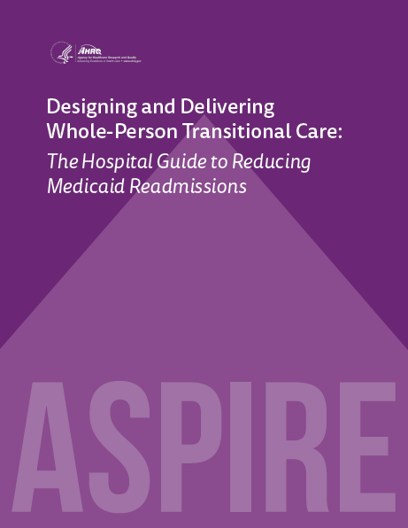
The guide comes with 13 customizable tools to be used in hospital teams’ day-to-day operations.
4

Slide 22
The ASPIRE Framework
Analysis
A
Analyze Your Data
S
Survey Your Current Readmission Reduction Efforts
P
I
Implement Whole-Person Transitional Care for All
Plan a Multi-faceted, Data-Informed Portfolio of Strategies
R
Reach Out and Collaborate with Cross-Continuum Providers
E
Enhance Services for High-Risk Patients
Reduce Medicaid Readmissions
Action
5

Slide 23
Teams with Results
Know their data –
Analyze, trend, track, display, share, post
Broad concept of “readmission risk”
Way beyond case finding for diagnoses
Multifaceted strategy
Improve standard care, collaborate across settings, enhanced care
Use technology to make this better, quicker, automated
Automated notifications, implementation tracking, dashboards
6

Slide 24
Examples: Data-informed “Socially Complex” Criteria
Adult, non-OB Medicaid patient
Medicare <65
Substance use disorder
High utilization (4+ admissions/12 months)
Whole-hospital readmission rate: 13%
“Socially complex” population readmission rate: 37%
That’s data-informed targeting!
7

Slide 25
Designing Services for High Risk Target Populations
There may be several target populations at high risk of readmission identified by your data analyses
Consider the following high risk target populations:
Adults with behavioral health comorbidities;
Adults residing in group homes or other residential settings;
Adults with a personal history of repeated hospitalizations in the past year
One “standard” transitional care model would not likely meet the needs and address the root causes of readmissions for all these populations
Design “enhanced services” to meet the needs of each target population
8

Slide 26
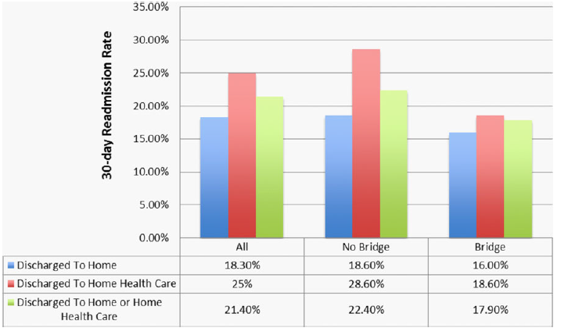
Social Work-Provided Transitional Care
Assess whole-person needs
Anticipates needs will change over time
Repeated assessments
Customized interventions
Link individuals to existing providers and services
Provide psycho-therapeutic support
Identify person-centered priorities and goals
Advocate for timely services, patient preferences, etc.
- 20% reduction
- All hospital
- All cause
- At Scale (1500+)
Boutwell et at JAGS May 2016
9

Slide 27
10

Slide 28
“Whole-Person” Adaptations to Transitional Care
Navigating
Hand-holding
Arranging for….
Providing with….
Harm reduction
Meet “where they are”
Patient priorities first
Relationship-based
11

Slide 29
Summary
Know your data – use it as a powerful tool
Constantly work to understand why patients return to the hospital
Design services that will meet the needs of specific target populations
For people with behavioral health comorbidities, deploy care teams that actively “do for” – navigate, advocate, support
Don’t over-medicalize readmissions or hospital utilization
It is possible to meaningfully improve care and reduce readmissions for people with behavioral health conditions!
12

Slide 30
THANK YOU! Questions? chia.webmaster@MassMail.State.MA.US

